Slide 1
May Webinar Continuing advocacy on Tuberculosis May 11, 2023

Slide 2
Our Values & Resources
2
​At RESULTS we pledge to create space for all voices, including those of us who are currently experiencing poverty. We will address oppressive behavior in our interactions, families, communities, work, and world. Our strength is rooted in our diversity of experiences, not in our assumptions.
With unearned privilege comes the responsibility to act so the burden to educate and change doesn’t fall solely on those experiencing oppression. When we miss the mark on our values, we will acknowledge our mistake, seek forgiveness, learn, and work together as a community to pursue equity.
Read our full anti-oppression values statement here at results.org/values.
Check out the 2023 Spring Anti-Oppression Workshop Schedule for training opportunities.
Find these resources and more at results.org/volunteers/anti-oppression:
Resource Guides from our Diversity & Inclusion trainings, including:
Interrupting Microaggressions
Creating Space for Critical Conversations
Information on how RESULTS responds to oppressive incidents

Slide 3
Tonight’s Webinar
Welcome and Introductions
Continuing to speak powerfully for the end of TB (EPIC Laser Talk Training)
Follow Up Advocacy Action: Requesting co-sponsorship of the End TB Now Act (S. 288/ H.R. 1776)
Closing
Notes:
Karyne

Slide 4
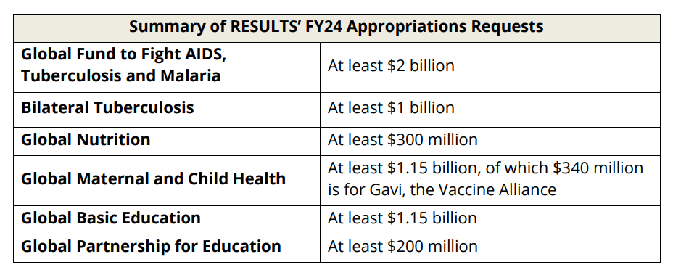
FY24 Appropriations Requests

Slide 5
What do we care about TB?
It’s the leading infectious disease killer in the world that is almost completely preventable, treatable, curable. It’s a neglected disease because of who it impacts (98% of cases are in low- and middle-income countries). TB is still the leading killer of people with HIV.
It devastates families—takes down breadwinners. It’s a huge barrier to economic advancement and growth due to how it isolates people and how it is stigmatized in most places.
This is a justice issue. Can we imagine what would be happening if TB were a huge issue in this country? We used to send people sanatoriums, which were all over the country. We’ve managed TB here, so we have less concern about TB elsewhere.
Our TB solutions are way behind—the TB vaccine is over 100 years old. Neglect of TB has caused us to fail in coming up with better prevention and treatments.

Slide 6
What do we care about TB?
COVID set us back over a decade on progress with TB. We need to do more.
2023 is the time. Where we can get most attention, an influence leading to UN High Level Meeting.

Slide 7
Reports say there is still more work to do
An estimated 10.6 million people fell ill with tuberculosis (TB)
in 2021, an increase of 4.5% from 2020, and 1.6 million people died from TB, up from 1.5 in 2020 and 1.4 in 2019.
The burden of drug-resistant TB (DR-TB) also increased by 3% between 2020 and 2021, with 450 000 new cases.
The reported number of people newly diagnosed with TB fell from 7.1 million in 2019 to 5.8 million in 2020. There was a partial recovery to 6.4 million in 2021, but this was still well below pre-pandemic levels. We are missing a huge number of people with TB.
World Health Organization Global TB Report, Oct. 2022
Notes:
Ken

Slide 8
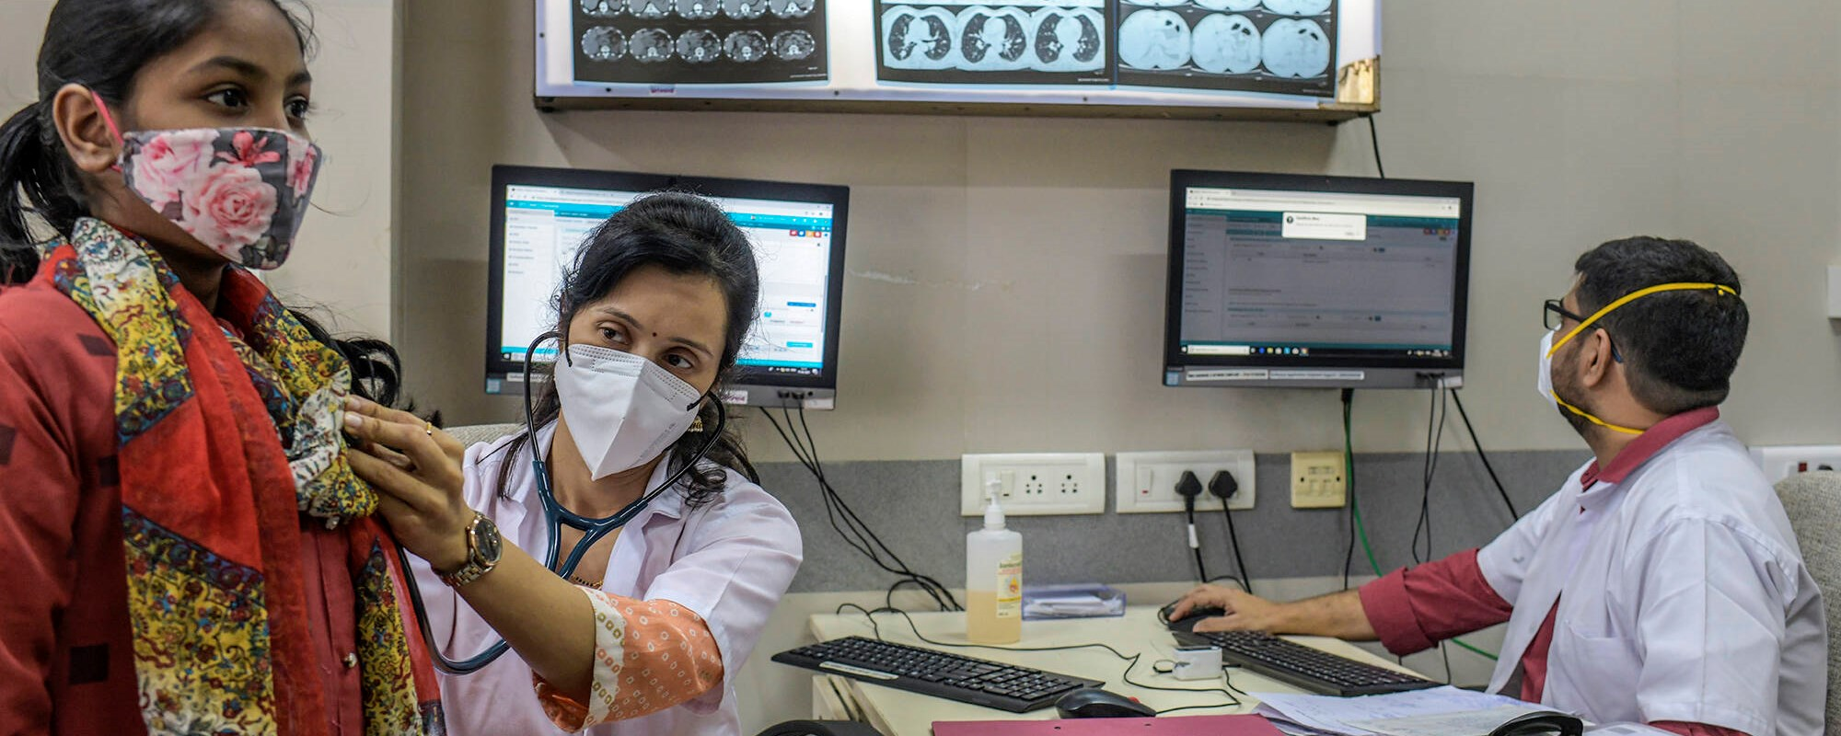
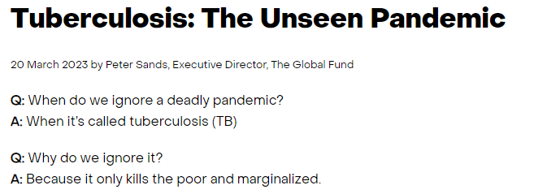
Tuberculosis: The Unseen Pandemic Peter Sands, Executive Director, The Global Fund
Notes:
Ken

Slide 9
End TB Now Act (S.288, H.R.1776)
Requires the U.S. to establish bold goals for reaching the most vulnerable populations
Strengthens U.S. bilateral coordination to develop comprehensive global TB response
Catalyzes support for TB research and development (R&D)
Improves the capacity of countries and affected communities with high burdens of TB
Requires annual reporting to Congress on U.S. TB activities and their impact
Evaluates the performance of TB programs that are supported by U.S.

Slide 10
We want to pass the End TB Now Act this year!
See if your member of Congress has supported TB in any way using our Congressional Scorecard

Slide 11
What have you heard from your Representatives and Senators about TB?
Notes:
Ken

Slide 12
Advocacy Training:
Speaking Powerfully for the End of Tuberculosis
Notes:
Ken

Slide 13
Notes:
https://www.youtube.com/watch?v=mzMzGDyx19c

Slide 14
EPIC
ENGAGE your audience
State the PROBLEM
INFORM about solutions
CALL to action

Slide 15
Tuberculosis (TB) is often thought of as a disease of the past. But this airborne contagion is both a driver and an exacerbator or global poverty, and it targets vulnerable populations. TB kills more people each year than HIV/AIDS and malaria combined.
Notes:
Karyne
Engage: Tuberculosis - an airborne bacteria - now kills more people each year than HIV and malaria combined.
Problem: COVID, conflict, and other crises have specifically taken a toll on the fight against tuberculosis. This disease drives and exacerbates global poverty, and it targets vulnerable populations. Alarmingly, TB cases increased in both 2020 and 2021. In 2021, 1.6 million people worldwide died from this often-curable disease.
Inform: The U.S. has been a leader in the fight against TB, and fiscal year 2024 decisions will soon be made in Congress by the committee that funds foreign aid.
Call to Action: Will you write and speak to the leadership of the State and Foreign Operations Subcommittee of Appropriations and ask that they include at least $1 billion for USAID bilateral tuberculosis funding in the FY24 spending bill? Will you also ask for at least $2 billion for the Global Fund to Fight AIDS, TB and Malaria?

Slide 16
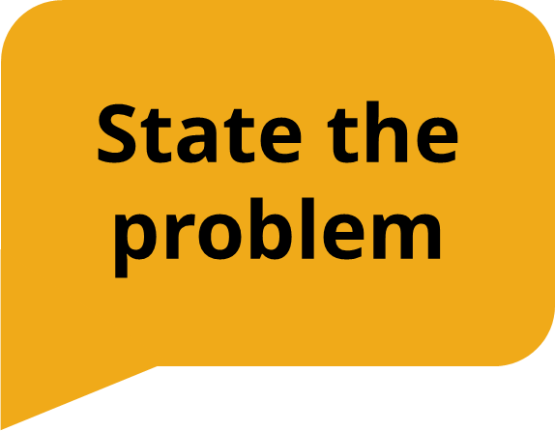
While incredible strides were being made in the fight against TB, when COVID-19 arrived, TB resources around the world were diverted toward fighting the new pandemic. This devastated the TB response. In 2021, the World Health Organization (WHO) reported that both the rates of TB sickness and number of TB deaths increased.
Notes:
Karyne

Slide 17
But, Congress can make a difference. The bipartisan, bicameral End TB Now Act (H.R. 1776/ S. 288) calls for setting bold U.S. goals to reach those most vulnerable to the disease. It will help save lives and provide the frontline support needed to address future pandemics.
Notes:
Karyne

Slide 18
Will you co-sponsor the End Tuberculosis Now Act today?
Notes:
Karyne

Slide 19
Make it personal!
Why do you care about the issue?
How is the issue impacting you currently (or how has it impacted you in the past?)
How does the issue show up in your country of service?
What values are motivating you to support solving this issue?

Slide 20
Why is this topic important to you?
Notes:
Karyne
Engage: Tuberculosis - an airborne bacteria - now kills more people each year than HIV and malaria combined.
Problem: COVID, conflict, and other crises have specifically taken a toll on the fight against tuberculosis. This disease drives and exacerbates global poverty, and it targets vulnerable populations. Alarmingly, TB cases increased in both 2020 and 2021. In 2021, 1.6 million people worldwide died from this often-curable disease.
Inform: The U.S. has been a leader in the fight against TB, and fiscal year 2024 decisions will soon be made in Congress by the committee that funds foreign aid.
Call to Action: Will you write and speak to the leadership of the State and Foreign Operations Subcommittee of Appropriations and ask that they include at least $1 billion for USAID bilateral tuberculosis funding in the FY24 spending bill? Will you also ask for at least $2 billion for the Global Fund to Fight AIDS, TB and Malaria?

Slide 21
How have you seen the devastation of TB in your country or service?
Notes:
Karyne

Slide 22
How could the End TB Now Act work to end TB and strengthen healthcare systems in your country of service?
Notes:
Karyne

Slide 23
Will you co-sponsor the End Tuberculosis Now Act today?
Notes:
Karyne

Slide 24
Develop your EPIC Laser Talk
10 min: Personalize your own EPIC Laser Talk
5 min: Share

Slide 25
Tips for Delivering Your EPIC Laser Talk:
Practice to the point that you feel comfortable, not rote. You don’t have to memorize the whole thing word for word.
Memorizing key facts and details is key.
When you practice, talk without stopping, even if you stumble.
Critique yourself and others with kindness.

Slide 26
Advocacy Training:
Requesting co-sponsors for the End TB Now Act (S. 288 / H.R. 1776)
Notes:
Ken

Slide 27
Co-Sponsoring the End TB Now Act
Find your Legislator’s foreign policy staff (Legislator Lookup)
Personalize this draft email, and Email them at: (House) FirstName.LastName@mail.house.gov (Senate) FirstName_LastName@SenatorsLastName.Senate.gov
Follow up, follow up, follow up
Share this action with others!
Notes:
Karyne Sample email - https://docs.google.com/document/d/1-2MLO5-q81zIBy14Q2l-7gthusBMylf7NokAbGf303s/edit Share - https://results.org/volunteers/action-center/action-alerts?vvsrc=%2fcampaigns%2f97042%2frespond

Slide 28
UN High-Level Meeting on TB
September 18 - 23, 2023
Notes:
https://www.stoptb.org/advocate-to-endtb/world-tb-day

Slide 29
Global Allies Program Coaching Support
Sign up for additional coaching support between webinars!
https://results.salsalabs.org/globalalliesprogram
Notes:
Sign Up - https://results.salsalabs.org/globalalliesprogram

Slide 30
- Next GAP Webinar: June 8- 8:30 PM ET https://bit.ly/GAP2023Webinars - RESULTS Global Policy Forum – Thursday, May 18 9:00PM ET Speaker: Selamawit Bekele, Manager, RESULTS Global Health Partnerships will continue our important discussion about combatting tuberculosis around the world - Peace Corps Upcoming Events Missed a webinar? Watch past webinars at the organizational partners page on our website.
Upcoming Events

Slide 31
Thanks for joining us tonight!

