Slide 1
RESULTS May 2019 Global National Webinar
The Global Fund to Fight AIDS, Tuberculosis and Malaria
Join at https://results.zoom.us/j/510407386. Or by phone at (669) 900-6833 or (929) 436-2866, meeting ID 510-407-386
Closed captioning: http://west.typewell.com/faelapgb

Slide 2
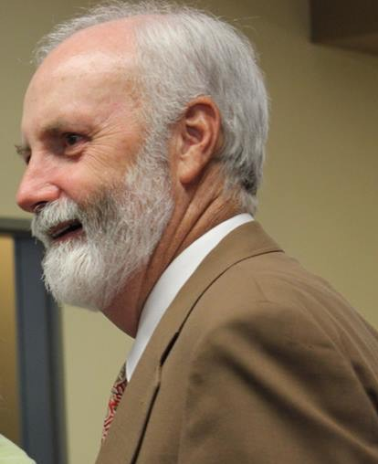
Roger Hudson
RESULTS Anchorage

Slide 3
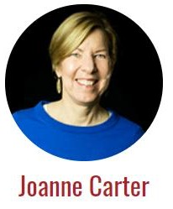
Executive Director

Slide 4
RESULTS Values Statement
RESULTS is a movement of passionate, committed everyday people. Together we use our voices to influence political decisions that will bring an end to poverty. Poverty cannot end as long as oppression exists. We commit to opposing all forms of oppression, including racism, classism, colonialism, white saviorism, sexism, homophobia, transphobia, ableism, xenophobia, and religious discrimination.
At RESULTS we pledge to create space for all voices, including those of us who are currently experiencing poverty. We will address oppressive behavior in our interactions, families, communities, work, and world. Our strength is rooted in our diversity of experiences, not in our assumptions.
With unearned privilege comes the responsibility to act so the burden to educate and change doesn’t fall solely on those experiencing oppression. When we miss the mark on our values, we will acknowledge our mistake, seek forgiveness, learn, and work together as a community to pursue equity.
There are no saviors — only partners, advocates, and allies. We agree to help make the RESULTS movement a respectful, inclusive space.

Slide 5
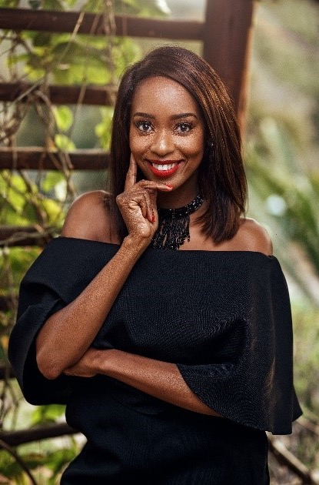
Today’s Guest
Sibuele (Sibu) Sibaca

Slide 6
Open Phones
On the webinar? Unmute by clicking the microphone.
On by phone? Unmute by hitting *6.
If you are not speaking, please stay muted.

Slide 7
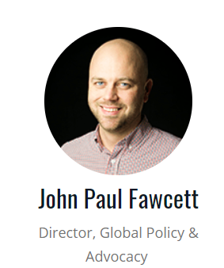
Campaigns Update
Appropriations
Global Fund

Slide 8
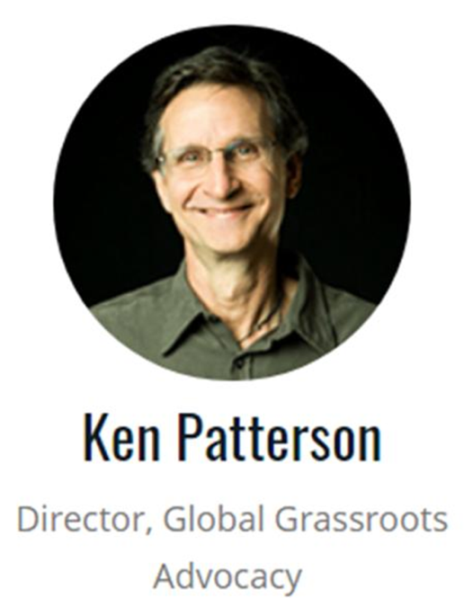
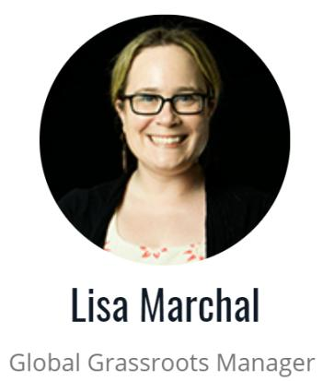
Grassroots Café
2nd Trimester – Off and Running!

Slide 9
Let’s Keep Going!
Make a bold plan for 2nd Trimester
Continue moving your members of Congress up the Champion Scale
Generate lots of media in all 50 states
Show up in force at the RESULTS International Conference

Slide 10
Why I Advocate for the Global Fund Open Phones
On the webinar? Unmute by clicking the microphone.
On by phone? Unmute by hitting *6.
If you are not speaking, please stay muted.

Slide 11
Let’s Keep Going!
Make a bold plan for 2nd Trimester
Continue moving your members of Congress up the Champion Scale
Generate lots of media in all 50 states
Show up in force at the RESULTS International Conference

Slide 12
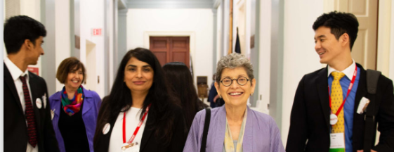
Make a Plan
About 45% of Groups made a plan for 1st trimester.
We are looking to increase that for the 2nd trimester!

Slide 13
Let’s Keep Going!
Make a bold plan for 2nd Trimester
Continue moving your members of Congress up the Champion Scale
Generate lots of media in all 50 states
Show up in force at the RESULTS International Conference

Slide 15
Congressional Meetings Reported Through April
 | # of Meetings | Percentage of Groups Participating
Face-to-Face House | 46 | 30%
Face-to-Face Senate | 14 | 8%
House Staff | 72 | 40%
Senate Staff | 42 | 29%
Overall Total: 174 meetings, 70% Group Participation
Other: 6 Free Agents had meetings, 23 Global Groups covered US Poverty issues in 59 meetings.
Goal: 100% of Groups have meetings.

Slide 16
Week of May 27 Congressional Recess How will you take best advantage of this time?

Slide 17
Let’s Keep Going!
Make a bold plan for 2nd Trimester
Continue moving your members of Congress up the Champion Scale
Generate lots of media in all 50 states
Show up in force at the RESULTS International Conference

Slide 18
Getting Published on the Global Fund Editorial Packet May Action Sheet Online Action Who can join you? Media as outreach strategy? You bet!

Slide 19
Let’s Keep Going!
Make a bold plan for 2nd Trimester
Continue moving your members of Congress up the Champion Scale
Generate lots of media in all 50 states
Show up in force at the RESULTS International Conference

Slide 20
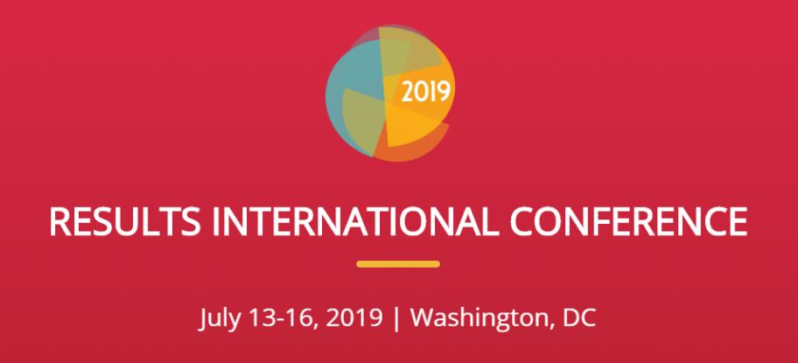
Earlybird Registration Deadline – May 15

Slide 21
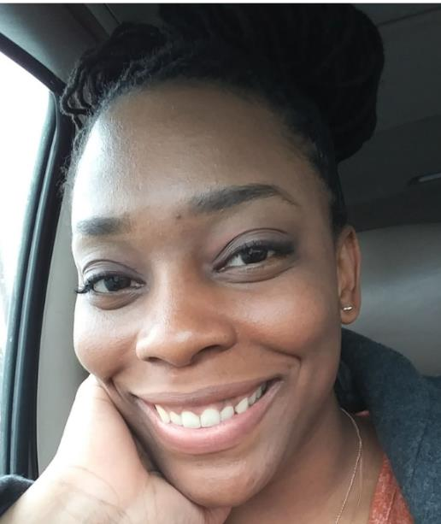
Why the IC?
Candace Ellis
RESULTS Southern Ilinois

Slide 22
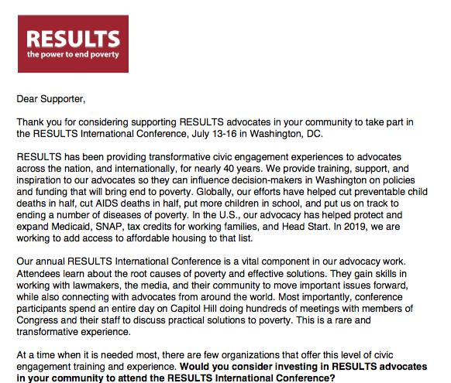

Slide 23
Spring Fundraising Campaign Going On Now

Slide 24
Mark Your Calendars! See the Weekly Update for details on how to join.
May 14, 12 pm ET. New Advocate Orientation.
May 16, 9 pm ET. Quiet Leadership. Continuing on the third Thursday of each month up until the International Conference. A focus on learning and practicing the coaching techniques explored in David Rock’s book Quiet Leadership. You can find the syllabus online.
May 20, 1 pm ET and 8 pm ET. RESULTS Global Free Agents Webinars (choose one).
June 4, 8 pm ET. Special national webinar on “Organizing vs Mobilizing” with Dr. Hahrie Han. All advocates should attend!

Slide 25
Let us know how many joined you today
directly in the chat box or send to
Lisa Marchal
lmarchal@results.org

Slide 26
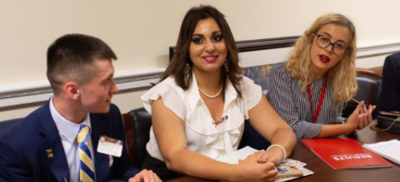
Thank you for being so persistent, consistent, and effective!

