Slide 1
Maximize Your Impact for Change
September 24, 2024

Slide 2
Welcome
Please let us know in the chat where you are joining us from!
Notes:
8:30-8:35 PM: Welcome/Introductions (Margaret) - Brief opening: Happy to see new faces as well as our sterling champion advocates
introduce Beverley, talk about why she’s a great CEO (has revitalized Rise and opened it up to more, members, grantees, and partners)
Link to full bio - https://togetherwomenrise.org/about-us/senior-staff/

Slide 3
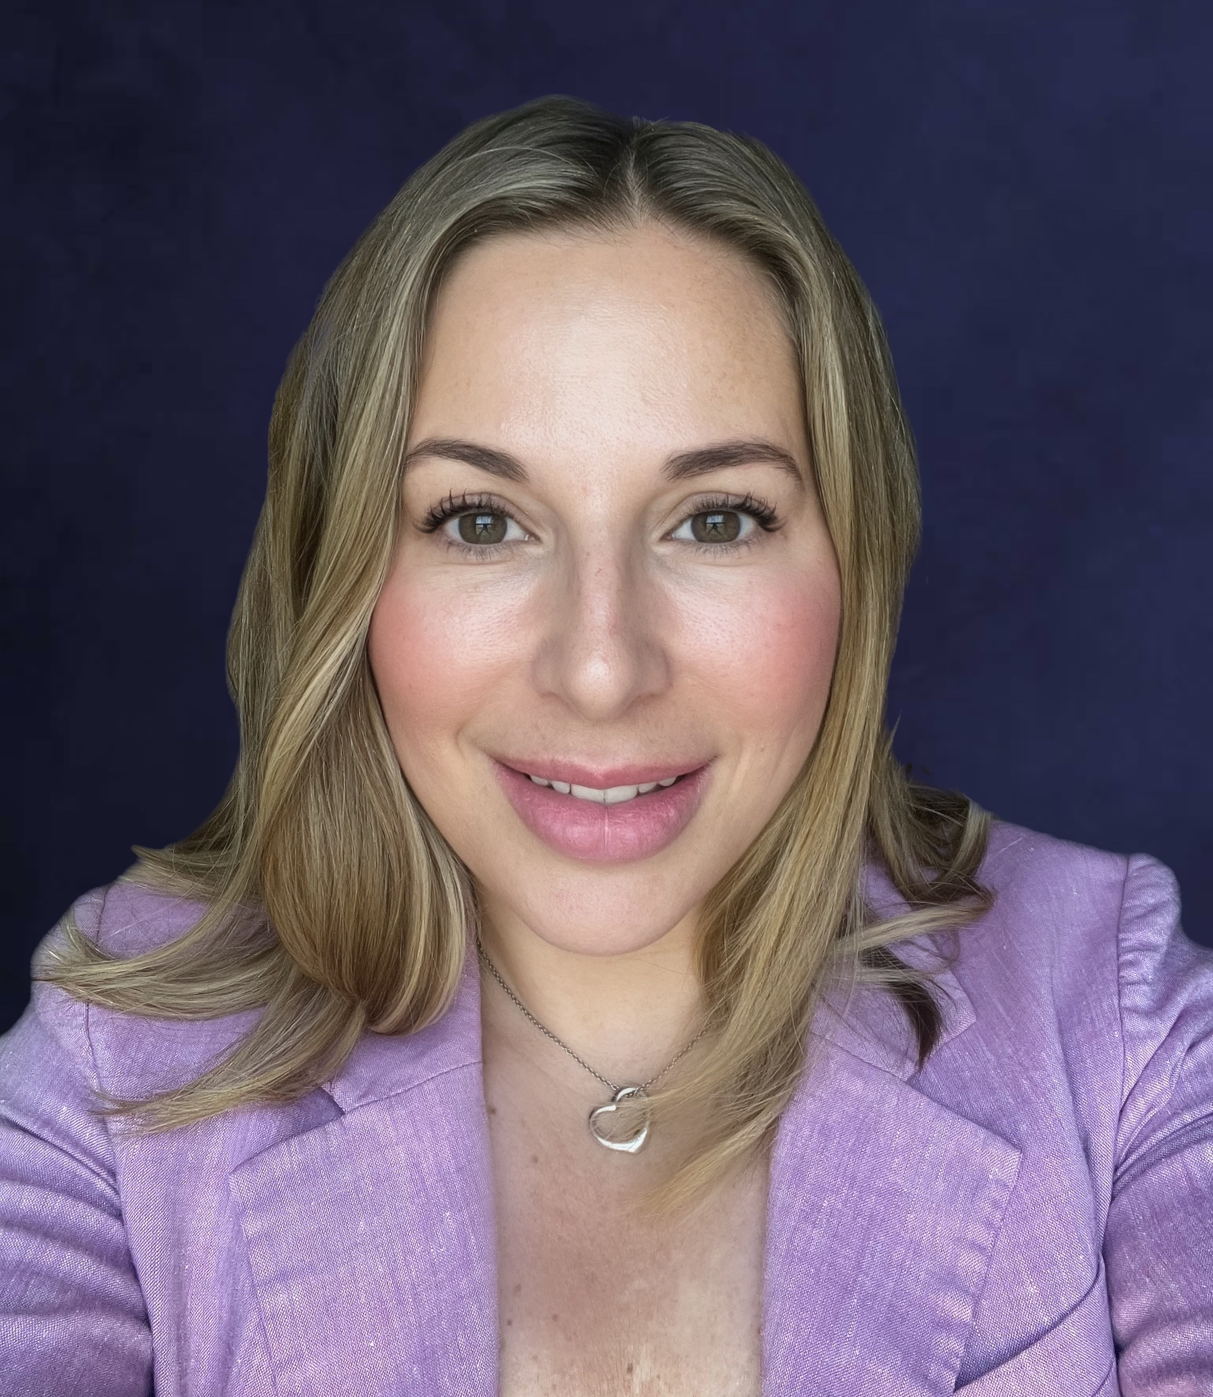
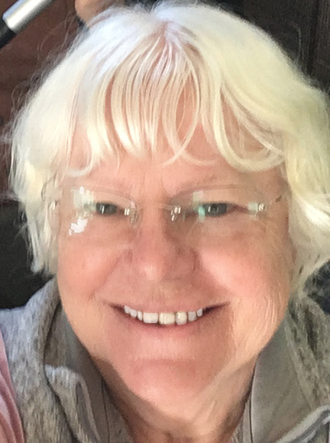
Advocacy Chapter Chairs
Margaret Moodian & Susan Wright Together Women Rise Advocacy Chapter, co-chairs 2024
Notes:
8:40 - 8:49 PM: About the Together Women Rise Advocacy Chapter with RESULTS (Susan & Karyne) Susan
Why we advocate on the issues we advocate, linkage with Rise grantees and with their success (Susan)
How valuable we have found engaging in advocacy, strong partnership with RESULTS
Together Women Rise’s Mission Together Women Rise cultivates the collective power of community to achieve global gender equality. Our vision Together Women Rise envisions a world where every person has the same opportunities to thrive regardless of their gender or where they live.

Slide 4
Mission & Vision
Together Women Rise’s Mission
Together Women Rise cultivates the collective power of community to achieve global gender equality.
OUR VISION
Together Women Rise envisions a world where every person has the same opportunities to thrive regardless of their gender or where they live.
Notes:
Margaret or Susan (during “About” section?)
Together Women Rise:
Vision
Together Women Rise envisions a world where every person has the same opportunities to thrive regardless of their gender or where they live.
Gender Equality Beliefs
Together Women Rise champions gender equality because women’s rights are human rights. When women and girls are treated equally, the world is healthier, safer, more peaceful, inclusive, and economically just for everyone.
https://togetherwomenrise.org/our-anti-oppression-commitment/

Slide 5
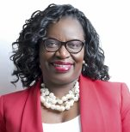
Beverley Francis-Gibson CEO
Together Women Rise
Notes:
8:35-8:40 PM: Together Women Rise CEO, Beverley Francis Gibson - the importance of advocacy as a part of Rise’s mission

Slide 6
Advocacy Amplifies the Success of Rise Grantees
Rise grants improve the ability of girls and women in low-income communities and to take advantage of basic services for health and education
The availability and quality of those services depends on national programs
US support for global initiatives provides critical inputs for these national health and education programs
Examples of US programs that allow women and girls in Rise programs to thrive:
Reproductive, Maternal and Child Health, including Nutrition
International Basic Education
Gavi, the Global Vaccine Initiative
Support for the Global Fund against Aids, TB and Malaria
The Rise advocacy team, in partnership with RESULTS, urges Representatives and Senators across the US to maintain and increase funding for these key programs
Notes:
Susan 8:40 - 8:49 PM: About the Together Women Rise Advocacy Chapter with RESULTS (Susan & Karyne)
Advocacy Amplifies the Success of Rise Grantees
Rise grants improve the ability of girls and women in low-income communities and to take advantage of basic services for health and education
The availability and quality of those services depends on national programs
US support for global initiatives provides critical inputs for these national health and education programs
Examples of US programs that allow women and girls in Rise programs to thrive:
Reproductive, Maternal and Child Health, including Nutrition
International Basic Education
Gavi, the Global Vaccine Initiative
Support for the Global Fund against Aids, TB and Malaria
The Rise advocacy team, in partnership with RESULTS, urges Representatives and Senators across the US to maintain and increase funding for these key programs

Slide 7
About the Rise Advocacy Chapter with RESULTS
Partnership between Together Women Rise and RESULTS began in 2019
Over 200 volunteer advocates, representing 32 states and D.C., and 133 of 435 Congressional Districts, and 64 Senators.
Advocacy Chapter meets every 3rd Tuesday at 8:30 PM ET
Goal: Share congressional updates, learn and practice new advocacy skills, and take an action together in a supportive community.
Mentors: Karyne Bury (FL), Anne Child (TN), Joanna DiStefano (WV), Lesley Heilig (MA), Sarah Leone (IN), Jim Hennigan (KY) & Susan Wright (CA)
Connection with Rise grantees and policies on the issues they address.
Notes:
Susan 8:40 - 8:49 PM: About the Together Women Rise Advocacy Chapter with RESULTS (Susan & Karyne)
We are happy to have you join us for our webinar tonight - Maximize Your Impact for Change. Together Women Rise and RESULTS have been in partnership since 2019, and we are going into the 5th year of our partnership. Together, we are committed to a shared goal of achieving gender equity and creating a world where .
The Rise Advocacy Chapter has grown to 212 volunteers, who represent 33 states. We cover 133 members of the House of Representatives and over half the Senate (64 Senators!). This adds up to a powerful, unified voice for change, impacting foundational issues of poverty in ways that we will share with you tonight. And we invite you to be a part of it!
Everyone is welcome–you do not need to be a member of a RISE chapter but we hope you might consider learning more about RISE https://togetherwomenrise.org/about-us/
The Rise Advocacy chapter meets monthly on the third Tuesday at 8:30 PM ET
The goal is to share congressional updates, learn and practice new advocacy skills, and take action together in a supportive community. Each month we discuss an issue of poverty, and review timely advocacy actions we can take to make a difference on the issue, introducing a new skill set–how to meet with and speak powerfully to a member of Congress, write an LTE, and we take action together.
Each advocate has a mentor from our network of mentors across the country who works with them individually between each webinar - some of whom are joining us tonight: myself, Anne Child, Joanna DiStefano,Leslye Heilig, Sarah Leone, Jim Hennigan, and Susan Wright.
We also present a Rise Grantee at our monthly webinars to connect how the issues we work on affect women/girls on the ground. Can share a link where folks can find more information on grantees and also join Rise webinars on the first Thursday of each month. https://togetherwomenrise.org/learn/featured-programs/
https://togetherwomenrise.org/grantee-reports/

Slide 8
Our Values & Resources
​At RESULTS we pledge to create space for all voices, including those of us who are currently experiencing poverty. We will address oppressive behavior in our interactions, families, communities, work, and world. Our strength is rooted in our diversity of experiences, not in our assumptions.
With unearned privilege comes the responsibility to act so the burden to educate and change doesn’t fall solely on those experiencing oppression. When we miss the mark on our values, we will acknowledge our mistake, seek forgiveness, learn, and work together as a community to pursue equity.
Read our full anti-oppression values statement here at results.org/values.
Find these resources and more at results.org/volunteers/anti-oppression:
Resource Guides from our Diversity & Inclusion trainings, including:
Interrupting Microaggressions
Creating Space for Critical Conversations
Information on how RESULTS responds to oppressive incidents
Notes:
Karyne
RESULTS Anti-Oppression Statement: https://results.org/volunteers/anti-oppression
Hello everyone, my name is Karyne Bury and I am a manager with RESULTS Grassroots Impact Team who has had the pleasure in supporting the growth and vision for the Together Women Rise Advocacy Chapter, working alongside chairs Susan Wright and Margaret Moodian and previously with our past chair, Leslye Heilig.

Slide 9
Advocacy Actions
101 reported congressional meetings included Together Women Rise Advocacy Chapter volunteers since 2019
34 LTEs (Letters to the Editor) from 2022 through August 2024
99 actions were taken on the RESULTS Action Center
Notes:
Karyne 8:40 - 8:49 PM: About the Together Women Rise Advocacy Chapter with RESULTS (Susan & Karyne) 101 reported congressional meetings included Together Women Rise Advocacy Chapter volunteers
34 LTEs (Letters to the Editor) from 2022 through August 2024
99 actions were taken on the RESULTS Action Center

Slide 10
Advocacy Impact
Global funding for vital programs mostly maintained (Appropriations)
​
​
USAID Bilateral Tuberculosis ​
Global Fund to Fight AIDS, TB and Malaria​
USAID Nutrition
Maternal & Child Health, including Gavi, The Vaccine Alliance
Education​: Global Partnership for Education ​
US Leadership at Global Forums
​Nutrition for Growth 106 Reps (more than doubled from 51 signers).
Gavi, the Vaccine Alliance - $1.58 billion commitment from the Biden Administration ​
Bills
Global Malnutrition Prevention and Treatment Act (H.R. 4693, S. 2956)
End TB Now Act (H.R. 1776, S. 288)​: Passed in Senate with Unanimous Consent on 9/19
Notes:
Karyne 8:40 - 8:49 PM: About the Together Women Rise Advocacy Chapter with RESULTS (Susan & Karyne)
Slide 9
Over time Rise advocacy chapter members have deepened the impact of our advocacy and requests made to the members of congress. One area in particular is funding for important global programs such as the Global Fund to Fight AIDS, TB and Malaria, USAID programs in Nutrition and Maternal and Child Health, and Gavi, the Vaccine Alliance.
This year, the House State and Foreign Operations bill was cut by $7.6 billion (around 11-12%) from FY24 enacted, so the fact that most of our accounts were maintained is a great sign that your advocacy has made an impact!
While the House cut topline funding for their State and Foreign Operations (SFOPS) bill, the Senate has a slight increase. The Senate SFOPS subcommittee called for an increase to USAID Maternal and Child Health, from $915 million to $940 million. They also maintained FY24 funding levels for Gavi, the Vaccine Alliance, Nutrition, and Tuberculosis.
We count on our members of Congress to help support US Leadership at Global Forums - for example the Nutrition for Growth forum where the world will come together in March 2025 to make commitments on the end of malnutrition. In just one week, we more than doubled signatures from House members from 51 to 106 signatures
In June, the U.S. made a commitment of at least $1.58 billion to fund Gavi, the Vaccine Alliance’s work in expanding children’s access to basic vaccinations, and new innovations to strengthen healthcare systems.
We also have worked on Congressional bills - advocating for the passage of the Global Malnutrition Prevention and Treatment Act (H.R. 4693/ S.2956)
And, most recently the passage of the End TB Now Act which passed the Senate with unanimous consent last Thursday

Slide 11
Advocacy Impact
What advocacy does over time…
Educates members of Congress and staff on issues affecting women, children, and families
Builds relationships: Relationships = Influence
Inspires others to take action
Builds your own skills and confidence in being a changemaker
Impacts the lives of millions of women
Notes:
Karyne 8:40 - 8:49 PM: About the Together Women Rise Advocacy Chapter with RESULTS (Susan & Karyne) Advocacy Impact
Beyond the outputs and actions, the important thing about advocacy is the “stick to it-ness” of the work. Advocacy is a long game. It takes persistence because, unlike direct service volunteering for example, you don't always see the effects of the action you take immediately.But changing policy, or making our tax payer dollars continue to a budget that reflects our values will impact millions.
With advocacy, overtime you educate MOCs on issues they don’t know about - it seems like they may know everything, but they don’t know all the things about all the issues. They count on communications with constituents to educate them.
As you develop relationship with you MOC you become a trusted voice
Your advocacy action and using your voice can inspire others to do the same
And with each action you build your own skills and confidence in being a changemaker
And collectively our actions will continue to positively impact the lives of women

Slide 12
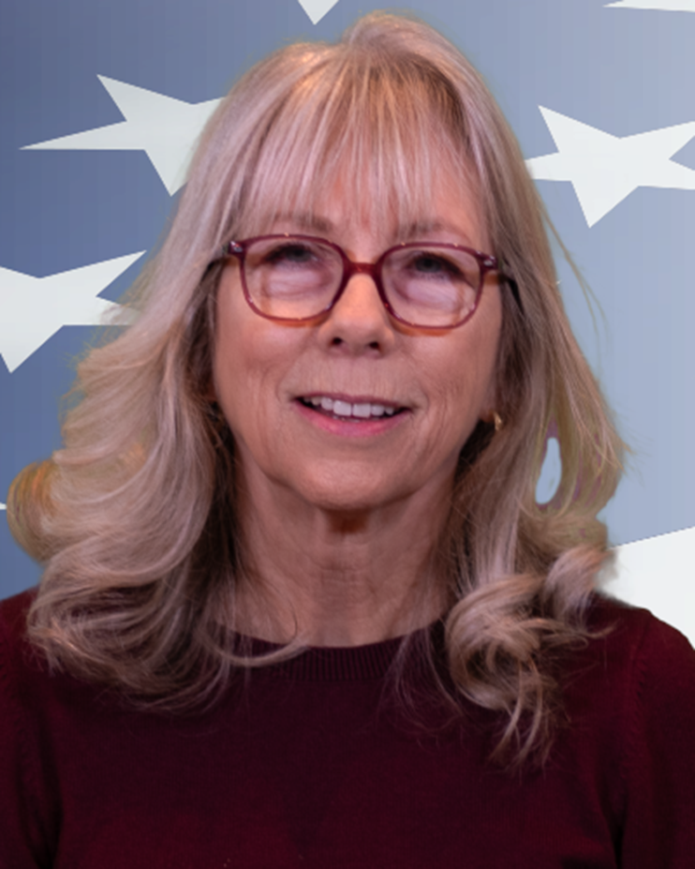
Teresa (Terry) Schmall-Van Horne former Lead District Representative, Rep. Mike Levin (CA-45)
Notes:
Margaret reads bio & facilitates questions with Terry 8:50 PM - 9:05 PM: Guest Speaker, Terry VanHorne, former District Office Lead with Rep. Mike Levin (CA-45) (Confirmed) 7 to 8 mins talk by Terry -
Opening question: How she got into it, and what she gained from it
How does constituent advocacy influence Representatives’ staffers work?
Any examples of specific actions that Rep Levin took related to international funding, womens’ health, etc. influenced by our advocacy?
How do you work with staffers from members who haven’t prioritized those issues?

Slide 13
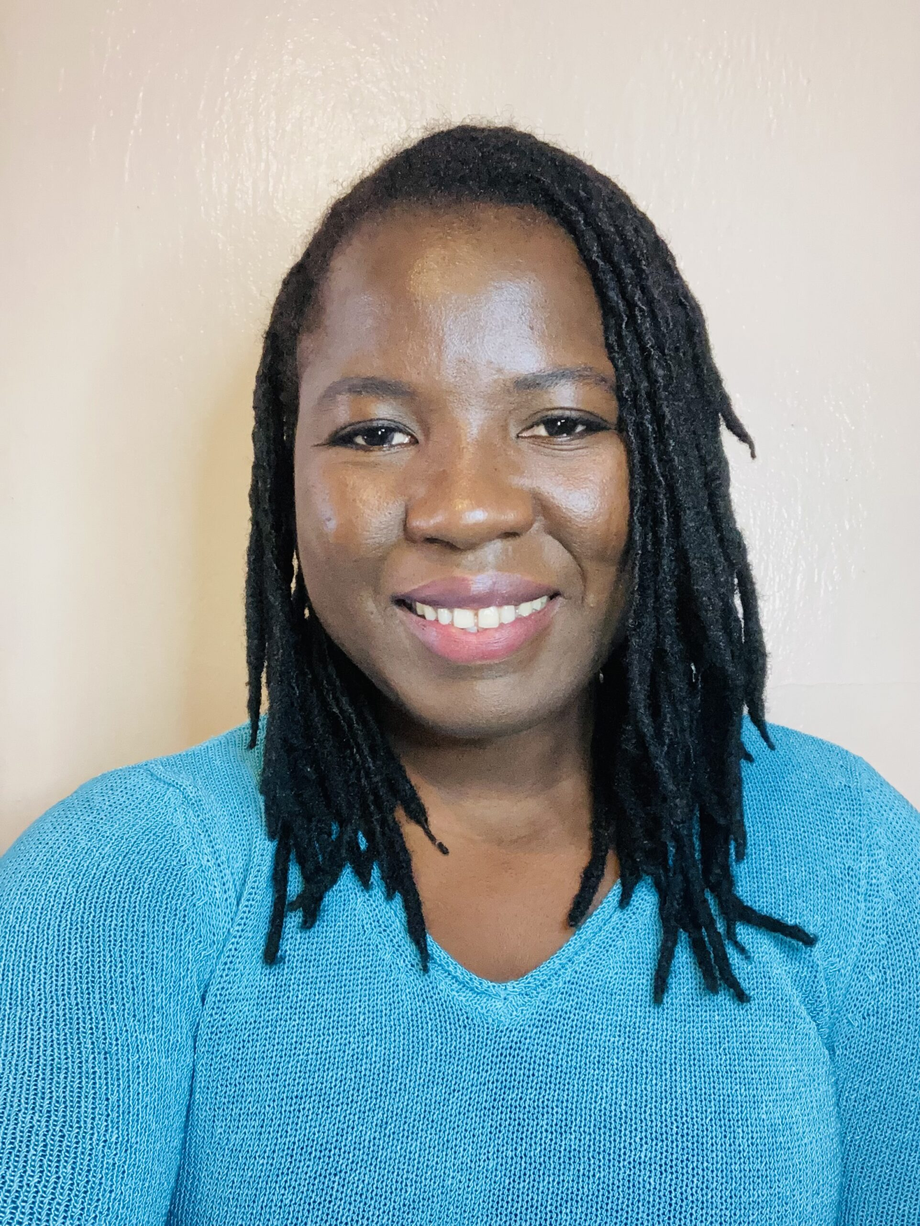
Sahaletou Yelebo Global Advocacy Associate, Integrate Health
Notes:
Susan reads bio & passes to Saha who will start with 2 min video before her presentation 9:05 PM - 9:20 PM: Rise Grantee Presentation: Integrate Health (Confirmed)
& questions
Thank you Margaret!
Saha’s bio
We will begin with 2 min video presented by Saha Yelebo of the work that Integrate Health does in country in Togo Karyne will play video
10 min presentation + 3 mins Q&A
Thank you Saha for that wonderful presentation. I’m pleased to welcome our last speaker, our founder and former chair of the Together Women Rise Advocacy Chapter with RESULTS, Leslye Heilig

Slide 14
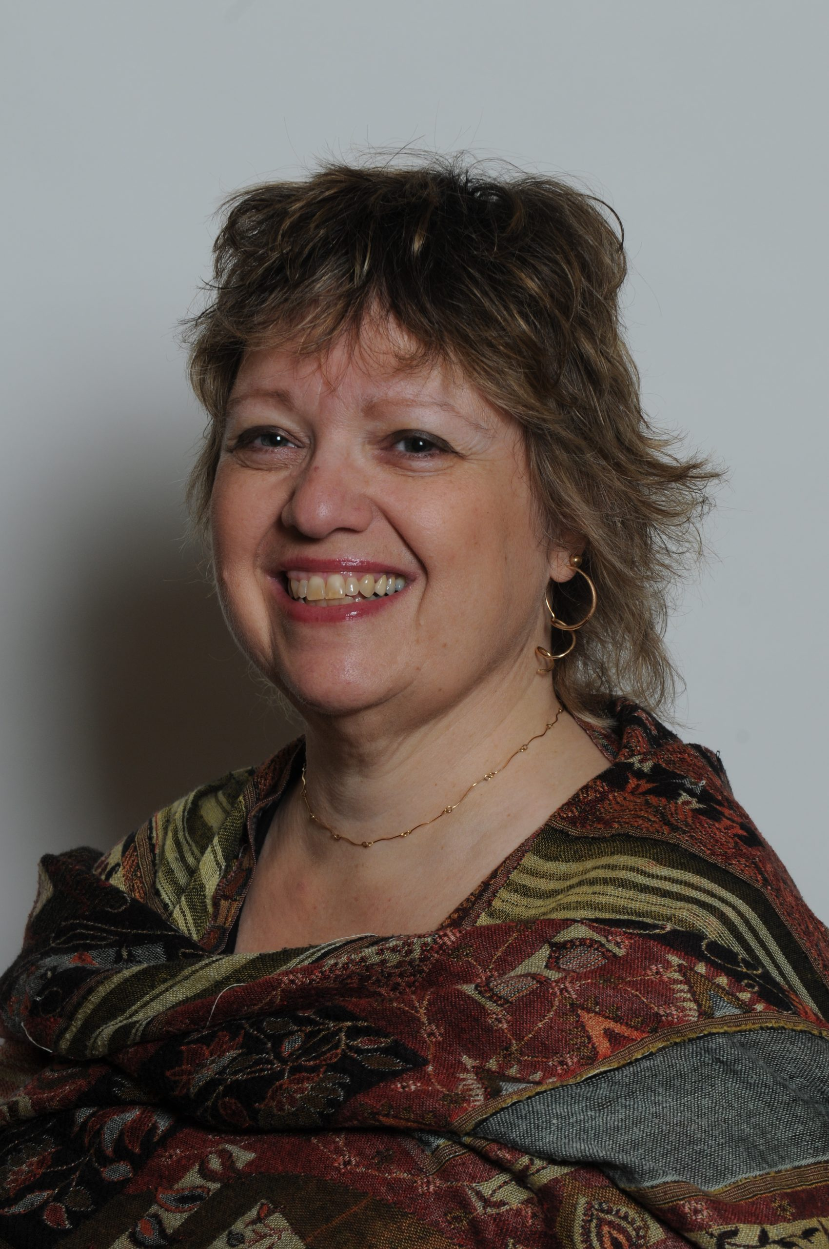
Leslye Heilig Together Women Rise Advocacy Chapter, co-chair 2018-2023
Notes:
9:20 PM - 9:25 PM: Hear from a Rise Advocacy Chapter Member, Leslye Heilig, previous Together Women Rise Advocacy Chapter chair
Leslye will share how advocacy experience has transformed them and their sense of power for change,
If you would like to learn more and take action with us, we would like to invite you to fill out our sign up, Karyne will drop it in the chat http://tinyurl.com/JoinRiseAdvocacyChapter Karyne drop the link to sign up in the chat

Slide 15
Invite others to join us in
changing the world together!
Sign up here: http://tinyurl.com/JoinRiseAdvocacyChapter
Notes:
Leslye
If you would like to learn more and take action with us, we would like to invite you to fill out our sign up, Karyne will drop it in the chat http://tinyurl.com/JoinRiseAdvocacyChapter Karyne drop the link to sign up in the chat

Slide 16
Together Women Rise Advocacy Chapter October Meeting Tuesday, October 15 at 8:30 PM ET
Save the Date!
Notes:
Karyne

