Slide 1
Monthly Webinar March 13, 2025

Slide 2
Welcome everyone!
Let us know where you are joining us
from in the chat!
Share a greeting in another language if you know one.

Slide 3
Our Values & Resources
3
​At RESULTS we pledge to create space for all voices, including those of us who are currently experiencing poverty. We will address oppressive behavior in our interactions, families, communities, work, and world. Our strength is rooted in our diversity of experiences, not in our assumptions.
With unearned privilege comes the responsibility to act so the burden to educate and change doesn’t fall solely on those experiencing oppression. When we miss the mark on our values, we will acknowledge our mistake, seek forgiveness, learn, and work together as a community to pursue equity.
Read our full anti-oppression values statement here at results.org/values.
Check out the Anti-Oppression Workshop Schedule for training opportunities.
Find these resources and more at results.org/volunteers/anti-oppression:
Resource Guides from our Diversity & Inclusion trainings, including:
Interrupting Microaggressions
Creating Space for Critical Conversations
Information on how RESULTS responds to oppressive incidents

Slide 4
Tonight’s Agenda
Welcome & Introductions
Campaign Update: First 100 Days & FY 26 Appropriations
Advocacy Actions
Closing

Slide 5
How have you engaged with your community about foreign aid?
How have your engaged with your MoC?

Slide 6
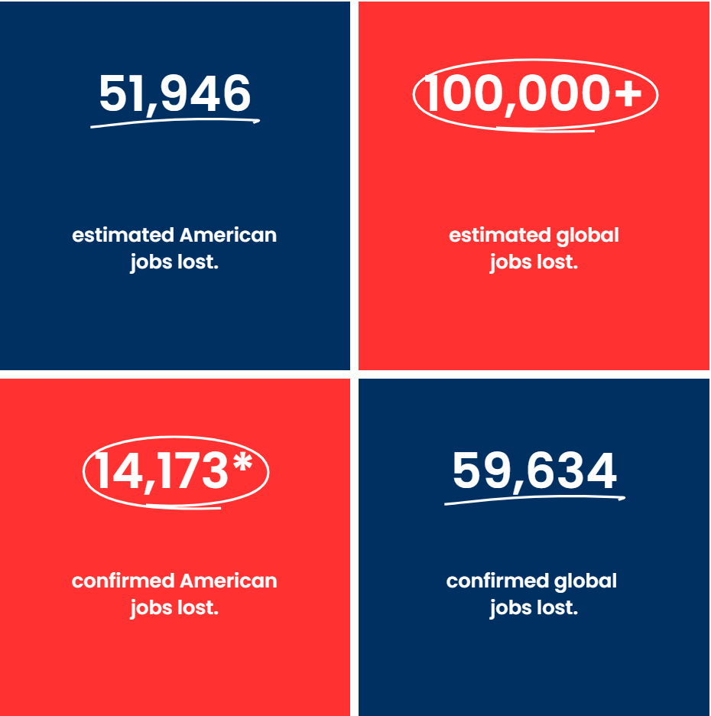
Source: www.usaidstopwork.com/documents

Slide 7
Notes:
https://www.nytimes.com/video/us/politics/100000009999341/georgia-factory-trump-doge-usaid.html

Slide 8
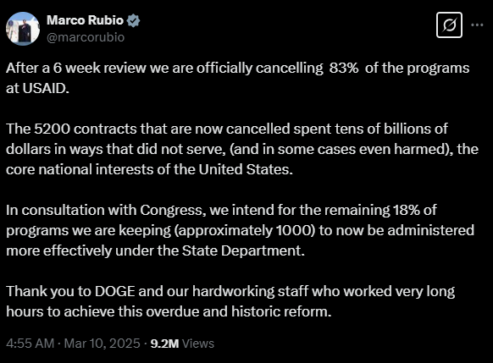

Slide 9
The First 100 Days campaign

Slide 10
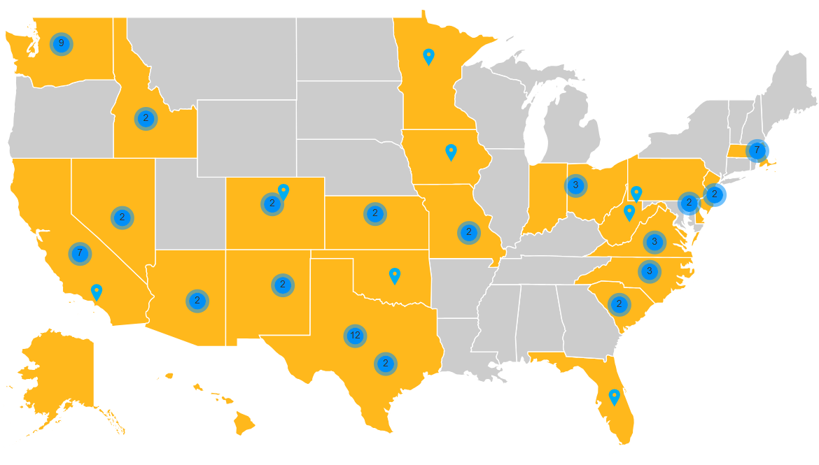
As of 3/11/2025

Slide 11
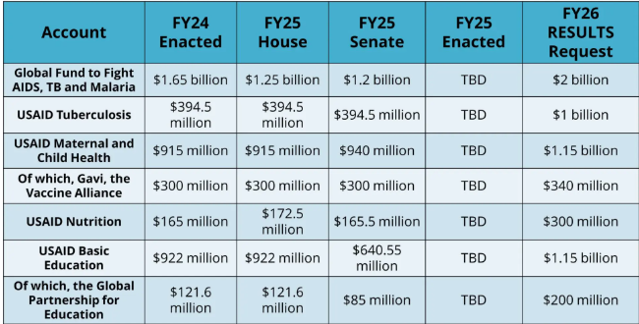
FY26 Appropriations
Notes:
Fiscal year 2026 appropriation memos: https://results.org/resources/fy26-global-appropriations-memos

Slide 12
FY26 Appropriations
How we advocate:
Dear Colleague Letters
Appropriations request forms
Direct Outreach to Legislators (Phone calls, emails, lobby meetings)
Media (Letters to the editor, Op Eds, etc.)

Slide 13
Take action now!

Slide 14
Advocacy Action
Contact your members of Congress, request that:
End the stop-work order, and reinstate critical programs and staff to carry them out.
Push the State Department to verify that programs under the waiver have restarted, and expand the waiver to all global health and development programs.
Ensure Congress is involved in shaping the future of foreign aid — standing up for programs that are focused on ending poverty and creating good health, and committed to humanitarian and lifesaving impact.
Notes:
https://results.org/blog/emergency-action-to-protect-lifesaving-foreign-aid

Slide 15
Advocacy in 2025
Research & reach out to members of Congress
Continue to write and submit media
Engage with your community
What will be your next step?

Slide 16
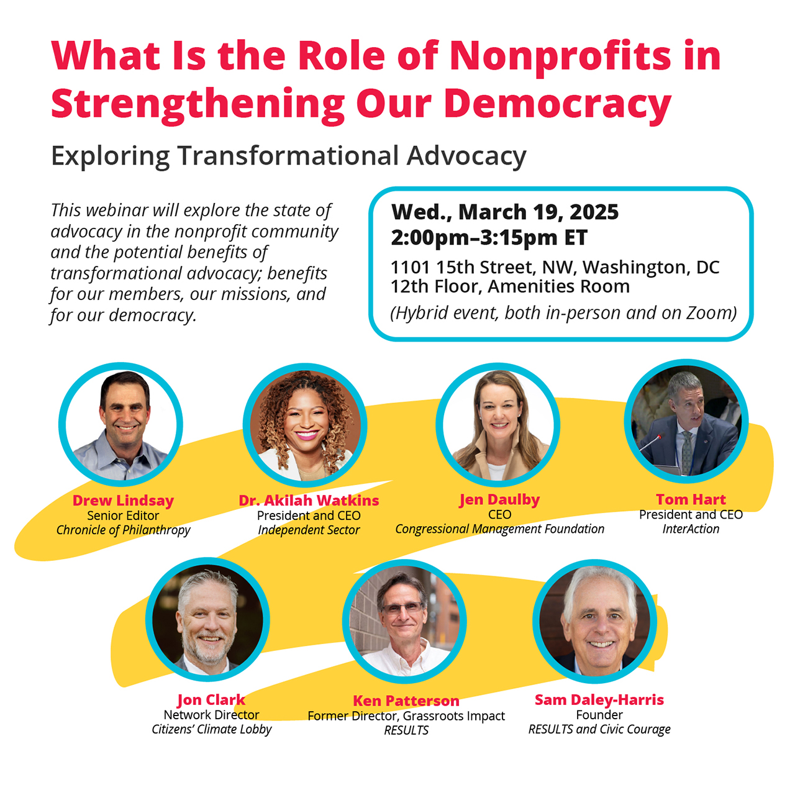

Slide 17
Next Webinar:
Thursday, April 10 at 8:30 PM ET Invite others to join: https://tinyurl.com/2025GAPWebinars

Slide 18
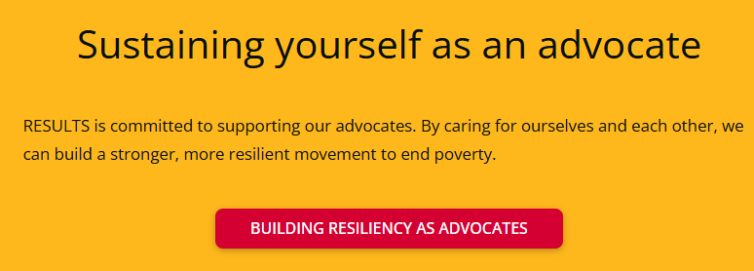
Notes:
Building resiliency as advocates: https://results.org/wp-content/uploads/Building-Resilience-as-an-Advocate_resources.pdf

