Slide 1
March Webinar March 14, 2024

Slide 2
Welcome everyone!
Let us know where you are joining us
from in the chat!
Share a greeting in another language if you know one.

Slide 3
Our Values & Resources
3
​At RESULTS we pledge to create space for all voices, including those of us who are currently experiencing poverty. We will address oppressive behavior in our interactions, families, communities, work, and world. Our strength is rooted in our diversity of experiences, not in our assumptions.
With unearned privilege comes the responsibility to act so the burden to educate and change doesn’t fall solely on those experiencing oppression. When we miss the mark on our values, we will acknowledge our mistake, seek forgiveness, learn, and work together as a community to pursue equity.
Read our full anti-oppression values statement here at results.org/values.
Check out the Anti-Oppression Workshop Schedule for training opportunities.
Find these resources and more at results.org/volunteers/anti-oppression:
Resource Guides from our Diversity & Inclusion trainings, including:
Interrupting Microaggressions
Creating Space for Critical Conversations
Information on how RESULTS responds to oppressive incidents

Slide 4
Overview of tonight’s webinar
Review of the appropriations process & FY 25 Requests
Advocacy Action: Make your requests to your MOCs!
Check in on lobby meetings
Closing Announcements

Slide 5
FY25 Appropriations

Slide 6
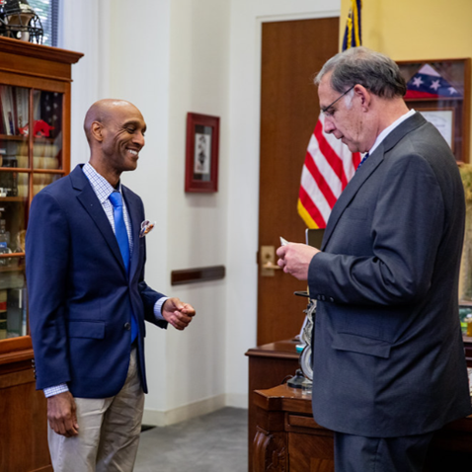
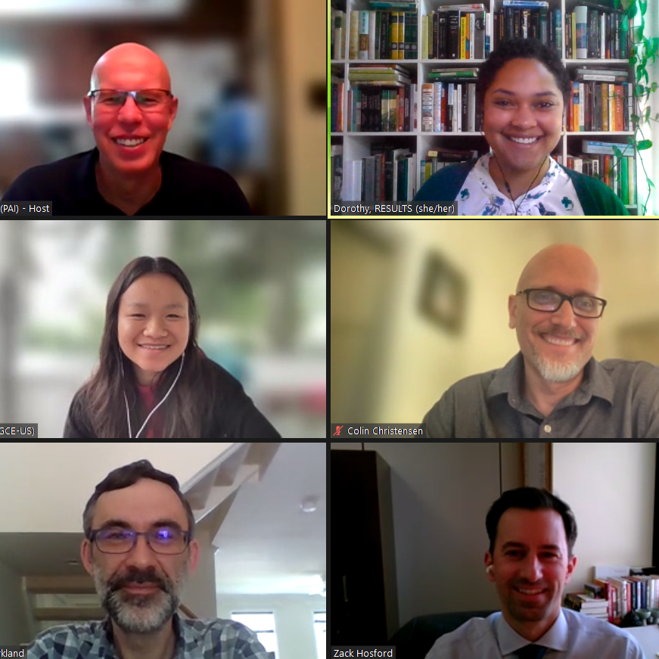
1) Asking MoCs/staff to include our requests in their submissions to SFOPS and following up 2) Meeting with MoC/staff at home & in DC to make our requests
We influence appropriations by…
Notes:
Mention lobby prep, Set the Agenda resources
Most Americans don’t follow the Appropriations process, meaning members of Congress don’t always feel pressure from their constituents to fight for specific programs. But you can get our issues on their radar by sending an email, calling their offices, and asking for a meeting with their Foreign Policy staffers. Your goal is to introduce our appropriations asks, share why those issues matter to you, and ask your senator or representative to speak to members of SFOPs about our requests.

Slide 7
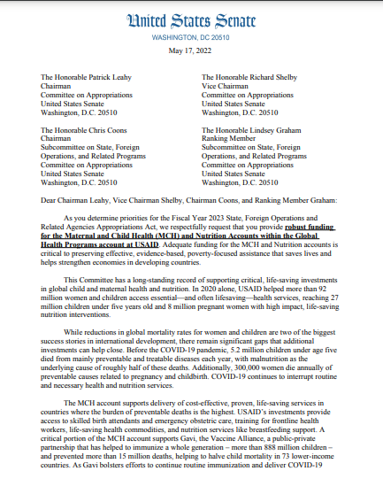
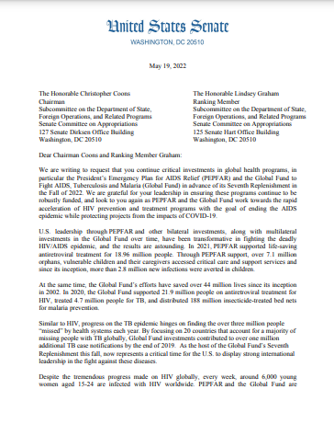
3) Asking MoCs to sign “dear colleague” letters on our appropriations asks
we influence appropriations by…
Notes:
DCs- one for each issue
During the appropriations process, members of Congress can make their priorities known by signing on to “Dear Colleague” letters for issues that they care about. Each letter is circulated by champions in Congress asking other members to join them, like a petition. Then, the letters are sent to the leaders of the SFOPs subcommittee, which writes the foreign aid spending bill. These letters can have a lot of sway, and a large number of bipartisan signers shows the committee that there is strong support for that issue.
Our job is to ask members of Congress to sign the letters we’re endorsing. Typically, we prioritize Dear Colleague letters on global Tuberculosis, Maternal and Child Health and Nutrition, the PEPFAR/ Global Fund to Fight AIDS, Tuberculosis, and Malaria, and global education.

Slide 8
The Impact of Dear Colleague Letters
Account | FY17 Signers | FY17 Funding | FY20 Signers | FY20 Funding | FY23 Signers | FY23 Funding
USAID Maternal and Child Health | 146 House 27 Senate | $814.5 million | 146 House 37 Senate | $851 million | 178 House 35 Senate | $910 million
USAID Tuberculosis | 71 House 16 Senate | $241 million | 77 House 29 Senate | $310 million | 120 House 30 Senate | $394.5 million
Notes:
Increased number of signers-- higher priority for SFOPS-- greater funding

Slide 9
You don't have to ask for everything!
Check the RESULTS Scorecard
Do a little research:
What do they care about?
Connect what they care about with our issues
Ask for one more thing than they've supported in the past
Notes:
Karyne

Slide 10
Let’s Take Action Tonight on FY 25 Appropriations!
Sample Request Letter
Notes:
Karyne

Slide 11
Let’s Take Action Tonight on FY 25 Appropriations!
Look up your MOCs foreign policy aide using the Legislator Lookup page: https://results.org/volunteers/legislator-lookup
If you have trouble, contact Karyne (kbury@results.org) or Ken (kpatterson@results.org) to help, we have access to the back end of the website and can find alternate contacts in the office
House: FirstName.LastName@mail.house.gove Senate: FirstName_LastName@SenatorLastName.senate.gov
Copy the draft message below into an email to your MOC’s Foreign Policy Aide. Select 1 or 2 issues that are particularly close to you in addition to the funding request for PC. Personalize and share why this issue is important to you as an RPCV.
Notes:
Karyne

Slide 12
Remember to follow up!
Notes:
Karyne

Slide 13
Lobby meetings! Who has met with their House or Senate offices?
Notes:
Karyne

Slide 14
Goal:
Meet with all of our members of Congress between February – April
(350 meetings!)
Notes:
Karyne

Slide 15
Request to meet with your member of Congress: a) Use Legislator Look Up, find the scheduler b) Use sample meeting request letter, copy staff
Request times that work with the people you want to join you if possible
Follow up on the request!
Requesting a Meetings
with Congress
Notes:
Ken

Slide 16
Requesting a Meeting
Once you have a time, invite people to join you: RPCVs, friends, family, RESULTS, faith community
Contact Karyne or Ken to set up a meeting planning time.
Review materials, leave behinds, laser talks
Notes:
Ken

Slide 17
Preparing to Meet
Create an agenda and assign roles using the RESULTS Lobby Planning Form
Practice speaking points (EPIC)
Reconfirm your meeting the day before
Notes:
Ken

Slide 18
After Your Meeting
Send a thank you note and summary of asks
Report your meeting
Continue to follow up on requests
Notes:
Ken

Slide 19
Join our next GAP webinar: April 11 at 8:30 PM ET Feel free to bring a friend or fellow RPCV!

Slide 20
Thanks for joining us tonight!

