Slide 1
RISE Advocacy Chapter with RESULTS March Webinar
March 15, 2022
Notes:
Leslye

Slide 2
Welcome & Introductions

Slide 3
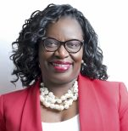
Welcome & Introductions
Beverley Francis-Gibson
CEO Together Women Rise

Slide 4
Mission & Vision
Together Women Rise’s Mission
Together Women Rise cultivates the collective power of community to achieve global gender equality.
OUR VISION
Together Women Rise envisions a world where every person has the same opportunities to thrive regardless of their gender or where they live.
Notes:
Leslye

Slide 5
RESULTS Anti-Oppression Values
​RESULTS is a movement of passionate, committed everyday people. Together
we use our voices to influence political decisions that will bring an end to poverty.
Poverty cannot end as long as oppression exists.
We commit to opposing all forms of oppression, including racism, classism, colonialism, white saviorism, sexism, homophobia, transphobia, ableism, xenophobia, and religious discrimination. ​
At RESULTS we pledge to create space for all voices, including those of us who are currently experiencing poverty. We will address oppressive behavior in our interactions, families, communities, work, and world. Our strength is rooted in our diversity of experiences, not in our assumptions. ​
With unearned privilege comes the responsibility to act so the burden to educate and change doesn’t fall solely on those experiencing oppression. When we miss the mark on our values, we will acknowledge our mistake, seek forgiveness, learn, and work together as a community to pursue equity.
There are no saviors — only partners, advocates, and allies. We agree to help make the RESULTS movement a respectful, inclusive space.​
Find all our anti-oppression resources at: https://results.org/volunteers/anti-oppression/

Slide 6
Updates and Current Campaign
Notes:
we are still waiting on the COVID supplement. The Omnibus was passed last week without it. We are trying to get a global COVID supplement passed separate from the domestic one—there is bipartisan support for global funding.
Thanks to you we had 137 signers for the letter to Pres Biden for $18 billion pledge for Global Fund

Slide 7
Global Fund to Fight AIDS, TB and Malaria
44 million lives saved and scaled up treatment for 3 diseases:
AIDS related deaths down 68%
TB deaths down by 28%
Malaria deaths down by 45%
Global Fund - first on the scene with support for COVID-19 with existing healthcare infrastructure
Connections between TB and HIV, and TB and women

Slide 8
Global Fund to Fight AIDS, TB and Malaria
Huge opportunity later this year: U.S. is host of the Global Fund Replenishment conference.
We have been supporting Global Fund since 2002 because it works.
First step in successful replenishment: Administration must be ready to make a bold pledge. Bipartisan House Sign-On letter a key tool in this. Thank you for taking action on this! There were 137 signers.
We will be taking other actions on this campaign.
Notes:
Link to sign on letter: https://results.org/wp-content/uploads/House-Replenishment-Pledge-Letter.pdf

Slide 9
Grantee Spotlight
Notes:
Grantee spotlight

Slide 10
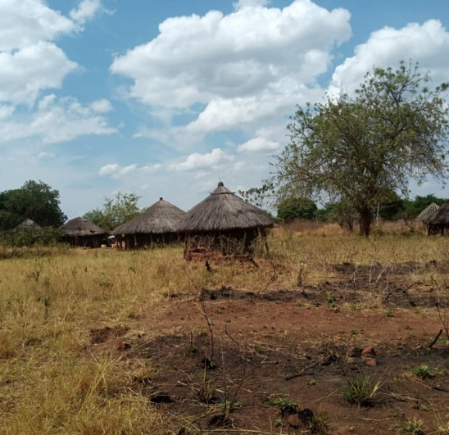
Introducing The Center for Victims of Torture
Mental Health Counseling for Women and Girls in Uganda
Works to end torture and heal the wounds of torture
for individuals and families from refugee and local communities
with focus in Uganda on rehabilitative care of women and girls kidnapped and trafficked as child soldiers or sex slaves of male combatants
Notes:
Purpose: The goal of the CVT Uganda program is two-fold, providing mental health services to torture and trauma survivors, as well as developing the capacity of mental health practitioners, particularly women and the broader community. CVT aims to improve the quality of life for women and help them pursue their own goals and create lasting change in their lives.

Slide 11
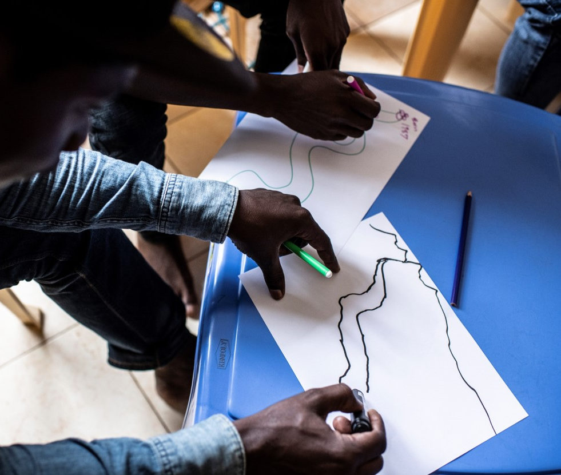
Life Challenges
For women in Uganda
Recovering from nearly 20 years of conflict including widespread torture and human rights violations
Health, societal, and financial challenges are barriers to accessing social services and opportunities
Notes:
Uganda hosts nearly 1.5 million refugees fleeing from neighboring humanitarian emergencies, and it is also still recovering from nearly 20 years of conflict between the government and the Lord’s Resistance Army (LRA) – whose leaders stand accused and have been convicted by the International Criminal Court (ICC) of widespread torture and human rights violations. Therefore, Uganda is striving to provide opportunities and basic social services to its citizens and refugees, but health and financial challenges continue to be barriers while accessing such services.

Slide 12
Life Challenges
Thousands of baby girls were kidnapped, trafficked, and forced to be child soldiers, or used as sex slaves for male combatants
During captivity, many women contracted HIV and delivered children born of rape
Women feel immense shame, lack access to resources, have limited education, experience trauma symptoms, and may face rejection from community
They were victims of violence and also forced to perpetrate violence
Uganda is among the 22 countries concentrating 80% of the TB burden in the world.
Notes:
The LRA conflict was particularly troublesome for women and children, as thousands of baby girls were kidnapped from their families, trafficked, and forced to be child soldiers, or used as sex slaves for male combatants. During captivity, many women contracted HIV and delivered children born of rape. Women returning home after capture feel immense shame and self-blame, are unable to access resources, have limited education, and experience trauma symptoms from growing up and living amidst violence. In addition, they may face rejection and blame from their families and communities.
Women survivors (70 percent of CVT clients) of the LRA conflict are different from other trauma survivors, as they were victims of violence and also forced to perpetuate it. Children were forced to kill their parents, men forced to rape their sisters, and children abducted and forced to be LRA soldiers.

Slide 13
Let’s Hit Send! Take Action on the Global Fund
Notes:
How to take action on GF, let’s do so together tonight! Link to sample email to Foreign Relations aide - Google Doc Link: https://docs.google.com/document/d/184QMSpUa4tj2uxWHZ7LIFgKZ8H3ISrITIeeWBr6rGcc/edit?usp=sharing Personalize the message, as a Rise advocate, why is this issue important to you? What role will the fight against AIDS, TB, and Malaria have in closing the gender gap?

Slide 14
Additional Actions on the Global Fund
Notes:
https://docs.google.com/document/d/1_nFFq72UgQjUNikp0_HPwfH0yOe1CNqaISYDra_vLdA/edit

Slide 15
Let’s Keep Up the Momentum
Lee/McCaul Letter Closed with 137 signers!
Thank you for making it happen!
Online action:
Continue the relationship with your member of Congress (Thanks…or no thanks…)
Get friend, family and followers to take action with you!
Notes:
Link to the final letter: https://results.org/wp-content/uploads/Final-Signed-House-Replenishment-Pledge-Letter.pdf
Link to online action: https://results.org/volunteers/action-center/action-alerts/?vvsrc=%2fcampaigns%2f91313%2frespond

Slide 16
Let’s Keep Up the Momentum
Sample of LTEs published by advocate, Willie Dickerson (Snohomish, WA)
Notes:
Link to sample LTE template: https://docs.google.com/document/d/1QCnEERVFpRWpBn57zf4zWmBzGB9R6ZD1T3bmNpawHS8/edit
Online Action alert: https://results.org/volunteers/action-center/action-alerts/?vvsrc=%2fcampaigns%2f63557%2frespond
Sample LTEs (published by Willie Dickerson): https://drive.google.com/drive/folders/1FTBkZLApRCxKEDBGqt1QHZ8J3fQX1UoI?usp=sharing

Slide 17
Let’s Keep Up the Momentum
Tonight we will draft and submit a letter to the editor, sample LTE template
100% of the LTEs that aren’t submitted do not get published, so let’s hit send tonight!
Notes:
Link to sample LTE template: https://docs.google.com/document/d/1QCnEERVFpRWpBn57zf4zWmBzGB9R6ZD1T3bmNpawHS8/edit
Online Action alert: https://results.org/volunteers/action-center/action-alerts/?vvsrc=%2fcampaigns%2f63557%2frespond

Slide 18
Upcoming Events
Global Policy Forum March 17 at 9:00 PM ET Guest Speaker: Dr. Madhukar Pai McGill University
Notes:
Drop RSVP Link in the Chat:

Slide 19
Upcoming Events
2022 Monthly Webinars: 3rd Tuesday at 8:30 PM ET Next Webinar: April 19 Invite others to take action with you!

Slide 20
Happy Birthday Chris!

Slide 21
Keep up the great advocacy!
21

