Slide 1
Knowledge Does Not Translate Itself! how communication, advocacy and diplomacy can help bridge the know-do gap between evidence & impact
Professor Madhukar Pai, MD, PhD, FRSC
Inaugural Chair, Department of Global and Public Health
Editor-in-Chief, PLOS Global Public Health
@paimadhu

Slide 2
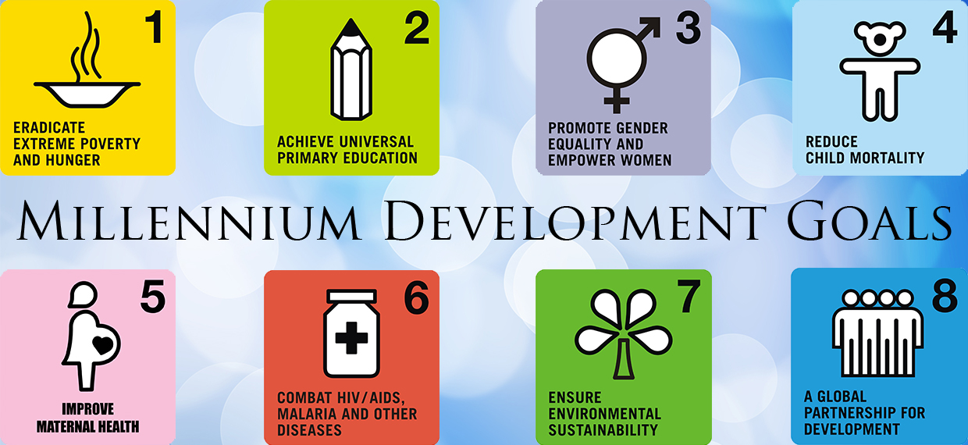
Know-do gap: the sad story of global health

Slide 3
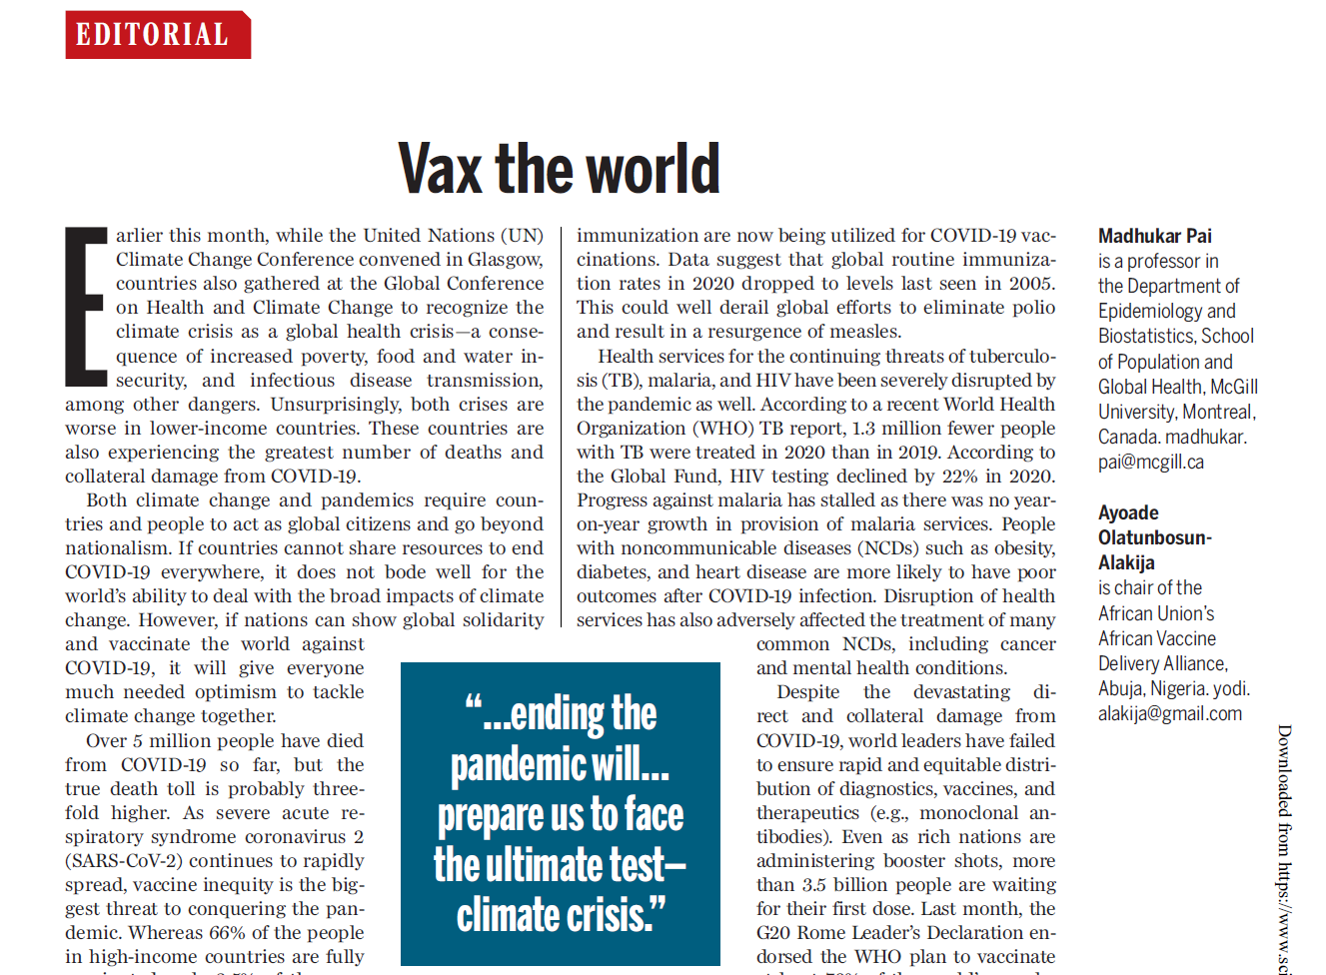
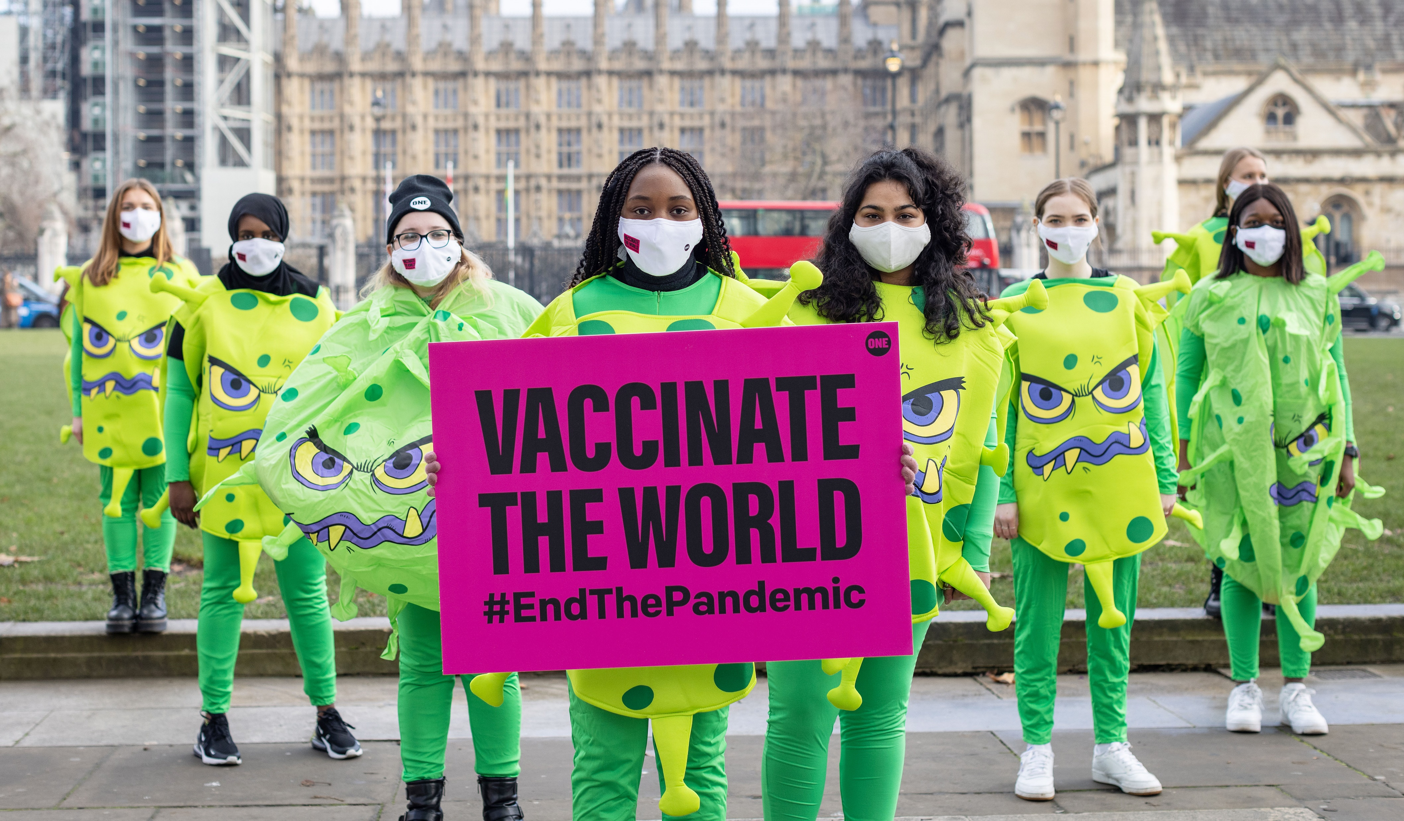
Covid-19: failure to deliver on vaccine equity
https://www.science.org/doi/10.1126/science.abn3081

Slide 4
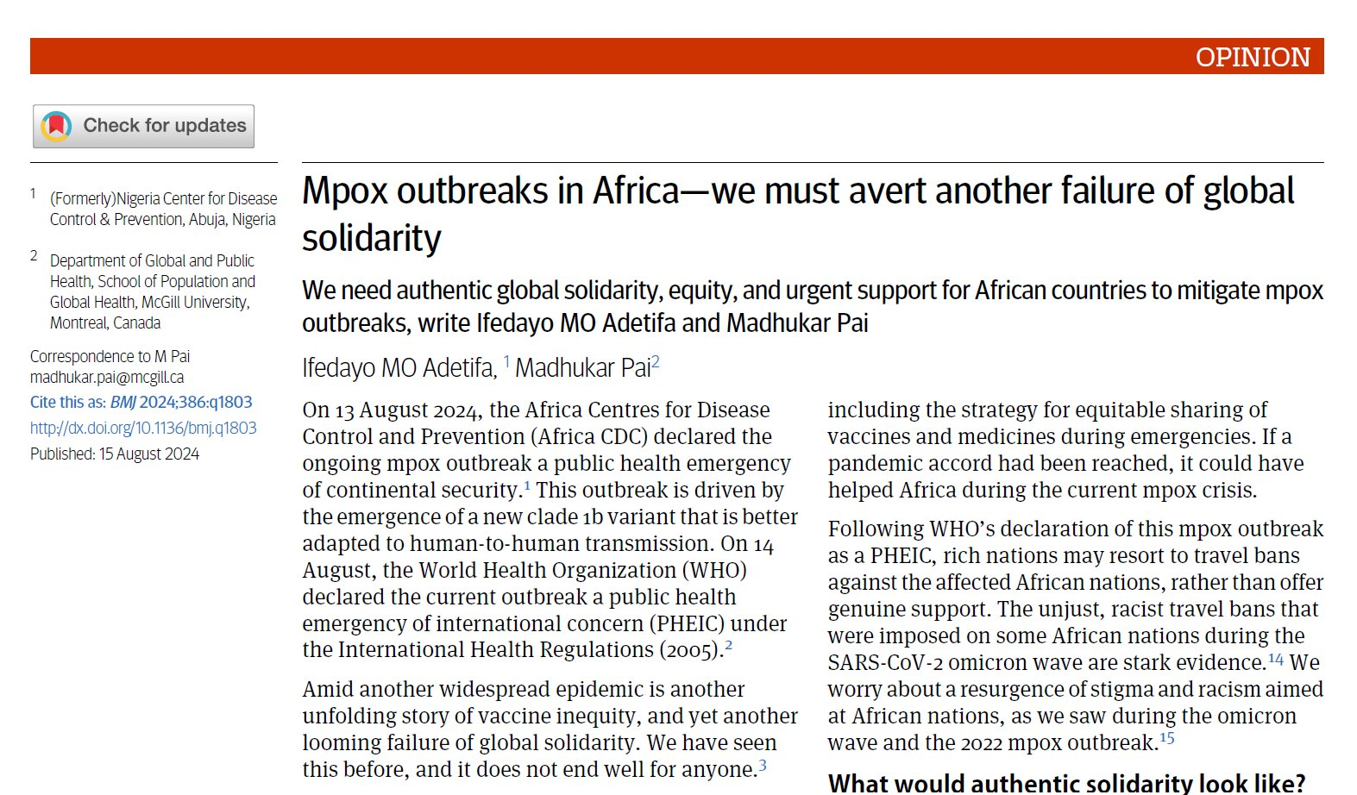
https://www.bmj.com/content/386/bmj.q1803.full?ijkey=4nCgptSl0izXZwq&keytype=ref

Slide 5
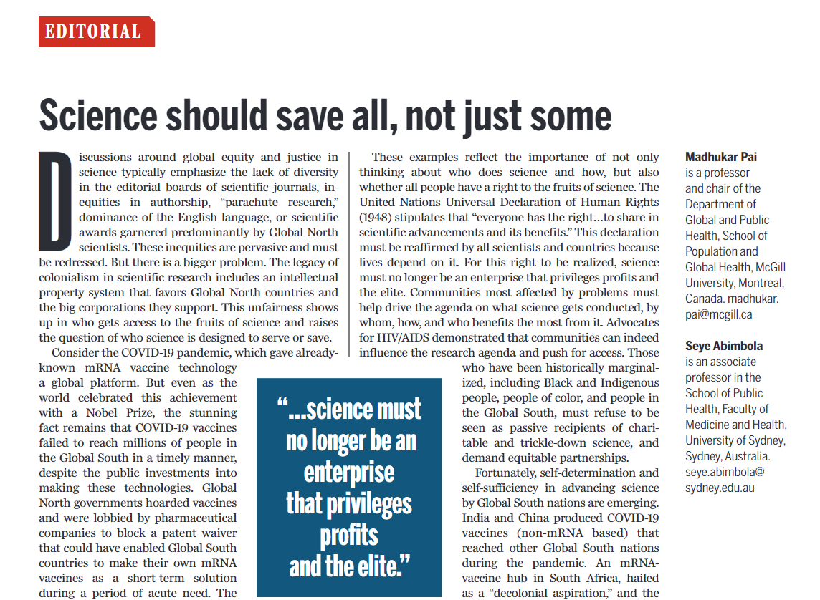
https://www.science.org/doi/10.1126/science.ads2151

Slide 6
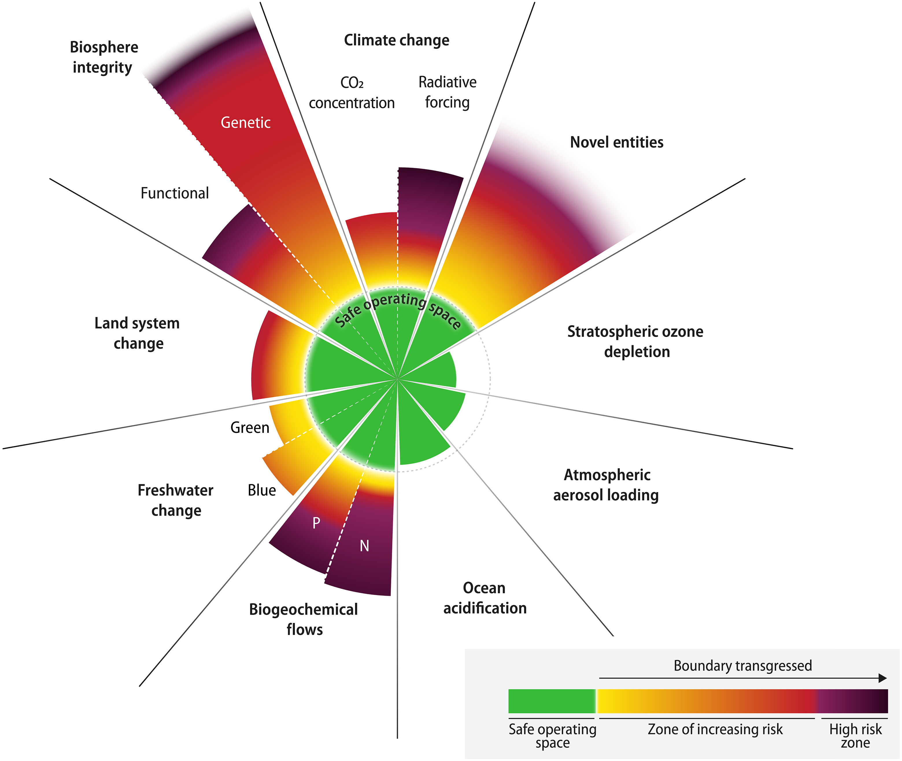
We are not acting fast enough on climate crisis
"Earth is now well outside of the safe operating space for humanity"
6 of the 9 planetary boundaries are transgressed
https://www.science.org/doi/full/10.1126/sciadv.adh2458

Slide 7
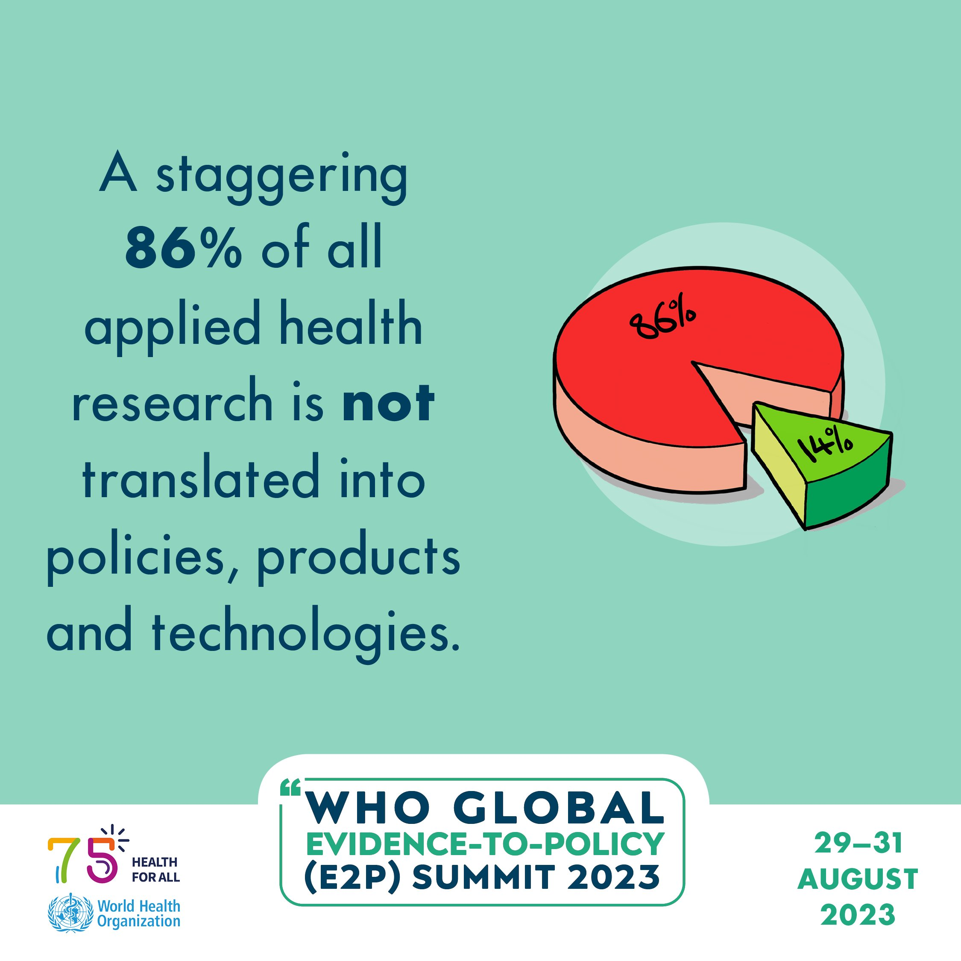

Slide 8
Yet, we still teach this ideal model of knowledge translation
Science & research
Policy
Implementation & practice
Health impact
Evidence

Slide 9
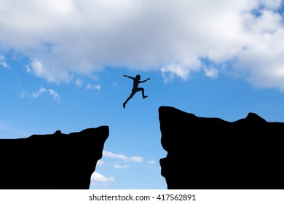
We should be teaching this instead
from science to evidence
from evidence to policy
from policy to practice

Slide 10
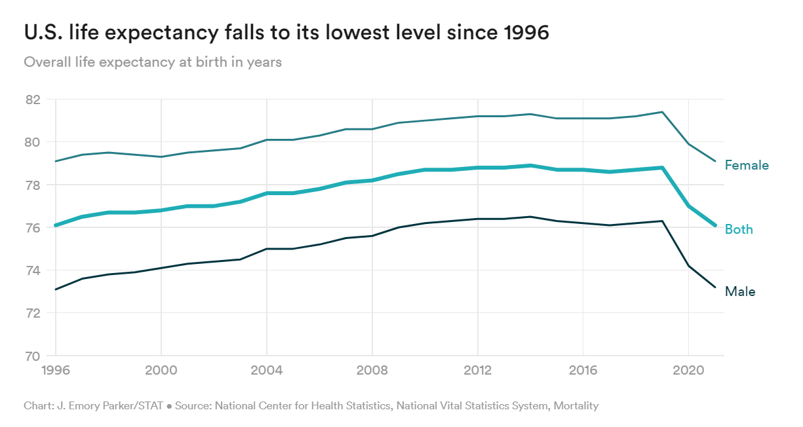
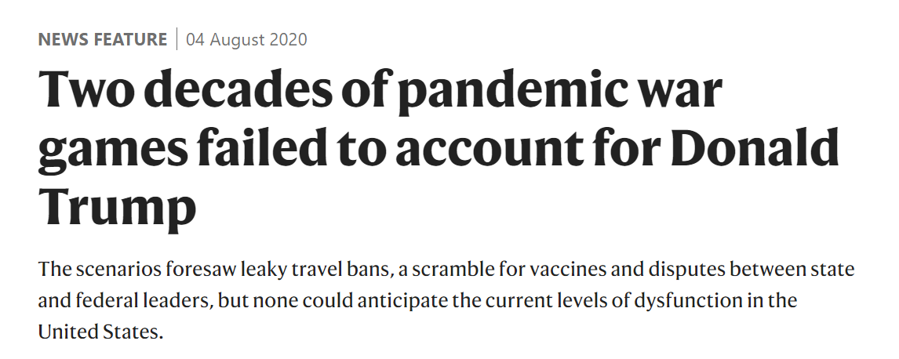
USA: 1.1+ million Covid deaths Why? Politics

Slide 11
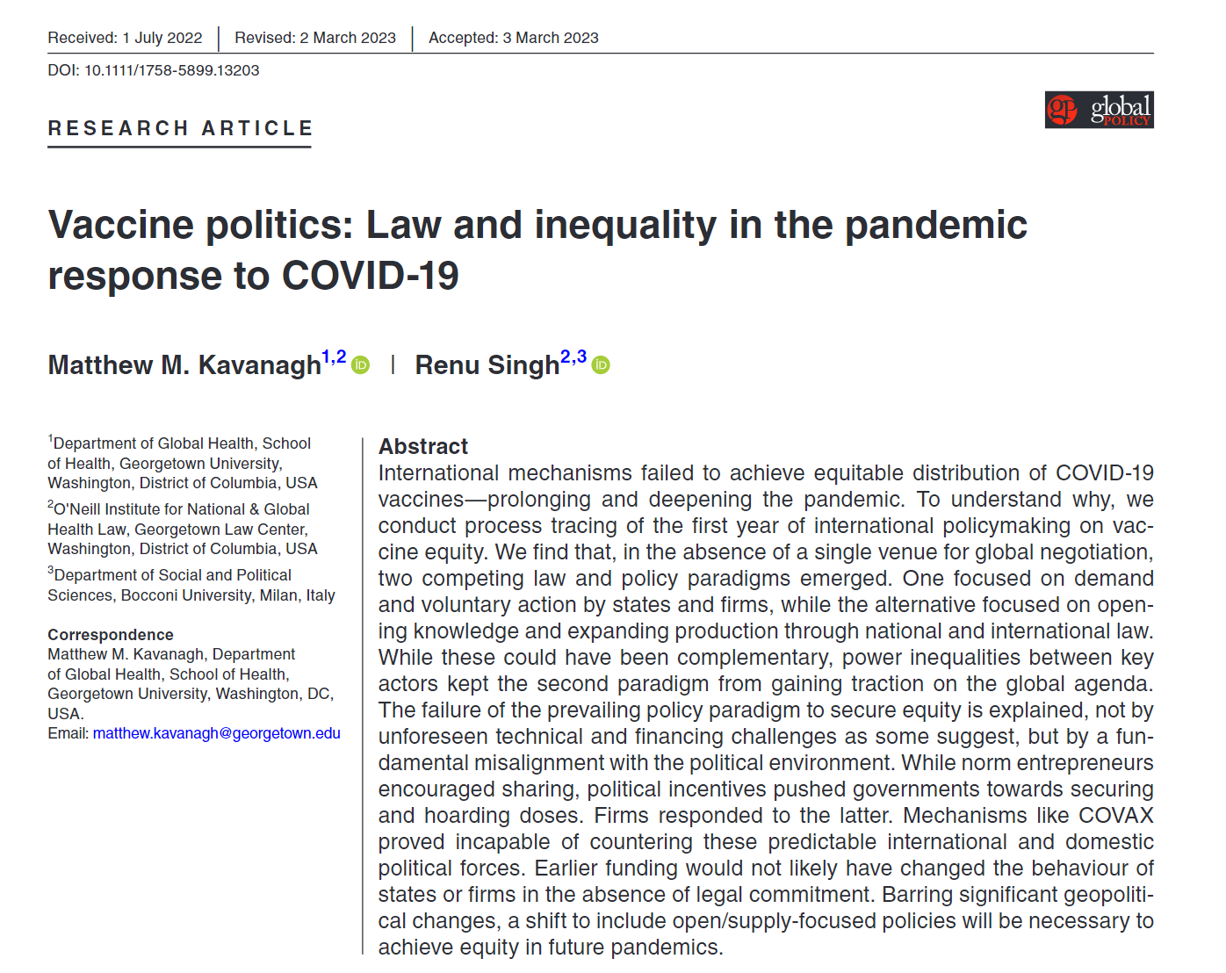
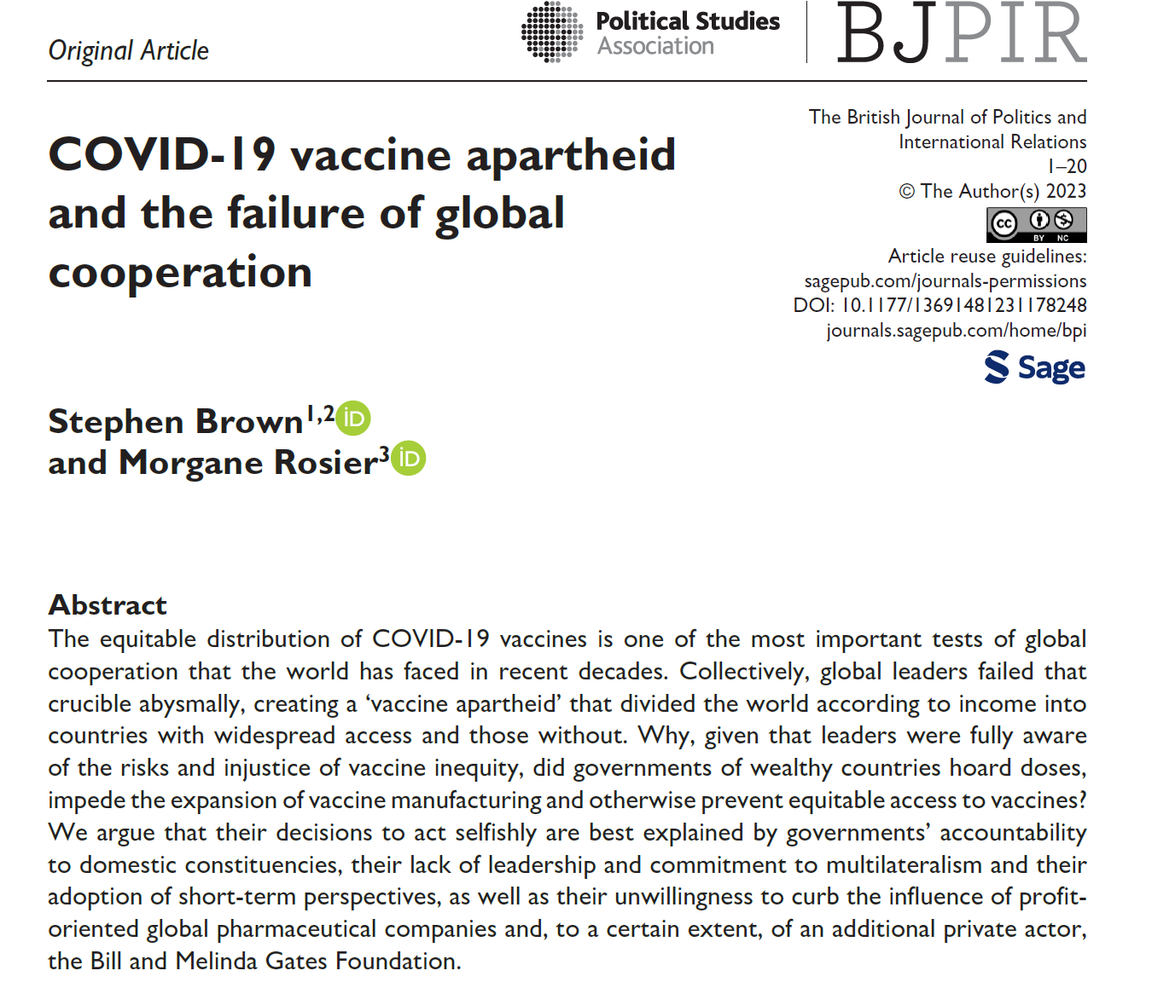
Politics & populism trumped all concerns during Covid
https://journals.sagepub.com/doi/10.1177/13691481231178248
https://onlinelibrary.wiley.com/doi/epdf/10.1111/1758-5899.13203

Slide 12
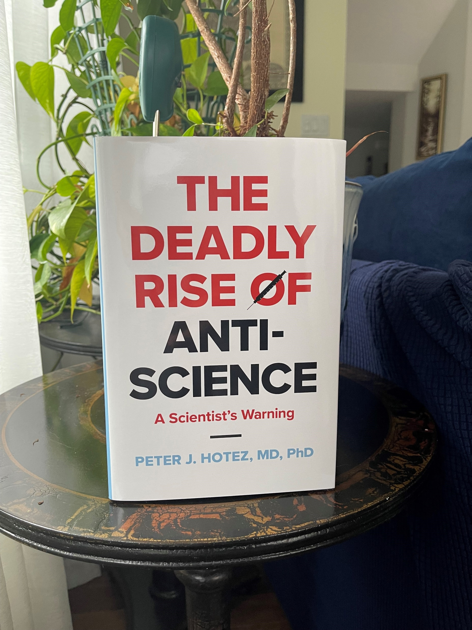
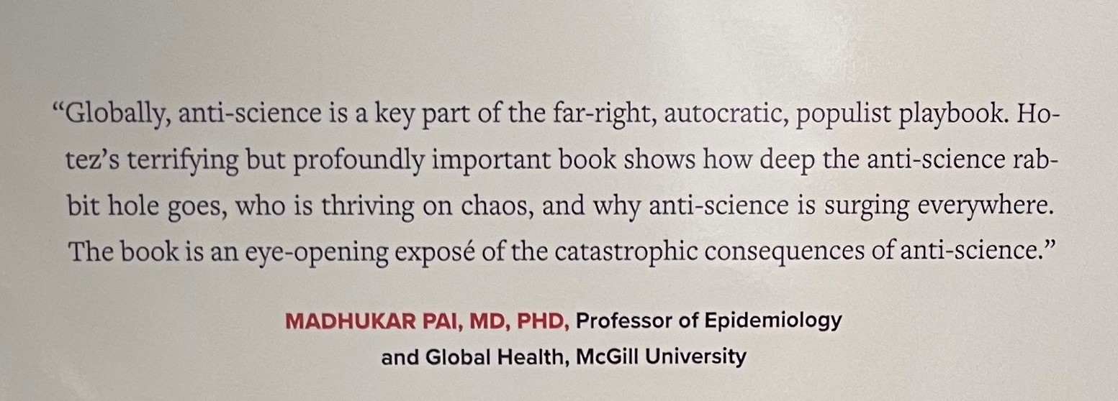
Why are we dealing with measles and whooping cough in 2024?
“Misinformation makes it sound like it’s random junk that appears out of nowhere on the Internet. It’s not: it’s an organized, well-financed, politically motivated campaign that’s meant to tear down the fabric of science. And we have to frame it as ‘anti-science aggression’”
Peter Hotez

Slide 13
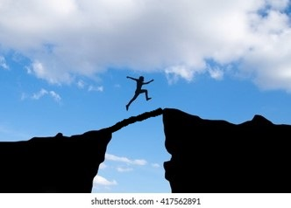
While they cannot solve all problems, comms, advocacy and diplomacy can help bridge some know-do gaps
from science to evidence
from evidence to policy
from policy to practice

Slide 14
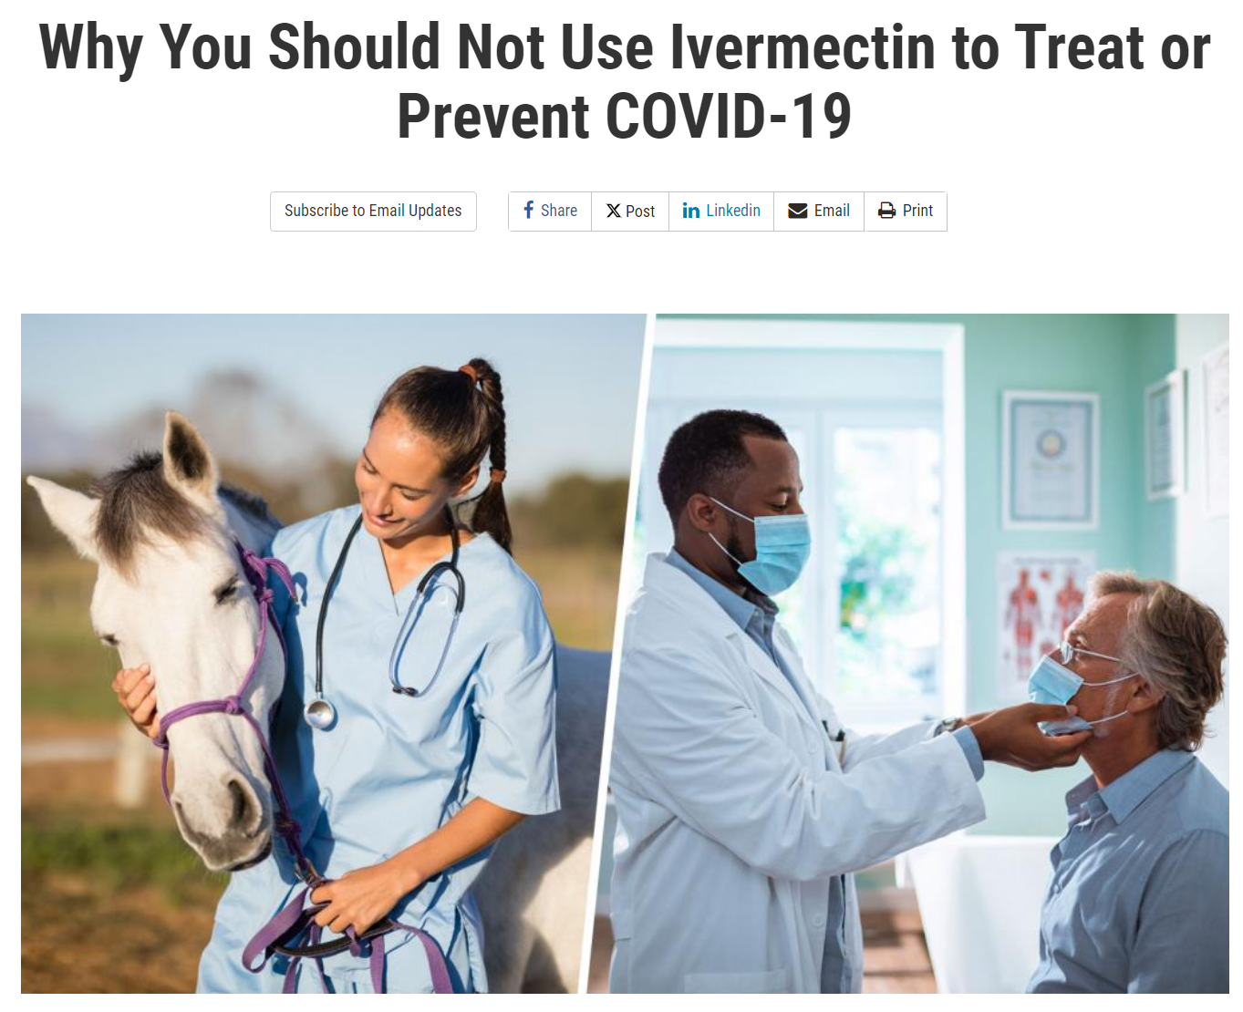
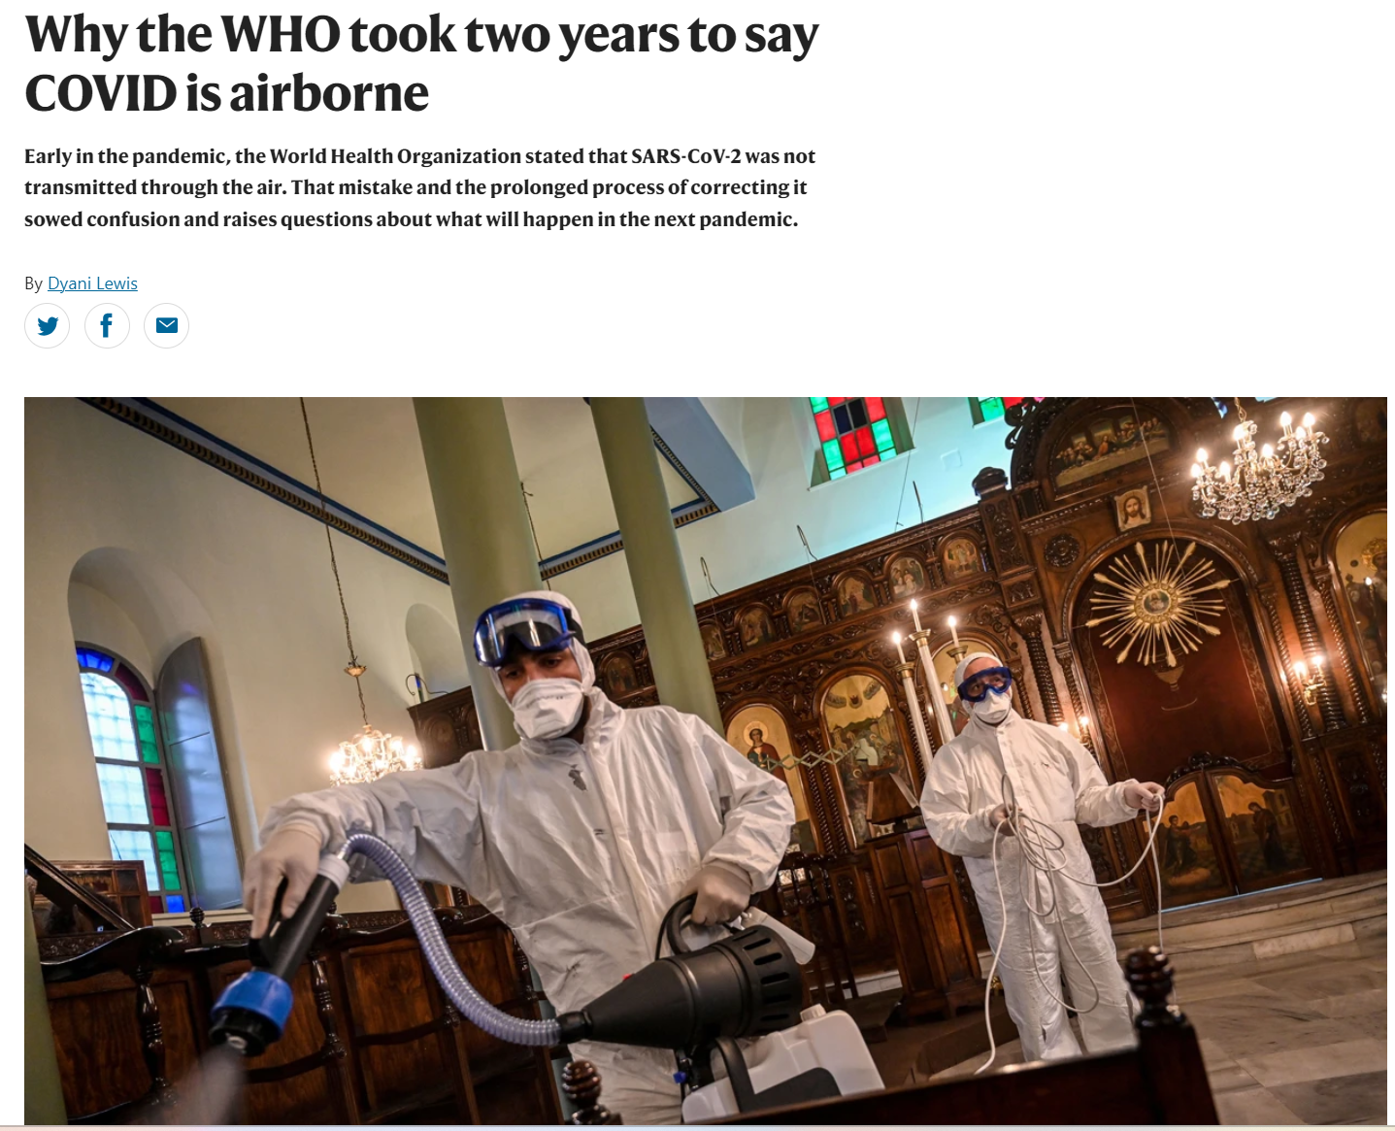
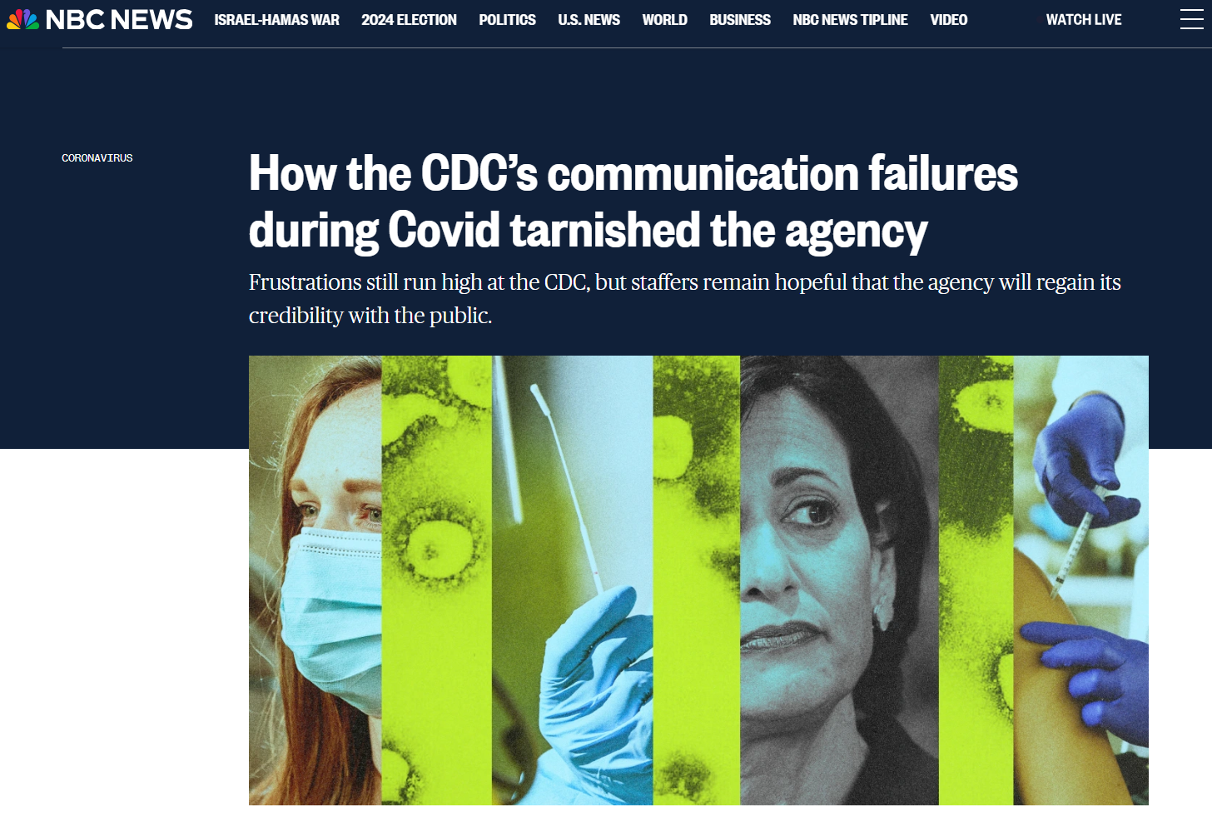
Why communication matters

Slide 15
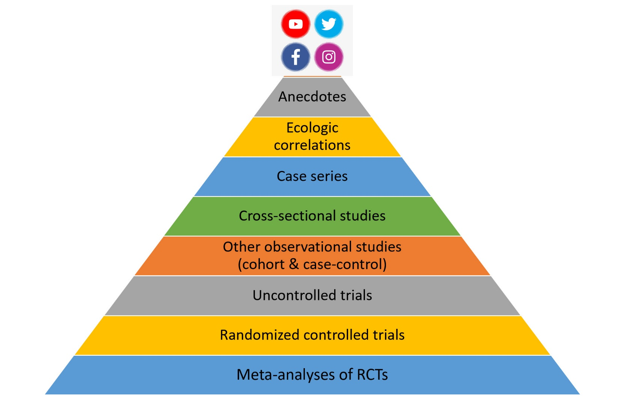
During Covid, people were trusting Whatsapp more than WHO!

Slide 16
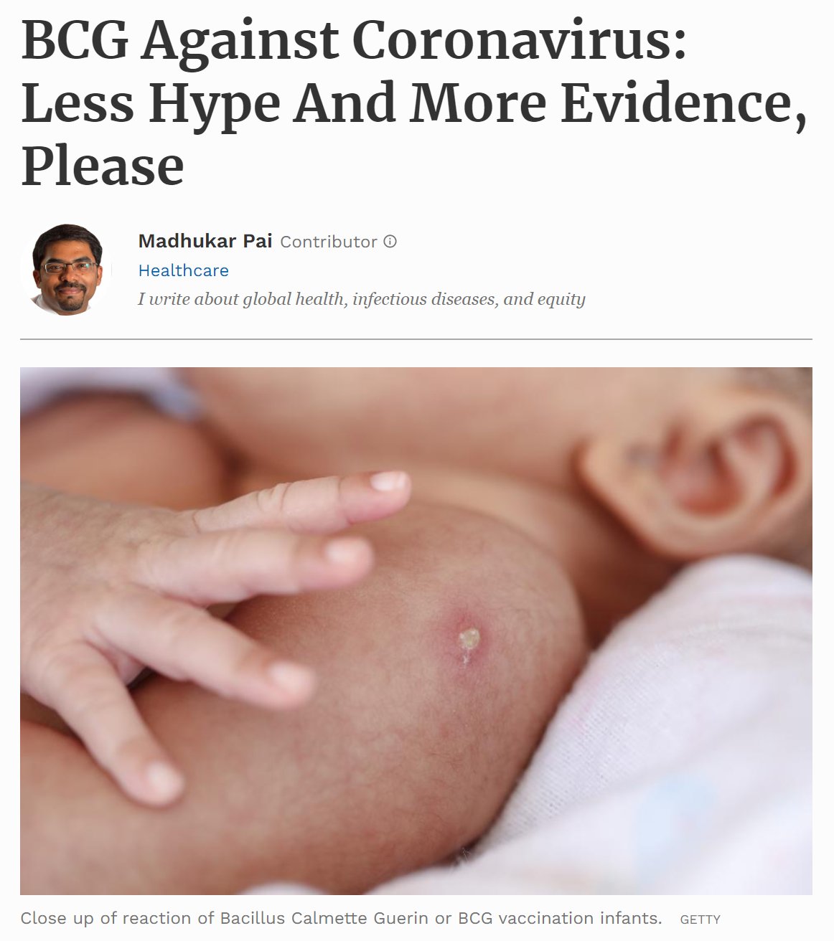
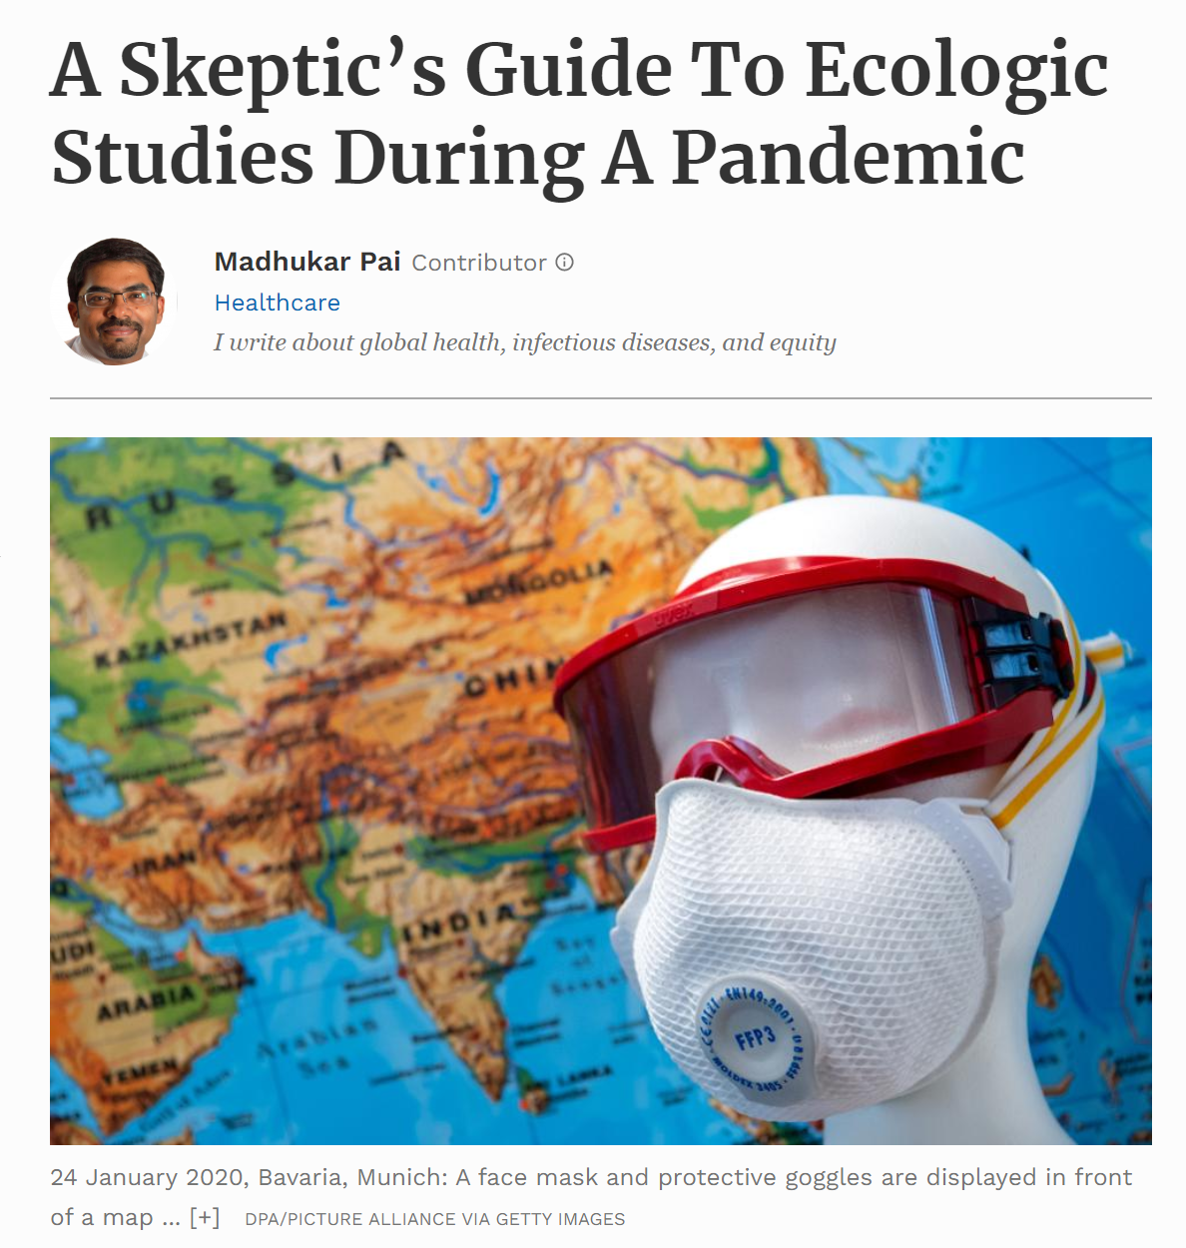
https://www.forbes.com/sites/madhukarpai/2020/04/12/bcg-against-coronavirus-less-hype-and-more-evidence-please/?sh=1ee9eeed6b4f
https://www.forbes.com/sites/madhukarpai/2020/04/22/a-skeptics-guide-to-ecologic-studies-during-a-pandemic/?sh=25aa8a868941

Slide 17
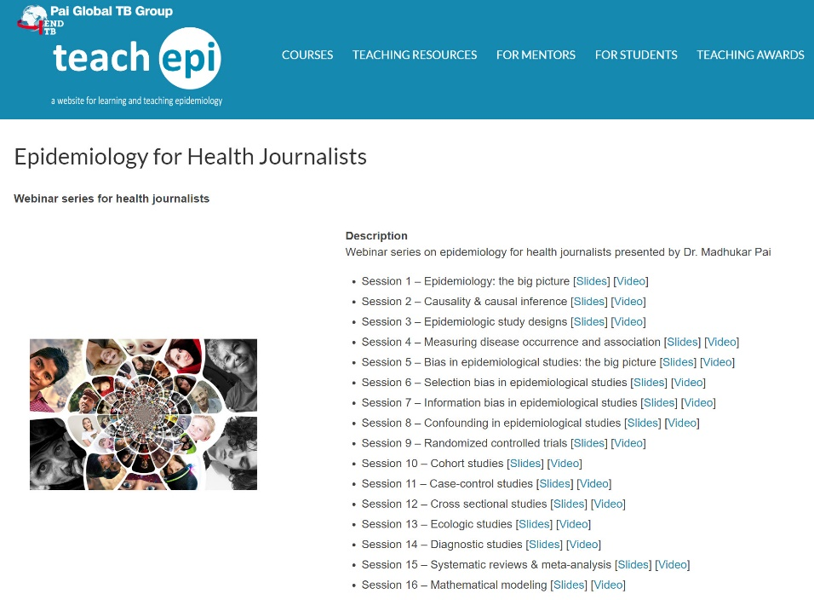
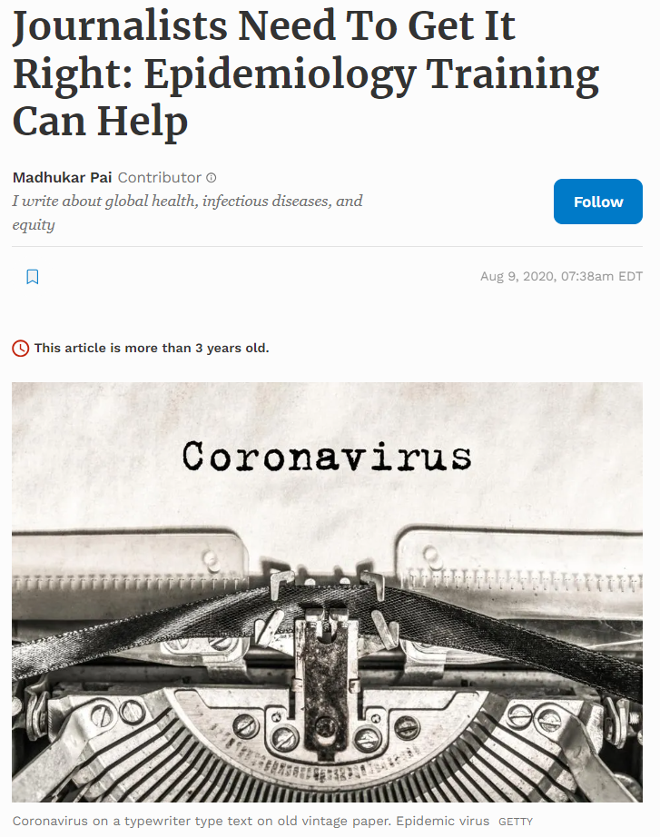
https://www.teachepi.org/courses/epidemiology-for-health-journalists/
https://www.forbes.com/sites/madhukarpai/2020/08/09/journalists-need-to-get-it-right-epidemiology-training-can-help/?sh=5a33dc8466a2

Slide 18
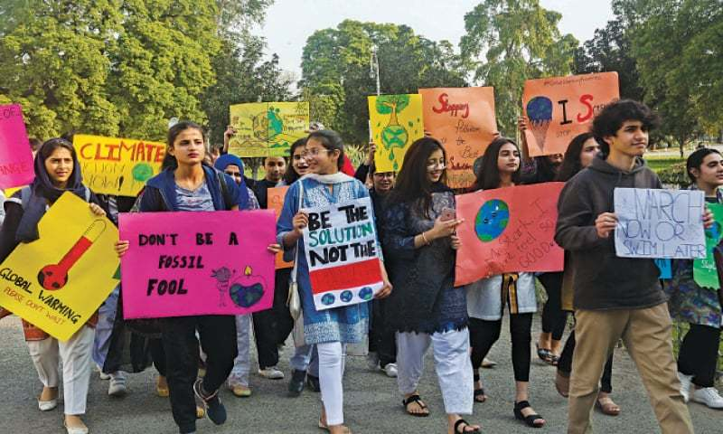
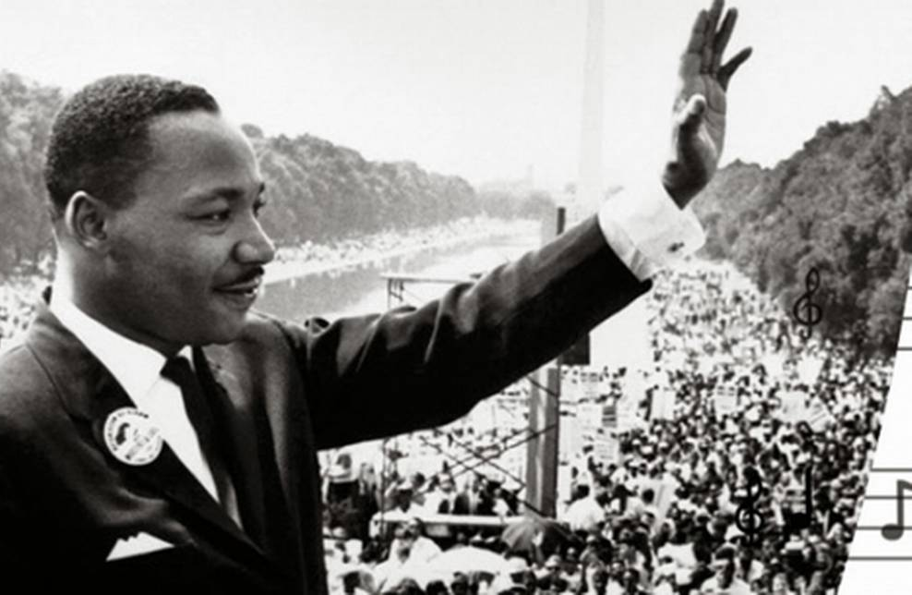
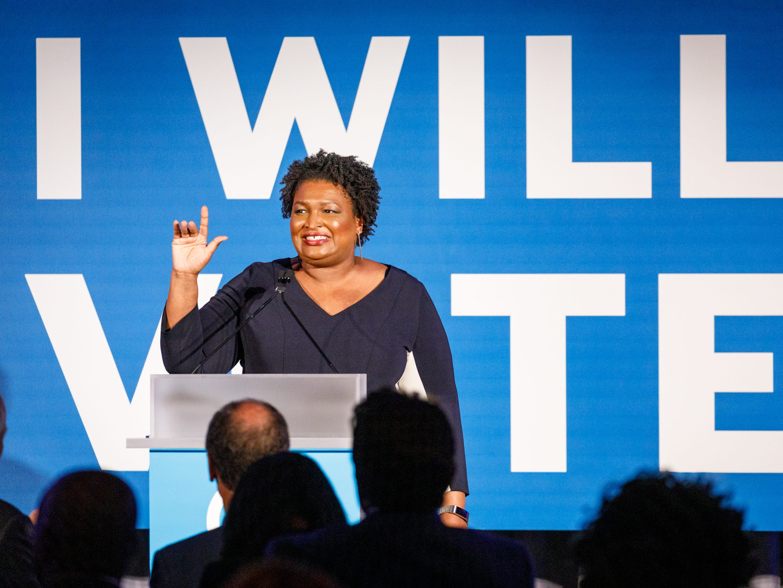
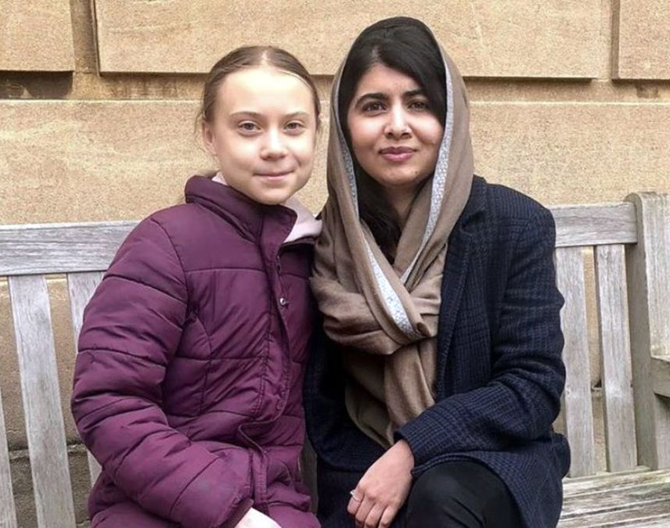
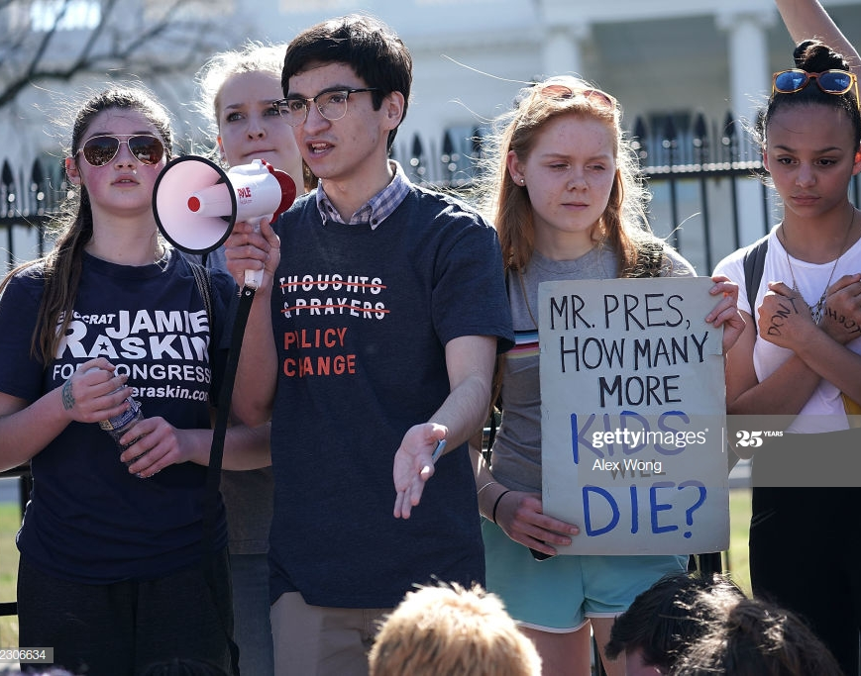
Why Advocacy Matters

Slide 19
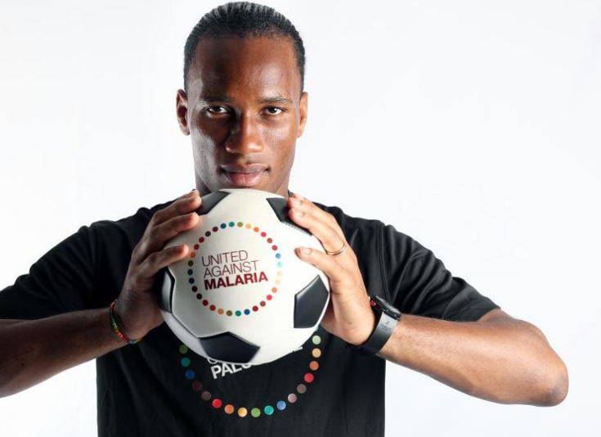
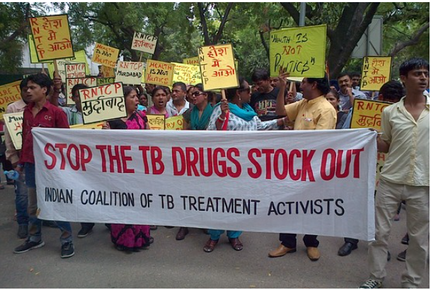
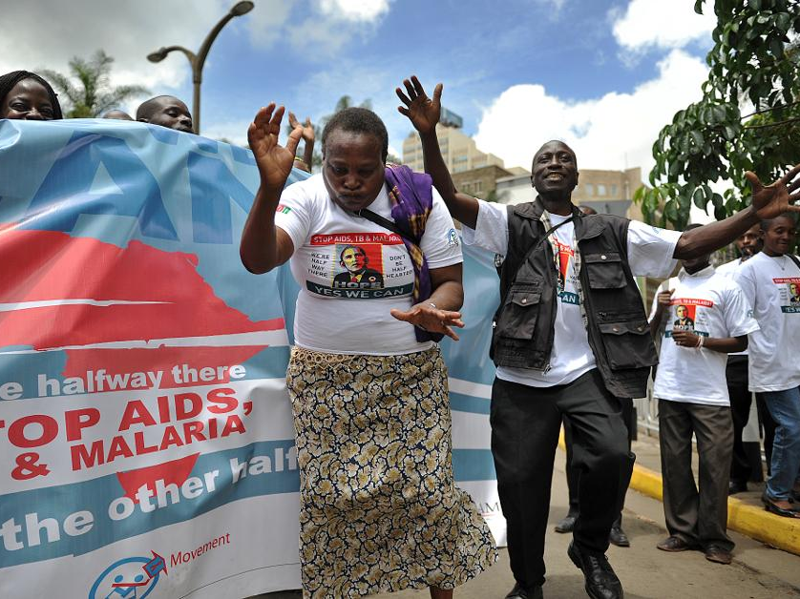
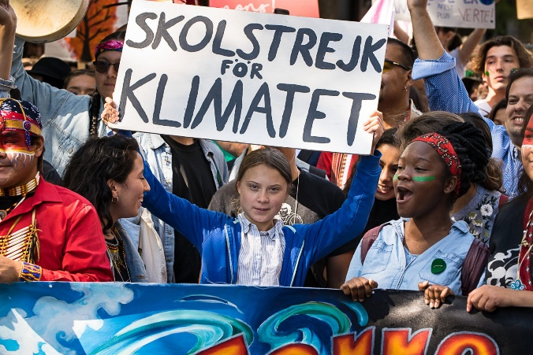
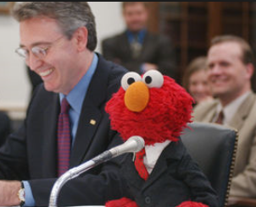
Advocacy is necessary, because things rarely happen on their own

Slide 21
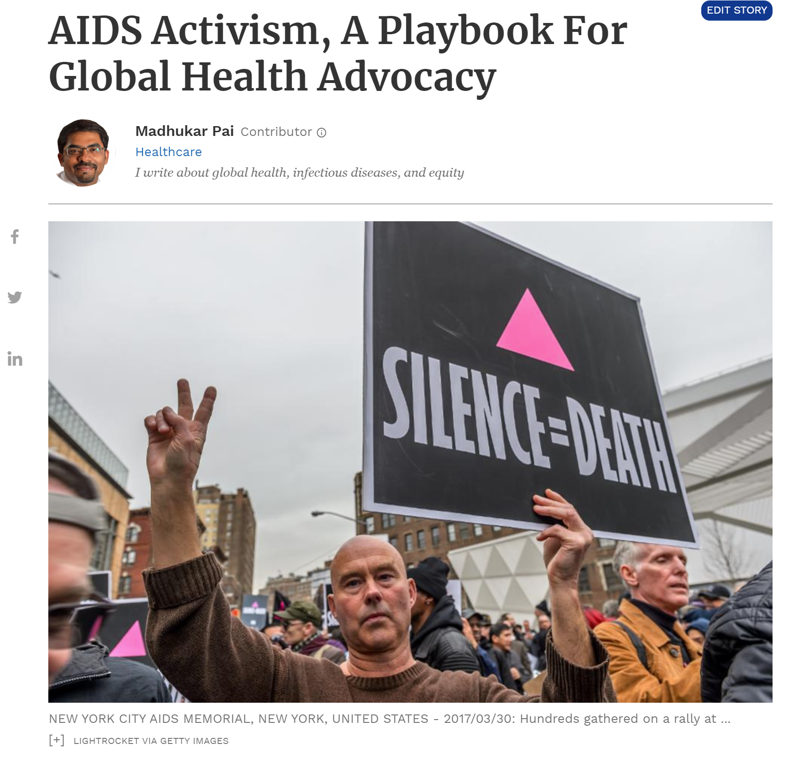
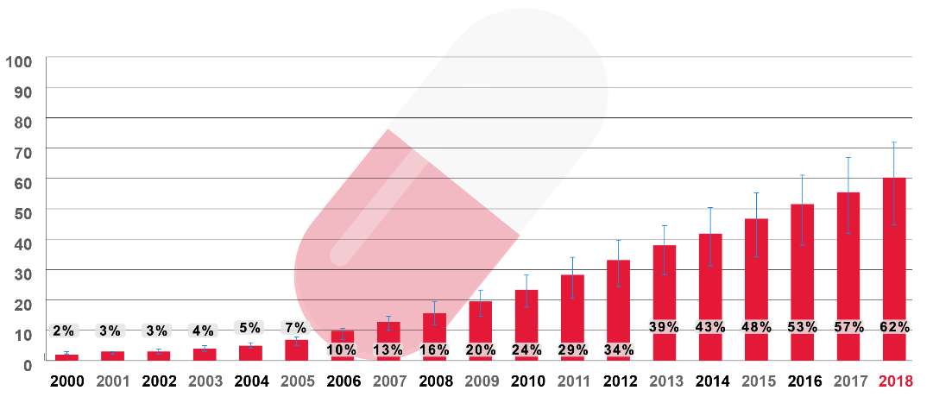
https://www.forbes.com/sites/madhukarpai/2019/11/30/aids-activism-a-playbook-for-global-health-advocacy/#289c014840a1

Slide 22
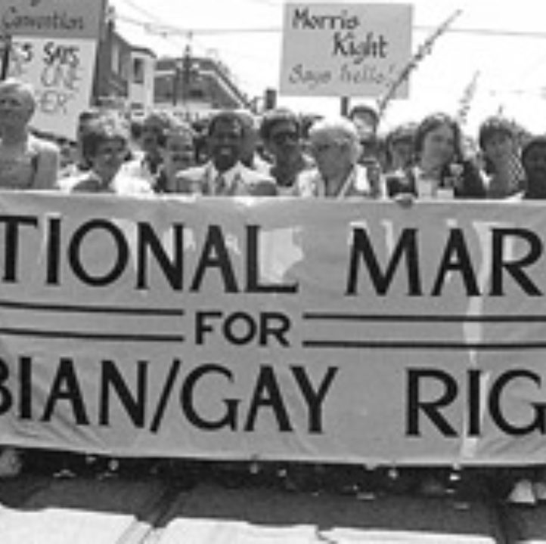
AIDS activists built on other movements
Gay rights
Civil rights
Anti-apartheid…

Slide 23
They channeled the fear and outrage
“What makes activism work is [patients’] anger and fear…somehow you have to be able to capture that, put it in a bottle and bottle it and use it.”
Larry Kramer

Slide 24
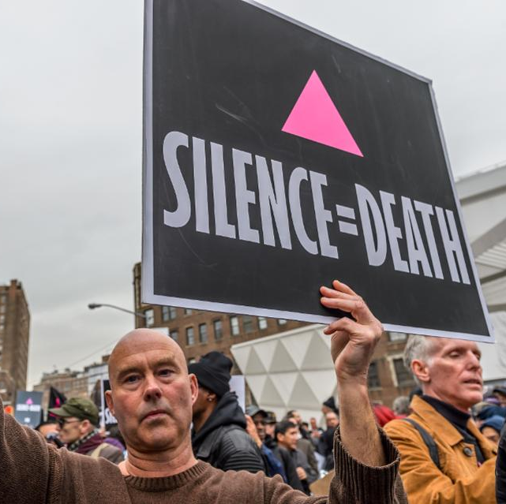
They mobilized and organized

Slide 25
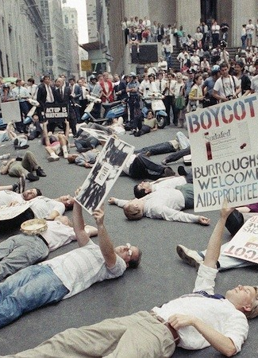
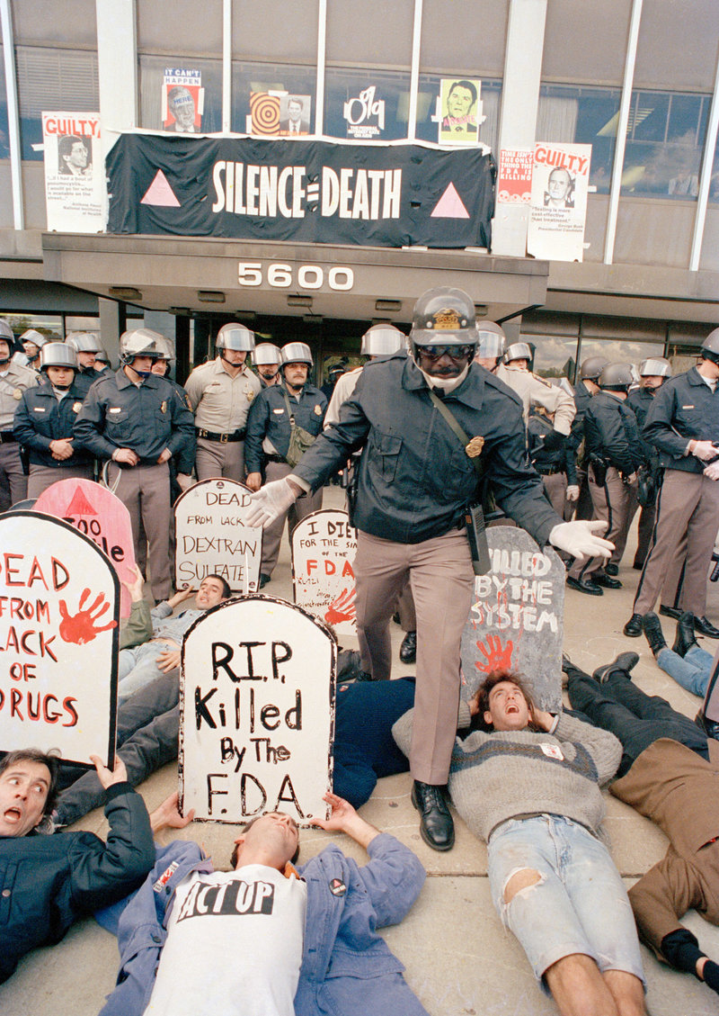
They played good cop/bad cop

Slide 26
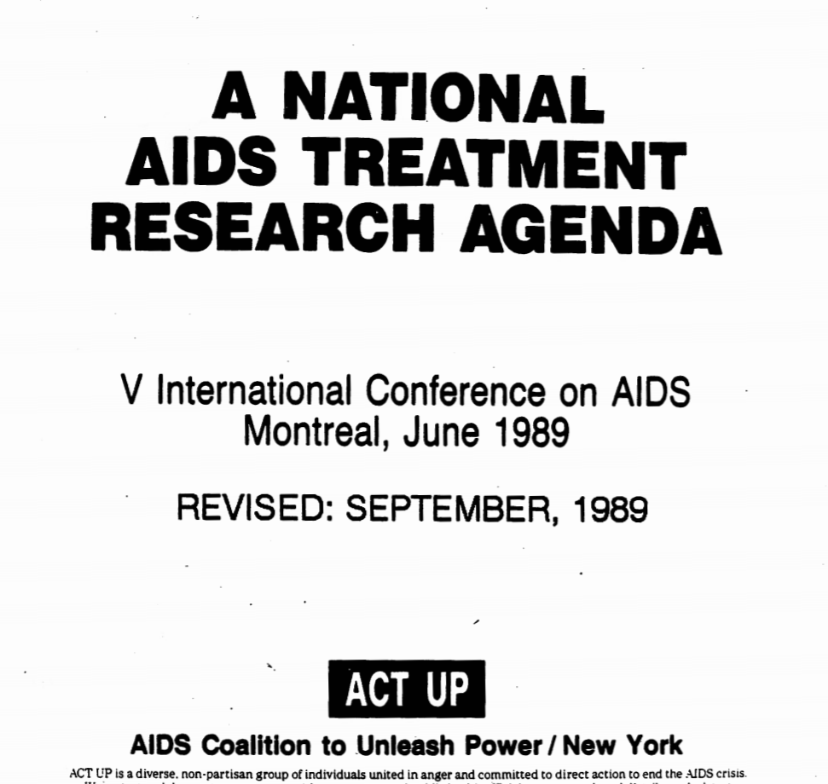
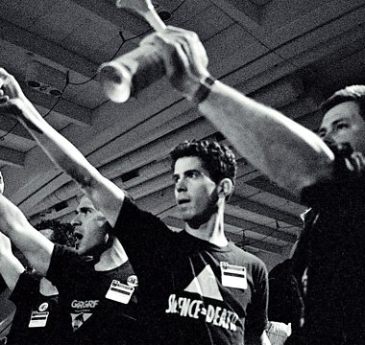
They knew their stuff & got involved with R&D, funding, trials, regulation, and pricing/access

Slide 27
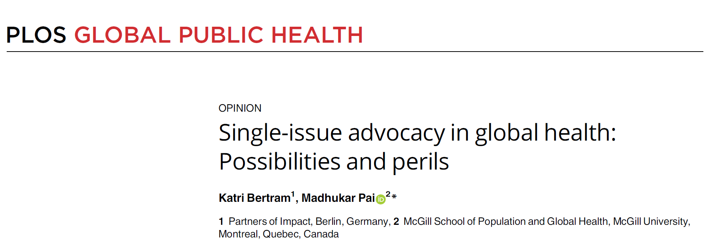
While AIDS offers a good playbook, single-issue advocacy has its perils
we must advocate for UHC, stronger health systems, and greater investments in issues that affect health outcomes overall, in addition to advocating for whatever we are most passionate about
https://journals.plos.org/globalpublichealth/article?id=10.1371/journal.pgph.0002368

Slide 28
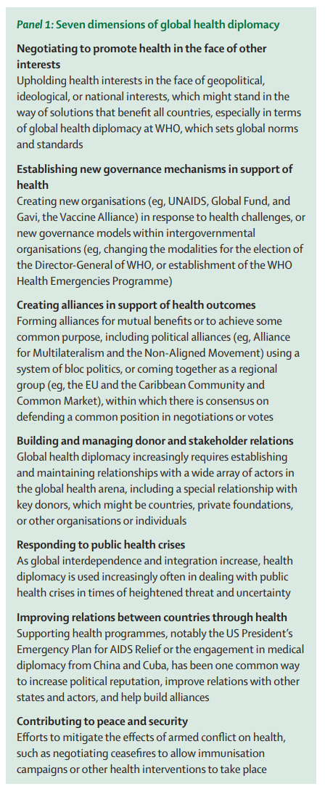
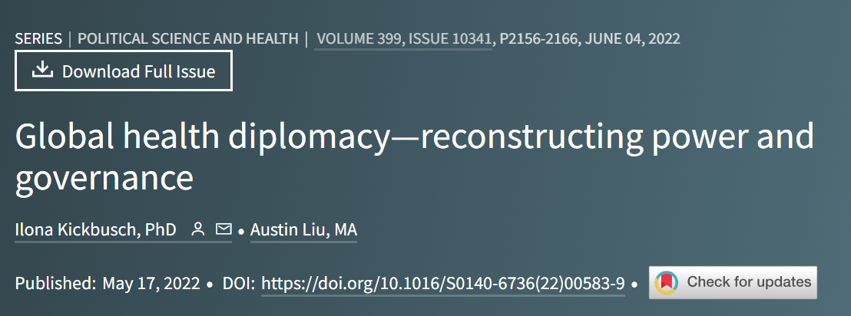
Why Diplomacy Matters
https://www.thelancet.com/journals/lancet/article/PIIS0140-6736(22)00583-9/fulltext

Slide 29
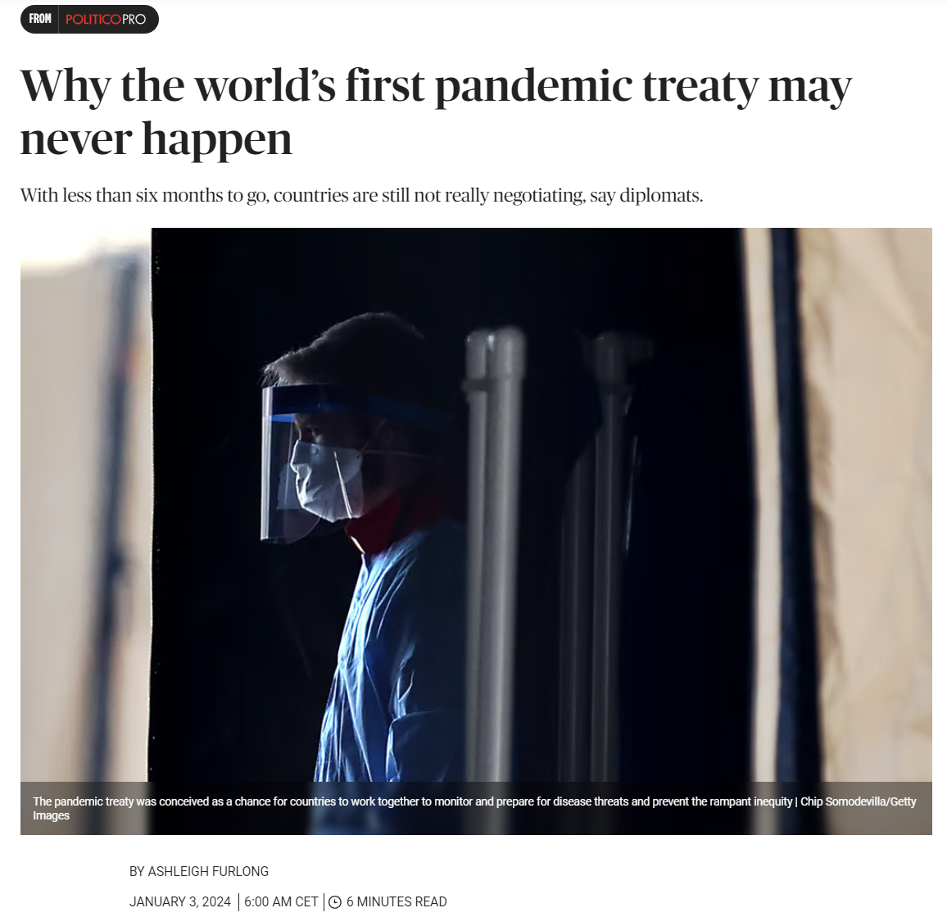
https://www.politico.eu/article/pandemic-treaty-negotiations-countries-risking-failure-covid-who-sharing-mechanism/

Slide 30
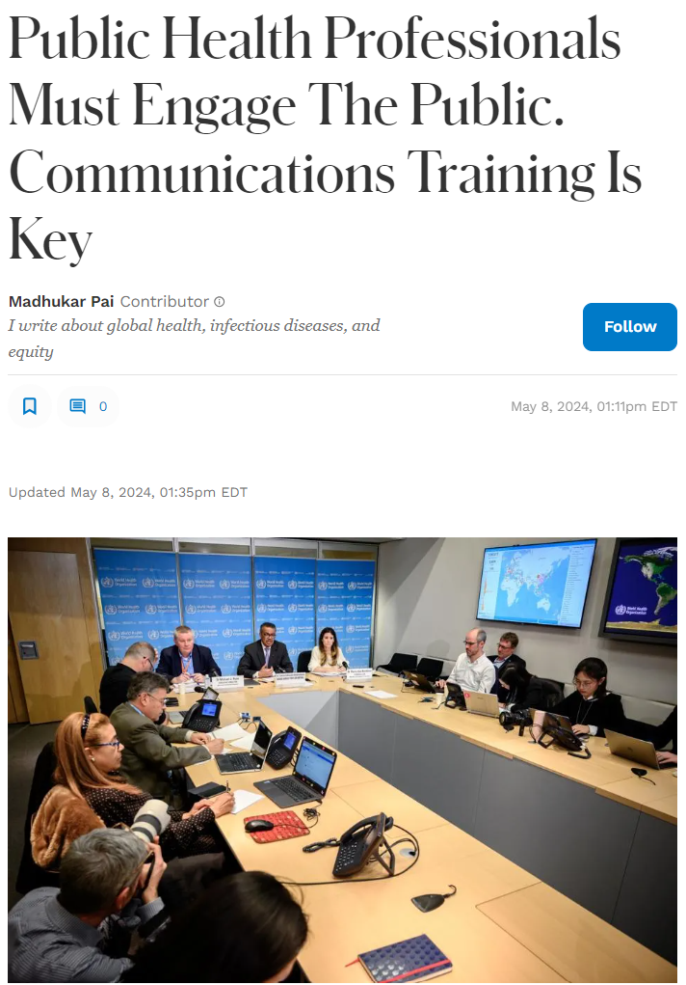
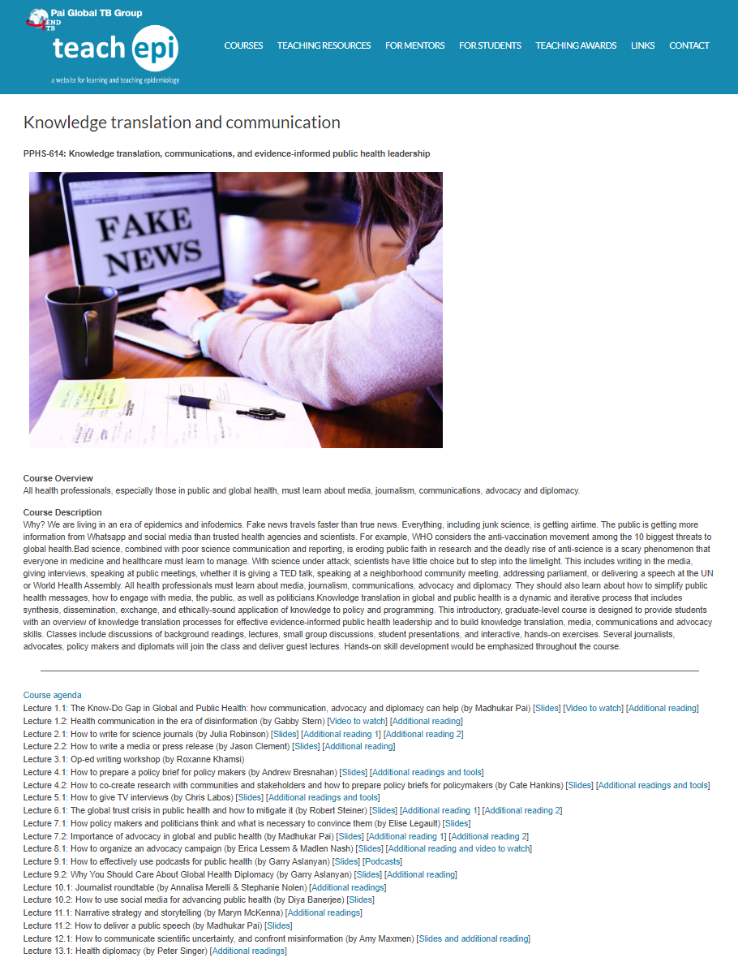
https://www.forbes.com/sites/madhukarpai/2024/05/08/public-health-professionals-must-engage-the-public-communications-training-is-key/
https://www.teachepi.org/courses/knowledge-translation-communications-and-evidence-informed-public-health-leadership/

Slide 31
Key lessons from the course
Invite journalists
Emphasize practice, not theory
Teach students advocacy & invite professional advocates
Teach diplomacy & invite diplomats
Teach students how to deal with misinformation

Slide 32
The course was NOT about theory!
Students learnt practical skills on how to:
Engage with media
Write op-eds
Write for journals
Write media releases
Write policy briefs
Develop advocacy materials
Do TV interviews
Podcasts
Launch an advocacy campaign
Give a short, impactful speech

Slide 33
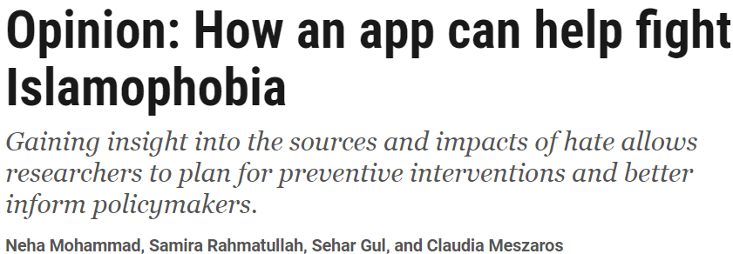
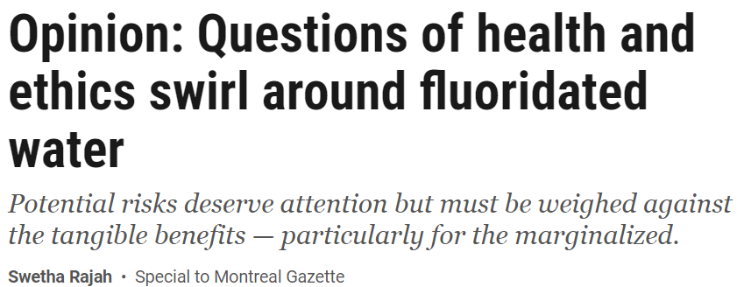
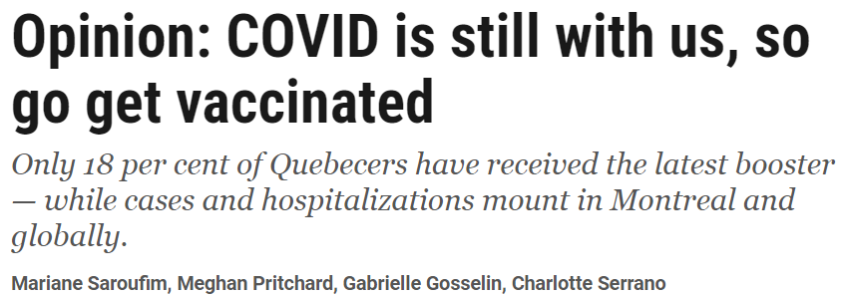

Slide 35
You can find me at
Twitter: @paimadhu
Forbes column: https://www.forbes.com/sites/madhukarpai/?sh=117f37645aff
Nature blog: https://communities.springernature.com/users/20892-madhukar-pai
Journal: https://journals.plos.org/globalpublichealth/
Thank you! Merci!

