Slide 1
June Webinar June 6, 2024

Slide 2
Welcome everyone!
Let us know where you are joining us
from in the chat!
Share a greeting in another language if you know one.

Slide 3
Our Values & Resources
3
​At RESULTS we pledge to create space for all voices, including those of us who are currently experiencing poverty. We will address oppressive behavior in our interactions, families, communities, work, and world. Our strength is rooted in our diversity of experiences, not in our assumptions.
With unearned privilege comes the responsibility to act so the burden to educate and change doesn’t fall solely on those experiencing oppression. When we miss the mark on our values, we will acknowledge our mistake, seek forgiveness, learn, and work together as a community to pursue equity.
Read our full anti-oppression values statement here at results.org/values.
Check out the Anti-Oppression Workshop Schedule for training opportunities.
Find these resources and more at results.org/volunteers/anti-oppression:
Resource Guides from our Diversity & Inclusion trainings, including:
Interrupting Microaggressions
Creating Space for Critical Conversations
Information on how RESULTS responds to oppressive incidents

Slide 4
June Anti-Oppression (AO) Workshop
Disrupting Biases on Poverty and Classism
Facilitated by RESULTS Experts on Poverty Friday, June 7, 12:00-1:30 p.m. ET
Ending poverty is not possible without addressing oppression and centering the voices of those with lived experiences of poverty. The tools provided in this session will help you build more transformational relationships and create inclusive, welcoming environments in your groups with trauma-informed advocacy in mind.
For more information and to register: https://tinyurl.com/DistruptingBias

Slide 5
June Anti-Oppression (AO) Workshop
Restorative Justice & Global Conflict, facilitated by DC Peace Team
June 17 | 8 PM ET to 10 PM ET
This session will be held as a space for you to openly share how global conflict is impacting how you show up as an advocate. This space will NOT be an exchange for political or religious ideology, but rather a safe place for expression and how war in other areas of the world is affecting us. The space will also allow for reflection on how we can utilize restorative processes to move toward personal and global healing.
For more information and to register: https://tinyurl.com/RestorativeJusticeDCPeace

Slide 6
Overview of tonight’s webinar
Welcome & Introductions
Wrap up of FY25 Appropriations
Guest Speaker: Dr. Karen Brenner, RPCV Niger 83’-86’
Advocacy Action: Gavi, the Vaccine Alliance
Closing Announcements

Slide 7
FY25 Appropriations
Notes:
Ken
8:35-8:45 PM: Campaigns Updates (Ken)
World Bank advocacy action, letter that closed on 4/12 (maybe share a copy of the letter if we have it by then)
FY25 Appropriations
Dear Colleague Letters, with squishy deadlines - on the RESULTS blog linked here: https://results.org/blog/fy25-appropriations-tell-congress-to-fund-the-fight-against-poverty
House Basic Education letter closes 4/17 Close of Business (maybe take action on this one the night of the webinar)
Others are TBD, but give us some urgency
Scorecard for Dear Colleague letters can be found at the top of the page, direct link: https://docs.google.com/spreadsheets/d/1x35soUUCN2Io0sPfBvqIdjnQ6Sa6I_31HC-HVi2MlAo/edit?usp=sharing
Completing forms online (share about the training coming up by RESULTS on this?)
So you can see how the money we advocate for shows up on the ground, we will hear from Susan who will share a story from her work with USAID in Madagascar

Slide 8
Notes:
Ken

Slide 9
Congrats!
Dear Colleague Letters | House FY25 | House FY24 | Senate FY25 | Senate FY24
MNCH, Gavi, Nutrition | 138 | 154 | 39 | 42
TB | 131 | 129 | 26 | 33*
Global Fund | 161 | 144 | 36 | 38
Education | 115 | 129 | 33 | 36
Notes:
Leslye
8:30-8:35 PM: Welcome/Introductions (Leslye)
Susan & Karyne can check for new names
Welcome new folks, Please let us know in the chat where you are based. Introduce yourself since first time you are doing this.
Be sure to introduce people, Introduce Ken and Karyne and the rest of the Advocacy team of mentors and committee –Anne Child, Sarah Leone, Joanna Distefano, Susan Wright, Leslye Heilig, Margaret Moodian
Invite new folks to introduce themselves in the chat and share about their interest in advocacy
This is a non-partisan space where we learn how to build relationships with our members of Congress to influence policy. We center ourselves around mutual respect and inclusion.
Intro to vision and values of both organizations, provide the links to full statements
Invite Rise members to learn more about RESULTS by exploring their website, and RESULTS members to do the same with Together Women Rise. Review mission/vision/anti-oppression (only feel need to read full statement if there is time, but share links in any case)

Slide 10
What’s next?
Thank members who signed: see the FY25 scorecard.
See and share the signed letters! Find them here.
Notes:
Leslye
8:30-8:35 PM: Welcome/Introductions (Leslye)
Susan & Karyne can check for new names
Welcome new folks, Please let us know in the chat where you are based. Introduce yourself since first time you are doing this.
Be sure to introduce people, Introduce Ken and Karyne and the rest of the Advocacy team of mentors and committee –Anne Child, Sarah Leone, Joanna Distefano, Susan Wright, Leslye Heilig, Margaret Moodian
Invite new folks to introduce themselves in the chat and share about their interest in advocacy
This is a non-partisan space where we learn how to build relationships with our members of Congress to influence policy. We center ourselves around mutual respect and inclusion.
Intro to vision and values of both organizations, provide the links to full statements
Invite Rise members to learn more about RESULTS by exploring their website, and RESULTS members to do the same with Together Women Rise. Review mission/vision/anti-oppression (only feel need to read full statement if there is time, but share links in any case)

Slide 11
Tonight’s Guest Speaker
Dr. Karen Brenner
RPCV, Niger ‘83 – ‘86
Notes:
Leslye
8:30-8:35 PM: Welcome/Introductions (Leslye)
Susan & Karyne can check for new names
Welcome new folks, Please let us know in the chat where you are based. Introduce yourself since first time you are doing this.
Be sure to introduce people, Introduce Ken and Karyne and the rest of the Advocacy team of mentors and committee –Anne Child, Sarah Leone, Joanna Distefano, Susan Wright, Leslye Heilig, Margaret Moodian
Invite new folks to introduce themselves in the chat and share about their interest in advocacy
This is a non-partisan space where we learn how to build relationships with our members of Congress to influence policy. We center ourselves around mutual respect and inclusion.
Intro to vision and values of both organizations, provide the links to full statements
Invite Rise members to learn more about RESULTS by exploring their website, and RESULTS members to do the same with Together Women Rise. Review mission/vision/anti-oppression (only feel need to read full statement if there is time, but share links in any case)

Slide 12
vaccines save lives
Notes:
Globally, infectious diseases, including pneumonia, diarrhea, and malaria are the leading cause of deaths of kids under 5. Many of these are vaccine preventable.
Today, it costs $18 to fully immunize children in low-income countries. This price has reduced from $23 in 2013. This would not have happened on its own. It’s the result of sustained global partnership to save children’s lives. There is no reason why every child in the world should not receive the protection of lifesaving vaccines.
https://data.unicef.org/topic/child-survival/under-five-mortality/#:~:text=In%202022%2C%204.9%20million%20children,birth%20and%20intrapartum%2Drelated%20complications.

Slide 15
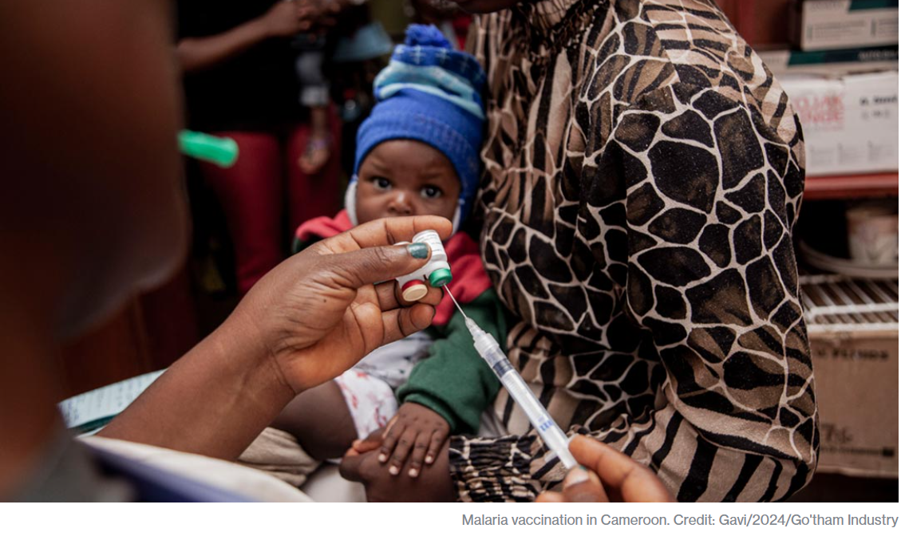

Slide 16
gavi by the numbers
1 billion children immunized
17 million future deaths prevented
50% of the world’s children vaccinated by Gavi
$54 returned for every $1 invested
19 countries transitioned out of support

Slide 17
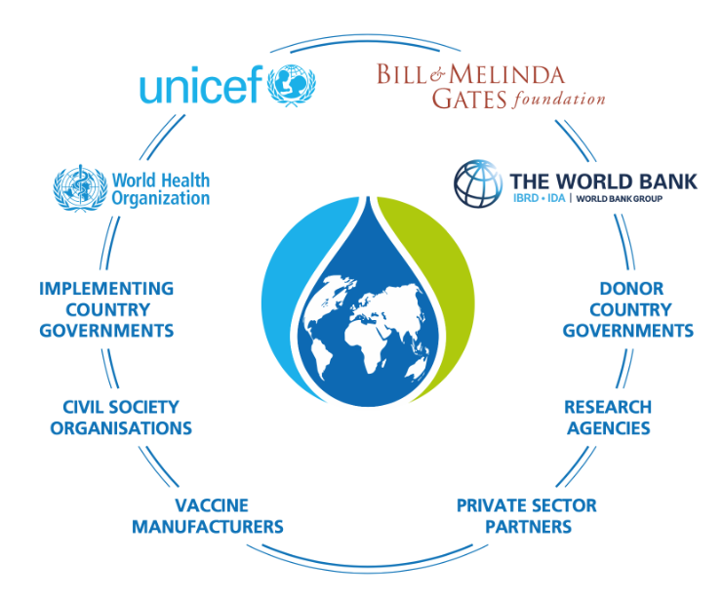

Slide 18
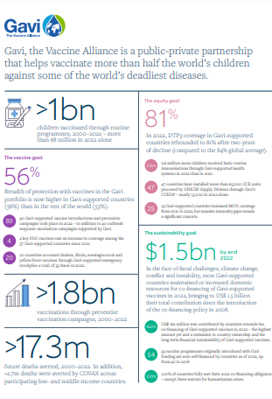
Learn more about Gavi’s amazing results here!
Notes:
https://digital.sciencehistory.org/works/wp988j884

Slide 19
why gavi? why now?

Slide 20
JUNE
Investment Opportunity Launch
Paris, France
20
Notes:
Gavi will launch their investment case to fund their next strategic period from 2026-2030.
https://www.gavi.org/our-alliance/strategy/phase-6-2026-2030

Slide 21
Advocacy Action:
Take Action on Gavi!
Check this scorecard see if your Representative or Senator has signed (Column AP).
Use Legislator Lookup (if you are unsure of who to reach out to, please don’t hesitate to reach out to us for support).
Email convention: FirstName_LastName@SenatorsLastName.Senate.Gov (example: alex_moree@rubio.senate.gov).
Personalize this sample email requesting your Senators to co-sponsor S. Res. 684.
Follow up!
Notes:
Karyne

Slide 22
Senate Resolution - S. Res. 684
S. Res. 684 – lead cosponsors Sens. Wicker (R-MI) and Cardin (D-MD)
Calls for United States to have supporting role in saving children’s lives of children and protecting people’s health through Gavi, the Vaccine Alliance.
Gavi has been a major contributor in reducing the number of childhood deaths in lower-income countries due to vaccine-preventable disease by 70 percent since 2000.
Country ownership and sustainability are at the core of the Gavi model.
Notes:
Gavi will launch their investment case to fund their next strategic period from 2026-2030.
https://www.gavi.org/our-alliance/strategy/phase-6-2026-2030

Slide 23
Join our next webinar Thursday, July 11 8:30 PM ET – 9:30 PM ET Feel free to bring a friend or fellow RPCV!
Register here: https://tinyurl.com/GAP2024Webinars

Slide 24
Thank you for taking action with us tonight!

