Slide 1
June Webinar Continuing advocacy on Tuberculosis June 8, 2023

Slide 2
Our Values & Resources
2
​At RESULTS we pledge to create space for all voices, including those of us who are currently experiencing poverty. We will address oppressive behavior in our interactions, families, communities, work, and world. Our strength is rooted in our diversity of experiences, not in our assumptions.
With unearned privilege comes the responsibility to act so the burden to educate and change doesn’t fall solely on those experiencing oppression. When we miss the mark on our values, we will acknowledge our mistake, seek forgiveness, learn, and work together as a community to pursue equity.
Read our full anti-oppression values statement here at results.org/values.
Check out the Anti-Oppression Workshop Schedule for training opportunities.
Find these resources and more at results.org/volunteers/anti-oppression:
Resource Guides from our Diversity & Inclusion trainings, including:
Interrupting Microaggressions
Creating Space for Critical Conversations
Information on how RESULTS responds to oppressive incidents

Slide 3
Tonight’s Webinar
Welcome and Introductions
Discussion: Our Connections with TB
United Nations High-Level Meeting on TB
Advocacy Action
Closing
Notes:
Karyne

Slide 4
Discussion: Our Connections to TB

Slide 5
Why do we care about TB?
It’s the leading infectious disease killer in the world that is almost completely preventable, treatable, curable.
It devastates families.
TB is a justice issue.
Our TB solutions are way behind.
COVID set us back over a decade on progress with TB.
2023 is the time.

Slide 6
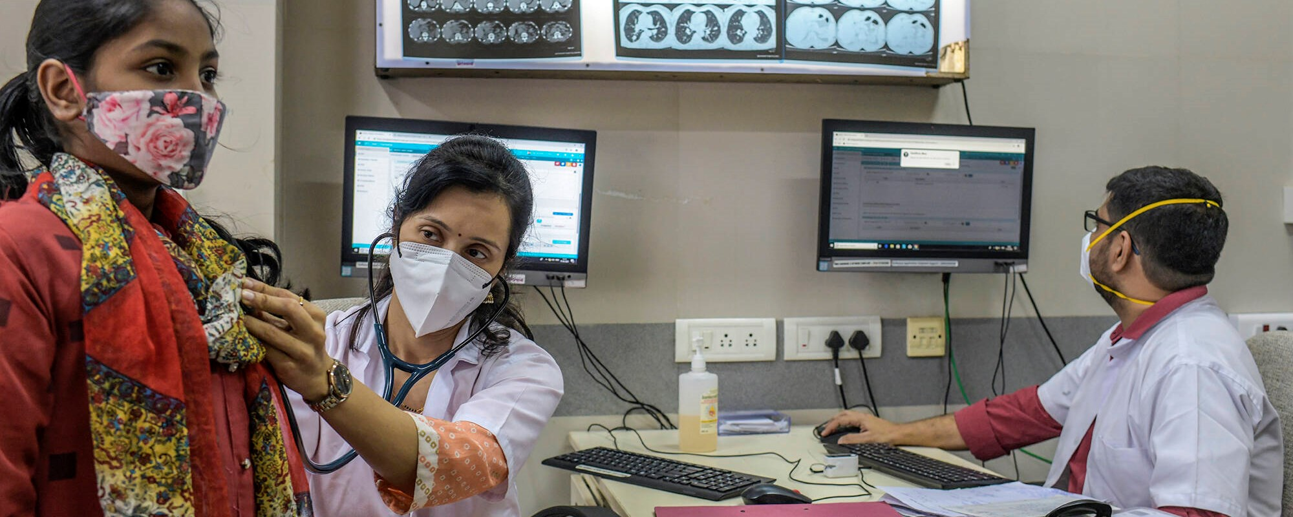
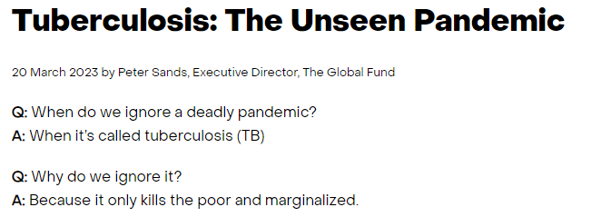
Tuberculosis: The Unseen Pandemic Peter Sands, Executive Director, The Global Fund
Notes:
Ken

Slide 7
End TB Now Act (S.288, H.R.1776)
Requires the U.S. to establish bold goals for reaching the most vulnerable populations
Strengthens U.S. bilateral coordination to develop comprehensive global TB response
Catalyzes support for TB research and development (R&D)
Improves the capacity of countries and affected communities with high burdens of TB
Requires annual reporting to Congress on U.S. TB activities and their impact
Evaluates the performance of TB programs that are supported by U.S.

Slide 8
We want to pass the End TB Now Act this year!
See if your member of Congress has supported TB in any way using our Congressional Scorecard

Slide 9
What have you heard from your members of Congress about TB?
Discussion:
Notes:
Ken

Slide 10
UN High-Level Meeting on TB
September 22, 2023
Notes:
https://www.stoptb.org/advocate-to-endtb/world-tb-day

Slide 11
What other actions can we take now?
Request signers for Dear Colleague Letter to Biden Admin:
Specific measurable targets
Develop a while government strategy
High level representation to attend UNHLM
Encourage other global leaders

Slide 12
Five years ago….
Notes:
https://www.who.int/docs/default-source/un-high-level-meeting-on-tb/unhlm-tb-web-flyer-120x120.pdf

Slide 13
Progress?
 | 2017 | 2022
# of people falling ill with TB | 10 million | 10.5 million
TB Deaths | 1.6 million | 1.6 million
# of people diagnosed with MDR TB | 500,000 | 450,000
Sources:
UN General Assembly HLM on TB, 2018 WHO – Global Tuberculosis Report 2022, 2.3 Drug-resistant TB
RESULTS January 2023 Global Tuberculosis Policy Brief
Notes:
Reactions

Slide 14
Reactions?
Notes:
Reactions

Slide 15
Nandita Venkatesan's Opening Address at 2018 United Nations General Assembly
Notes:
Nandita Venkatesan's Opening Address at 2018 United Nations General Assembly
https://youtu.be/4yfZsFoXtRc

Slide 16
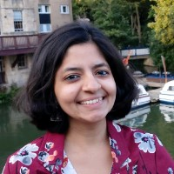
“Your declaration will only make a difference if it is backed by action…”
- Nandita Venkatesan

Slide 17
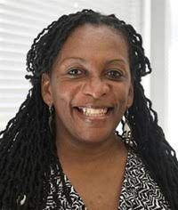
“ I am going to be a grandmother because of the power of the work that people like you do...”
- Carol Nawina Kachenga, CITAM + Board member of Stop TB Partnership
Notes:
https://results.zoom.us/rec/play/wUaq8mbiOw6SDwgv8rJ1M8V5yW6M5e53GyEvAC3KH8GbUJF2KbbzIe-9hOIrmsX8ROlmOe8z6hr_zgf2.qxrcPVylsgz-juEu?canPlayFromShare=true&from=share_recording_detail&continueMode=true&componentName=rec-play&originRequestUrl=https%3A%2F%2Fresults.zoom.us%2Frec%2Fshare%2F2IgFq7Kxu5qRQsudJQDqJMEhWuwjMuhMnMXA3yYn_RJ3xJKkaTiL6aTeXKEz-QlR.7HoFwQIgqCMbEWkZ

Slide 18
Advocacy Action:
Ask your Reps to join the Dear Colleague Letter to the Biden Administration We must demonstrate bold U.S. leadership at the UN High-Level Meeting (HLM) on TB
Notes:
Ken

Slide 19
Advocacy Action
Check the Congressional scorecard
Find your Legislator’s foreign policy staff (Legislator Lookup)
Write to your Representative’s office, personalize this draft email, FirstName.LastName@mail.house.gov
Follow up, follow up, follow up!
Share this action with others!
Notes:
Karyne Sample email - https://docs.google.com/document/d/1-2MLO5-q81zIBy14Q2l-7gthusBMylf7NokAbGf303s/edit Share - https://results.org/volunteers/action-center/action-alerts?vvsrc=%2fcampaigns%2f97042%2frespond

Slide 20
Progressive Advocacy Actions
Spring (March through May):
FY24 Appropriations
Set the Agenda Lobby Meetings
Co-Sponsors for H.R. 1776 & S. 281
Summer (June through August):
June: Signers on UNHLM Dear Colleague Letter
July: Writing media (Op Eds, Letters to the Editor)
August: In District Lobby Meetings

Slide 21
Global Allies Program Coaching Support
Sign up for additional coaching support between webinars!
https://results.salsalabs.org/globalalliesprogram
Notes:
Sign Up - https://results.salsalabs.org/globalalliesprogram

Slide 22
- Next GAP Webinar: June 8- 8:30 PM ET https://bit.ly/GAP2023Webinars - RESULTS Global Policy Forum – Thursday, May 18 9:00PM ET Speaker: Selamawit Bekele, Manager, RESULTS Global Health Partnerships will continue our important discussion about combatting tuberculosis around the world, register here. - Peace Corps Upcoming Events Missed a webinar? Watch past webinars at the organizational partners page on our website.
Upcoming Events

Slide 23
Thanks for joining us tonight!

Slide 24
Tuberculosis (TB) is often thought of as a disease of the past. But this airborne contagion is both a driver and an exacerbator or global poverty, and it targets vulnerable populations. TB kills more people each year than HIV/AIDS and malaria combined.
Notes:
Karyne
Engage: Tuberculosis - an airborne bacteria - now kills more people each year than HIV and malaria combined.
Problem: COVID, conflict, and other crises have specifically taken a toll on the fight against tuberculosis. This disease drives and exacerbates global poverty, and it targets vulnerable populations. Alarmingly, TB cases increased in both 2020 and 2021. In 2021, 1.6 million people worldwide died from this often-curable disease.
Inform: The U.S. has been a leader in the fight against TB, and fiscal year 2024 decisions will soon be made in Congress by the committee that funds foreign aid.
Call to Action: Will you write and speak to the leadership of the State and Foreign Operations Subcommittee of Appropriations and ask that they include at least $1 billion for USAID bilateral tuberculosis funding in the FY24 spending bill? Will you also ask for at least $2 billion for the Global Fund to Fight AIDS, TB and Malaria?

Slide 25
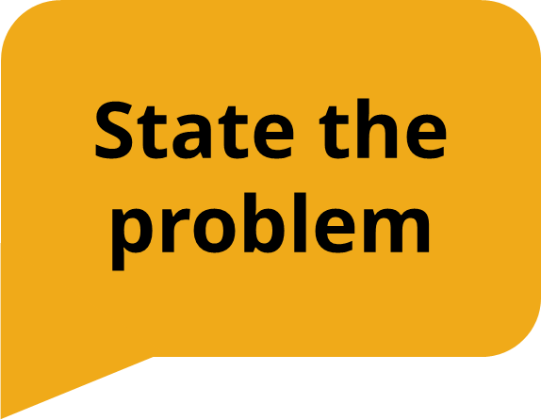
While incredible strides were being made in the fight against TB, when COVID-19 arrived, TB resources around the world were diverted toward fighting the new pandemic. This devastated the TB response. In 2021, the World Health Organization (WHO) reported that both the rates of TB sickness and number of TB deaths increased.
Notes:
Karyne

Slide 26
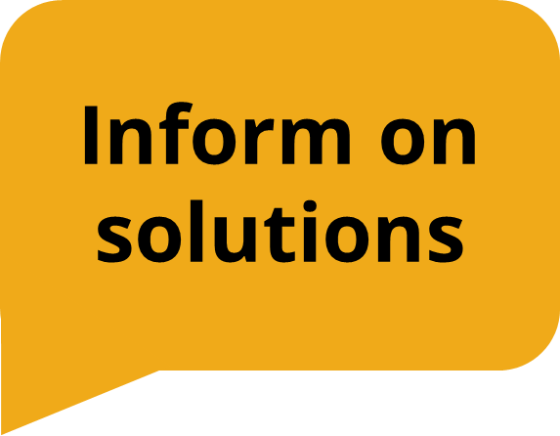
But, Congress can make a difference. The bipartisan, bicameral End TB Now Act (H.R. 1776/ S. 288) calls for setting bold U.S. goals to reach those most vulnerable to the disease. It will help save lives and provide the frontline support needed to address future pandemics.
Notes:
Karyne

Slide 27
Will you co-sponsor the End Tuberculosis Now Act today?
Notes:
Karyne

Slide 28
Why is this topic important to you?
Notes:
Karyne
Engage: Tuberculosis - an airborne bacteria - now kills more people each year than HIV and malaria combined.
Problem: COVID, conflict, and other crises have specifically taken a toll on the fight against tuberculosis. This disease drives and exacerbates global poverty, and it targets vulnerable populations. Alarmingly, TB cases increased in both 2020 and 2021. In 2021, 1.6 million people worldwide died from this often-curable disease.
Inform: The U.S. has been a leader in the fight against TB, and fiscal year 2024 decisions will soon be made in Congress by the committee that funds foreign aid.
Call to Action: Will you write and speak to the leadership of the State and Foreign Operations Subcommittee of Appropriations and ask that they include at least $1 billion for USAID bilateral tuberculosis funding in the FY24 spending bill? Will you also ask for at least $2 billion for the Global Fund to Fight AIDS, TB and Malaria?

Slide 29
How have you seen the devastation of TB in your country or service?
Notes:
Karyne

Slide 30
How could the End TB Now Act work to end TB and strengthen healthcare systems in your country of service?
Notes:
Karyne

Slide 31
Will you co-sponsor the End Tuberculosis Now Act today?
Notes:
Karyne

Slide 32
Tips for Delivering Your EPIC Laser Talk:
Practice to the point that you feel comfortable, not rote. You don’t have to memorize the whole thing word for word.
Memorizing key facts and details is key.
When you practice, talk without stopping, even if you stumble.
Critique yourself and others with kindness.

Slide 33
Make it personal!
Why do you care about the issue?
How is the issue impacting you currently (or how has it impacted you in the past?)
How does the issue show up in your country of service?
What values are motivating you to support solving this issue?

Slide 34
Develop your EPIC Laser Talk
10 min: Personalize your own EPIC Laser Talk
5 min: Share

