Slide 1
July Grassroots Webinar: Celebrating Our Advocacy July 9, 2016, 12:30 pm ET https://www.fuzemeeting.com/fuze/f2988286/30204806 To join by phone only, dial (201) 479-4595, meeting ID 30204806 Closed captioning: http://west.typewell.com/faelapgb

Slide 2
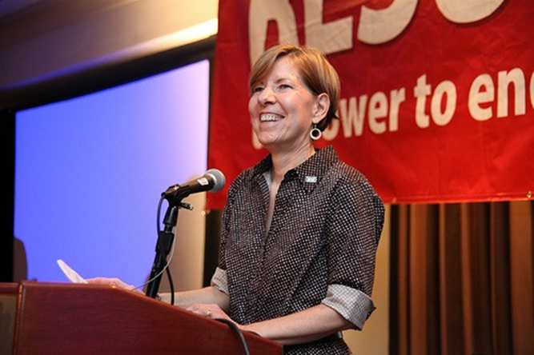
Welcome from Executive Joanne Carter
July 2016 RESULTS National Conference Call/Webinar Slides

Slide 3
Grassroots Board Member Election Results Congratulations!
July 2016 RESULTS National Conference Call/Webinar Slides

Slide 4
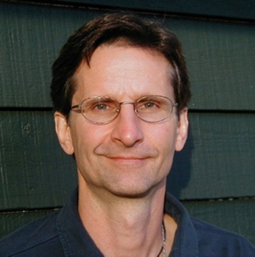
Open Phones Ken Patterson Director of Global Grassroots Advocacy
July 2016 RESULTS National Conference Call/Webinar Slides

Slide 5
Let’s Hear From You!

Slide 6
Let’s Hear From You
Something you learned
Someone who inspired you
Breakthrough you had in exercising your personal and political power
Breakthrough with a congressional office
Highlight from the conference

Slide 7
Let’s Hear From You
To share about your International Conference experience (either in DC or back at home), unmute your webinar line or hit *1 on your phone.
Give us your name, and group or city name.

Slide 8
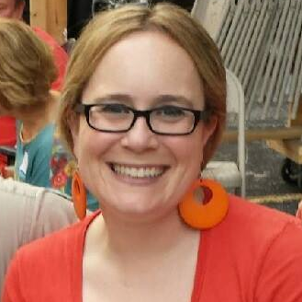
International Conference Follow-up Lisa Marchal Senior Global Grassroots Associate
July 2016 RESULTS National Conference Call/Webinar Slides

Slide 9
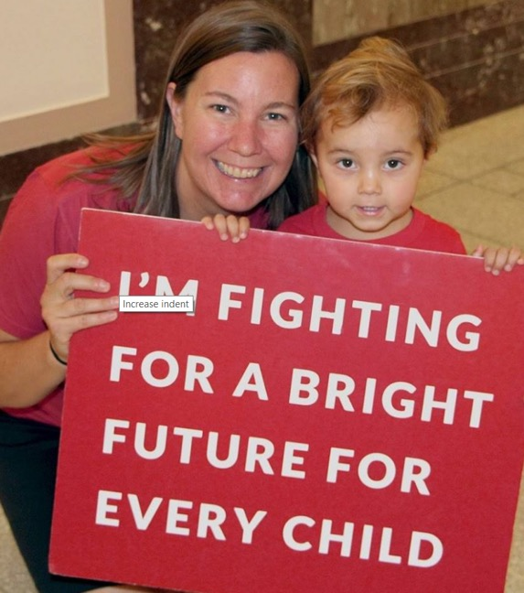
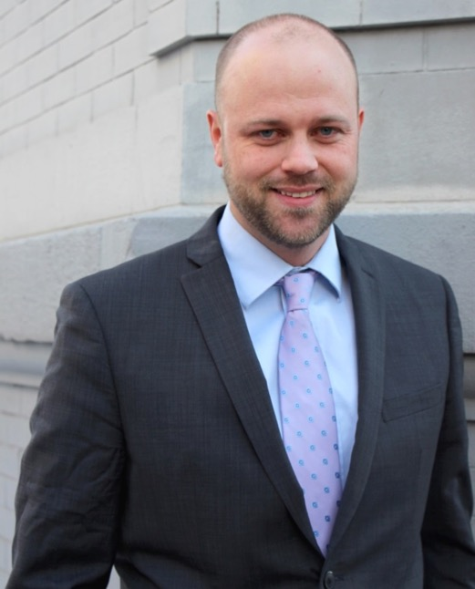
Campaigns Update Meredith Dodson – Director, US Poverty Campaigns John Fawcett - Director, Global Policy & Advocacy
July 2016 RESULTS National Conference Call/Webinar Slides

Slide 10
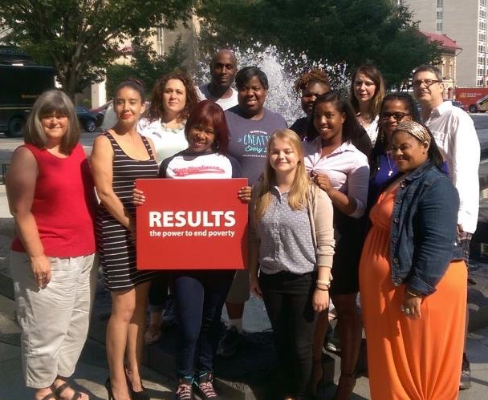
Shout Out to RESULTS Experts on Poverty!
Special thanks to RESULTS Experts on Poverty – many of whom were featured speakers at our conference, and are helping shape our work.
Storify recap of the RESULTS Experts on Poverty Twitter Chat: https://storify.com/RESULTS_Tweets/expertsonpoverty-twitter-chat

Slide 11
International Conference Follow-up
Conference resources: http://www.results.org/skills_center/2016_results_international_conference_resources/
Lobby Report form: www.tinyurl.com/RESLRF
Share about Conference experiences with friends and family, writing letters to the editor and op-eds, sharing on social media. (Great photos, quotes, etc. from IC - #Voices4RESULTS)
Take a look at the RESULTS Flickr and Storify pages.
Flickr: http://tinyurl.com/RESULTSFlickr
Storify: http://tinyurl.com/RESULTSStorify
5. Use conference follow-up as an opportunity to do outreach.
July 2016 RESULTS National Conference Call/Webinar Slides

Slide 12
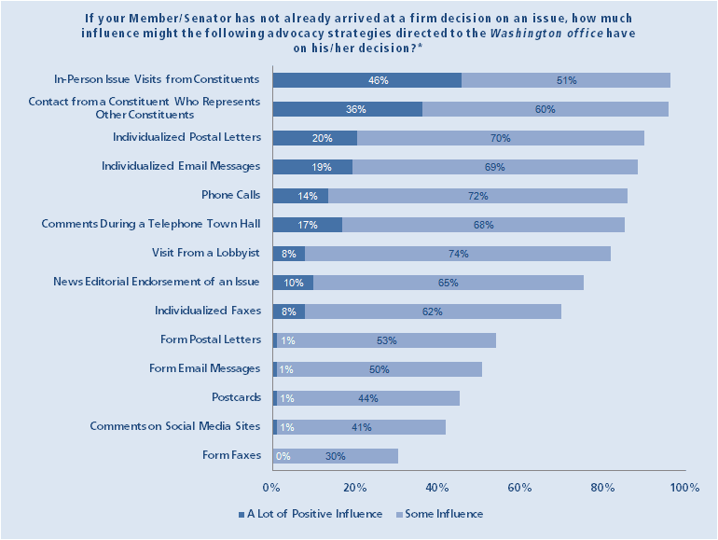
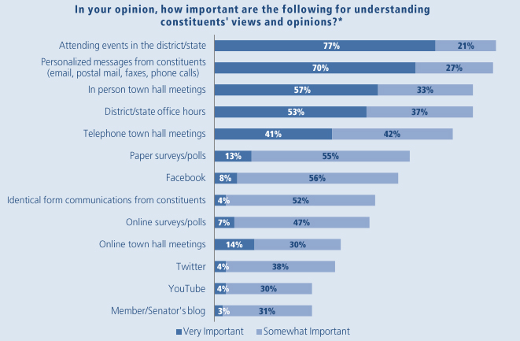
U.S. Poverty Action for July: Request Face-to-Face Meetings with Members of Congress AND Candidates
Find talking points for your meetings in the July U.S. Poverty Action: http://www.results.org/take_action/july_2016_u.s._poverty_action/.

Slide 13
Proposals to expand EITC
Both proposals lower the eligibility age from 25 to 21
The Obama/Ryan proposal would lift an additional 2.1 million African American workers, nearly 3 million Latino workers, and more than 600,000 veterans out of poverty
Compared to the numbers above, the Brown/Neal proposal lifts 2.6 African Americans, nearly 4 million Latino workers, and over 715,000 veterans out of poverty

Slide 14
Impact of EITC Expansion
Community | Number of workers benefiting from expanded EITC under Ryan/Obama expansion | Number of workers without dependents not taxed into or further into poverty under Ryan/neal | Number of workers benefiting from expanded EITC under Brown/Neal expansion | Number of workers without dependents not taxed into or further into poverty under Brown/Neal
African Americans | 2.1 million | 1.1 million | 2.6 million | 1.2 million
Latinxs | 2.9 | 1.3 million | 3.8 million | 1.6 million
Veterans | 600,000 | 192,000 | 716,000 | 216,000
Millennials | 7 million | 3.9 million | 9 million | 4.5 million

Slide 15
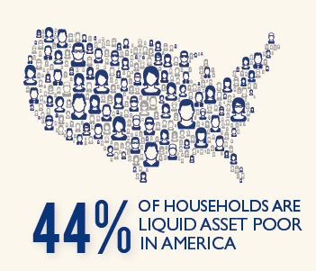
Asset Poverty:
Millions of Americans cannot afford a financial crisis
Liquid asset-poverty: insufficient amount of readily accessible assets to live at the poverty level without income for three months.
These households are vulnerable to falling into poverty after a job loss, large medical bill, or any other unanticipated financial crisis.
Source: http://scorecard.assetsandopportunity.org/2013/measure/liquid-asset-poverty-rate

Slide 16
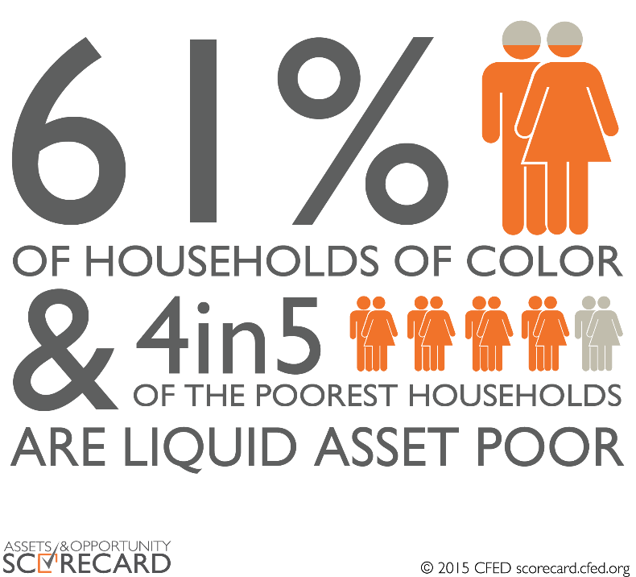
Asset Poverty and Wealth Inequality
Households of Color are far more likely to be affected by asset poverty.
The racial disparities in asset-building opportunities and wealth created by racially-motivated public policy and generations of racial discrimination.
Nearly 44% of households are liquid asset poor, meaning they have less than three months of savings to cover expenses if they lose a job, face a medical emergency or are hit by some other unexpected income disruption
Source: http://assetsandopportunity.org/scorecard/about/main_findings/
http://assetsandopportunity.org/assets/pdf/2016_Scorecard_Financial_Assets_Income_Report.pdf

Slide 17
Global Campaigns: Progress Since the IC
Reach Every Mother and Child Act: 10 New Cosponsors
Rep. Brenda Lawrence (D-MI)
Rep. Grace Napolitano (D-CA)
Rep. Nydia Velazquez (D-NY)
Rep. Peter DeFazio (D-OR)
Rep. John Yarmuth (D-KY)
Rep. Richard Neal (D-MA)
Rep. Hank Johnson (D-GA)
Rep. John Carney (D-DE)
Rep. Mike Pompeo (R-KS)
Rep. John Kline (R-MN)

Slide 18
Global Campaigns: Progress Since the IC
Education for All Act: 8 New Cosponsors
Rep. Chris Van Hollen (D-MD)
Rep. Suzan DelBene (D-WA)
Rep. Alan Grayson (D-FL)
Rep. William Keating (D-MA)
Rep. Brad Ashford (D-NE)
Rep. Connine Brown (D-FL)
Rep. Kathy Castor (D-FL)
Rep. David Jolly (R-FL)

Slide 19
Global Campaigns: Progress Since the IC
Senate Global Fund Letter: 12 Signers
Sen. Chris Coons (D-DE)
Sen. Johnny Isakson (R-GA)
Sen. Patty Murray (D-WA)
Sen. Roger Wicker (R-MS)
Sen. Robert Menendez (D-NJ)
Sen. Ed Markey (D-MA)
Sen. Lisa Murkowski (R-AK)
Sen. Dick Durbin (D-IL)
Sen. Ron Wyden (D-OR)
Sen. Dan Sullivan (R-AK)
Sen. Maria Cantwell (D-WA)
Sen. Gary Peters (D-MI)

Slide 20
Global Campaigns: Take Action
Global Fund Replenishment
Save an additional 9 million lives through programs supported by the Global Fund, leading to over 30 million lives saved cumulatively by 2020
Prevent 300 million new infections across the three diseases
Leverage $41 billion in contributions from affected countries from their own domestic budgets
Coons-Isakson sign-on letter: http://www.results.org/uploads/files/Global_Fund_Senate_Sign-on_Letter.pdf

Slide 21
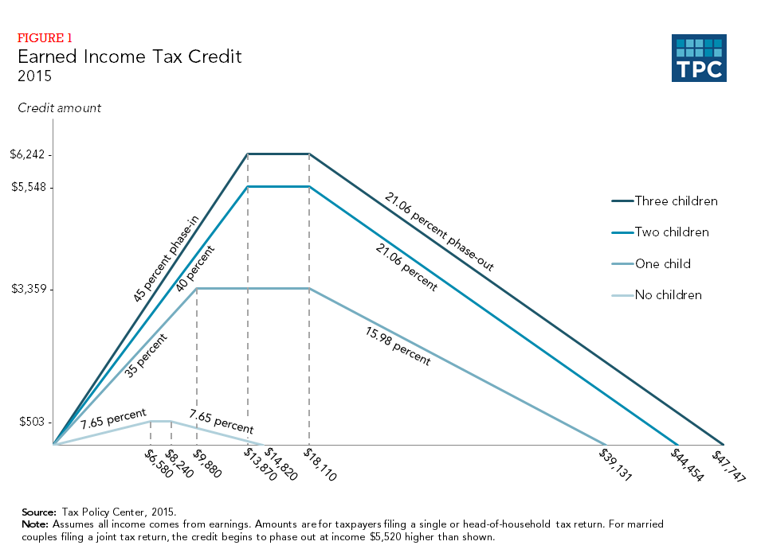
Creating Economic Mobility: The Earned Income Tax Credit (EITC)
The EITC:
was designed to “make work pay”.
is fully refundable, so if a family’s EITC exceeds the amount of federal taxes owed, the family receives the difference as a refund
increases as earnings increase up to a certain income level, then gradually decreases.
Source: http://www.cbpp.org/research/policy-basics-the-earned-income-tax-credit

Slide 22
Candidate Engagement
Make Poverty a Priority in the 2016 Election
Kristy Martino
U.S. Poverty Grassroots Organizer
kmartino@results.org
@kristymartino

Slide 23
Find Events
Town Halls
Call in-district offices for schedule
Get on email lists, follow on social media
Call town halls, meeting places directly
Rally / Public Appearances
Connect with local campaign organizer
Get on email lists, worth mentioning twice!
TV / Radio / and More
Special events for voters
Local news, radio station interviews
Submit debate questions to networks

Slide 24
Get There Early
Be Strategic
Sit in front or in aisles, find the mics, sit next to them
Dress for success, grab a button or sticker
Bring friends and spread out
FIRST, FAST, and HIGH!
Listen for Q&A announcement
Be the eager-est beaver, raise that arm first, fast, high
Be Prepared, Never Let Go
Practice, practice, practice your question beforehand
Be “EPIC” with clear yes or no answer
Hold onto mic and follow up to get clear response

Slide 25
More Opportunities
Work the Handshake Line
Follow the candidate, be patient, assertive
Hold that handshake until satisfied
Get a photo, ask another question
Find staff, swap contact info, follow up
Work the Media
Find folks with reporter’s notebooks/in laptop aisle
Linger by the cameras, talk your issue
Share, Share, Share, and Share
Share on social media networks, tag candidates
Use as material for media piece

Slide 26
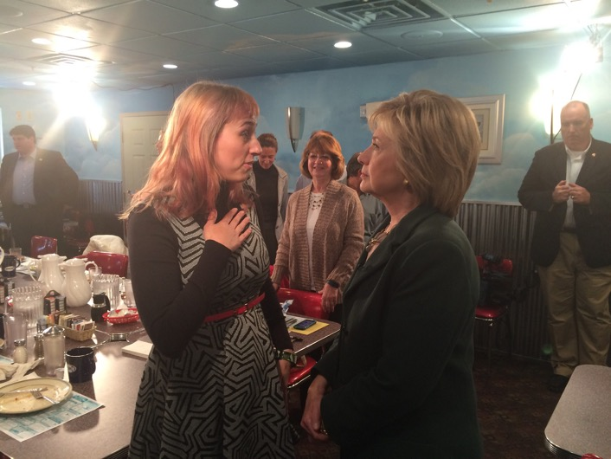
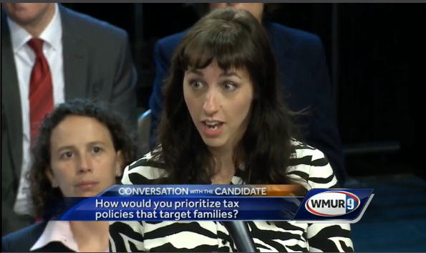
One Last Idea…
Move to New Hampshire!
Or you can find more resources, and upcoming trainings on
candidate engagement at RESULTS.org | kmartino@results.org

Slide 27
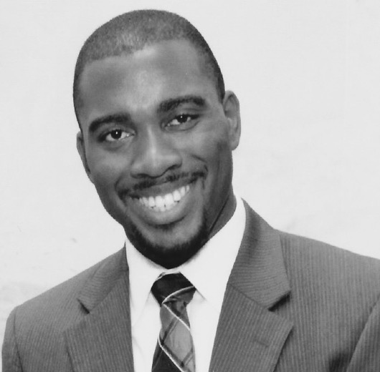
Mark Campbell
Global Health Associate
July 2016 RESULTS National Conference Call/Webinar Slides

Slide 28
How to Participate in the RESULTS Road to Rio Challenge
Step 1: Solo or as a Team
You can join the Road to Rio Challenge as an individual or as a team. Start a team with your RESULTS group or with friends and family. There are currently many individuals and seven teams already signed up to participate.
Step 2: Set Your Fundraising Goal and Build Your Page
Set a goal for what you plan to raise from friends and family. Pick an amount that you feel is ambitious, but achievable. Once you have a goal, set up your personal Road to Rio Fundraising Page.
WE ARE JUST $9000 AWAY FROM UNLOCKING a generous $15,000 match from a board member and his family.
Our Goal: $50,000
Step 3: Reach Out to Friends and Family
Reach out to friends and family and ask them to sponsor your efforts with a donation. Contact them by email, social media, phone, and in person. You can get sample language to use in emails, Facebook posts, Tweets and more from the development team!
Visit the website for more information, to register, and
Frequently Asked Questions and Answers: www.tinyurl.com/2016R2R
For assistance in setting up your individual or team pages
please contact Jen DeFranco at jdefranco@results.org.
July 2016 RESULTS National Conference Call/Webinar Slides

Slide 29
Other Great Things Upcoming
July 13, 9 pm ET. RESULTS Introductory Call. The perfect RESULTS
primer. For more information, contact Amanda Beals, abeals@results.org.
2. On-going group leader trainings on group health and skill-building.
Next trainings with open spots: September in Washington state and
Louisville. Contact Lisa Marchal at lmarchal@results.org for more
information.
July 2016 RESULTS National Conference Call/Webinar Slides

Slide 30
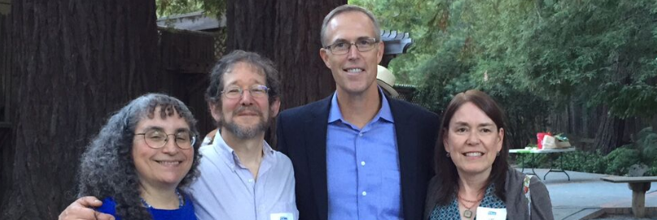
“Success is never final, failure is never fatal. It's courage that counts.”
- John Wooden

