Slide 1


Monthly Webinar July 10, 2025

Slide 2
Welcome everyone!
Let us know where you are joining us
from in the chat!

Slide 3
What is the Global Allies Program?
“Cause Related” Affiliate Group of NPCA.
Gain advocacy skills in support of global health, education, and economic development.
Meets virtually every 2nd Thursday of the month.
Open group, no paid membership, everyone welcome!

Slide 4
Our Values & Resources
4
​At RESULTS we pledge to create space for all voices, including those of us who are currently experiencing poverty. We will address oppressive behavior in our interactions, families, communities, work, and world. Our strength is rooted in our diversity of experiences, not in our assumptions.
With unearned privilege comes the responsibility to act so the burden to educate and change doesn’t fall solely on those experiencing oppression. When we miss the mark on our values, we will acknowledge our mistake, seek forgiveness, learn, and work together as a community to pursue equity.
Read our full anti-oppression values statement here at results.org/values.
Check out the Anti-Oppression Workshop Schedule for training opportunities.
Find these resources and more at results.org/volunteers/anti-oppression:
Resource Guides from our Diversity & Inclusion trainings, including:
Interrupting Microaggressions
Creating Space for Critical Conversations
Information on how RESULTS responds to oppressive incidents
Notes:
Anti-Oppression
RESULTS and the Global Allies Program, are committed to ending poverty at its root cause, and the oppressive systems that perpetuate it.
Important to continue to name it as we advocate in an environment where attacks on DEI J are happening
Poverty is a symptom of oppression, and the political decisions which have led us there. It’s laws and policies that are the first step toward ending oppression. You can read our full anti-oppression values statement and find resources at https://results.org/volunteers/anti-oppression.

Slide 5
Tonight’s Agenda
Welcome
Aftermath of BBB
Deep dive on the Global Fund to Fight AIDS, TB, and Malaria
Advocacy Action
Closing

Slide 6
How are you?
Notes:
Agenda
Tonight’s agenda (1 min)
Welcome and introductions
Recent Advocacy Updates: How have folks engaged with advocacy since our March meeting?
FY 26 Appropriations
Closing

Slide 7
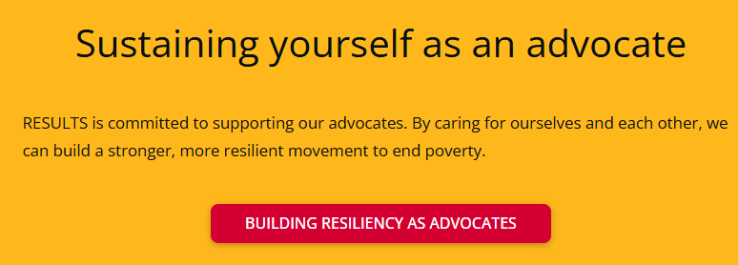
Notes:
Building resiliency as advocates: https://results.org/wp-content/uploads/Building-Resilience-as-an-Advocate_resources.pdf

Slide 8
“For in the final analysis, our most basic common link is that we all inhabit this small planet. We all breathe the same air. We all cherish our children’s future. And we are all mortal.” – President John F. Kennedy, June 10, 1963
Notes:
Agenda
Tonight’s agenda (1 min)
Welcome and introductions
Recent Advocacy Updates: How have folks engaged with advocacy since our March meeting?
FY 26 Appropriations
Closing

Slide 9

Senate Rescissions Vote: Protect remaining funds!
Contact your Senator now at (202) 224-3121 and tell them to vote “No” on rescissions.
Senate will vote no later than July 18 (next Friday)

Slide 10
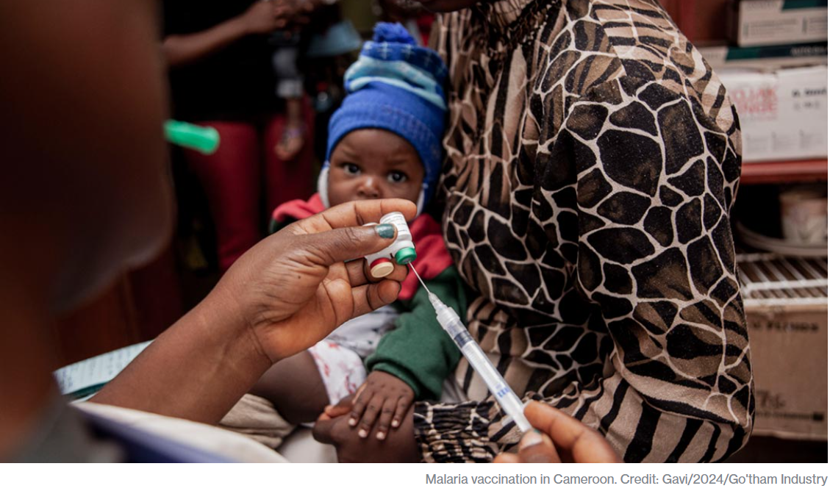
Protect key programs! Gavi, the Vaccine Alliance
1 billion children immunized
17 million future deaths prevented
50% of the world’s children vaccinated by Gavi
$54 returned for every $1 invested
19 countries transitioned out of support
Over 8 million lives saved through 2023
Notes:
Agenda
Tonight’s agenda (1 min)
Welcome and introductions
Recent Advocacy Updates: How have folks engaged with advocacy since our March meeting?
FY 26 Appropriations
Closing

Slide 11

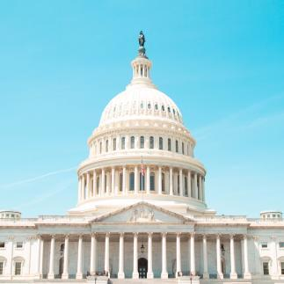

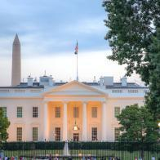
Championing the Global Fund

Slide 12

65 million lives saved
Global Fund raises money
Global Fund provides oversight
Countries & communities make plans
Local experts lead the programs
Global Fund reviews and approves
Notes:
The global fund is a worldwide partnership where world leaders meet at a conference every 3 years to pledge a specific amount of money to last the following three years.
Countries in need of assistance take the lead in determining where and how to best fight AIDs, TB, and malaria, tailoring their own response and taking into consideration their political, cultural, and epidemiological context.
Once a plan has been proposed for a specific country, the Global fund has to review and approve of the plan
After approval, local healthcare workers, government, and communities are elected to lead the program
In the background, the global fund is providing oversight and making sure that their plan can become a success
This has led to millions of saved lives and success in low income countries.
This is all done efficiently with only 6.2% of funds going secretariat overhead costs meaning the vast majority goes directly to countries and programs being implemented

Slide 13
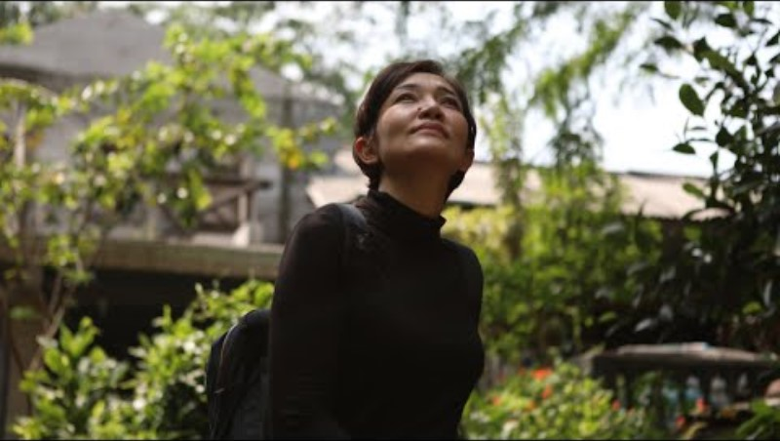
Mei’s Fight: Hard Work and Hope to End TB for Good

Slide 14
Championing the Global Fund

Slide 15

Take action now!
Personalize this sample email to your member of Congress’ Foreign Policy aide
Or take this online action

Slide 16

Take action now!
Personalize and submit this draft “Letter to the Editor”
Or take this online action

Slide 17

Summer 2025 Rallies and Actions Supporting the Peace Corps
July 19 & 20 – Peace Corps Connect
July 21 – Capitol Hill Advocacy Day (and beyond)
Secure a meeting with the district office of your lawmaker(s) during the week of July 21st.
August Recess (July 28 – August 30): Another great time to organize district office meetings with lawmakers.
Plan informal drop-by visit to the office to show support for the Peace Corps.
Plan to write or call your representatives on July 21st to demonstrate large and passionate support for the Peace Corps as our advocates are walking the halls of Congress!
Notes:
Invite others to join: https://tinyurl.com/2025GAPWebinars

Slide 18

Join our media action webinar!
Write to Fight Back: RESULTS Media Action Webinar Protecting SNAP, Medicaid, and Global health programs
Tuesday, July 22 at 8:00 PM ET
Join us for an advocacy webinar where you'll learn how to write and submit a letter to the editor (LTE) that calls on Congress to protect critical anti-poverty programs. Register here: https://tinyurl.com/WritetoFight
Notes:
Invite others to join: https://tinyurl.com/2025GAPWebinars

Slide 19

Join Peace Corps Connect+
Website: community.peacecorpsconnect.org
Notes:
Invite others to join: https://tinyurl.com/2025GAPWebinars

Slide 20
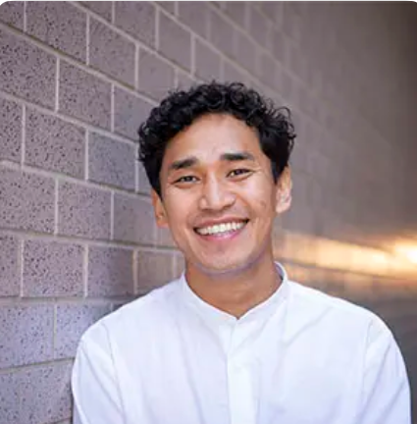
Join us next month for a joint webinar Tuesday, August 14 at 8:30 PM ET
Tenzin Kunor
Senior Policy Associate, RESULTS Global Policy Team
Invite others to join: https://tinyurl.com/2025GAPWebinars
Notes:
Invite others to join: https://tinyurl.com/2025GAPWebinars

Slide 21
Thank you!

Slide 22
Advocacy Action
Contact your members of Congress, request that:
End the stop-work order, and reinstate critical programs and staff to carry them out.
Push the State Department to verify that programs under the waiver have restarted, and expand the waiver to all global health and development programs.
Ensure Congress is involved in shaping the future of foreign aid — standing up for programs that are focused on ending poverty and creating good health, and committed to humanitarian and lifesaving impact.
Notes:
https://results.org/blog/emergency-action-to-protect-lifesaving-foreign-aid

