Slide 1
Monthly Webinar July 11, 2024

Slide 2
Welcome everyone!
Let us know where you are joining us
from in the chat!
Share a greeting in another language if you know one.

Slide 3
Our Values & Resources
3
​At RESULTS we pledge to create space for all voices, including those of us who are currently experiencing poverty. We will address oppressive behavior in our interactions, families, communities, work, and world. Our strength is rooted in our diversity of experiences, not in our assumptions.
With unearned privilege comes the responsibility to act so the burden to educate and change doesn’t fall solely on those experiencing oppression. When we miss the mark on our values, we will acknowledge our mistake, seek forgiveness, learn, and work together as a community to pursue equity.
Read our full anti-oppression values statement here at results.org/values.
Check out the Anti-Oppression Workshop Schedule for training opportunities.
Find these resources and more at results.org/volunteers/anti-oppression:
Resource Guides from our Diversity & Inclusion trainings, including:
Interrupting Microaggressions
Creating Space for Critical Conversations
Information on how RESULTS responds to oppressive incidents

Slide 4
Overview of tonight’s webinar
Welcome & Introductions
Follow up on FY 25 Appropriations
Recap on Gavi Investment Opportunity Launch in Paris
Advocacy Action: Congress must deliver on Gavi
Closing Announcements

Slide 5
FY25 Appropriations
Notes:
Ken
8:35-8:45 PM: Campaigns Updates (Ken)
World Bank advocacy action, letter that closed on 4/12 (maybe share a copy of the letter if we have it by then)
FY25 Appropriations
Dear Colleague Letters, with squishy deadlines - on the RESULTS blog linked here: https://results.org/blog/fy25-appropriations-tell-congress-to-fund-the-fight-against-poverty
House Basic Education letter closes 4/17 Close of Business (maybe take action on this one the night of the webinar)
Others are TBD, but give us some urgency
Scorecard for Dear Colleague letters can be found at the top of the page, direct link: https://docs.google.com/spreadsheets/d/1x35soUUCN2Io0sPfBvqIdjnQ6Sa6I_31HC-HVi2MlAo/edit?usp=sharing
Completing forms online (share about the training coming up by RESULTS on this?)
So you can see how the money we advocate for shows up on the ground, we will hear from Susan who will share a story from her work with USAID in Madagascar

Slide 6
Notes:
Ken

Slide 7
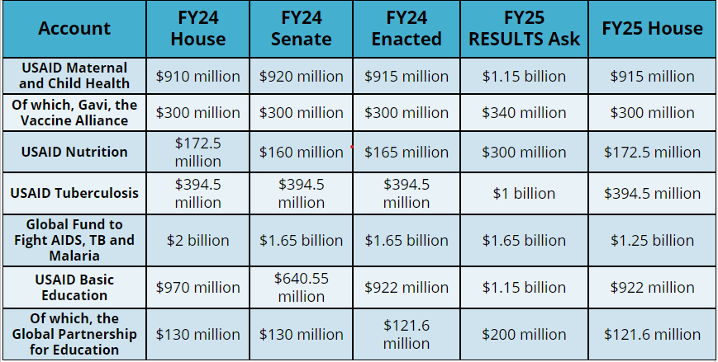
Where are we with FY25 appropriations?
Notes:
Ken https://results.org/blog/a-promising-first-step-on-fy25-appropriations

Slide 8
Congrats on Dear Colleague Letters!
Dear Colleague Letters | House FY25 | House FY24 | Senate FY25 | Senate FY24
MNCH, Gavi, Nutrition | 138 | 154 | 39 | 42
TB | 131 | 129 | 26 | 33*
Global Fund | 161 | 144 | 36 | 38
Education | 115 | 129 | 33 | 36
Notes:
Karyne
8:30-8:35 PM: Welcome/Introductions (Leslye)
Susan & Karyne can check for new names
Welcome new folks, Please let us know in the chat where you are based. Introduce yourself since first time you are doing this.
Be sure to introduce people, Introduce Ken and Karyne and the rest of the Advocacy team of mentors and committee –Anne Child, Sarah Leone, Joanna Distefano, Susan Wright, Leslye Heilig, Margaret Moodian
Invite new folks to introduce themselves in the chat and share about their interest in advocacy
This is a non-partisan space where we learn how to build relationships with our members of Congress to influence policy. We center ourselves around mutual respect and inclusion.
Intro to vision and values of both organizations, provide the links to full statements
Invite Rise members to learn more about RESULTS by exploring their website, and RESULTS members to do the same with Together Women Rise. Review mission/vision/anti-oppression (only feel need to read full statement if there is time, but share links in any case)

Slide 9
What to do next?
Thank members who signed: see the FY25 scorecard.
See and share the signed letters! Find them here.
Notes:
Karyne
8:30-8:35 PM: Welcome/Introductions (Leslye)
Susan & Karyne can check for new names
Welcome new folks, Please let us know in the chat where you are based. Introduce yourself since first time you are doing this.
Be sure to introduce people, Introduce Ken and Karyne and the rest of the Advocacy team of mentors and committee –Anne Child, Sarah Leone, Joanna Distefano, Susan Wright, Leslye Heilig, Margaret Moodian
Invite new folks to introduce themselves in the chat and share about their interest in advocacy
This is a non-partisan space where we learn how to build relationships with our members of Congress to influence policy. We center ourselves around mutual respect and inclusion.
Intro to vision and values of both organizations, provide the links to full statements
Invite Rise members to learn more about RESULTS by exploring their website, and RESULTS members to do the same with Together Women Rise. Review mission/vision/anti-oppression (only feel need to read full statement if there is time, but share links in any case)

Slide 11
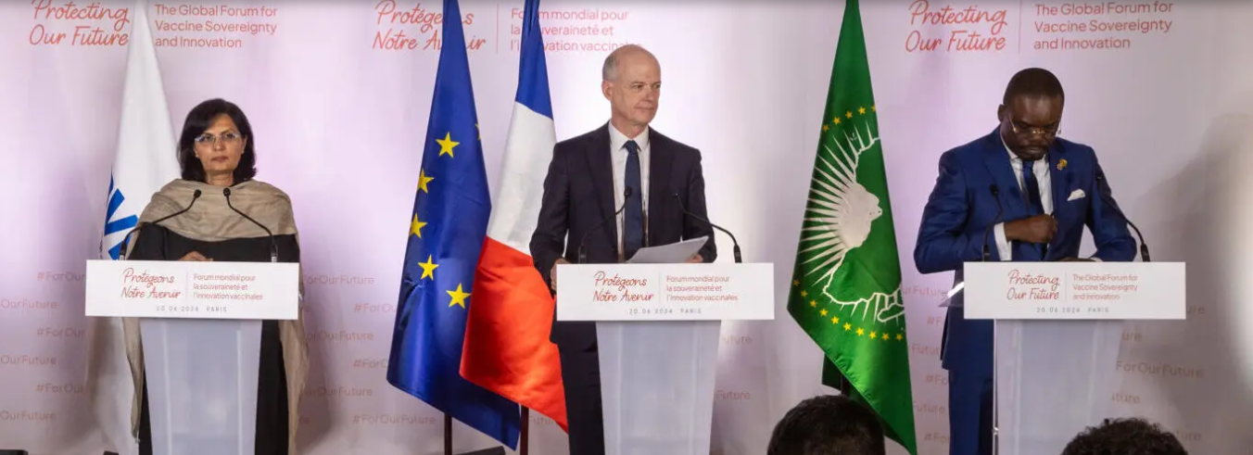
A historic step for global child survival
Gavi Pre-Replenishment Conference and Investment Opportunity, Paris June 20, 2024

Slide 12
Recap of Gavi Global Forum in Paris
At June 20 conference, Gavi officially introduced a new 5-year strategy and aims to protect 500 million children save more than 8 million lives between 2026-2030
60 % by 2040 - Launch of the African Vaccine Manufacturing Accelerator (AVMA), African Union has a goal to produce 60% of the continents’ vaccines by 2024
The Biden Administration’s figure of $1.58 billion over 5 years sets us up for historic success.
U.S. pledge with ample bipartisan support was never a “given” – this is a result of your advocacy efforts!
Now we’ll need Congress to deliver that funding — and push the amount even higher.
Notes:
https://www.gavi.org/news/media-room/protecting-more-children-gavi-vaccine-alliance-plans-next-5-year-period

Slide 14
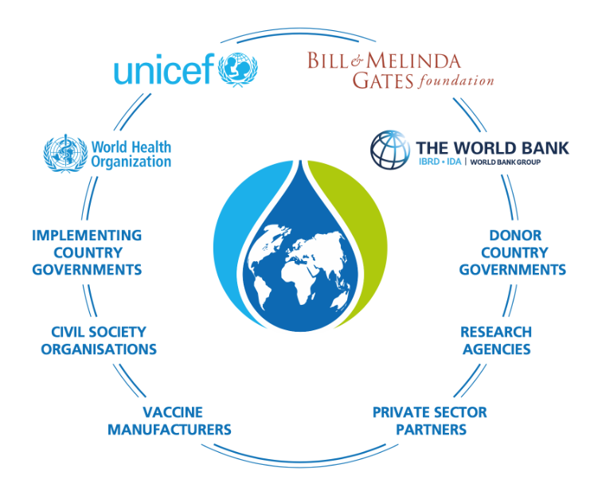

Slide 15
gavi by the numbers
1 billion children immunized
17 million future deaths prevented
50% of the world’s children vaccinated by Gavi
$54 returned for every $1 invested
19 countries transitioned out of support

Slide 16
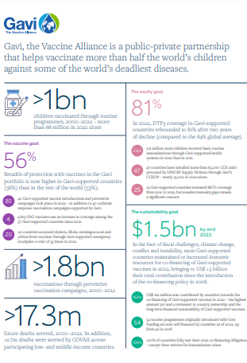
Learn more about Gavi’s amazing results here!
Notes:
https://digital.sciencehistory.org/works/wp988j884

Slide 17
why gavi? why now?

Slide 18
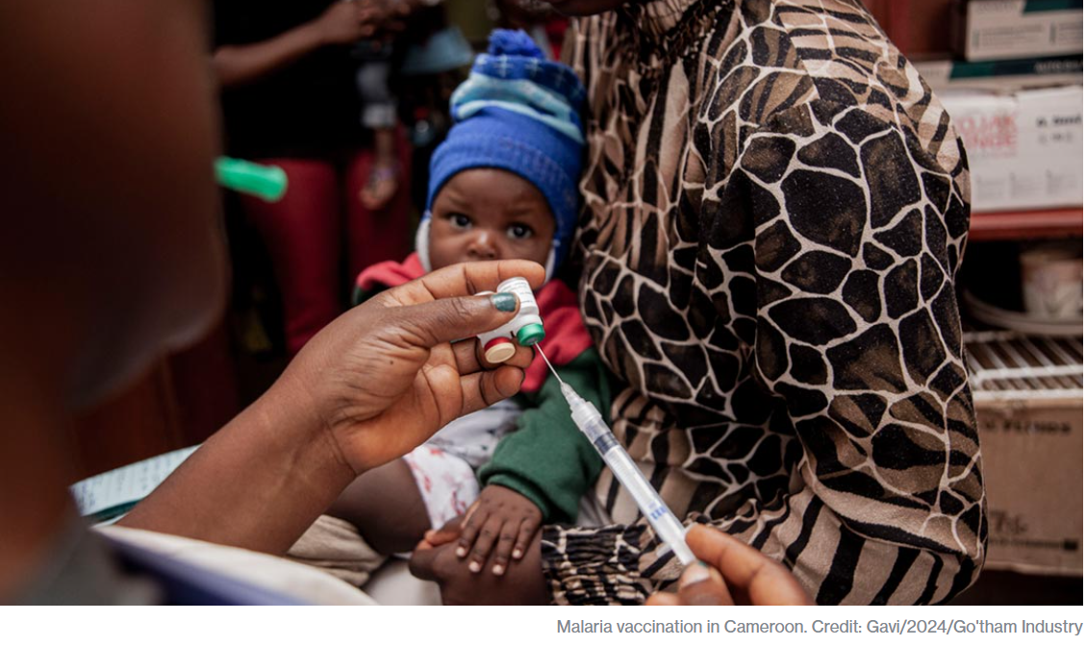

Slide 19
Gavi Resolutions – H.Res. 1286/ S. Res. 684
Senate Lead Sponsors: Sens. Wicker (R-MI) and Cardin (D-MD) House Lead Sponsors: Representatives Kean (R-NJ), Amo (D-RI), Salazar (R-FL), and Jacobs (D-CA).
Calls for United States to have supporting role in saving children’s lives of children and protecting people’s health through Gavi, the Vaccine Alliance.
Gavi has been a major contributor in reducing the number of childhood deaths in lower-income countries due to vaccine-preventable disease by 70 percent since 2000.
Country ownership and sustainability are at the core of the Gavi model.
Notes:
Gavi will launch their investment case to fund their next strategic period from 2026-2030.
https://www.gavi.org/our-alliance/strategy/phase-6-2026-2030

Slide 20
Call or Write: Take Action on Gavi!
Check this scorecard see if your Representative or Senator has signed on to the Gavi Resolution (H. Res. 1286/ S. Res. 684).
Use Legislator Lookup (if you are unsure of who to reach out to, please don’t hesitate to reach out to us for support).
Email convention: Senate - FirstName_LastName@SenatorsLastName.Senate.Gov (example: alex_moree@rubio.senate.gov) House – FirstName.LastName@mail.house.gov (example: Max.Price@mail.house.gov)
Personalize this sample email requesting your members of Congress co-sponsor H. Res. 1286 or S. Res. 684.
Follow up! If you’ve taken one action today, take the other action tomorrow.
Notes:
Karyne

Slide 21
Call or Write: Take Action on Gavi!
Capitol Switchboard – (202) 224 - 3121
Hello! My name is Name. I am a Returned Peace Corps Volunteer and constituent living in city or zip code. I am calling to share my support for Gavi, The Vaccine Alliance and House Resolution 1286/ Senate Resolution 684.
Shockingly, last year almost 5 million children worldwide died before their fifth birthday. The leading cause of death is a lack of access to basic health services like vaccines. Last year, 14 million kids missed out on the most basic vaccines and this is the most cost-effective way to save lives. Since 2000, Gavi, the Vaccine Alliance, has helped improve access and introduce new vaccines to fight killers like pneumonia, diarrhea, and now malaria. Gavi is preparing to support over 20 African countries to introduce the new malaria vaccine and help others vaccinate low- and no-dose children for these insidious diseases. Representative/Senator Name, will you co-sponsor the bipartisan Gavi resolutions (S.Res. 684/H.Res. 1286)? It will send a message to the rest of the world that we need to act now. Thank you!
Notes:
Karyne

Slide 22
Join our next webinar Thursday, August 8 8:30 PM ET – 9:30 PM ET Feel free to bring a friend or fellow RPCV!
Register here: https://tinyurl.com/GAP2024Webinars

Slide 23
Thank you for taking action with us tonight!

