Slide 1
July Webinar Developments in the Fight Against TB July 13, 2023

Slide 2
Our Values & Resources
2
​At RESULTS we pledge to create space for all voices, including those of us who are currently experiencing poverty. We will address oppressive behavior in our interactions, families, communities, work, and world. Our strength is rooted in our diversity of experiences, not in our assumptions.
With unearned privilege comes the responsibility to act so the burden to educate and change doesn’t fall solely on those experiencing oppression. When we miss the mark on our values, we will acknowledge our mistake, seek forgiveness, learn, and work together as a community to pursue equity.
Read our full anti-oppression values statement here at results.org/values.
Check out the Anti-Oppression Workshop Schedule for training opportunities.
Find these resources and more at results.org/volunteers/anti-oppression:
Resource Guides from our Diversity & Inclusion trainings, including:
Interrupting Microaggressions
Creating Space for Critical Conversations
Information on how RESULTS responds to oppressive incidents

Slide 3
Tonight’s Webinar
Welcome and Introductions
Developments in prevention and treatment of Tuberculosis
Update on Dear Colleague Letter to Biden Administration on UN HLM
Deepening your advocacy action this month
Closing
Notes:
Karyne

Slide 4
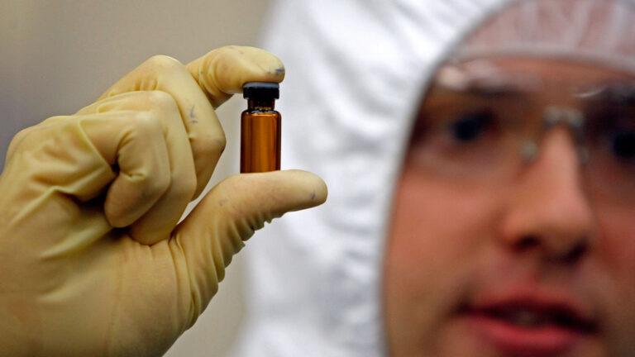
Developments in TB Vaccines
Notes:
Ken Developments on TB Prevention and Treatment
Gates Foundation to fund trial of long-awaited new tuberculosis vaccine candidate – https://www.statnews.com/2023/06/28/tuberculosis-vaccine-gates/?utm_campaign=daily_recap&utm_medium=email&_hsmi=264371837&_hsenc=p2ANqtz--PLmtXs25QfnfXZpUtDPHRK9txJI5IwcXPysCRhzD0KbnT73oG9gRU-xoeqXALbA8ry8YfrMIMiJ_5Viky_f5KahuAQw&utm_content=264371837&utm_source=hs_email

Slide 5
Developments in TB Vaccines
26,000-person, Phase 3 study, set to begin next year, will test a vaccine known as M72/AS01 that showed promising results from a smaller trial in 2019.
Being developed by the Gates Medical Research Institute, affiliate of Gates Foundation. It will cost $550m, of which the Gates Foundation will contribute $400m ( their largest investment in a single product.)
Tuberculosis vaccine first developed in1921 - French team created what’s known as the BCG vaccine from the bacteria that causes bovine tuberculosis.
Current vaccine given to many children in low- and middle-income countries, however effectiveness have shown mixed results, and it doesn’t protect adolescents or adults.
Little progress on vaccines due in part because of scientific hurdles
— tuberculosis is a far more complex pathogen than, say, SARS-CoV-2
In part because the disease primarily affects the planet’s poorest, providing little financial incentive for pharma companies.
Notes:
Ken Developments on TB Prevention and Treatment
Gates Foundation to fund trial of long-awaited new tuberculosis vaccine candidate – https://www.statnews.com/2023/06/28/tuberculosis-vaccine-gates/?utm_campaign=daily_recap&utm_medium=email&_hsmi=264371837&_hsenc=p2ANqtz--PLmtXs25QfnfXZpUtDPHRK9txJI5IwcXPysCRhzD0KbnT73oG9gRU-xoeqXALbA8ry8YfrMIMiJ_5Viky_f5KahuAQw&utm_content=264371837&utm_source=hs_email
A new TB vaccine could save 8.5m lives over the next quarter of a century – https://www.economist.com/science-and-technology/2023/06/28/a-new-tb-vaccine-could-save-85m-lives-over-the-next-quarter-of-a-century?giftId=b4f37459-7bcc-498a-b0d5-063dee05d12b

Slide 6
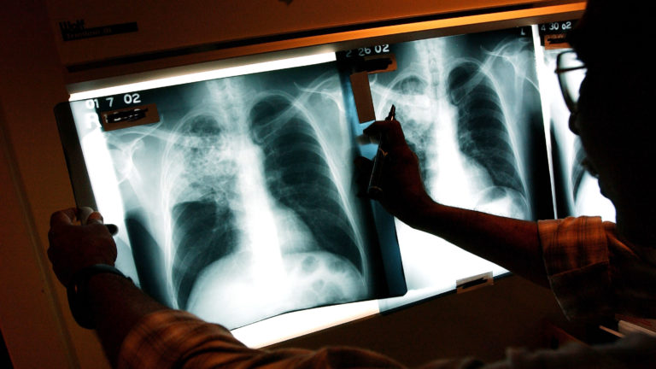
Getting back to pre-COVID levels
Notes:
Ken

Slide 7
Getting back to pre-COVID levels
In the first year of the pandemic (2020), the rate of TB cases fell to 2.2 per 100,000, rising to 2.4 per 100,000 in 2021.
2022 increase was due to more cases among people newly arrived in the United States as well as a higher incidence of cases among American Indians, Alaska Natives, Native Hawaiians, and other Pacific Islanders.
Increases among persons aged 15–24 years, and in children aged 4 and younger. More devastating impact on children, including meningitis and disseminated TB, as well as impacts on neurologic development.
TB cases were confused with COVID, causing delays in diagnoses.
Notes:
Ken

Slide 8
Developments in Treatment
Overcoming Drug Resistant TB in the Ukraine
Notes:
Ken
https://vimeo.com/803174907

Slide 9
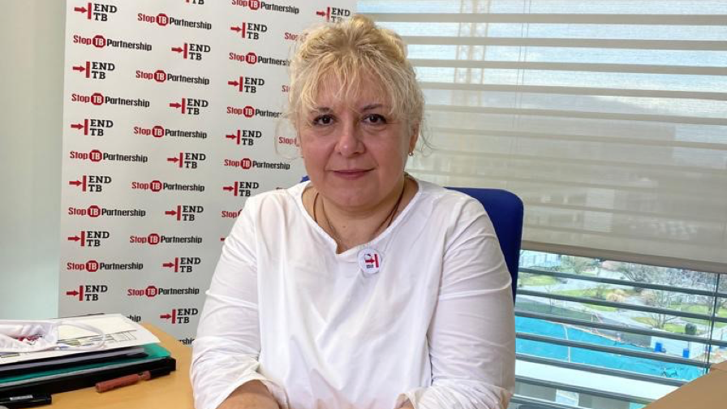
Devex & Stop TB Partnership Series
Notes:
Talking TB - Ending the World’s deadliest disease by 2023 https://pages.devex.com/talking-tb?utm_medium=link&utm_source=newsletter&utm_campaign=cs_TalkingTb
Interview with Dr. Lucicia Ditiu, Executive director of Stop TB Partnership who shares what they envision for the coming UN HLM on TB: Video link: https://www.youtube.com/watch?v=i2YgWqGW-NE&t=3s
Secure working with partners, esp. WHO to ensure the meeting goes as plan – start with process of consultation around priorities
Civil society and communities, fully supported in getting organized and having the right voice – Stop TB is planning to support here
We have targets that need to be achieved by the end of 20XX reports to analyze how we did, “Deadly Divide” produced in 2020 between the promises and achievements around TB – planning to develop another one working with civil society and member states

Slide 10
Devex & Stop TB Partnership Series
Resources to learn more about the dynamics of TB
Listen to testimony from people who are living with TB,
Learn how technology is being leveraged to develop tools for impact,
Learn how we learning from the past and gaining momentum to shape future successes
Notes:
folks to explore the TB Series from Devex with Stop TB Partnership
Resources on the dynamics of the disease, testimony from people who are living with TB, Leveraging technology and tools for impact, and gaining momentum by learning from past successes and shaping future successes in eradicating the disease.
Video (2:53) Dr. Lucicia Ditiu, what they hope to see from UN HLM Meeting

Slide 11
UN High-Level Meeting on TB
September 22, 2023
Notes:
https://www.stoptb.org/advocate-to-endtb/world-tb-day

Slide 12
UN High-Level Meeting on TB
The letter, co-led by Reps. Bera (D-CA-6), Salazar (R-FL-27) McCaul (R-TX-10), and Meeks (D-NY-5) , urges the Administration to:
Demonstrate U.S. leadership against TB by bringing ambitious commitments with specific, measurable targets to the HLM;
Develop a whole of government strategy for advancing the global targets to be endorsed at the HLM;
Send high level representation to attend the HLM; and
Encourage other global leaders to bring bold leadership, commitments, and investments to the HLM.

Slide 13
UN High-Level Meeting on TB
Check out this link to the final letter here.
Closed today with 108 signers
95 Democrats
10 Republicans
Ranking members:
Chairman McCaul (R-TX)
Meeks (D-NY)
Smith (R-NJ)
Signers who are not yet co-sponsors of End TB Now Act (H.R. 1776) 73 House members!
Signers of $1 Billion TB Appropriations Letter, but did not sign current Dear Colleague Letter – 53 members
Notes:
Final list of signers, scorecard - https://docs.google.com/spreadsheets/d/1QF2HKawtGx1kYYfYwGibPpKKnFs0jmX5-RxcpWyEpsk/edit#gid=2081581321
10 Republicans Smith, Chris NJ R 4
Cole, Tom OK R 4
Fitzpatrick, Brian PA R 1
Gonzalez-Colon, Jenniffer PR R AL
Wilson, Joe SC R 2
Fleischmann, Chuck TN R 3
McCaul, Michael TX R 10
Signers Not yet cosponsors on H.R. 1776
Peltola, Mary AK D AL
Radewagen, Amata AS R AL
Carbajal, Salud CA D 24
Costa, Jim CA D 21
DeSaulnier, Mark CA D 10
Eshoo, Anna CA D 16
Garamendi, John CA D 8
Huffman, Jared CA D 2
Jacobs, Sara CA D 51
Lieu, Ted CA D 36
Matsui, Doris CA D 7
Mullin, Kevin CA D 15
Panetta, Jimmy CA D 19
Porter, Katie CA D 47
Sanchez, Linda CA D 38
Thompson, Mike CA D 4
Caraveo, Yadira CO D 8
Crow, Jason CO D 6
DeGette, Diana CO D 1
Courtney, Joe CT D 2
Hayes, Jahana CT D 5
Larson, John CT D 1
Castor, Kathy FL D 14
Moskowitz, Jared FL D 23
Wilson, Frederica FL D 24
Johnson, Hank GA D 4
Scott, David GA D 13
Williams, Nikema GA D 5
Davis, Danny IL D 7
Jackson, Jonathan IL D 1
Quigley, Mike IL D 5
Schakowsky, Janice IL D 9
Keating, Bill MA D 9
Ruppersberger, Dutch MD D 2
Stevens, Haley MI D 11
Tlaib, Rashida MI D 12
Wagner, Ann MO R 2
Foushee, Valerie NC D 4
Manning, Kathy NC D 6
Kuster, Ann NH D 2
Pappas, Chris NH D 1
Gottheimer, Josh NJ D 5
Norcross, Donald NJ D 1
Pallone, Frank NJ D 6
Sherrill, Mikie NJ D 11
Smith, Chris NJ R 4
Stansbury, Melanie NM D 1
Lee, Susie NV D 3
Clarke, Yvette NY D 9
Meeks, Gregory NY D 5
Nadler, Jerrold NY D 12
Velázquez, Nydia NY D 7
Cole, Tom OK R 4
Blumenauer, Earl OR D 3
Bonamici, Suzanne OR D 1
Hoyle, Val OR D 4
Salinas, Andrea OR D 6
Dean, Madeleine PA D 4
Evans, Dwight PA D 3
Houlahan, Chrissy PA D 6
Wild, Susan PA D 7
Gonzalez-Colon, Jenniffer PR R AL
Fleischmann, Chuck TN R 3
Casar, Greg TX D 35
Castro, Joaquin TX D 20
Garcia, Sylvia R. TX D 29
Jackson Lee, Sheila TX D 18
McCaul, Michael TX R 10
Connolly, Gerry VA D 11
Plaskett, Stacey VI D AL
Balint, Becca VT D AL
Gluesenkamp Pérez, Marie WA D 3
Larsen, Rick WA D 2
Moore, Gwen WI D 4
$1 Billion Approps letter, but not dear colleague letter Sewell, Terri AL D 7
Grijalva, Raul AZ D 7
Barragan, Nanette CA D 44
Brownley, Julia CA D 26
Cardenas, Tony CA D 29
Ruiz, Raul CA D 25
Schiff, Adam CA D 30
Sherman, Brad CA D 32
Vargas, Juan CA D 52
Neguse, Joe CO D 2
Soto, Darren FL D 9
McBath, Lucy GA D 7
Nunn, Zach IA R 3
Casten, Sean IL D 6
Garcia, Chuy IL D 4
Krishnamoorthi, Raja IL D 8
Schneider, Brad IL D 10
Davids, Sharice KS D 3
Carter, Troy LA D 2
Auchincloss, Jake MA D 4
Neal, Richard MA D 1
Trahan, Lori MA D 3
Raskin, Jamie MD D 8
Pingree, Chellie ME D 1
Dingell, Debbie MI D 6
Scholten, Hillary MI D 3
Slotkin, Elissa MI D 7
Thanedar, Shri MI D 13
Omar, Ilhan MN D 5
Bush, Cori MO D 1
Thompson, Bennie MS D 2
Adams, Alma NC D 12
Davis, Don NC D 1
Pascrell, Bill NJ D 9
Sablan, Gregorio NMI D AL
Horsford, Steven NV D 4
Titus, Dina NV D 1
Bowman, Jamaal NY D 16
Higgins, Brian NY D 26
Torres, Ritchie NY D 15
Malliotakis, Nicole NY R 11
Molinaro, Marcus NY R 19
Scanlon, Mary Gay PA D 5
Cicilline, David RI D 1
Doggett, Lloyd TX D 37
Escobar, Veronica TX D 16
Fletcher, Lizzie TX D 7
Green, Al TX D 9
Beyer, Donald VA D 8
Scott, Bobby VA D 3
DelBene, Suzan WA D 1
Jayapal, Pramila WA D 7
Schrier, Kim WA D 8

Slide 14
What does it take to get a response?
Notes:
Karyne

Slide 15
Senate Letter?
Contact your Senators on Dear Colleague Letter to Biden Admin Letter to be released soon!
Likely the same language
Specific measurable targets
Develop a while government strategy
High level representation to attend UNHLM
Encourage other global leaders

Slide 16
We want to pass the End TB Now Act this year!
See if your member of Congress has supported TB in any way using our Congressional Scorecard

Slide 17
End TB Now Act (S.288, H.R.1776)
Requires the U.S. to establish bold goals for reaching the most vulnerable populations
Strengthens U.S. bilateral coordination to develop comprehensive global TB response
Catalyzes support for TB research and development (R&D)
Improves the capacity of countries and affected communities with high burdens of TB
Requires annual reporting to Congress on U.S. TB activities and their impact
Evaluates the performance of TB programs that are supported by U.S.

Slide 18
Next Steps
Choose your own adventure…
Photo courtesy of Dariusz Sankowski, Unsplash.com
Notes:
Karyne

Slide 19
Next Steps: Choose your own adventure…
Send a follow up email or make a phone call
Meet with your Representative and Senators during their time in the district (August Recess)
Inform other RPCVs in your network about the impact of TB in your country of service and how they can make a difference through advocacy (online action)
Write a letter to the editor (LTE) or other media
Other ideas? Get creative!
Notes:
Karyne
Resources:
Congressional Scorecard - https://docs.google.com/spreadsheets/d/1QF2HKawtGx1kYYfYwGibPpKKnFs0jmX5-RxcpWyEpsk/edit#gid=2081581321
Legislator Lookup - https://results.org/volunteers/legislator-lookup Sample email https://docs.google.com/document/d/1xDZ3ZwITvXbg7Eppk-I47jnXqf4TuI4WfeGuuCLCQrk/edit Share - https://results.org/volunteers/action-center/action-alerts?vvsrc=%2fcampaigns%2f97042%2frespond

Slide 20
Progressive Advocacy Actions
Summer
June: Signers on UNHLM Dear Colleague Letter (House)
July: UNHLM Dear Colleague Letter (Senate), Writing media (Op Eds, Letters to the Editor)
August: In District Lobby Meetings
Fall
September: UN HLM takes place
October - December: Passing the End TB Now Act!

Slide 21
Global Allies Program Coaching Support
Sign up for additional coaching support between webinars!
https://results.salsalabs.org/globalalliesprogram
Notes:
Sign Up - https://results.salsalabs.org/globalalliesprogram

Slide 22
Notes:
Sign Up - https://results.salsalabs.org/globalalliesprogram

Slide 23
- Next GAP Webinar: August 10, 8:30 PM ET Register here: https://bit.ly/GAP2023Webinars - RESULTS Global Policy Forum – Thursday, July 20 9:00PM ET - Peace Corps Upcoming Events: Peace Corps Connect 2023 September 8 – 9 Learn more and register here. - Effective Advocacy Tools and Practices Advocacy Training for Country of Service Groups September 27, 8:00PM ET Learn more and register here.
Upcoming Events

Slide 24
Thanks for joining us tonight!

Slide 25
Why do we care about TB?
It’s the leading infectious disease killer in the world that is almost completely preventable, treatable, curable.
It devastates families.
TB is a justice issue.
Our TB solutions are way behind.
COVID set us back over a decade on progress with TB.
2023 is the time.

Slide 26
Tuberculosis (TB) is often thought of as a disease of the past. But this airborne contagion is both a driver and an exacerbator or global poverty, and it targets vulnerable populations. TB kills more people each year than HIV/AIDS and malaria combined.
Notes:
Karyne
Engage: Tuberculosis - an airborne bacteria - now kills more people each year than HIV and malaria combined.
Problem: COVID, conflict, and other crises have specifically taken a toll on the fight against tuberculosis. This disease drives and exacerbates global poverty, and it targets vulnerable populations. Alarmingly, TB cases increased in both 2020 and 2021. In 2021, 1.6 million people worldwide died from this often-curable disease.
Inform: The U.S. has been a leader in the fight against TB, and fiscal year 2024 decisions will soon be made in Congress by the committee that funds foreign aid.
Call to Action: Will you write and speak to the leadership of the State and Foreign Operations Subcommittee of Appropriations and ask that they include at least $1 billion for USAID bilateral tuberculosis funding in the FY24 spending bill? Will you also ask for at least $2 billion for the Global Fund to Fight AIDS, TB and Malaria?

Slide 27
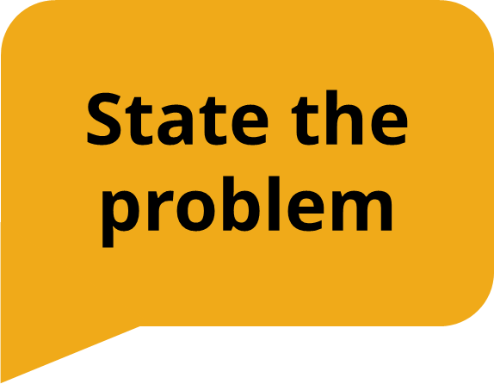
While incredible strides were being made in the fight against TB, when COVID-19 arrived, TB resources around the world were diverted toward fighting the new pandemic. This devastated the TB response. In 2021, the World Health Organization (WHO) reported that both the rates of TB sickness and number of TB deaths increased.
Notes:
Karyne

Slide 28
But, Congress can make a difference. The bipartisan, bicameral End TB Now Act (H.R. 1776/ S. 288) calls for setting bold U.S. goals to reach those most vulnerable to the disease. It will help save lives and provide the frontline support needed to address future pandemics.
Notes:
Karyne

Slide 29
Will you co-sponsor the End Tuberculosis Now Act today?
Notes:
Karyne

Slide 30
Why is this topic important to you?
Notes:
Karyne
Engage: Tuberculosis - an airborne bacteria - now kills more people each year than HIV and malaria combined.
Problem: COVID, conflict, and other crises have specifically taken a toll on the fight against tuberculosis. This disease drives and exacerbates global poverty, and it targets vulnerable populations. Alarmingly, TB cases increased in both 2020 and 2021. In 2021, 1.6 million people worldwide died from this often-curable disease.
Inform: The U.S. has been a leader in the fight against TB, and fiscal year 2024 decisions will soon be made in Congress by the committee that funds foreign aid.
Call to Action: Will you write and speak to the leadership of the State and Foreign Operations Subcommittee of Appropriations and ask that they include at least $1 billion for USAID bilateral tuberculosis funding in the FY24 spending bill? Will you also ask for at least $2 billion for the Global Fund to Fight AIDS, TB and Malaria?

Slide 31
How have you seen the devastation of TB in your country or service?
Notes:
Karyne

Slide 32
How could the End TB Now Act work to end TB and strengthen healthcare systems in your country of service?
Notes:
Karyne

Slide 33
Will you co-sponsor the End Tuberculosis Now Act today?
Notes:
Karyne

Slide 34
Tips for Delivering Your EPIC Laser Talk:
Practice to the point that you feel comfortable, not rote. You don’t have to memorize the whole thing word for word.
Memorizing key facts and details is key.
When you practice, talk without stopping, even if you stumble.
Critique yourself and others with kindness.

Slide 35
Make it personal!
Why do you care about the issue?
How is the issue impacting you currently (or how has it impacted you in the past?)
How does the issue show up in your country of service?
What values are motivating you to support solving this issue?

Slide 36
Develop your EPIC Laser Talk
10 min: Personalize your own EPIC Laser Talk
5 min: Share

