Slide 1
January Webinar January 11, 2024

Slide 2
Welcome and happy 2024
Let us know where you are joining us
from in the chat!
Notes:
Karyne

Slide 3
Our Values & Resources
3
​At RESULTS we pledge to create space for all voices, including those of us who are currently experiencing poverty. We will address oppressive behavior in our interactions, families, communities, work, and world. Our strength is rooted in our diversity of experiences, not in our assumptions.
With unearned privilege comes the responsibility to act so the burden to educate and change doesn’t fall solely on those experiencing oppression. When we miss the mark on our values, we will acknowledge our mistake, seek forgiveness, learn, and work together as a community to pursue equity.
Read our full anti-oppression values statement here at results.org/values.
Check out the Anti-Oppression Workshop Schedule for training opportunities.
Find these resources and more at results.org/volunteers/anti-oppression:
Resource Guides from our Diversity & Inclusion trainings, including:
Interrupting Microaggressions
Creating Space for Critical Conversations
Information on how RESULTS responds to oppressive incidents

Slide 4
Overview of Tonight’s Webinar
Reflecting on 2023
Overview of 2024 campaigns
Advocacy Action
Closing
Notes:
Karyne

Slide 5
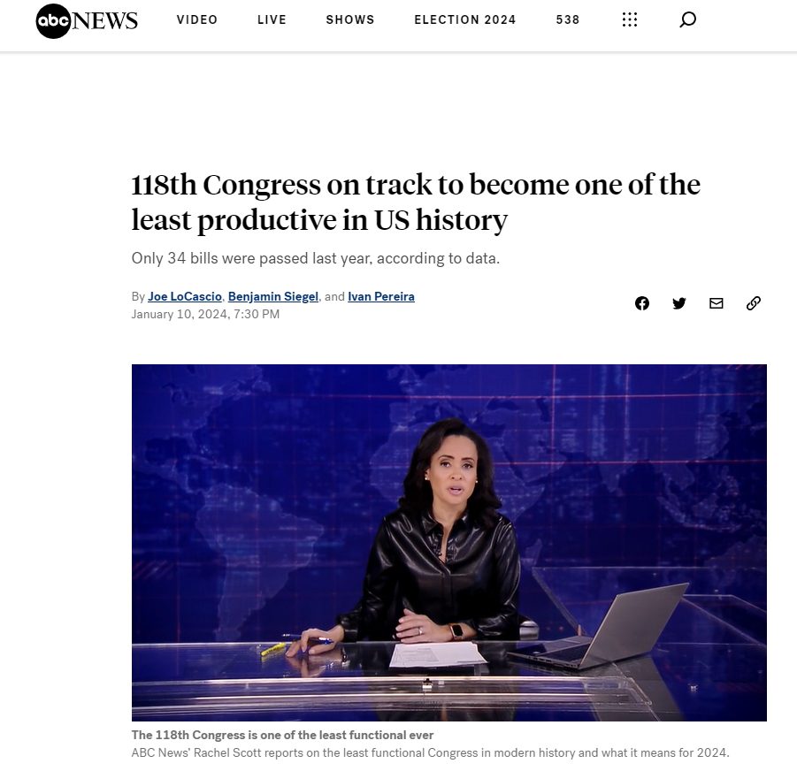
Reflecting on 2023
Notes:
Karyne News clip: https://abcnews.go.com/Politics/118th-congress-track-become-productive-us-history/story?id=106254012 0:00 – 1:30

Slide 6
Reflecting on 2023
Global Appropriations
USAID Tuberculosis and Global Fund to Fight AIDS, TB and Malaria
Nutrition
Maternal and Child Health/ Gavi, Vaccine Alliance ($10 Million increase)
Education
UN High Level Meeting on TB
Bills:
End TB Now Act (H.R. 1776/ S. 288)
READ Act (H.R. 681/ S.41)

Slide 7
How you showed up in 2023
Total lobby meetings: 370 meetings (83 face-to-face)
111 Senate meetings, including 12 face-to-face
257 House meetings including 71 face-to-face
2 candidate meetings

Slide 8
How you showed up in 2023
Total media: 567 pieces (2022 total: 477)
322 discuss the Child Tax Credit
138 discuss Renter Tax Credit or housing
94 discuss global tuberculosis
43 discuss global education
States published: 45 plus national publications
Groups published: 60 groups published plus Free Agents and Action Network members
72 percent of all 2023 media came during our Apr-Jun and Sep-Dec media campaigns

Slide 9
Reflecting on 2023
What are some transformational moments you recall from 2023?
How does this inform your story and your sense of purpose?
What would you like to see yourself doing in 2024?

Slide 10
Looking ahead at 2024
Because of advocacy, we've made a lot of progress on poverty globally, 38% to 12%
But at the current rate we won't reach 2030 Sustainable Development Goal of ending extreme poverty.
There are still have 700 million people living on less than $2.15/day. More than half are children.
We need to double-down on our advocacy.
Notes:
Ken

Slide 11
2024: Malnutrition
Malnutrition is an underlying cause of poverty, affecting physical and mental health, and the ability to work.
Malnutrition is the underlying cause of nearly 50% of preventable child deaths, causes stunting (short for age) and is a leading cause of disabilities
1 in 5 children are affected by stunting—it robs children of their future potential.
Good nutrition starts with the mother.
Notes:
Ken

Slide 12
2024: Malnutrition
We will:
Hold USAID accountable on the Global Malnutrition Prevention and Treatment Act.
Advocate for increased funding for global maternal and child health and nutrition.
Lay the groundwork for a US leadership around a Nutrition for Growth pledging moment, likely in 2025.
Notes:
Ken

Slide 13
2024: Vaccines
We will:
Advocate for increased funding for Gavi, the Vaccine Alliance.
Lay the groundwork for a bold, 4-year, US pledge for the Gavi replenishment moment.
Gavi has vaccinated over 1 billion children and prevented 17 million deaths.
Notes:
Ken

Slide 14
2024: Education
We will:
Advocate for the passage of the READ Act
Advocate for increased funding for global education
Lay the groundwork for a bold US pledge the Global Partnership for Education during an upcoming pledging moment
Notes:
Ken

Slide 15
2024: Our Boldness
We need to feature or boldness and fearlessness in 2024, taking action, reaching out to others, showing that they too can be powerful.
Notes:
Ken

Slide 16
Advocacy Action:
How will you deepen your relationships with MOCs this year?
Notes:
Karyne

Slide 17
Advocacy Action:
How will you deepen your relationships your community?
Notes:
Karyne

Slide 18
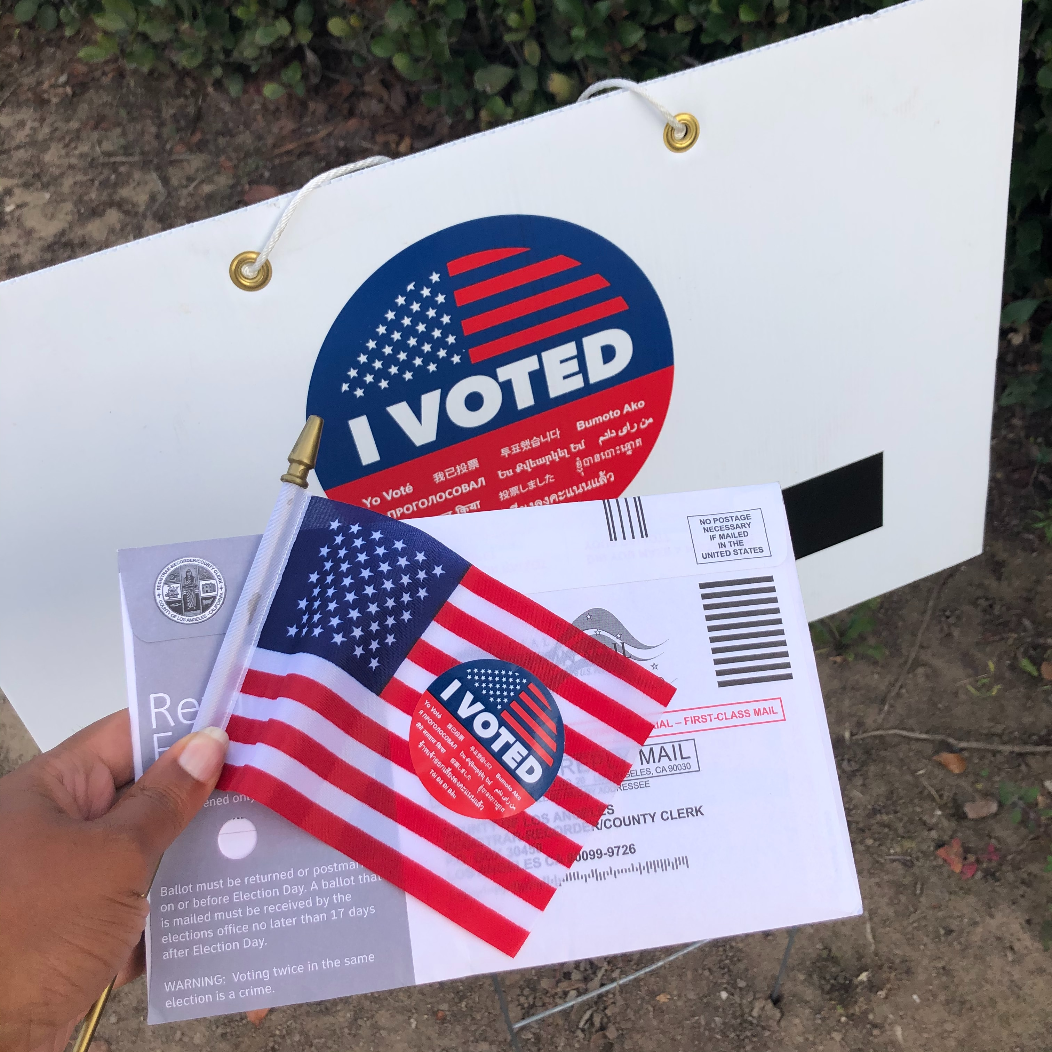
How will you use this opportunity to make a difference in 2024?
Photo courtesy of Unsplash.com (Janice Robinson)
Notes:
Karyne

Slide 19
Join our next GAP webinar: February 8 at 8:30 PM ET Feel free to bring a friend!
Notes:
Karyne

Slide 20
Thanks for joining us tonight!

