Slide 1
The World Bank: Not Your Traditional Bank

Slide 2
Facilitator
Xochitl Sanchez, Senior Advisor, ACTION
Speakers
Joyce Ng'ang'a, Policy Advisor, WACI Health
Dr. Robyn Waite, Director of Policy and Advocacy, Results Canada

Slide 3
Let’s keep the conversation going! Connect with us:
@ACTION_tweets
@RESULTS_Tweets
@ResultsCda
@WACI_Tweets
@WaiteRobyn
#Voices4RESULTS
#YesHealthEquity
#IDAWorks
#InvestInHealth

Slide 4
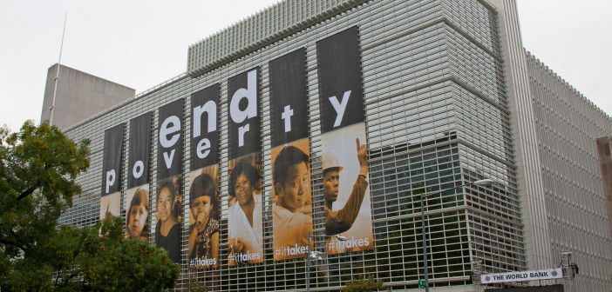
What is the World Bank and why does
our work with the Bank matter?
The World Bank’s Mission: End extreme poverty within a generation and boost shared prosperity by …..
2030
Photo Credit: World Bank

Slide 5
World Bank Group
Five Institutions
The International Bank for Reconstruction and Development (IBRD)
The International Development Association (IDA).
The International Finance Corporation (IFC)
The Multilateral Investment Guarantee Agency (MIGA)
The International Centre for Settlement of Investment Disputes (ICSID)
The International Bank for Reconstruction and Development (IBRD) - Lends to governments of middle income and credit worthy low-income countries. Charges higher interest rates than IDA.
The International Development Association (IDA) - Provides virtually interest-free (“concessional”) loans called credits and grants to governments of the poorest countries.

Slide 6
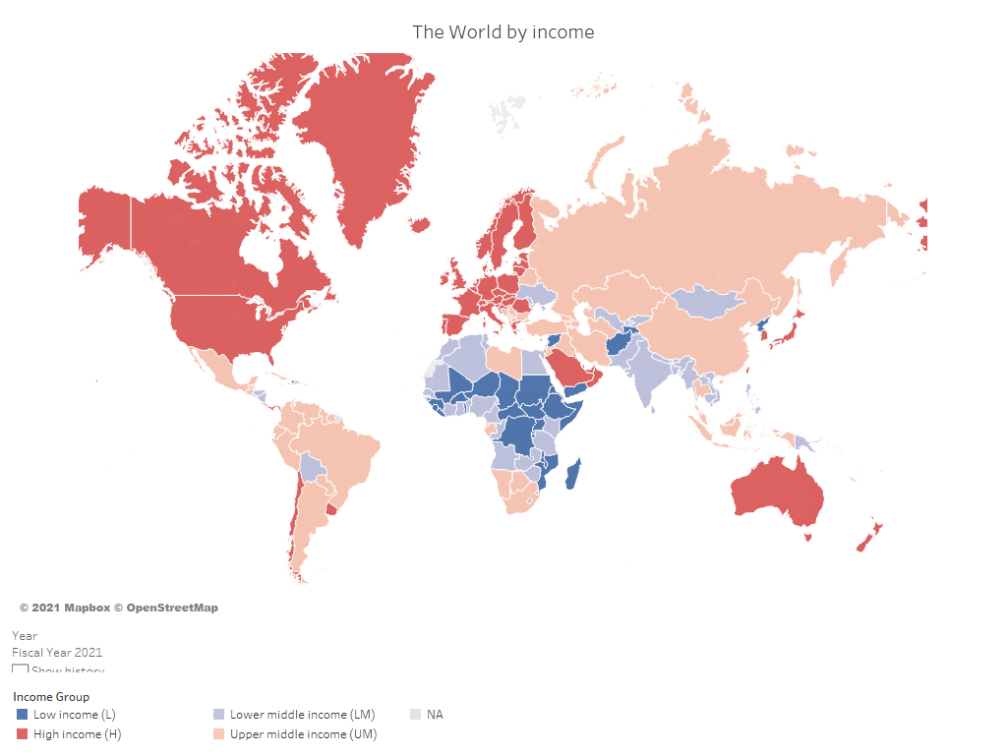
Country Classifications
Photo Credit: World Bank

Slide 7
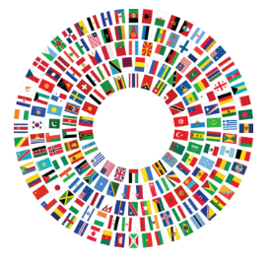
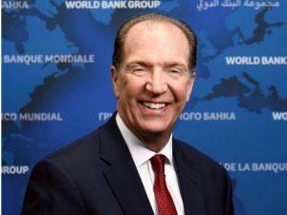
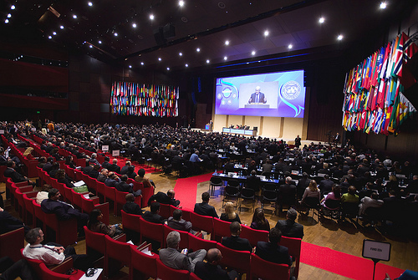
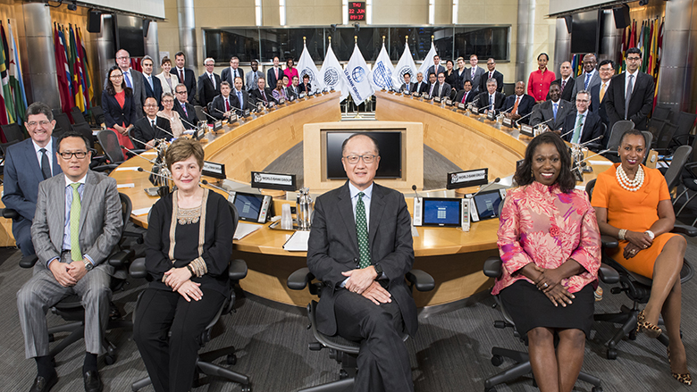
Governance
189
World Bank Member
Countries
Board of Governors
President
Board of Directors
Photo Credit: World Bank

Slide 8
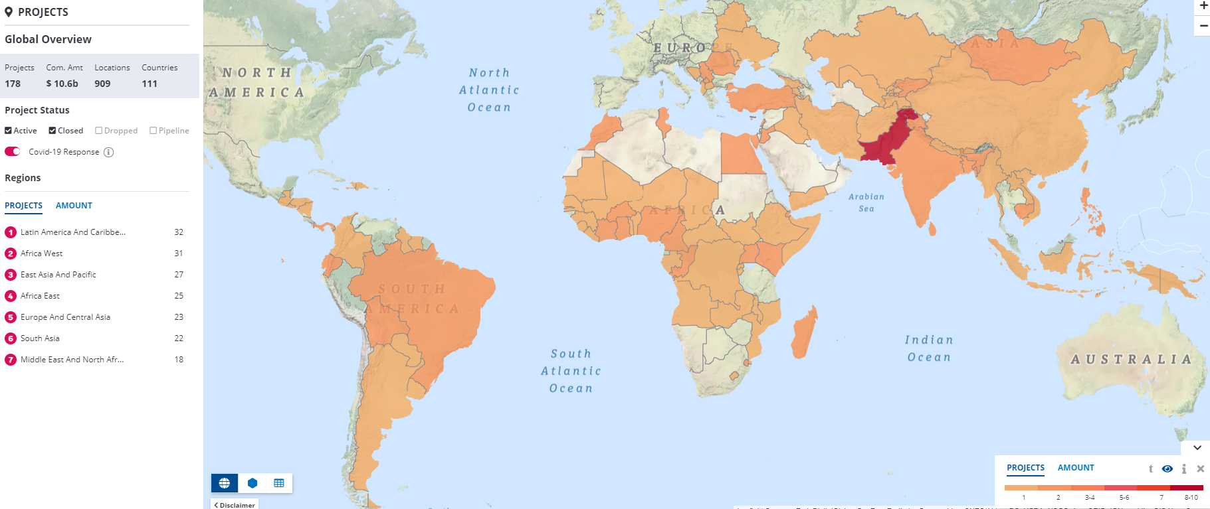
World Bank COVID-19 Response
In March 2020, approved $14 billion package of fast-track financing
In October 2020, approved $12 billion for vaccine rollout
World Bank Group Committed to $160 billion in financing capacity through end of June 2021 COVID-19 through
Photo Credit: World Bank COVID-19 Database

Slide 9
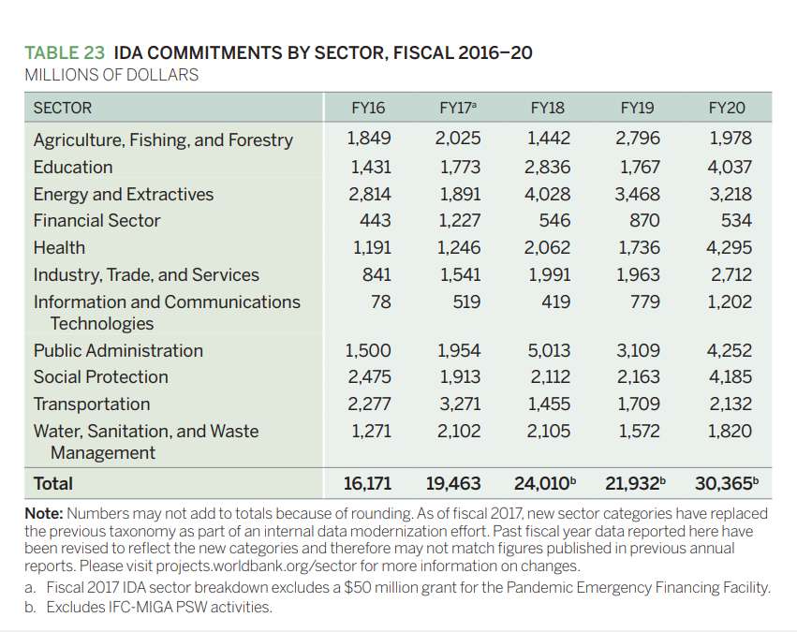
International Development Association
IDA 19
historic $82 billion financing package f
stronger presence in Fragile and Conflict-affected States (FCS)
a new Sustainable Development Finance Policy (SDFP)
a scaled-up Regional Window
a new early response framework for slower-onset crises under the Crisis Response Window (CRW)
Photo Credit: World Bank Annual Report 2020

Slide 10
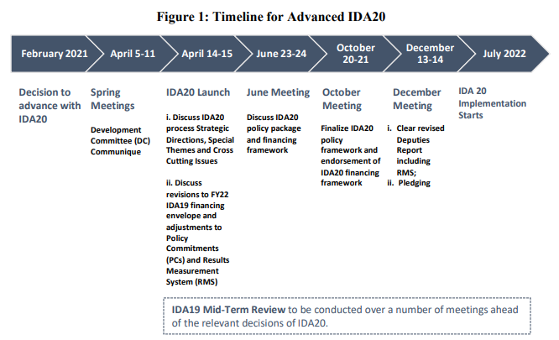
IDA 20 Replenishment
Human Capital will be added as a special theme for IDA 20!!
Photo Credit: World Bank IDA 20

Slide 11
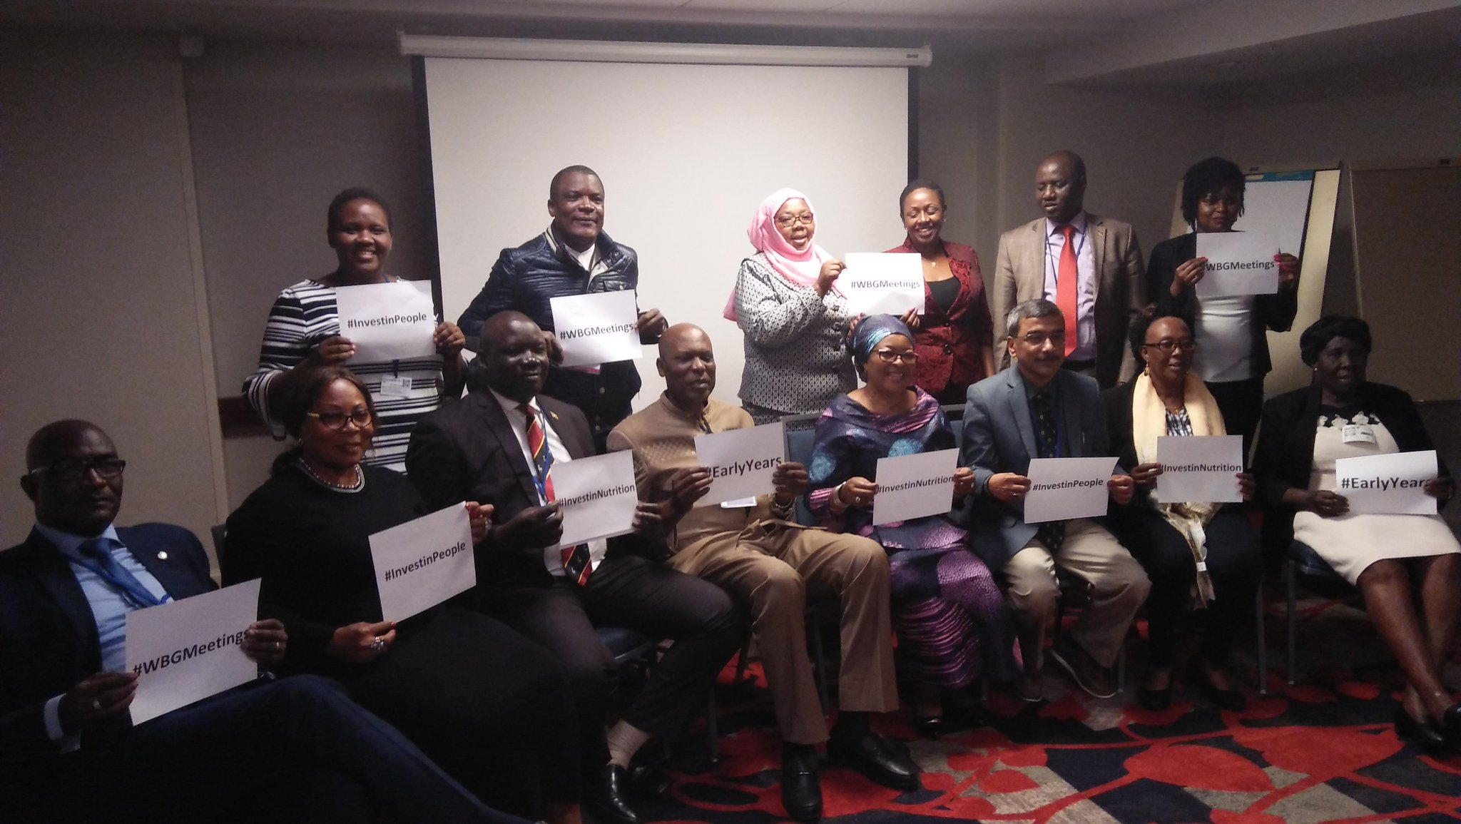
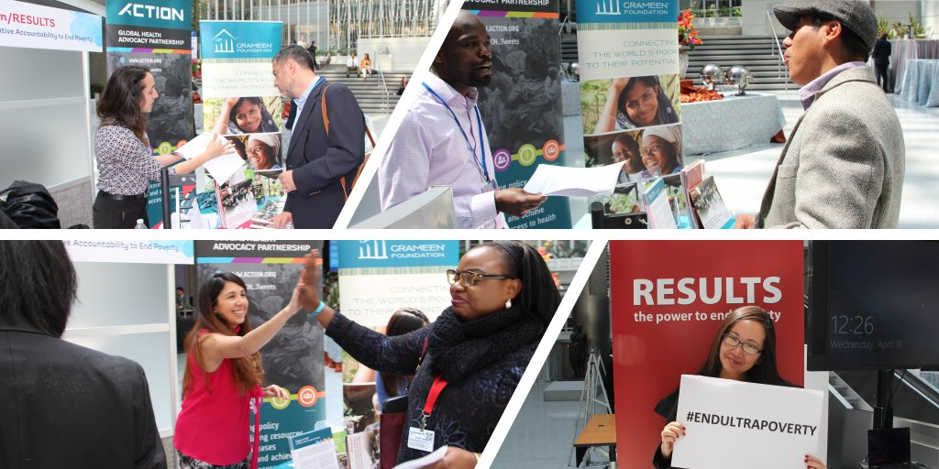
Our Strategy & Tactics
High-level Meetings
Engagement with WB staff
Accountability Tools
Coalition and partner Mobilization
Analysis
Tracking & Monitoring
Reports
Communications and Media
Policy Makers and Parliamentarians
Photo Credit: ACTION/RESULTS

Slide 12
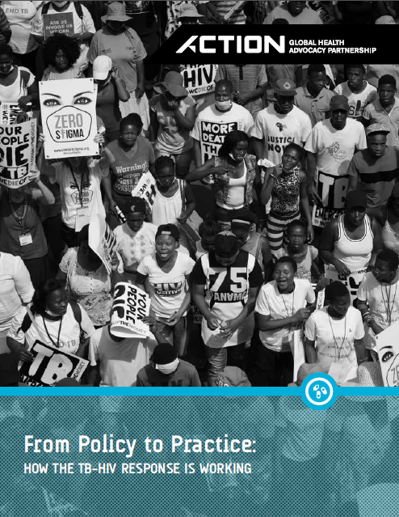
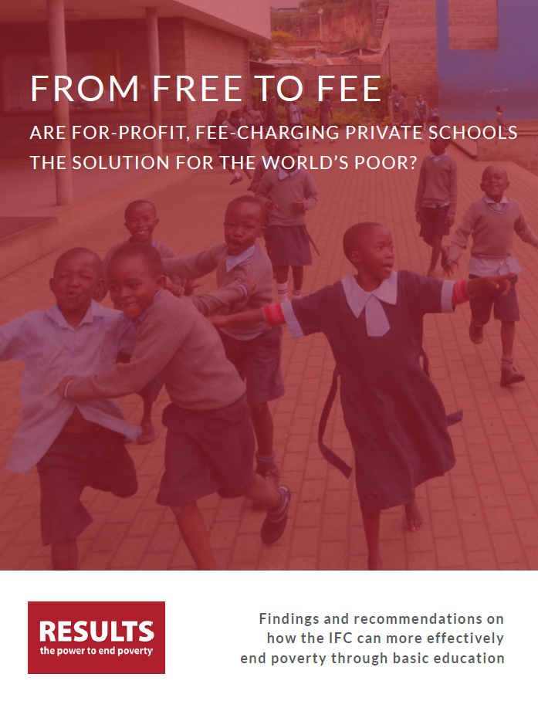
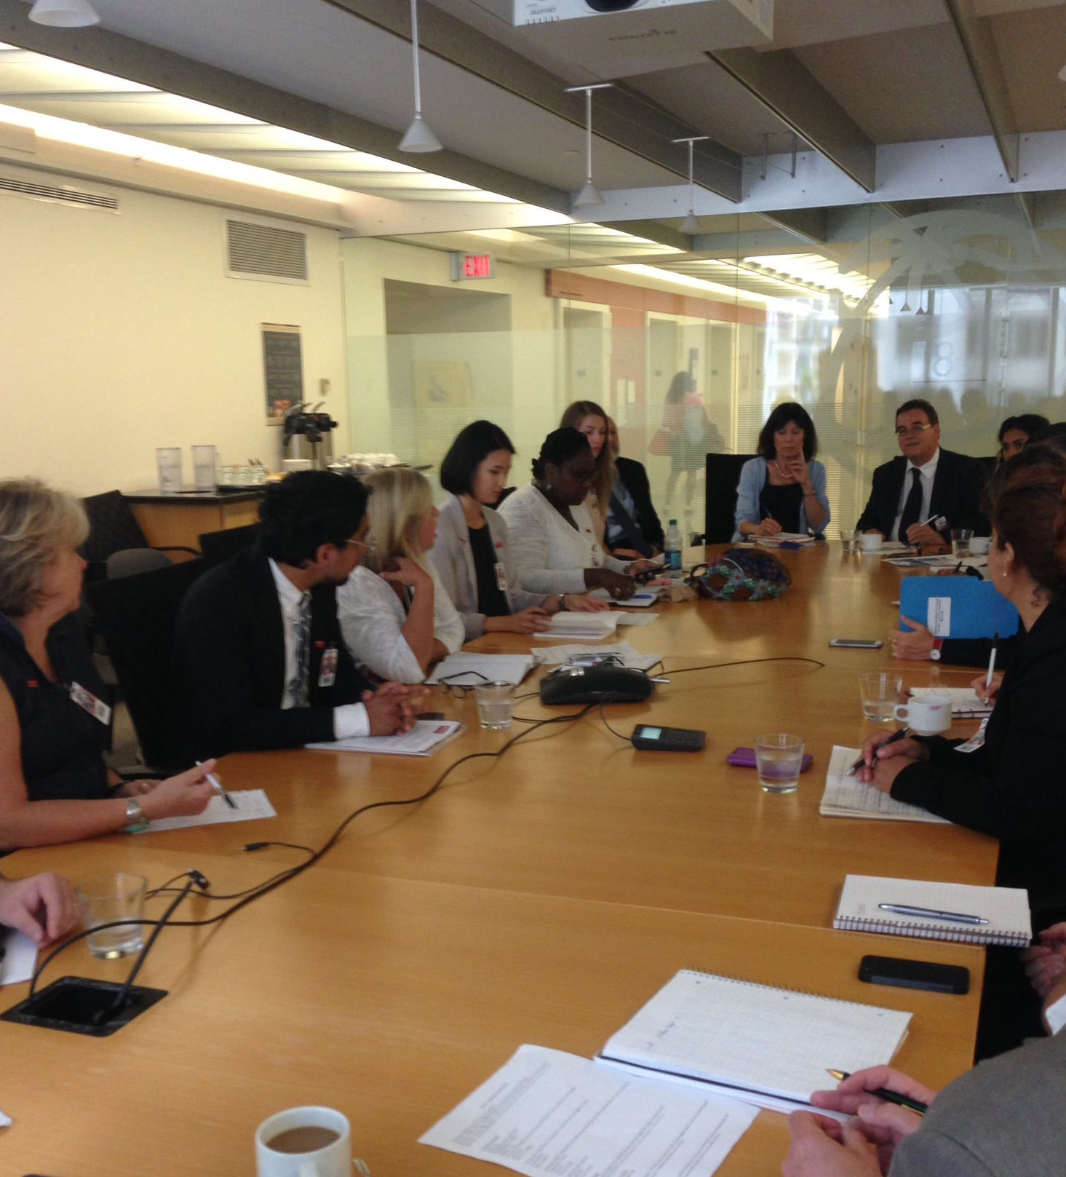
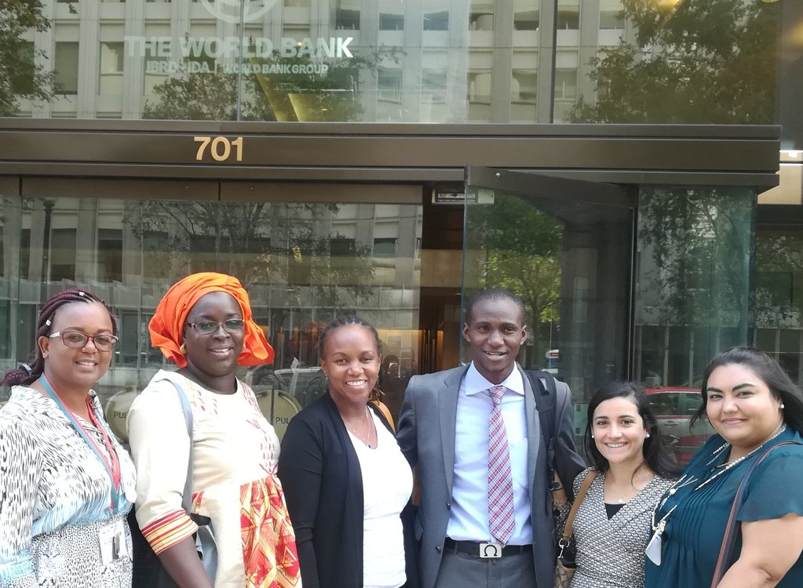
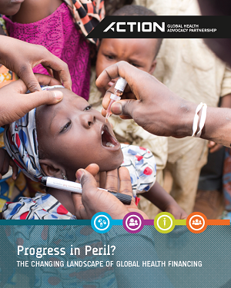
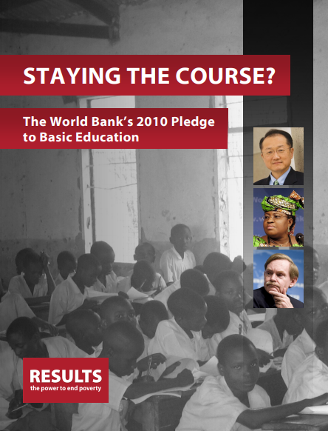
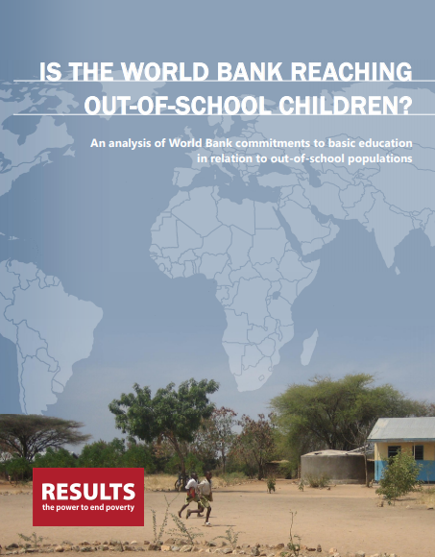
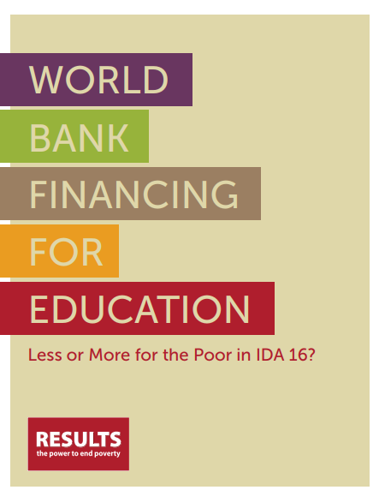
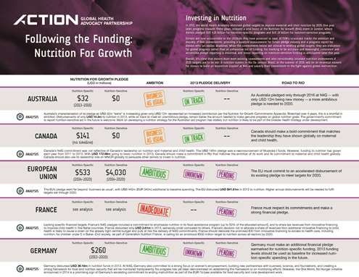
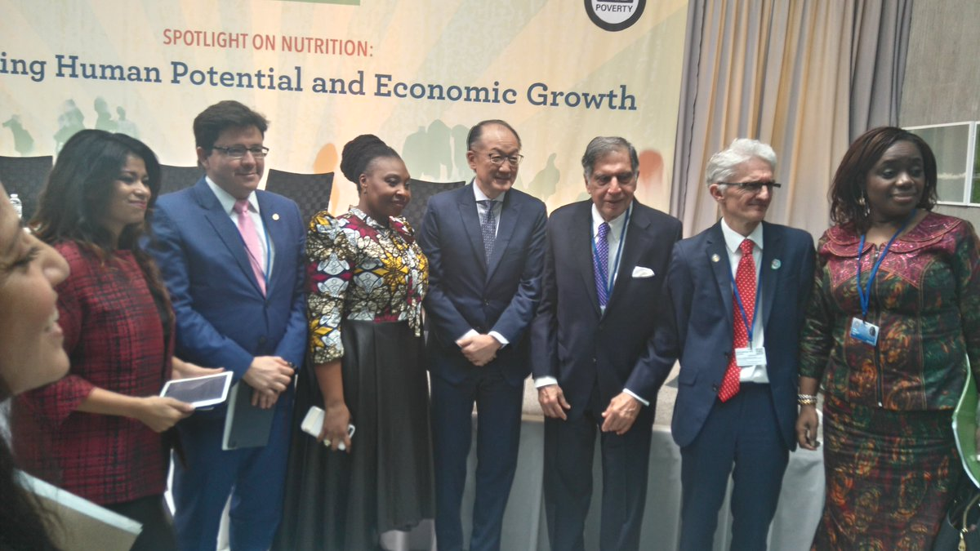
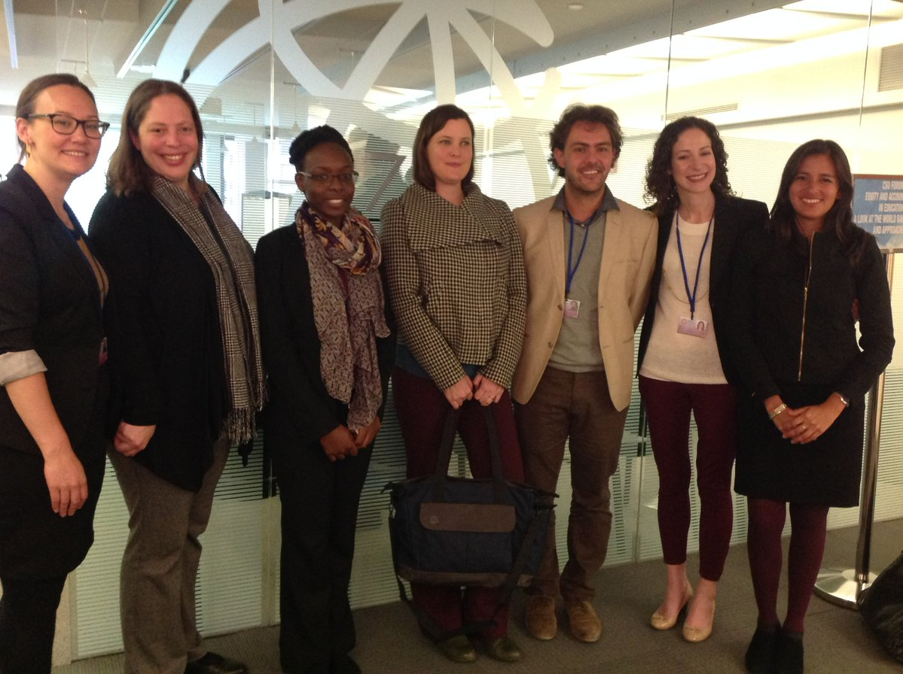
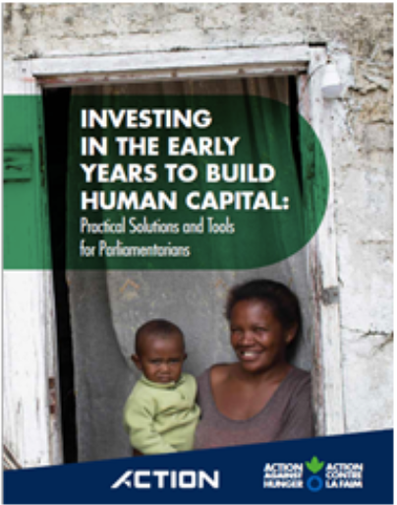
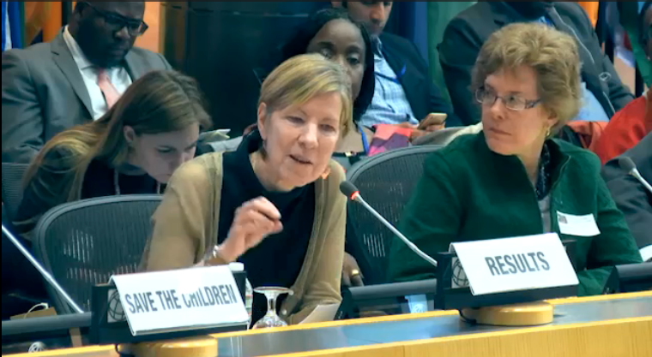
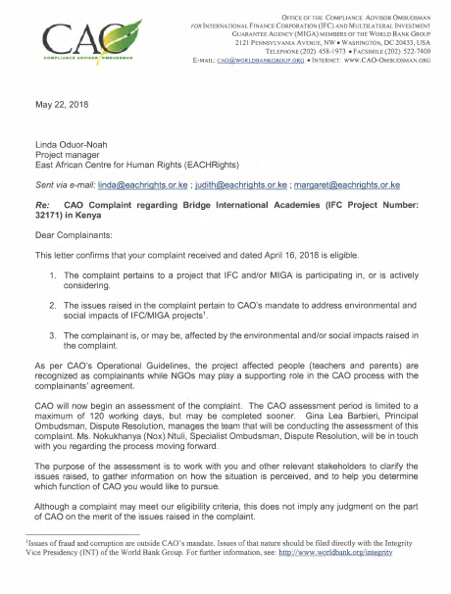
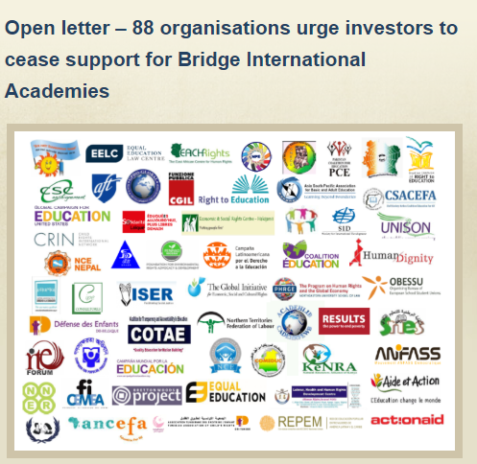
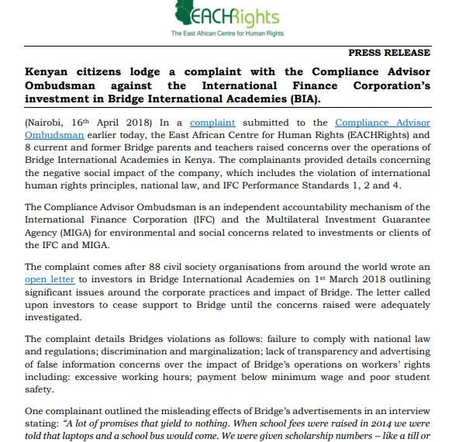
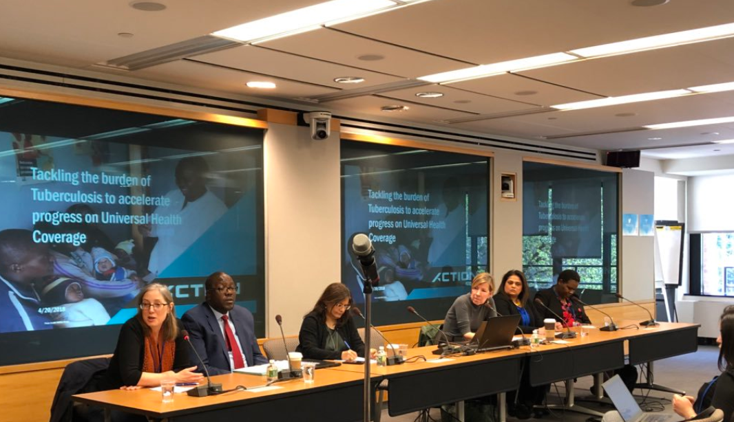
Photo Credit: ACTION/RESULTS

Slide 13
World Bank Discussion

Slide 14
Q & A

Slide 15
Thank you!

Slide 16
Let’s keep the conversation going! Connect with us:
@ACTION_tweets
@RESULTS_Tweets
@ResultsCda
@WACI_Tweets
@WaiteRobyn
#Voices4RESULTS
#YesHealthEquity
#IDAWorks
#InvestInHealth

