Slide 1
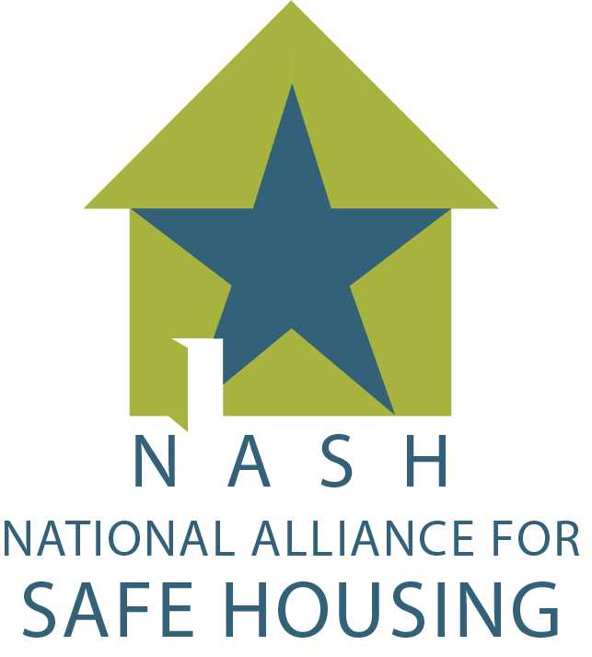
2021 RESULTS Conference: Perspectives on Making the Case for Equitable and Affordable Housing Safe Housing for Survivors of Domestic Violence and Sexual Assault June 13, 2021
Karlo Ng
Director of Legal Initiatives
National Alliance for Safe Housing

Slide 2
National Alliance for Safe Housing
NASH’s mission is to ensure that survivors of domestic and sexual violence have a full range of safe housing options, through improved access, increased resources, and innovative solutions, ultimately catalyzing a safe housing movement.
Our vision is to create a world where safe housing is a human right shared by everyone.
Notes:
NASH provides technical assistance, training, and support to advocates across the country at the intersection of housing, homelessness, DV, and SA. We also work on federal, state, and local policy issues impacting safe housing for survivors of DV and SA.

Slide 3
Why is Safe and Stable Affordable Housing Critical?
Provides security and stability
Promotes good physical and mental health
Where you live determines your life expectancy
Enables employment and education opportunities
Reduces intergenerational poverty and increases economic mobility
Notes:
Stanford economist Raj Chetty found that children who moved to lower poverty neighborhoods saw their earnings as adults increase by approximately 31%, an increased likelihood of living in better neighborhoods as adults, and a lowered likelihood of becoming a single parent. And children living in stable, affordable homes are more likely to thrive in school and have greater opportunities to learn inside and outside the classroom.

Slide 4
Housing and Homelessness in U.S.
History of housing discrimination by federal government
Homelessness among survivors
Domestic violence is the leading cause of homelessness among women.
Many homeless individuals have experienced sexual assault before becoming homeless. Homeless individuals face high risks of sexual assault.
During COVID-19
Increase in domestic violence
More reports of sexual harassment by landlords
Survivor overrepresentation in shelters and underrepresentation in affordable housing
Notes:
Recommend reading Richard Rothstein’s The Color of Law.
U.S. government segregated America. When the federal government in the 1930s saw that there was a housing shortage, they designed a program as part of the New Deal intended to provide housing to white, middle-class and lower-middle class families. Black and other people of color were left out of the new suburban communities and pushed into the urban housing projects. The Federal Housing Administration also refused to insure mortgages in and around Black neighborhoods – policy known as redlining.
Because of this history, the federal government absolutely has a responsibility to address the housing and homelessness crises we are seeing today, especially among people of color and communities of color.
Before COVID-10, the U.S. faced a housing crisis; My co-presenters will talk more in detail about the disproportionate impacts of homelessness and COVID-19 on people of color. Here, I’ll focus on survivors.

Slide 5
What Safe Housing Barriers for Survivors?
Housing discrimination by housing providers
Lack of understanding about DV/SA
Bad or no credit history, criminal records, eviction history
Terminations and evictions because of “criminal activity”, nuisance ordinances
Sexual harassment by landlords
Additional barriers for BIPOC and immigrant survivors
Race, language access, and immigration status restrictions
Lack of affordable housing available
Finding “housing” that is safe and appropriate for survivors and their families.

Slide 6
What are Possible Solutions?
Federal government must monitor compliance
Private and public enforcement of housing protections
Fair housing laws
State and local landlord-tenant laws
Violence Against Women Act (VAWA)
Expanding housing protections
Amending fair housing laws to explicitly include survivors
VAWA 2021
Creating a range of housing assistance options
From crisis housing to permanent affordable housing
Housing assistance for immigrants

Slide 7
HR 1620: VAWA 2021 Housing Title
Protects survivors
from eviction based on criminal actions of perpetrators,
who are excluded from housing assistance or from the lease because of their perpetrators, when there is a family breakup,
from retaliation by housing providers,
right to report crime and emergencies from one's home,
Ensures that survivors can terminate their leases for safety reasons without penalty,
Creates a national pool of emergency transfer vouchers,
Requires trainings for staff of covered housing providers,
Establishes a VAWA Director position at HUD,
Requires federal agencies to ensure housing providers are complying with their VAWA obligations.

Slide 8
Safe Housing is Not One Size Fits All
Crisis response - shelter and transitional housing
Housing assistance must be low barrier and flexible
American Rescue Plan’s emergency vouchers
Limitations to vouchers
Immigration status requirements
Flexible financial assistance
Build more affordable housing targeting certain areas, populations, and providing optional supportive services
Low Income Housing Tax Credit program (federal and state)
Partnerships are key!
Homeownership assistance
Build trust with BIPOC by working with community-based orgs – culturally specific, victim service providers.
Notes:
Vouchers
How will people lease up? (No vacancies in many communities. Not enough housing stock.)
Source of income discrimination
Distrust of government by BIPOC
Flexible financial assistance is in President Biden’s budget

Slide 9
Thank You!
Karlo Ng
Director of Legal Initiatives
National Alliance for Safe Housing
kng@nashta.org
www.nashta.org

