Slide 1
Building a Vibrant Action Network for Greater Influence and Group Growth
RESULTS International Conference 2021

Slide 2
Thanks to CaptionAccess for sponsoring this session.

Slide 3
Welcome! Bienvenidas! ٱلسَّلَامُ عَلَيْكُمْ‎ (As-salamu alaykum) Benvenuta!

Slide 5
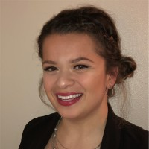
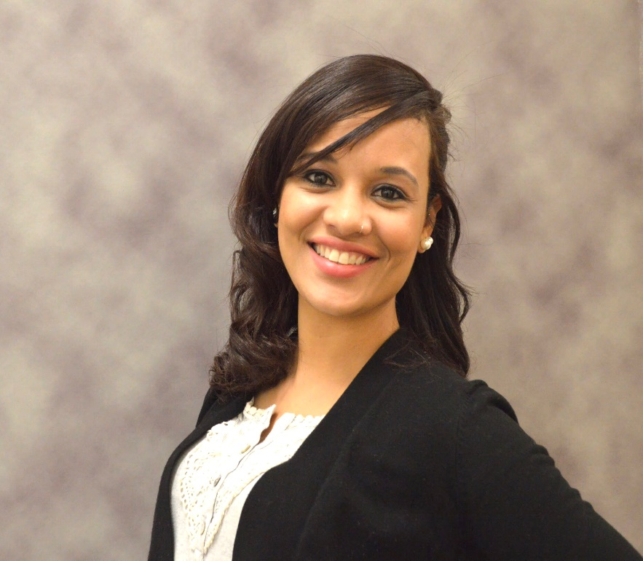
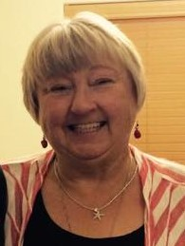
Speakers
Sarah Leone (She/Her)
GRASSROOTS IMPACT ASSOCIATE
RESULTS
Sarah Izabel (She/Her)
NIH - UGSP Research Fellow (OD-NINDS)
National Institute of Neurological Disorders and Stroke (NINDS)
Cheryl Harris
(She/Her)
CO-ACTION NETWORK MANAGER
RESULTS Albuquerque Group

Slide 6
Session Objectives
Participants will be able to:
Build an Action Network and have a decent understanding of how to manage one.
Identify the skills needed to be an Action Network Manager
Inspire people to act and identify new leaders

Slide 7
Terminology!
RESULTS Volunteer – Attends monthly meetings with their RESULTS Advocacy group. They attend meetings with Members of Congress, participate in training webinars, take action on anti-poverty issues. They spend more than a few hours each month advocating.
Action Network Manager (s) — Oversees the email and phone list of people who aren’t in a position to be part of your local group but will write letters, take online actions, sign petitions, write letters to the editor, etc. The Action Network Manager will monitor the list as it grows and let the members know what impact their action has made.
Action Network member — Takes action from the Manager(s) twice or more a month, online and/or over the phone. They do not participate in RESULTS Group meetings and other tasks like the RESULTS Volunteer, unless they take a personal interest.

Slide 8
What keeps you taking action with organizations you’re in touch with?

Slide 9
What is an Action Network?

Slide 10
We provide regular, simple actions to Action Network members.
Not everyone is ready to be a full member of a RESULTS group, so this is an option for them to take meaningful action and get to know RESULTS better.

Slide 11
For our purposes, the Action Network can…
Bolster our relationship-building actions with more transactional actions (taking an online action for example)
Help us find new leadership among the network of action takers.
Help grow your RESULTS group with a dedicated Action Network manager

Slide 12
Who facilitates the Action Network?

Slide 13
Action Network Member
Grassroots Impact Team Associate
Action Network Manager(s)
Personally, informs Manager(s) if they took an online action
Provides Action Alert and informs members of the impact their advocacy has had!
Provides Action Alert to Managers to forward to members, informing Manager(s) if their members have taken action, and sends any
news about the impact of previous actions, and

Slide 14
How do we keep Action Network members engaged each month?

Slide 15
Tips & Tricks
Leverage “Track & Resend”
Send emails earlier in the week
Send emails between 11am-4pm
Keep emails under 250 words
Include 1-2 Action Links At Most
Link to your Action earlier in the email

Slide 16
How do we identify and build leadership among Action Network members?

Slide 17
What’s the First step to creating an Action Network?

Slide 18
What’s the Second step in creating an Action Network?

Slide 19
What's the Third step in creating an Action Network?

Slide 20
What’s it like to be an Action Network Manager? Let’s hear from some!

Slide 21
Questions?

Slide 22
If you were meeting a friend for coffee after this training to talk about Action Networks (or have a Facetime call), what would you say?

Slide 23
Action Network Resources
Training Webinars:
How to Build Your Action Network 101 -- March 31st, 2021
Action Network Monthly Webinars:
RESULTS Action Network Monthly Webinar - April 15th, 2021
RESULTS Action Network Monthly Webinar – May 19th, 2021
Notes from May Webinar (would recommend taking a look at this)
Additional Action Network resources:
Sample Excel Spreadsheet for Member List
Role-Playing Activity (Identifying Action Network Managers)
Grassroots Roles
Supporting New Advocates to Grow

Slide 24
Please contact me for questions, comments or additional support:
Sarah Leone, BSW RESULTS Grassroots Impact Team
sleone@results.org

