Slide 1
Overview of Housing and Racial Wealth Equity
RESULTS Advocates Participate in Housing Week of Action

Slide 2
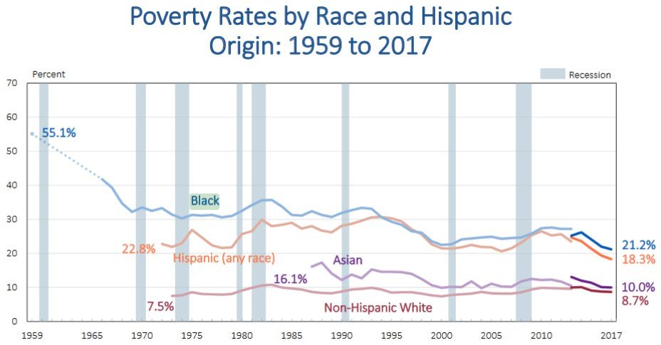
2
Poverty: Huge Disparities by Race
Source: United States Census Bureau
Notes:
Households of color are still twice as likely to live below the poverty line and earn the lowest wages. #RacialEquity in policies are needed.
EPI Economist and Director of the Program on Race, Ethnicity, and the Economy Valerie Wilson. “In 2015 and 2016, income growth was stronger for black and Hispanic households than for white households, but that trend has not continued. Today’s release shows that while in 2017, growth in Hispanic median household income continued to outpace that of white non-Hispanics, resulting in a slight narrowing of the Hispanic-white income gap, income growth stalled for median black households, reversing recent progress in closing the black-white income gap.”

Slide 3
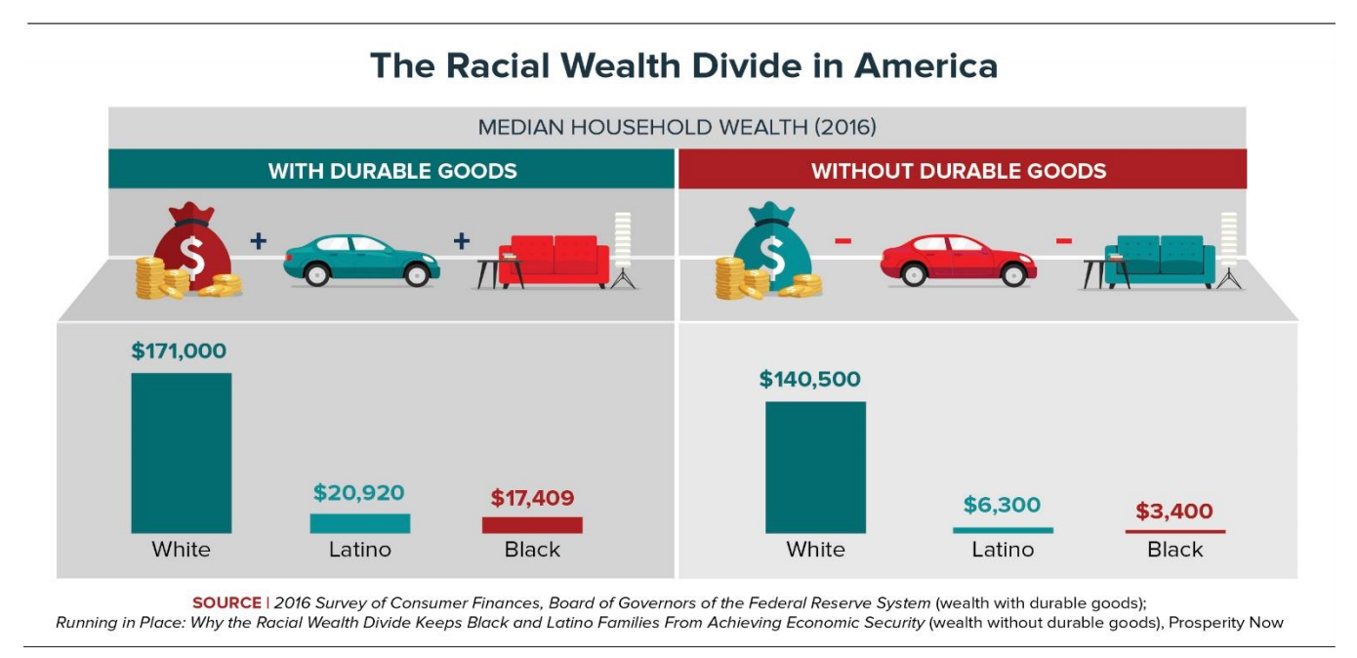
Racial Wealth Inequality
- “Wealth Building for the Wealthy through the Tax Code Continues as Families of Color Fall Farther Behind.” Prosperity Now
Notes:
When families have more wealth they are better able to weather financial storms and stay out of poverty. Yet, people of color in the US do not have even close to the wealth of white families.
https://prosperitynow.org/sites/default/files/resources/ITEP-Prosperity_Now-Race_Wealth_and_Taxes-FULL%20REPORT-FINAL_6.pdf

Slide 4
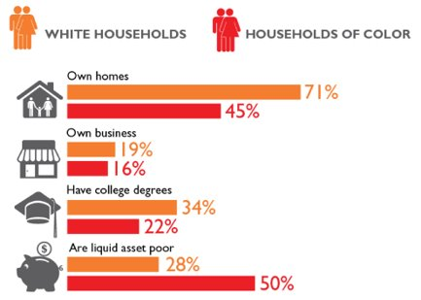
Race and Assets
In 2016, the median wealth for white families was 10 times greater than black families’ wealth and 8 times greater than Hispanic families’ wealth.
- Urban Institute, "Nine Charts About Wealth Inequality in America."
Notes:
Wealth is unequal especially along racial lines and across several measures of wealth such as homeownership and liquid assets. Housing is seen as one of the primary drivers of the wealth divide

Slide 5
The History Behind Racial Wealth Inequality
1865
Land Reversals (1865) and Land Seizures (1865-Present Day)
1933
Public Works Administration
1934
National Housing Act
1934
Federal Housing Administration
1935
Social Security Act
1938
Fair Labor Standards Act
1944
G.I. Bill
1955
Urban Renewal Projects
1970s-Present
Subprime Loans (1970s-Present Day)
1971-Present
"War on Drugs" (1971-Present Day)
1530s-1865
Forced Removal of Native Americans and Slavery in North America
2005-09
Housing Bubble and Great Recession
Adapted from Bread For the World Racial Wealth Gap Simulation Policy Packet
Notes:
Each of these policies played a role in contributing to and exacerbating racial wealth inequality through:
Forced removal and slavery: https://www.smithsonianmag.com/history/misguided-focus-1619-beginning-slavery-us-damages-our-understanding-american-history-180964873/
Stripping wealth building resources- land reversals/land seizures
Instituting homeownership discrimination/residential segregation – PWA, NHA, FHA, G.I. Bill essentially subsidized homeownership and movement into the suburbs primarily for white Americans, especially in the post-war era
Barring or limiting economic opportunity and financial security – SSA, FLSA, Subprime Loans
Displacing or disrupting communities of color – Urban renewal projects, War on drugs, housing bubble and foreclosures - Black median net worth decreased 61 percent from 2005 to 2009. Whites, in contrast, lost 21 percent of their wealth (US Census Data).

Slide 6
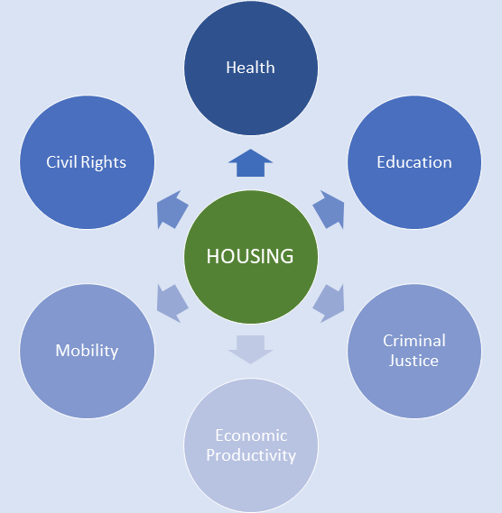
Why is Housing Important?
Housing is a major source of wealth for many middle-class Americans and remains a common path to wealth building
Where you live has implications for health, education, job access and security outcomes that all affect overall economic well being
The history of housing policy in the U.S. has been one where federal policies provided white Americans opportunities to build wealth while excluding Americans of color, particularly Blacks, from doing the same
- Opportunity Starts at Home Campaign
Notes:
Why is RESULTS taking this on?
Why these specific portions of Housing Policy?
How does this relate to broader racial justice and economic justice work in America
How will this campaign grow over the next 2 years?
Not only is housing a common form of wealth, it’s a reflection of wealth, and it is also linked to other factors that indirectly affect wealth such as quality education, economic activity and health

Slide 7
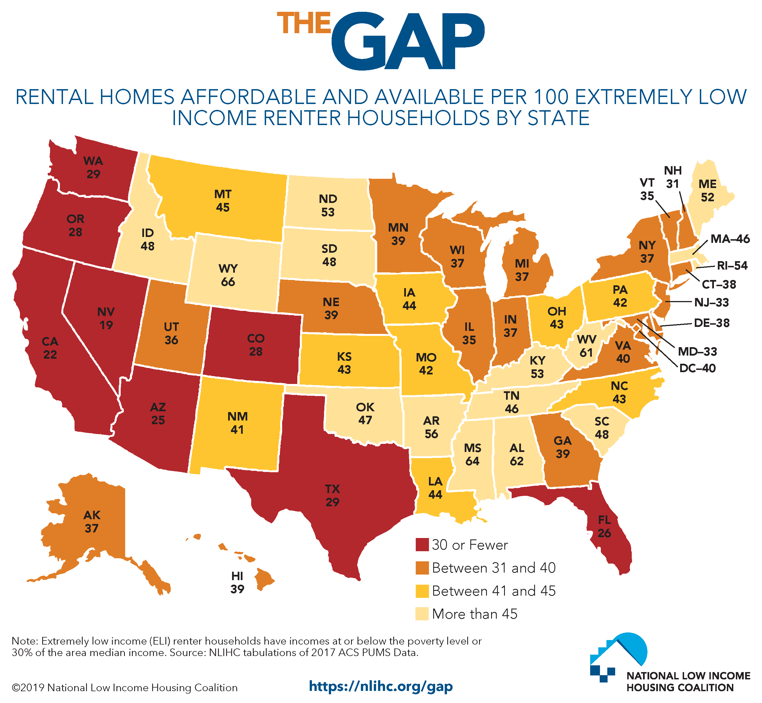
Affordable Housing Crisis
Notes:
Further, research shows that there is no state in the U.S. where a person making the prevailing minimum wage ($7.25/hour) can afford to buy a two bedroom on average. This graph shows the number of affordable and available rental homes in the by state. Dig into the data here https://nlihc.org/gap

Slide 8
Affordable Housing Crisis
72.5% of extremely low-income renters are severely cost burdened, meaning they spend more than half their income on housing
Since 1960, renter's incomes have gone up by 5% while rental cost has gone up by 61%.
Notes:
This shows that there are only 37 affordable and available rental homes for extremely low income renters nation-wide. Dig into the data here https://nlihc.org/gap
A few quick definitions:
Area Median Income (AMI) is the median family incomes in the metropolitan or nonmetropolitan area
An extremely low income renter is a households with incomes at or below the Poverty Guideline or 30% of AMI, whichever is higher. The AMI is calculated by location, to find your home's AMI go to your local HUD website.
(ex: for a family of 3 the federal poverty line is $21,330 but in LA county the Area Median Income is much higher so extremely low income is defined as a household of 3 making $28,220 which is higher than the poverty line)

Slide 9
Public Support for Housing Is Growing
-Opportunity Starts at Home Campaign
Notes:
The following slides show what public support looks like for housing.
https://www.opportunityhome.org/wp-content/uploads/2019/03/Full-Report-PPT-NoEM.pdf

Slide 10
Public Support for Governmental Action
-Opportunity Starts at Home Campaign
Notes:
https://www.opportunityhome.org/wp-content/uploads/2019/03/Full-Report-PPT-NoEM.pdf

Slide 11
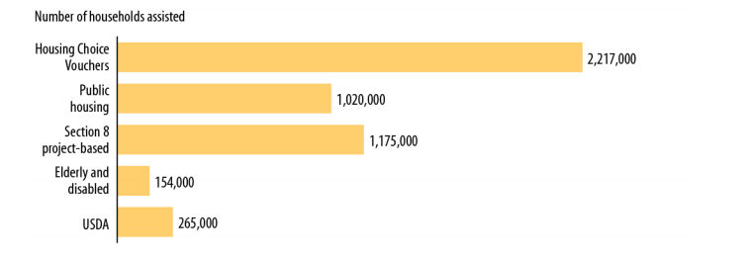
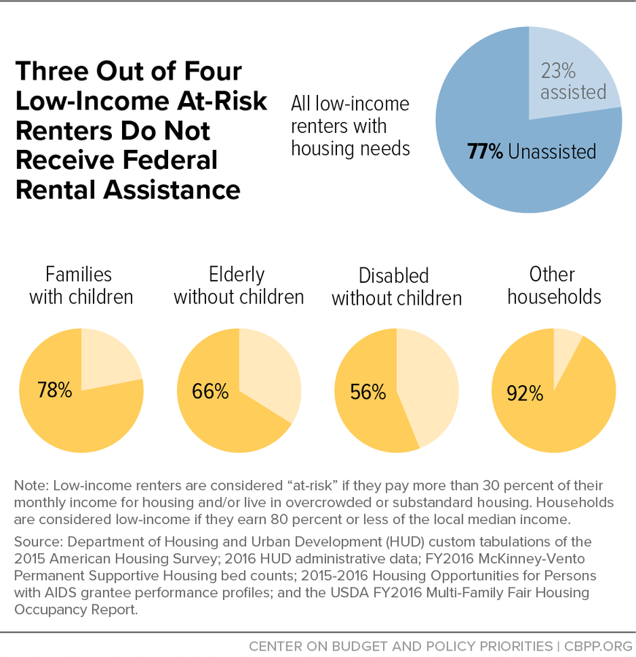
Major Federal Rental Assistance Programs
Housing assistance programs lifted 2.9 million people above the federal poverty line in 2017
But only one in four who need assistance receive it
Notes:
Luckily, we have housing assistance programs that help people with lower-incomes afford housing. The programs include: Housing Choice Vouchers, Public Housing, Section 8 Project Based Housing, and more. This chart shows the number of Households that are assisted by federal housing programs.
-Center on Budget and Policy Priorities: Graphic on 3 in 4 low income renters do not receive assistance
Housing assistance programs lifted 2.9 million people above the federal poverty line in 2017 Source: United States Census Bureau

Slide 12
One Solution: Renters Tax Credits
Notes:
More: https://nlihc.org/sites/default/files/Factsheet_08022018.pdf and
S. 3250: Rent Relief Act of 2018 (Sen. Kamala Harris) | 115th Congress (2017-2018)
S 3342: Housing, Opportunity, Mobility, and Equity Act of 2018 (Sen Cory Booker) | 115th Congress (2017-2018)
H.R. 5793: Housing Choice Voucher Mobility Demonstration Act of 2018 | 115th Congress (2017-2018)
Also:
H.R. 7050: Housing, Opportunity, Mobility, and Equity Act of 2018 (Rep. Clyburn) | 115th Congress (2017-2018)
S. 2945: Housing Choice Voucher Mobility Demonstration Act of 2018 | 115th Congress (2017-2018)
Related: CBPP proprosal: https://www.cbpp.org/new-federal-renters-credit-proposal The CBPP has, in the past, supported (and still does support) renter’s credits that states could give directly to tenants, but the project-based approach outlined in this recent report has the advantage of being much easier to administer and so “a good starting point for rebalancing federal housing tax policy.”
In 2016, the University of California, Berkeley’s Terner Center for Housing Innovation issued a report presenting three renters’ tax credit options. One of these would provide an entitlement, tenant-claimed credit sufficient to reduce all renters’ housing costs to 30% of their incomes, at an estimated cost of $76 billion per year. The second would provide a shallower tenant-claimed entitlement credit at an annual cost of $41 billion. The third is a “composite option” that would include a $5 billion capped, owner-claimed credit for extremely low-income families similar to that proposed by CBPP, and a smaller tenant-claimed credit for other renters costing $38 billion. The idea of a federal renters’ credit has received growing attention in recent years. The Bipartisan Policy Center, Center for American Progress, Urban Institute, Enterprise Community Partners, Center for Global Policy Solutions, Mortgage Bankers Association, and others have highlighted a renters’ credit as a promising strategy to address poverty, homelessness, and high rent burdens. In addition, legislation to establish a capped, state-administered renters’ credit has been introduced in the last two sessions of Congress: Representative Charles Rangel (D-NY) introduced the Renters Tax Credit Act in 2014; and Representative Barbara Lee (D-CA) included a renters’ credit in the Pathways Out of Poverty Act she introduced in 2014 and again in 2015.

Slide 13
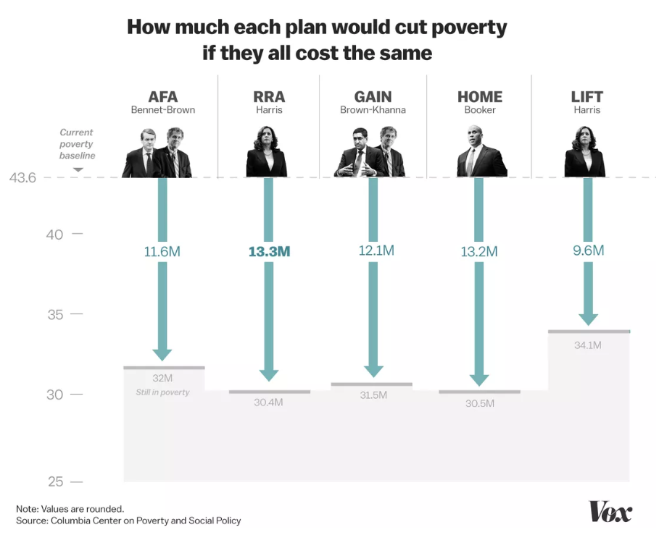
Expand Affordable Rental Housing via Tax Credits
We must address this housing crisis -- and we can begin to do so by shifting tax resources to support a “Renters Tax Credit” for low- and moderate-income renters. Several policymakers have introduced legislation that does this (H.R. 2169 and S. 1106, H.R. 7050 and S. 3342 in the last Congress).
TAKE ACTION: https://tinyurl.com/RESULTShousing
Notes:
From Vox: https://www.vox.com/future-perfect/2019/1/30/18183769/democrat-poverty-plans-2020-presidential-kamala-harris-booker-gillibrand.
We must address this housing crisis -- and we can begin to do so by shifting tax resources to support a “Renters Tax Credit” for low- and moderate-income renters. Several policymakers have introduced legislation that does this (H.R. 2169 and S. 1106, H.R. 7050 and S. 3342 in the last Congress).
More: https://nlihc.org/sites/default/files/Factsheet_08022018.pdf and
S. 3250: Rent Relief Act of 2018 (Sen. Kamala Harris) | 115th Congress (2017-2018)
S 3342: Housing, Opportunity, Mobility, and Equity Act of 2018 (Sen Cory Booker) | 115th Congress (2017-2018)
H.R. 5793: Housing Choice Voucher Mobility Demonstration Act of 2018 | 115th Congress (2017-2018)
Also:
H.R. 7050: Housing, Opportunity, Mobility, and Equity Act of 2018 (Rep. Clyburn) | 115th Congress (2017-2018)
S. 2945: Housing Choice Voucher Mobility Demonstration Act of 2018 | 115th Congress (2017-2018)
Related: CBPP proprosal: https://www.cbpp.org/new-federal-renters-credit-proposal The CBPP has, in the past, supported (and still does support) renter’s credits that states could give directly to tenants, but the project-based approach outlined in this recent report has the advantage of being much easier to administer and so “a good starting point for rebalancing federal housing tax policy.”
In 2016, the University of California, Berkeley’s Terner Center for Housing Innovation issued a report presenting three renters’ tax credit options. One of these would provide an entitlement, tenant-claimed credit sufficient to reduce all renters’ housing costs to 30% of their incomes, at an estimated cost of $76 billion per year. The second would provide a shallower tenant-claimed entitlement credit at an annual cost of $41 billion. The third is a “composite option” that would include a $5 billion capped, owner-claimed credit for extremely low-income families similar to that proposed by CBPP, and a smaller tenant-claimed credit for other renters costing $38 billion. The idea of a federal renters’ credit has received growing attention in recent years. The Bipartisan Policy Center, Center for American Progress, Urban Institute, Enterprise Community Partners, Center for Global Policy Solutions, Mortgage Bankers Association, and others have highlighted a renters’ credit as a promising strategy to address poverty, homelessness, and high rent burdens. In addition, legislation to establish a capped, state-administered renters’ credit has been introduced in the last two sessions of Congress: Representative Charles Rangel (D-NY) introduced the Renters Tax Credit Act in 2014; and Representative Barbara Lee (D-CA) included a renters’ credit in the Pathways Out of Poverty Act she introduced in 2014 and again in 2015.

Slide 14
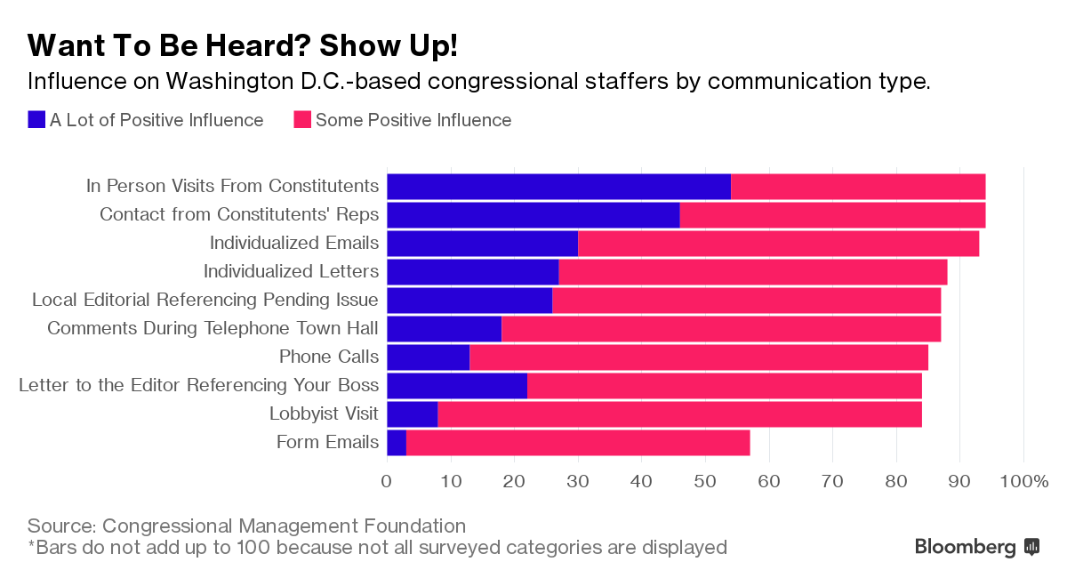
Advocacy Works!
14

