Slide 1
January 13, 2022

Slide 2
Welcome everyone!
Please introduce yourself in the chat!
Name and pronouns
Location
Country of Service in the Peace Corps

Slide 3
Our Anti-Oppression Values
3
​RESULTS is a movement of passionate, committed everyday people. Together we use our voices to influence political decisions that will bring an end to poverty. Poverty cannot end as long as oppression exists. We commit to opposing all forms of oppression, including ableism, ageism, biphobia, classism, colonialism, homophobia, racism, religious discrimination, sexism, transphobia, white saviorism, and xenophobia.
At RESULTS we pledge to create space for all voices, including those of us who are currently experiencing poverty. We will address oppressive behavior in our interactions, families, communities, work, and world. Our strength is rooted in our diversity of experiences, not in our assumptions.
With unearned privilege comes the responsibility to act so the burden to educate and change doesn’t fall solely on those experiencing oppression. When we miss the mark on our values, we will acknowledge our mistake, seek forgiveness, learn, and work together as a community to pursue equity.
There are no saviors — only partners, advocates, and allies. We agree to help make the RESULTS movement a respectful, inclusive space.
Find all our anti-oppression resources at: https://results.org/volunteers/anti-oppression/
Notes:
Play video – link: https://youtu.be/M_f-svFMTzo

Slide 4
Tonight’s Webinar
Welcome and Introductions
Speaker: John Fawcett, VP Policy & Advocacy, RESULTS
Deep dive on global nutrition
Advocacy actions
Upcoming events
Notes:
Karyne - intro 5 mins

Slide 5
2022 Global Policy Priorities
Pandemic response
Appropriations
Nutrition Legislation
Global Fund Replenishment
Notes:
Karyne - Future Global Advocacy campaigns will involved pandemic response, appropriations for education, nutrition and eradicating TB, nutrition legislation that we will hear more about tonight, and Global Fund replenishment

Slide 6
Issue Deep Dive: Global Nutrition

Slide 7
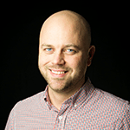
John Fawcett VP, Policy & Advocacy RESULTS
Notes:
John - 20 mins presentation + 5 mins Q&A

Slide 8
Notes:
Do we keep these slides?

Slide 9
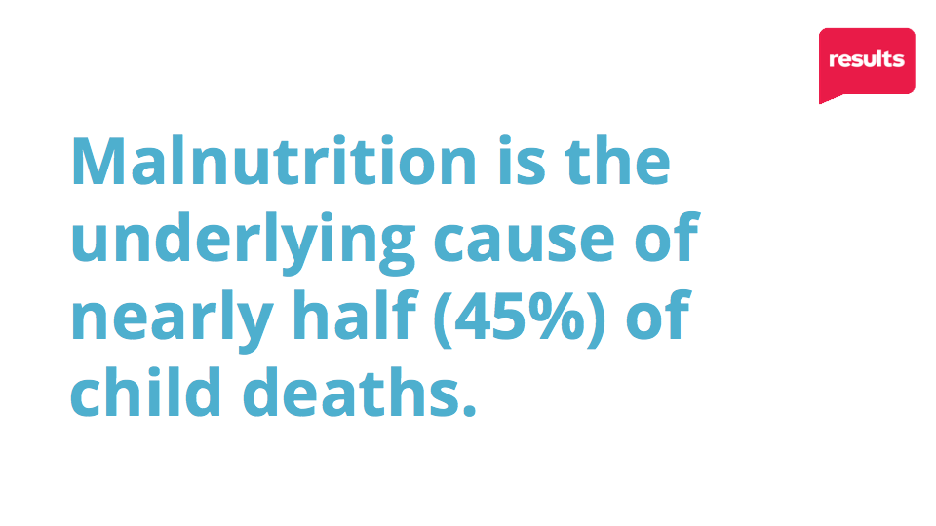
Notes:
5.2 million under 5, preventable deaths. 2 million from malnutrition

Slide 10
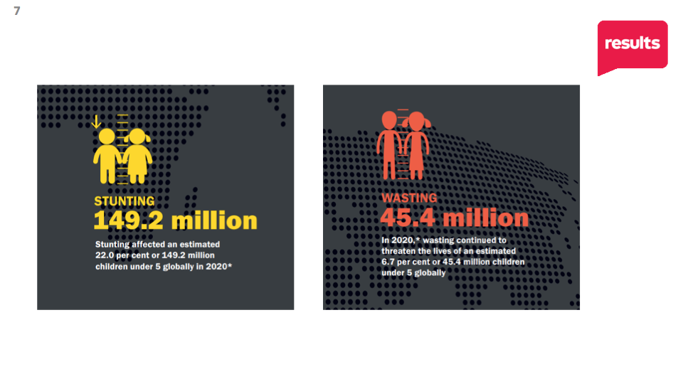

Slide 13
2021 Global Policy Priority
Malnutrition is a fixable crisis Ask your member of Congress to cosponsor S.2956/H.R.4693
Notes:
Ken - 20 mins, advocacy action
If time permits, let’s take a quick action together
Linked to campaign- Malnutrition is a fixable crisis https://results.org/volunteers/action-center/action-alerts/?vvsrc=%2fCampaigns

Slide 14
Next Steps
Take action with us on ending malnutrition, then share with your network.
Stay connected with GAP for upcoming trainings and actions.
Join us for additional actions on global malnutrition: Next meeting - February 10 at 8:30pm ET

Slide 15
Deepening Our Action
December: Learned laser talk on global nutrition, made calls to our members of Congress to cosponsor S.2956 & HR4693.
Find recording here: https://results.org/volunteers/training-webinars/
January: Take deeper action: reach out directly to the Foreign Policy aides for our Rep. and Senators, start building a relationship, follow up until we get an answer.

Slide 16
Deepening Our Action
Check the cosponsor list on www.Congress.gov
Look up the staff for members of Congress on Legislator Lookup: https://results.org/volunteers/legislator-lookup/ or get support from GAP staff (Karyne and Ken)
Craft your message and request to the foreign policy aides by combining your conconcerns, experience around the issue and RESULTS’ global nutrition laser talk in the RESULTS Action Center. Include one-page summary: https://results.org/?post_type=attachment&p=112372

Slide 17
Deepening Our Action
Email formula for reaching congressional staff:
Senate: firstname_lastname@SenatorLastName.senate.gov
House: firstname.lastname@mail.house.gov

Slide 18
Building a Relationship
What works in developing a relationship with someone?

Slide 19
Building an Effective Relationship
Communicate directly with the aide via email, phone, Zoom. Always be respectful and friendly.
Ask for a phone conversation in your email.
Make your communication personal–share a bit about yourself, ask questions, learn about the aide.
Don’t let a lack of response deter you–it is their job to related to constituents. Help them do their job.
Share additional information, videos, articles to reinforce your conversation.
Get to yes or no answers on your requests.

Slide 20
Building an Effective Relationship
Let’s write our messages and share them

Slide 22
Upcoming Events
January 25, 2022 - 8:30pm ET “At the intersection of climate change, health, and poverty”
Speaker: Dr. Cheryl Holder Associate Professor, and Associate Dean for Diversity, Equity, Inclusivity, and Community Initiatives at Florida International University, and Co-Chair, Florida Medical Society Consortium on Climate Change and Health
Notes:
RSVP: https://results.zoom.us/meeting/register/tJwtde6hqjwsGtwwYumEcUHmArRmahFcmdvo

