Slide 1
December 9, 2021

Slide 2
Welcome everyone!
Please introduce yourself in the chat!
Name and pronouns
Location
Country of Service in the Peace Corps

Slide 3
Our Anti-Oppression Values
3
​RESULTS is a movement of passionate, committed everyday people. Together we use our voices to influence political decisions that will bring an end to poverty. Poverty cannot end as long as oppression exists. We commit to opposing all forms of oppression, including ableism, ageism, biphobia, classism, colonialism, homophobia, racism, religious discrimination, sexism, transphobia, white saviorism, and xenophobia.
At RESULTS we pledge to create space for all voices, including those of us who are currently experiencing poverty. We will address oppressive behavior in our interactions, families, communities, work, and world. Our strength is rooted in our diversity of experiences, not in our assumptions.
With unearned privilege comes the responsibility to act so the burden to educate and change doesn’t fall solely on those experiencing oppression. When we miss the mark on our values, we will acknowledge our mistake, seek forgiveness, learn, and work together as a community to pursue equity.
There are no saviors — only partners, advocates, and allies. We agree to help make the RESULTS movement a respectful, inclusive space.
Find all our anti-oppression resources at: https://results.org/volunteers/anti-oppression/

Slide 4
Tonight’s Webinar
Welcome and Introductions
Update on Global Malnutrition Prevention and Treatment Act of 2021(S. 2956/ H.R. 4693)
Training: EPIC Laser Talk
Upcoming events in January 2022

Slide 5
2021-22 Global Policy Priorities
Pandemic response
Education
Nutrition
Tuberculosis
Notes:
Future Global Advocacy campaigns will involved pandemic response, education, nutrition and eradicating TB

Slide 6
Update: Global Nutrition Campaign

Slide 7
The true cost of childhood malnutrition, Hagirso’s Story
Notes:
https://ccga.ccgclients.com/hagirso/?fbclid=IwAR1KtNGi11nOYXK5NHDJYNRR3fbdPMeiRpPG5GBrfHBcwYvY6IXqH24_E9A

Slide 9
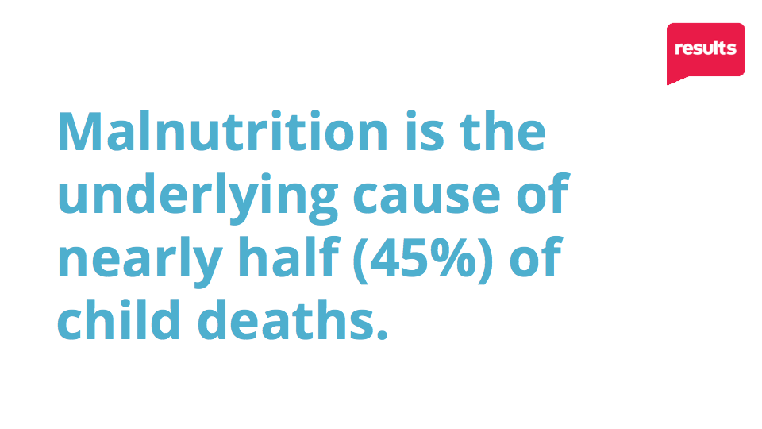
Notes:
5.2 million under 5, preventable deaths. 2 million from malnutrition

Slide 10
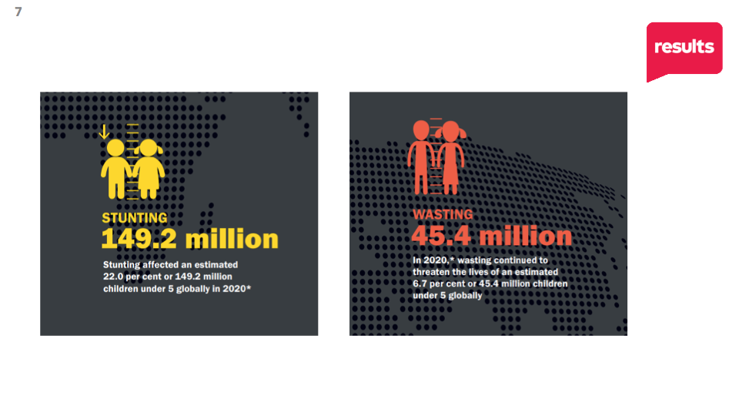

Slide 13
Global Nutrition Campaign
Global Malnutrition Prevention and Treatment Act of 2021 - introduced on 10/8/2021: “To advance targeted, high-impact, and evidence-based interventions for the prevention and treatment of global malnutrition, to improve the coordination of such programs, and for other purposes.”
Senator Coons: “COVID-19 has further underscored the need for continued U.S. leadership in addressing access to nutritious food around the world.”
Senator Wicker: “Malnutrition is one of the world’s greatest burdens on public health. It affects millions of people per year, especially pregnant women and children under five.”
Notes:
Sen Coons: https://www.coons.senate.gov/news/press-releases/sens-coons-wicker-kaine-boozman-introduce-legislation-to-address-global-malnutrition

Slide 14
Global Nutrition Campaign
The Global Malnutrition Prevention and Treatment Act:
Establishes clear goals for increasing coverage of high-impact, evidence-based interventions in priority countries;
Prioritizes the most vulnerable by targeting interventions to underserved, marginalized, or impoverished communities, including children under 5 and pregnant and breastfeeding women.
Directs the USAID administrator to select priority countries that would receive prioritized nutrition assistance;
Notes:
Sen Coons: https://www.coons.senate.gov/news/press-releases/sens-coons-wicker-kaine-boozman-introduce-legislation-to-address-global-malnutrition

Slide 15
Global Nutrition Campaign
The Global Malnutrition Prevention and Treatment Act:
Establishes the Nutrition Leadership Council to coordinate USAID’s efforts on preventing and treating malnutrition, with representatives from relevant inter- and intra-agency offices;
Prioritizes country leadership and country-specific implementation plans, including building capacity of local and community-based organizations and increasing the use of context and country-appropriate fortified staple foods.
Requires USAID to submit an annual report to Congress on the progress made towards preventing and treating global malnutrition.
Notes:
Sen Coons: https://www.coons.senate.gov/news/press-releases/sens-coons-wicker-kaine-boozman-introduce-legislation-to-address-global-malnutrition

Slide 16
Global Nutrition Campaign
House Companion Bill (7/26/2021) - McCaul, Meeks, Kim, Houlahan Introduce the Global Malnutrition Prevention and Treatment Act of 2021
Will authorize USAID to advance targeted interventions to prevent and treat malnutrition around the world,
Ensure a continued focus on multi-sectoral nutrition programs, and
Require robust monitoring of these interventions to ensure effective use of taxpayer dollars.
Notes:
House Companion Bill: https://gop-foreignaffairs.house.gov/press-release/mccaul-meeks-kim-houlahan-introduce-the-global-malnutrition-prevention-and-treatment-act-of-2021/

Slide 17
2021 Global Policy Priority
Malnutrition is a fixable crisis Ask your member of Congress to cosponsor S.2956/H.R.4693
Notes:
If time permits, let’s take a quick action together
Linked to campaign- Malnutrition is a fixable crisis https://results.org/volunteers/action-center/action-alerts/?vvsrc=%2fCampaigns

Slide 18
Global Malnutrition Prevention: EPIC Laser Talk
Notes:
https://results.org/resources/2021-global-poverty-laser-talk/
EPIC on Global Nutrition Printable versions: Word/PDF

Slide 19
Global Malnutrition Prevention: EPIC Laser Talk
Engage: No matter where they live, all children deserve a strong start in life. Shockingly, even before the COVID-19 crisis, malnutrition was an underlying cause of almost half of all preventable deaths of children under age 5.
Notes:
https://results.org/resources/2021-global-poverty-laser-talk/
EPIC on Global Nutrition Printable versions: Word/PDF

Slide 20
Global Malnutrition Prevention: EPIC Laser Talk
State Problem: Because of COVID-19, it’s predicted that 168,000 more young children could die over the next two years of malnutrition if we don’t act. That’s an additional 250 children per day dying needlessly.
Notes:
https://results.org/resources/2021-global-poverty-laser-talk/
EPIC on Global Nutrition Printable versions: Word/PDF

Slide 21
Global Malnutrition Prevention: EPIC Laser Talk
Inform: Fortunately, Congress has introduced a bipartisan bill, the Global Malnutrition Prevention and Treatment Act (S.2956/H.R.4693) that calls for a coordinated USAID strategy, clear targets, and solid interventions so that assistance reaches the most impoverished children.
Notes:
https://results.org/resources/2021-global-poverty-laser-talk/
EPIC on Global Nutrition Printable versions: Word/PDF

Slide 22
Global Malnutrition Prevention: EPIC Laser Talk
Call to Action: Children should not just survive; they should thrive. Will you cosponsor the Global Malnutrition Prevention and Treatment Act? I would be happy to provide any additional information your office might need.
Notes:
https://results.org/resources/2021-global-poverty-laser-talk/
EPIC on Global Nutrition Printable versions: Word/PDF

Slide 23
Q&A

Slide 24
In 2022…
Stay connected with GAP for upcoming trainings and actions.
Take action with us on ending malnutrition, then share with your network.
Join us for additional actions on global malnutrition: Next meeting - January 13 at 8:30pm ET

Slide 25
Upcoming Events
January 25, 2022 - 8:30pm ET “At the intersection of climate change, health, and poverty” Global Allies Program in partnership with RPCVs4EA
Speaker: Dr. Cheryl Holder, Co-Chair, Florida Medical Society Consortium on Climate Change and Health Associate Professor, and Associate Dean for Diversity, Equity, Inclusivity, and Community Initiatives at Florida International University
Notes:
RSVP: https://results.zoom.us/meeting/register/tJwtde6hqjwsGtwwYumEcUHmArRmahFcmdvo

Slide 26
Happy Winter Break!

