Slide 1
May 12, 2022

Slide 2
Our Anti-Oppression Values
2
​RESULTS is a movement of passionate, committed everyday people. Together we use our voices to influence political decisions that will bring an end to poverty. Poverty cannot end as long as oppression exists. We commit to opposing all forms of oppression, including ableism, ageism, biphobia, classism, colonialism, homophobia, racism, religious discrimination, sexism, transphobia, white saviorism, and xenophobia.
At RESULTS we pledge to create space for all voices, including those of us who are currently experiencing poverty. We will address oppressive behavior in our interactions, families, communities, work, and world. Our strength is rooted in our diversity of experiences, not in our assumptions.
With unearned privilege comes the responsibility to act so the burden to educate and change doesn’t fall solely on those experiencing oppression. When we miss the mark on our values, we will acknowledge our mistake, seek forgiveness, learn, and work together as a community to pursue equity.
There are no saviors — only partners, advocates, and allies. We agree to help make the RESULTS movement a respectful, inclusive space.
Find all our anti-oppression resources at: https://results.org/volunteers/anti-oppression/
Notes:
Play video – link: https://youtu.be/M_f-svFMTzo

Slide 3
Tonight’s Webinar
Welcome and Introductions
Celebrations
Senators, show us the money! Update on FY23 appropriations process
May Advocacy Action
Notes:
Overview of the agenda

Slide 4
Celebrations!

Slide 5
Celebrations!
House FY23 Dear Colleague Letters:
Maternal and Child Health Nutrition: 178 signers (FY22 117/135)
Global Fund to Fight AIDS, TB and Malaria: 149 signers (FY22 111)
Global Tuberculosis: 120 signers (FY22 107)

Slide 6
Celebrations!
Global Malnutrition Prevention and Treatment act (H.R. 4693) passed the House! Bipartisan Effort: 220 Democrats, 164 Republicans

Slide 7
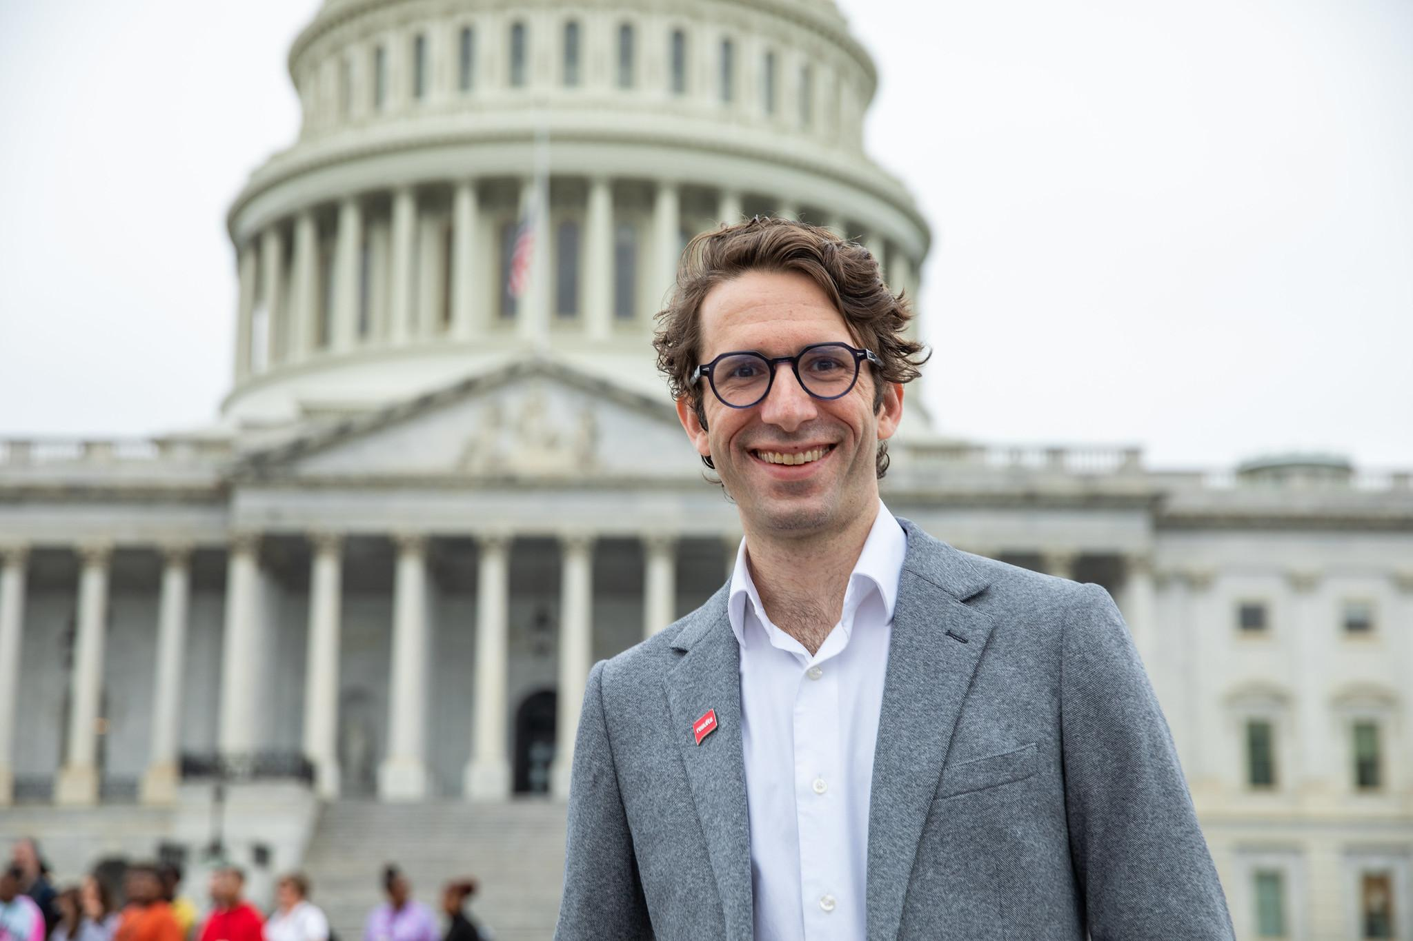
Celebrations!

Slide 8
Show us the Money! Deep Dive on Appropriations
Notes:
Karyne - Overview of GF

Slide 10
Appropriations vs. Authorization
Annual
🡳
Funds Programs
🡳
Sept. 30th/Oct. 1st Fiscal Year
Multiple years
🡳
Expands and Creates Programs
🡳
Needs To Be Reauthorized

Slide 11
Recent History of RESULTS Work on Appropriations
 | FY20 | FY21 | President’s FY22 Req. | RESULTS FY22 Req. | House FY22/ Senate FY22 | Final FY22 | Change from FY21 to FY22
USAID Tuberculosis | $310 M | $319 M | $319 M | $1 B | $465 M/ $400 M | $371 M | +$51 M
USAID Nutrition | $150 M | $150 M | $150 M | $300 M | $160M/ $160M | $155 M | +$5 M
Global Fund to Fight AIDS, TB, and Malaria | $1.56 B | $1.56 B | $1.56 B | $1.56 B | $1.56 B/ $1.56 B | $1.56 B | No Change

Slide 12
Recent History of RESULTS Work on Appropriations

Slide 13
FY23 Appropriations Requests
 | RESULTS FY23 Appropriations Request
MCH Nutrition | $300 million within USAID Global Health
Global Fund to Fight AIDS, Tuberculosis, and Malaria | At least $2 Billion
Global Tuberculosis | $1 Billion within USAID Global Health

Slide 14
Process Summary
President’s Budget
Congressional Budget Resolution
Appropriations

Slide 15
Appropriations Committee
Uses budget resolution to guide spending levels for 12 sub-committees
Sub-committees gather input on how to spend money (hearings, direct input from Reps/Senators, sign-on letters, conversations)

Slide 16
Appropriations Committee
Every member of Congress can give input on spending preferences to each sub-committee. That input comes from constituents.
RESULTS focuses on requests to the State & Foreign Operations Sub-Committee of Appropriations (SFOPS).

Slide 17
Our Requests
Please include our requests in your input to SFOPS. Use our “appropriations memos” to make the requests.
Please sign on to “Dear Colleague” letters regarding our requests.
Please speak or write to SFOPS leadership

Slide 18
Why These Issues?
Nutrition is a human right and children deserve the opportunity to reach their full potential.
People everywhere, regardless of their wealth, should have access to testing and treatment for diseases we know how to address.
Investing in global health benefits all of us—those who have direct access and the global community.

Slide 19
Senators, Show Us the Money!

Slide 20
Advocacy Action on Appropriations
Write to Senate office and ask them to prioritize global poverty programs in FY23 Appropriations

Slide 21
Summary of RESULTS FY23 Appropriations Requests
Issue | Senate Dear Colleague Letter Deadline
Global Fund to Fight AIDS, Tuberculosis, and Malaria | Friday, May 13
Global Tuberculosis | Tuesday, May 17
Maternal and Child Health Nutrition | TBD

Slide 22
Advocacy Action on Appropriations
Steps:
Review Congressional scorecard
Legislator Lookup: Find foreign policy aide
Personalize your letter and hit send!
Follow up!

Slide 24
Global Allies Program Coaching Support
Sign up for additional coaching support between webinars!
Want some additional support? Join us for our next webinar: June 9 at 8:30pm ET
Notes:
Sign Up - https://results.salsalabs.org/globalalliesprogram

