Slide 1
The Global Fund to Fight AIDS, Tuberculosis and Malaria

Slide 2
Global Fund: Deep Dive
The State of the Epidemics
The Global Fund
How it Works
Why it Works
Results
Replenishment

Slide 3
Tuberculosis
TB is now the leading cause of death from infectious disease, with 1.7 million deaths per year.
Over 10 million people become sick with TB every year, but 4 million people are missed by their health care system every year.

Slide 4
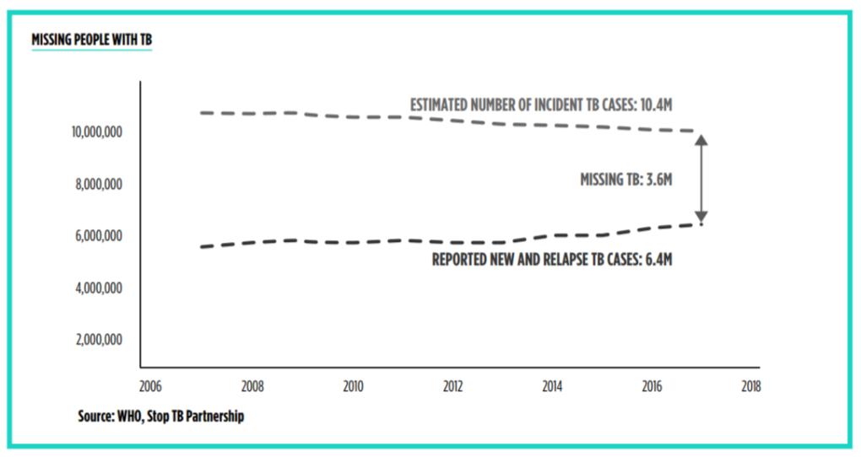

Slide 5
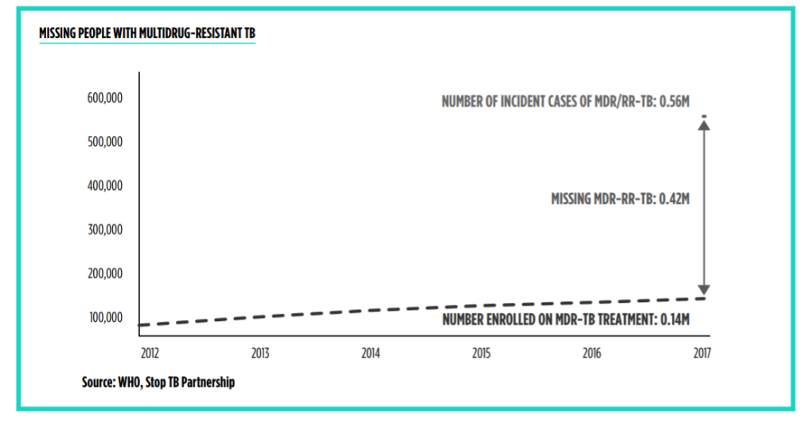

Slide 6
HIV/AIDS
AIDS-related deaths have declined 51% since their peak
2010: 1.4 million
2004: 1.9 million
2017: .94 million

Slide 7
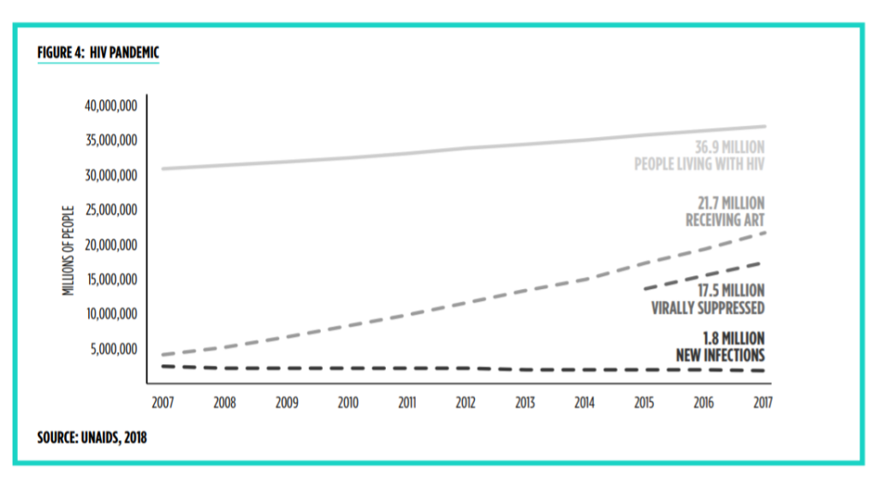

Slide 8
Malaria
Malaria deaths have dropped 60% globally since 2000.
219 million cases annually.
435,000 deaths annually, 95% in sub-Saharan Africa.

Slide 9
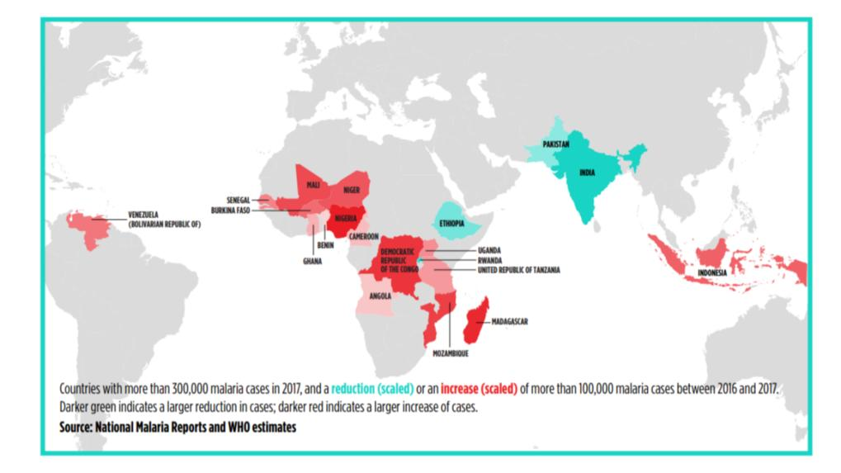

Slide 10
Key Challenges
Drug and insecticide resistance
Marginalized populations
Donor complacence

Slide 11
How it Works
Raise money (replenishment)
Develop proposals (Country Coordinating Mechanism)
Review proposals (Technical Review Panel)
Implement!
Monitor (Local Fund Agent, Office of Inspector General)

Slide 12
Why it Works
Participatory Governance
Board
Country Coordinating Mechanism
Pooled Procurement
2017 savings: $205 million
5-year savings: $855 million
Leverage
41% increase in implementing country commitments
U.S. matched 2:1 from other donors

Slide 13
Results
More than 27 million lives have been saved since 2002
In 2017 alone, countries supported by the Global Fund provided:
HIV antiretroviral therapy for 17.5 million people
TB treatment for 5 million people
200 million insecticide-treated bed nets were distributed to prevent malaria.

Slide 14
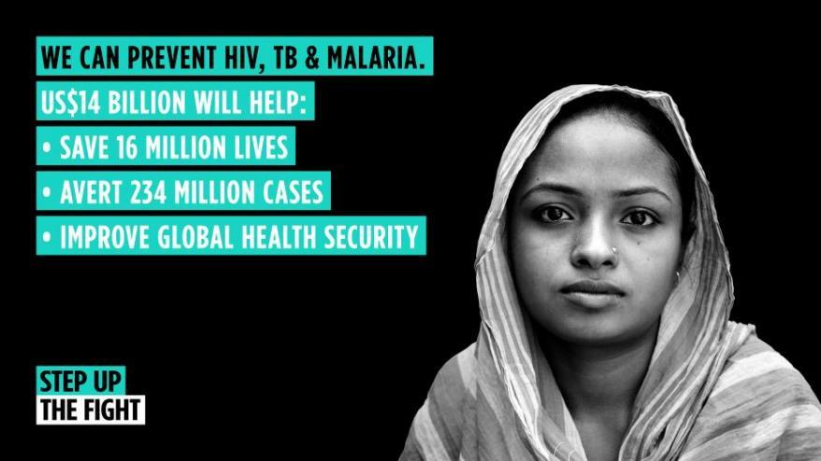
Replenishment

Slide 15
Replenishment
Objective: U.S. provide one-third, or at least $4.67 billion, over three years
Strategy:
Build support within Congress
Generate politically-relevant media
Engage the Administration

Slide 16
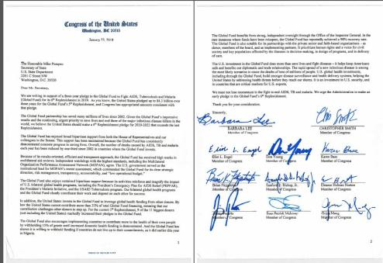
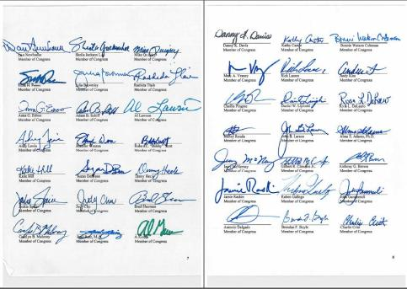
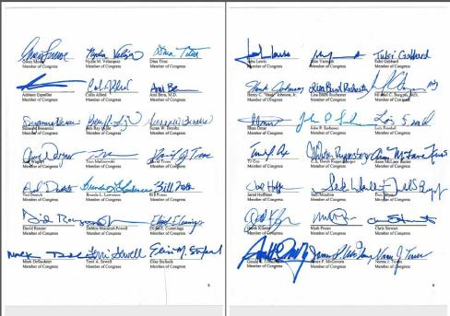
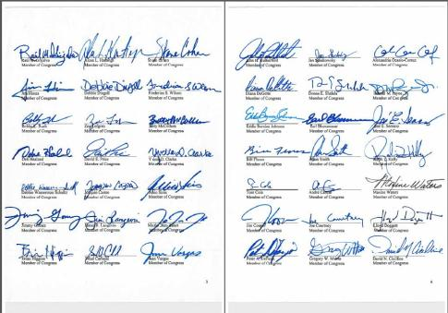

Slide 17
Resources
RESULTS Global Fund Campaign
https://results.org/issues/global-fund-to-fight-aids-tb-malaria
Global Fund: Step up the Fight
https://www.theglobalfund.org/en/stepupthefight/
Friends of the Global Fight
https://www.theglobalfight.org/

