Slide 1
Getting Ready for Advocacy Day: U.S. Poverty
RESULTS 2019 International Conference
Notes:
Two asks!

Slide 2

RESULTS is a movement of passionate, committed everyday people. Together we use our voices to influence political decisions that will bring an end to poverty. Poverty cannot end as long as oppression exists. We commit to opposing all forms of oppression, including racism, classism, colonialism, white saviorism, sexism, homophobia, transphobia, ableism, xenophobia, and religious discrimination.
At RESULTS we pledge to create space for all voices, including those of us who are currently experiencing poverty. We will address oppressive behavior in our interactions, families, communities, work, and world. Our strength is rooted in our diversity of experiences, not in our assumptions.
With unearned privilege comes the responsibility to act so the burden to educate and change doesn’t fall solely on those experiencing oppression. When we miss the mark on our values, we will acknowledge our mistake, seek forgiveness, learn, and work together as a community to pursue equity.
There are no saviors — only partners, advocates, and allies. We agree to help make the RESULTS movement a respectful, inclusive space.
Find all our anti-oppression resources at: https://results.org/volunteers/anti-oppression/

Slide 3
Make Advocacy a Good Experience for All
Agree on how to meet
Don’t dictate, invite
Listen
Be open to new roles and new ideas
Your story is your story
Learn from and trust each other
Mistakes will happen
Reflect and adjust
Ask for help

Slide 4

Agreements for building a strong RESULTS community
We have diverse experiences…
Can we agree to allow everyone to contribute and learn by listening to each other and creating space for transformative experiences?
Notes:
Can we get some agreement on this?

Slide 5

Agreements for building a strong RESULTS community
We have different ages, genders & orientations, countries of origin, races, abilities…
Can we agree to not make assumptions about people because of their age, race, how they look or other differences?
Notes:
Congratulations on finding an organization where you can make your voice count

Slide 6
Agreements for building a strong RESULTS community
We have Republicans, Democrats, and Independents who care about ending poverty...
Can we agree to being non-partisan during the conference?
Notes:
Congratulations on finding an organization where you can make your voice count

Slide 7
Fundraising Update
https://results.salsalabs.org/ic2019/p/internationalconference/index.html

Slide 8
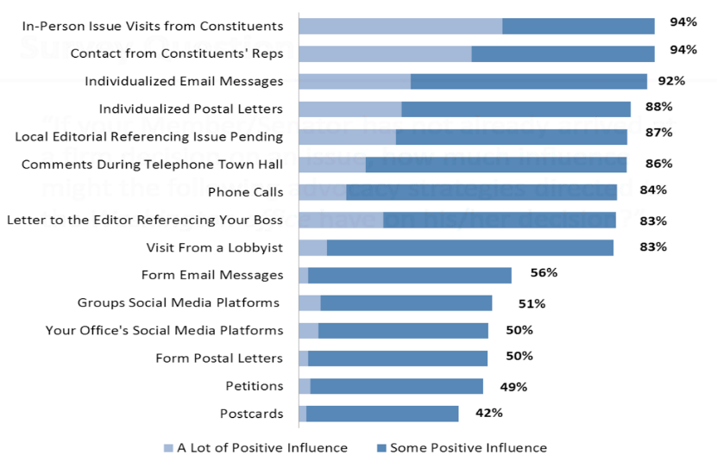
Do What Works!
Source: http://www.congressfoundation.org/projects/communicating-with-congress/citizen-centric-advocacy-2017

Slide 9
Find Everything You Need on the Conference Resources Page
https://results.org/resources/2019-international-conference-resources/
Source: http://www.congressfoundation.org/projects/communicating-with-congress/citizen-centric-advocacy-2017

Slide 10
Advocacy Day Quiz
Your alarm goes off at 6:30am and you decide to hit snooze, skip the Advocacy Day Kickoff, and just go to your first lobby meeting is at 10:00am. This is a:
  Good idea
  Bad idea

Slide 11
Advocacy Day Quiz
You’re deciding what to wear for lobby day. You should plan to wear…
The nicest clothes you brought with you
Nothing – it’s hot!
Something casual and comfortable so you feel less nervous

Slide 12
Advocacy Day Quiz
To ensure you have a pleasurable day on Capitol Hill, definitely:
Wear comfortable shoes
Hydrate
Take only what you need
All of the above

Slide 13
Advocacy Day Quiz
You forget to mute your phone beforehand and in the middle of a lobby meeting, you get a call from your dog groomer. You should:
Definitely take it
Discreetly turn your phone on mute and put it away
Distract them by making a duck with Legos

Slide 14
Advocacy Day Quiz
Your member of Congress asks you a question that you don’t know the answer to, you should:
Run
Say “I’m sorry I don’t have the answer to that today. But I am happy to do some research and follow up with your office.”
Make something up and hope they don’t find out

Slide 15
Advocacy Day Quiz
An aide takes a controversial position on an issue and it makes you mad. You should:
Tell him he’s being ridiculous
Calmly say “Let me make sure I am not misunderstanding your position. What I hear you saying is…”
Go Burr on him and challenge him to a duel

Slide 16
Advocacy Day Quiz
A member of Congress starts complaining that the other party is preventing any progress in Congress. You should:
Nod your head vigorously and say “I agree”
Vow to defeat them in the next election
Say something like, “I believe people from each party are concerned about poverty. From there, we can start to build common ground…”

Slide 17
Advocacy Day Quiz
They tell you you’ve run out of time before you can finish talking about all the issues you want to discuss. You should:
Tackle them
Thank them and leave
Thank them, give them your leave-behinds, and ask for their business card to follow up

Slide 18
Advocacy Day Quiz
You have to ask a question before your next lobby meeting. You should:
Go to the hotel to find staff
Go to your next meeting and wing it
Go to the Rayburn cafeteria and ask a staff person or fellow volunteer (and have a nice lunch while you’re there)

Slide 19
Advocacy Day Quiz
After a challenging lobby meeting, which of these should you NOT do?
Reflect on what worked and what you can make better
Let it go and not take it personally
Complain about the meeting in the hallway outside

Slide 20
Advocacy Day Quiz
When your lobby meetings are done you should:
Celebrate
Share about your day with volunteers and staff
Attend the Advocacy Day reception
Fill out the online RESULTS Lobby Report form for each meeting (https://tinyurl.com/RMoCReport)

Slide 21
Advocacy Day Quiz
What's one of the first things you want to do when you get back home?
Follow up
Follow up
Follow up

Slide 22
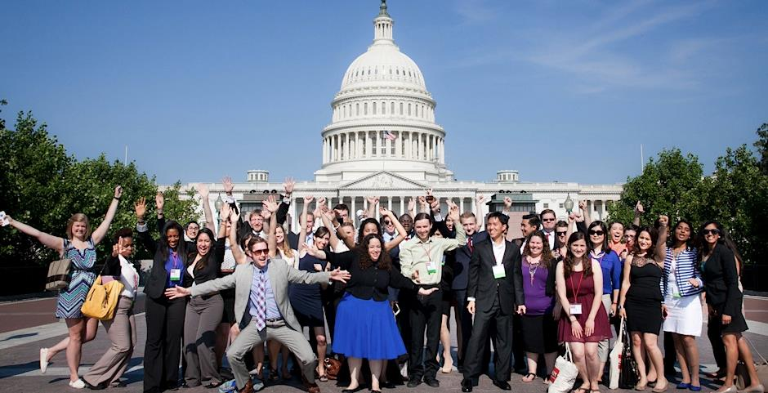
And remember – HAVE FUN!

Slide 23
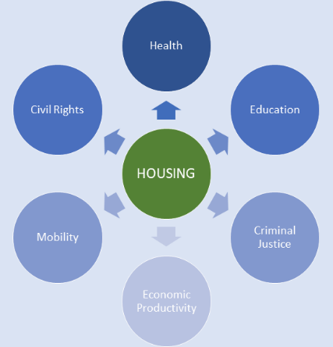
Why is Housing Important?
Housing is a major source of wealth for many middle-class Americans and remains a common path to wealth building
Where you live has implications for health, education, job access and security outcomes that all affect overall economic well being
The history of housing policy in the U.S. has been one where federal policies provided white Americans opportunities to build wealth while excluding Americans of color, particularly Blacks, from doing the same
- Opportunity Starts at Home Campaign
Notes:
Why is RESULTS taking this on?
Why these specific portions of Housing Policy?
How does this relate to broader racial justice and economic justice work in America
How will this campaign grow over the next 2 years?
Not only is housing a common form of wealth, it’s a reflection of wealth, and it is also linked to other factors that indirectly affect wealth such as quality education, economic activity and health

Slide 24
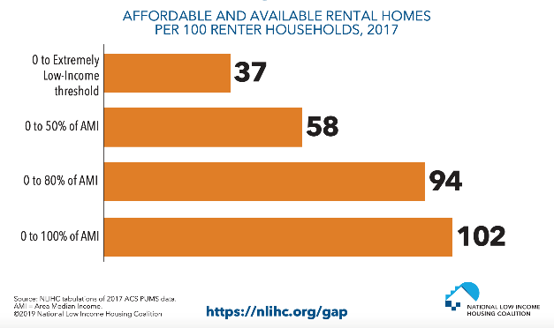
24
Affordable Housing Crisis
Since 1960, renter's incomes have gone up by 5% while rental cost has gone up by 61%.
72.5% of extremely low-income renters are severely cost burdened, meaning they spend more than half their income on housing
Notes:
This shows that there are only 37 affordable and available rental homes for extremely low income renters nation-wide. Dig into the data here https://nlihc.org/gap
A few quick definitions:
Area Median Income (AMI) is the median family incomes in the metropolitan or nonmetropolitan area
An extremely low income renter is a households with incomes at or below the Poverty Guideline or 30% of AMI, whichever is higher. The AMI is calculated by location, to find your home's AMI go to your local HUD website.
(ex: for a family of 3 the federal poverty line is $21,330 but in LA county the Area Median Income is much higher so extremely low income is defined as a household of 3 making $28,220 which is higher than the poverty line)

Slide 25
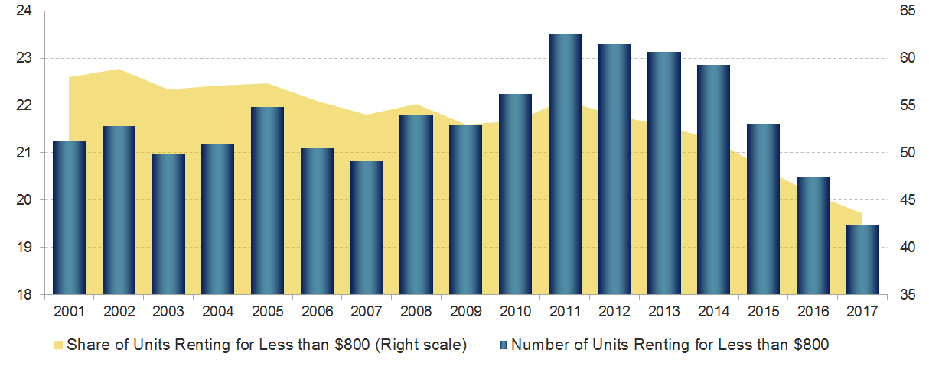
The Low-Rent Stock Has Shrunk by Four Million Units Since 2011
Notes:
Acknowledge that also need increase in stock of affordable housing. Alongside the rising cost of living there has been a decrease in the stock of low-cost rental housing. In 2017 alone, 1 million low-cost rental units ($800/month) were lost from the market.
Renters’ credits and expanding the National Housing Trust Fund to build affordable housing can help address the housing crisis for low-income renters and their families. Expanding the National Housing Trust Fund, a key resource for building affordable housing. States that are granted National Housing Trust Fund dollars must use at least 80 percent of the funds for rental housing and 10 percent for homeownership.27F Additionally, the housing must be targeted specifically at low and extremely low-income households, with the majority of resources targeted to extremely low-income households (those with income at or below 30 percent of the area median or less than the poverty line). Although small right now, the HTF has significant potential to increase the supply of affordable housing so that those with the lowest incomes can obtain an affordable home. Senator Elizabeth Warren’s American Housing and Economic Mobility Act (S. 787) would provide $445 billion to the Housing Trust Fund over ten years, or over $44 billion per year. This increase could create 2.1 million homes for families with low-incomes and lower rent costs by 10 percent.28F
Housing and Urban Development, “About Housing Trust Fund.” https://www.hudexchange.info/programs/htf/about/.
“American Housing and Economic Mobility Act – 116th Congress.” https://www.warren.senate.gov/imo/media/doc/American%20Housing%20and%20Economic%20Mobility%20Act%20Summary%20116th%20Congress%20(003).pdf. 2019.

Slide 26
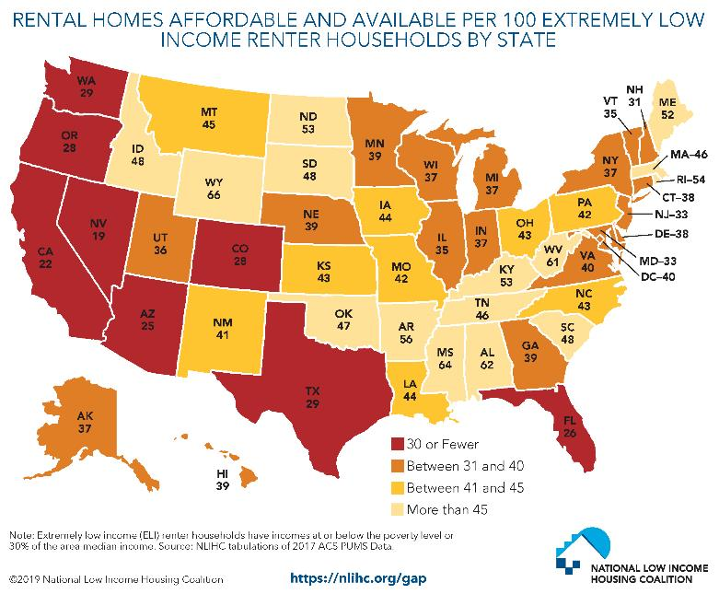
Affordable Housing Crisis
Notes:
Further, research shows that there is no state in the U.S. where a person making the prevailing minimum wage ($7.25/hour) can afford to buy a two bedroom on average. This graph shows the number of affordable and available rental homes in the by state. Dig into the data here https://nlihc.org/gap
Best spot to get your local data

Slide 27
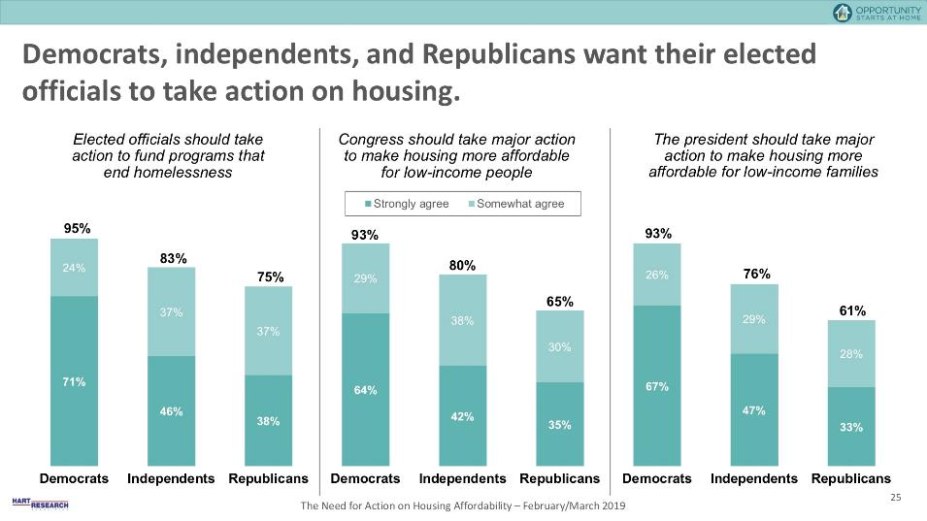
Public Support for Government Action
-Opportunity Starts at Home Campaign
Notes:
https://www.opportunityhome.org/wp-content/uploads/2019/03/Full-Report-PPT-NoEM.pdf
Remidner: housing more bipartisan, lots of policymakers looking for ideas

Slide 28
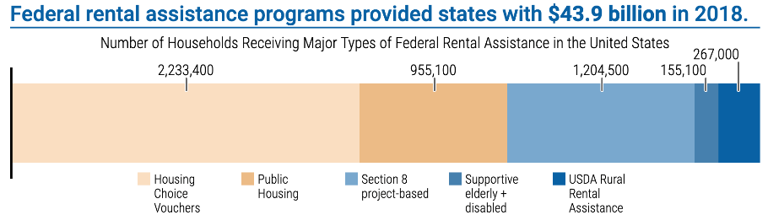
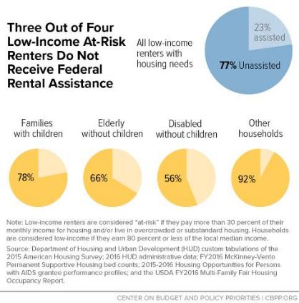
Major Federal Rental Assistance Programs
28
Housing assistance programs lifted 2.9 million people above the federal poverty line in 2017
But only one in four who need assistance receive it
Notes:
¼, as Jana said beyond incrementalism (and even need more than what we’ve talked about)
Luckily, we have housing assistance programs that help people with lower-incomes afford housing. The programs include: Housing Choice Vouchers, Public Housing, Section 8 Project Based Housing, and more. This chart shows the number of Households that are assisted by federal housing programs.
-Center on Budget and Policy Priorities: Graphic on 3 in 4 low income renters do not receive assistance
Housing assistance programs lifted 2.9 million people above the federal poverty line in 2017 Source: United States Census Bureau
On May 23, the House Transportation, Housing, and Urban Development (T-HUD) Appropriations Subcommittee approved their proposed funding bill for FY2020. It includes $1.2 billion increase for Housing Choice Vouchers (HCV), which includes the needed funding to maintain existing HCVs along with funding for 9,000 new vouchers for low-income families. Earlier this year as we began to engage in housing policy, RESULTS took on a goal of securing a substantial boost in housing assistance of $5 billion over the next two years to help 340,000 new families access vouchers, which we knew was going to be tough to get. But in this political environment, a proposed $1.2 billion increase is noteworthy in and of itself (the Senate may propose lower numbers).
While we had hoped for a more substantial increase, this is a reminder of just how important your advocacy is – and that Congress must be more ambitious.

Slide 29
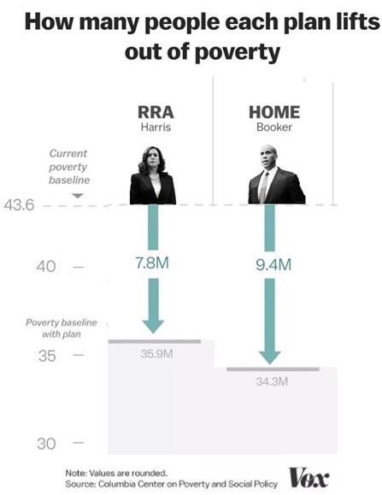
Renters’ Credits Will Reduce Poverty
29
We must address this housing crisis -- and we can begin to do so by shifting tax resources to support a “Renters Tax Credit” for low- and moderate-income renters. Several policymakers, including Senators Booker (D-NJ) and Harris (D-CA) and former Senator Heller (R-NV), have introduced legislation that does this (H.R. 2169 and S. 1106; S. 3590, H.R. 7050 and S. 3342 in the last Congress).
ONLINE ACTION: https://tinyurl.com/RESULTShousing
Notes:
How refundability works – you get a check.
Our role: the “coalition” working on this is 2 other orgs, no large-scale grassroots efforts.
Big and bold, hugely transformative. Huge proportion of people are paying above their affordability benchmark. Next slide shows how many millions will benefit
From Vox: https://www.vox.com/future-perfect/2019/1/30/18183769/democrat-poverty-plans-2020-presidential-kamala-harris-booker-gillibrand.
We must address this housing crisis -- and we can begin to do so by shifting tax resources to support a “Renters Tax Credit” for low- and moderate-income renters. Several policymakers have introduced legislation that does this (H.R. 2169 and S. 1106, H.R. 7050 and S. 3342 in the last Congress).
More: https://nlihc.org/sites/default/files/Factsheet_08022018.pdf and
S. 3250: Rent Relief Act of 2018 (Sen. Kamala Harris) | 115th Congress (2017-2018)
S 3342: Housing, Opportunity, Mobility, and Equity Act of 2018 (Sen Cory Booker) | 115th Congress (2017-2018)
H.R. 5793: Housing Choice Voucher Mobility Demonstration Act of 2018 | 115th Congress (2017-2018)
Also:
H.R. 7050: Housing, Opportunity, Mobility, and Equity Act of 2018 (Rep. Clyburn) | 115th Congress (2017-2018)
S. 2945: Housing Choice Voucher Mobility Demonstration Act of 2018 | 115th Congress (2017-2018)
Related: CBPP proposal: https://www.cbpp.org/new-federal-renters-credit-proposal The CBPP has, in the past, supported (and still does support) renter’s credits that states could give directly to tenants, but the project-based approach outlined in this recent report has the advantage of being much easier to administer and so “a good starting point for rebalancing federal housing tax policy.”
In 2016, the University of California, Berkeley’s Terner Center for Housing Innovation issued a report presenting three renters’ tax credit options. One of these would provide an entitlement, tenant-claimed credit sufficient to reduce all renters’ housing costs to 30% of their incomes, at an estimated cost of $76 billion per year. The second would provide a shallower tenant-claimed entitlement credit at an annual cost of $41 billion. The third is a “composite option” that would include a $5 billion capped, owner-claimed credit for extremely low-income families similar to that proposed by CBPP, and a smaller tenant-claimed credit for other renters costing $38 billion. The idea of a federal renters’ credit has received growing attention in recent years. The Bipartisan Policy Center, Center for American Progress, Urban Institute, Enterprise Community Partners, Center for Global Policy Solutions, Mortgage Bankers Association, and others have highlighted a renters’ credit as a promising strategy to address poverty, homelessness, and high rent burdens. In addition, legislation to establish a capped, state-administered renters’ credit has been introduced in the last two sessions of Congress: Representative Charles Rangel (D-NY) introduced the Renters Tax Credit Act in 2014; and Representative Barbara Lee (D-CA) included a renters’ credit in the Pathways Out of Poverty Act she introduced in 2014 and again in 2015.

Slide 30
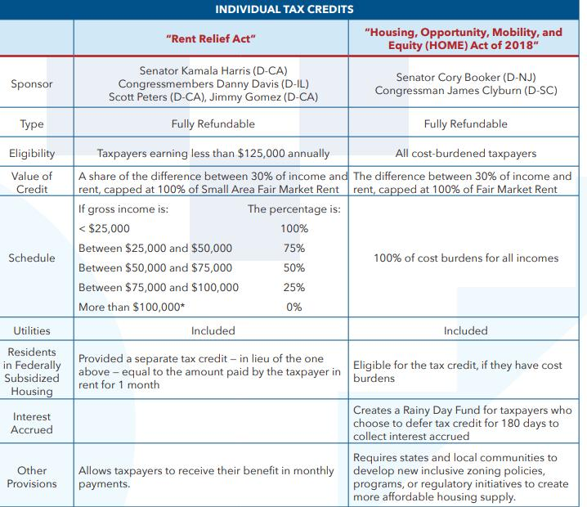
One Solution: Renters’ Tax Credits
30
Notes:
Description inc differences between Harris and Booker: https://nlihc.org/sites/default/files/Renters-Tax-Credit.pdf
Harris: $93 bil/year
Booker $134 bil year
These bills use two types of fair market rent determinations. The difference between these calculations is that the Small Area Fair Market rental determination analyzes a smaller area, and is more attuned to differences in regions. Take, for example, a city with four different neighborhoods, two of which (a & b) cost a lot to live in and the other two (c & d) which cost less. The Small Area Fair Market rent would more accurately report higher rental costs in the two higher cost neighborhoods (a & b). The Fair Market Rate takes a larger area into account when calculating rental costs, meaning it is less sensitive to differences within regions and often under reports the cost of living in high income areas. The benefit of the Small Area Market Rent is that it would allow residents to move into higher cost areas because the credit would more accurately reflect (and therefore reimburse) the high cost of living. See here for more information on this topic: https://www.nhlp.org/initiatives/housing-voucher-utilization/fair-market-rents/
S. 3250: Rent Relief Act of 2018 (Sen. Kamala Harris) | 115th Congress (2017-2018)
S 3342: Housing, Opportunity, Mobility, and Equity Act of 2018 (Sen Cory Booker) | 115th Congress (2017-2018)
H.R. 5793: Housing Choice Voucher Mobility Demonstration Act of 2018 | 115th Congress (2017-2018)
Also:
H.R. 7050: Housing, Opportunity, Mobility, and Equity Act of 2018 (Rep. Clyburn) | 115th Congress (2017-2018)
S. 2945: Housing Choice Voucher Mobility Demonstration Act of 2018 | 115th Congress (2017-2018)
Related: CBPP proposal: https://www.cbpp.org/new-federal-renters-credit-proposal The CBPP has, in the past, supported (and still does support) renter’s credits that states could give directly to tenants, but the project-based approach outlined in this recent report has the advantage of being much easier to administer and so “a good starting point for rebalancing federal housing tax policy.”
In 2016, the University of California, Berkeley’s Terner Center for Housing Innovation issued a report presenting three renters’ tax credit options. One of these would provide an entitlement, tenant-claimed credit sufficient to reduce all renters’ housing costs to 30% of their incomes, at an estimated cost of $76 billion per year. The second would provide a shallower tenant-claimed entitlement credit at an annual cost of $41 billion. The third is a “composite option” that would include a $5 billion capped, owner-claimed credit for extremely low-income families similar to that proposed by CBPP, and a smaller tenant-claimed credit for other renters costing $38 billion. The idea of a federal renters’ credit has received growing attention in recent years. The Bipartisan Policy Center, Center for American Progress, Urban Institute, Enterprise Community Partners, Center for Global Policy Solutions, Mortgage Bankers Association, and others have highlighted a renters’ credit as a promising strategy to address poverty, homelessness, and high rent burdens. In addition, legislation to establish a capped, state-administered renters’ credit has been introduced in the last two sessions of Congress: Representative Charles Rangel (D-NY) introduced the Renters Tax Credit Act in 2014; and Representative Barbara Lee (D-CA) included a renters’ credit in the Pathways Out of Poverty Act she introduced in 2014 and again in 2015.

Slide 31
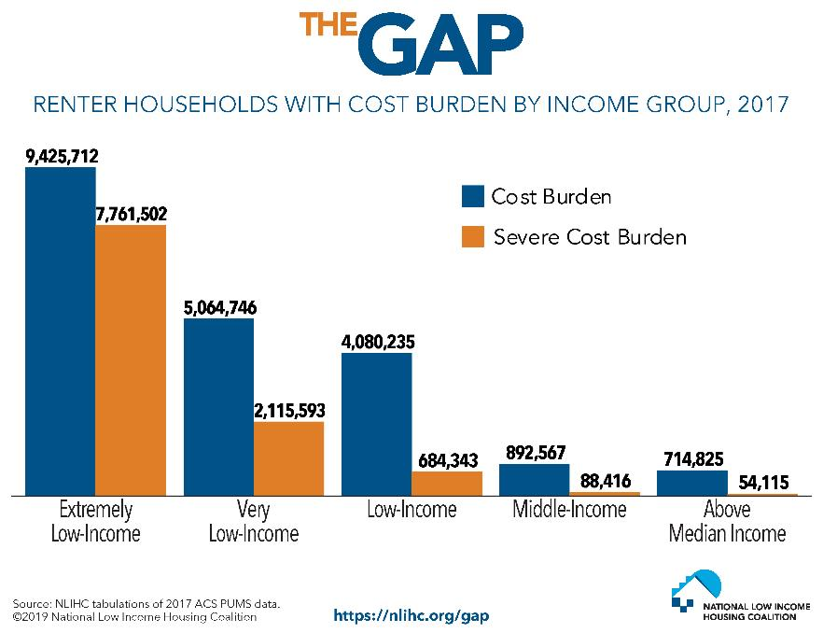
Disproportionate Impact of Rental Costs
31

Slide 32
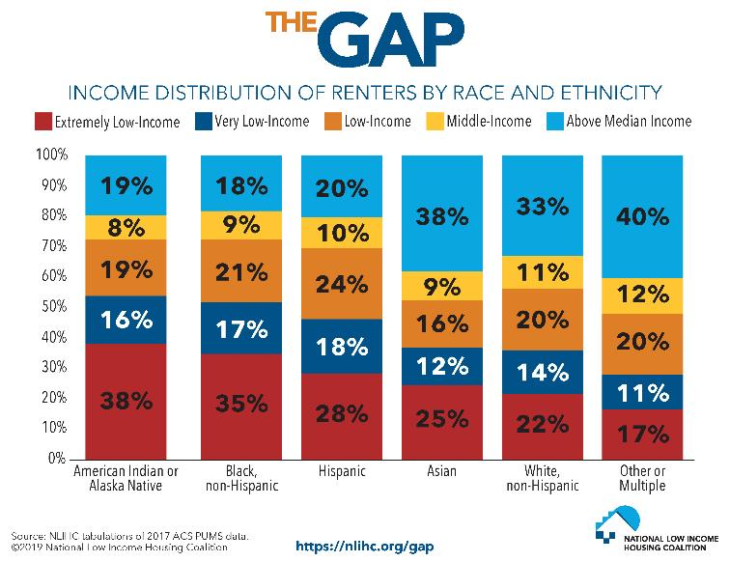
Disproportionate Impact of Rental Costs
32
Notes:
Luckily, we have housing assistance programs that help people with lower-incomes afford housing. The programs include: Housing Choice Vouchers, Public Housing, Section 8 Project Based Housing, and more. This chart shows the number of Households that are assisted by federal housing programs.
-Center on Budget and Policy Priorities: Graphic on 3 in 4 low income renters do not receive assistance
Housing assistance programs lifted 2.9 million people above the federal poverty line in 2017 Source: United States Census Bureau
On May 23, the House Transportation, Housing, and Urban Development (T-HUD) Appropriations Subcommittee approved their proposed funding bill for FY2020. It includes $1.2 billion increase for Housing Choice Vouchers (HCV), which includes the needed funding to maintain existing HCVs along with funding for 9,000 new vouchers for low-income families. Earlier this year as we began to engage in housing policy, RESULTS took on a goal of securing a substantial boost in housing assistance of $5 billion over the next two years to help 340,000 new families access vouchers, which we knew was going to be tough to get. But in this political environment, a proposed $1.2 billion increase is noteworthy in and of itself (the Senate may propose lower numbers).
While we had hoped for a more substantial increase, this is a reminder of just how important your advocacy is – and that Congress must be more ambitious.

Slide 33
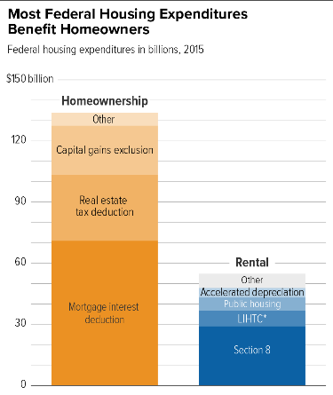
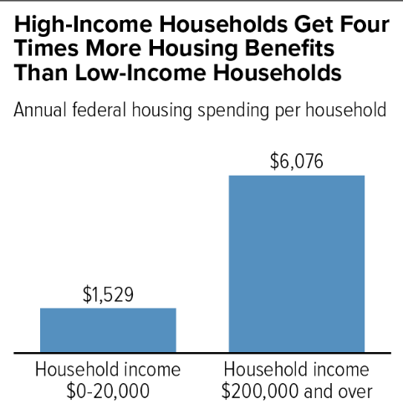
Renter Needs Outpace Homeowners but Homeowners Receive More Assistance (2015)
33
Notes:
https://www.cbpp.org/research/housing/chart-book-federal-housing-spending-is-poorly-matched-to-need
Connection between renters credit and wealth inequality
Disproportionate impact on rental housing crisis means that renters credit will disproportionately go to PoC
When not paying half income on housing, can pay for other things/save
Renters credit (and Working Fam Tax Relief Act, for overall savings) proposals allow savings account

Slide 34
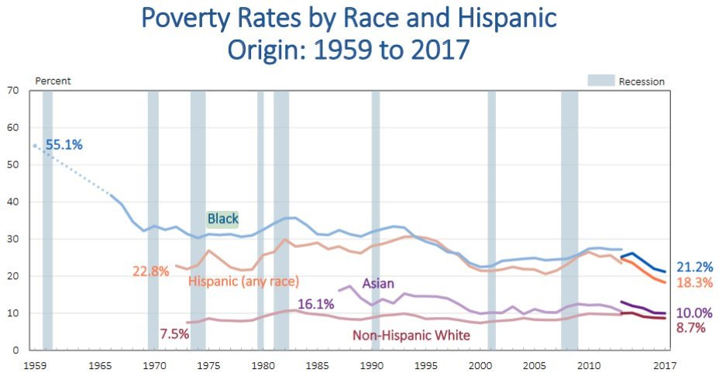
34
Poverty: Huge Disparities by Race
Source: United States Census Bureau
Notes:
Households of color are still twice as likely to live below the poverty line and earn the lowest wages. #RacialEquity in policies are needed.
EPI Economist and Director of the Program on Race, Ethnicity, and the Economy Valerie Wilson. “In 2015 and 2016, income growth was stronger for black and Hispanic households than for white households, but that trend has not continued. Today’s release shows that while in 2017, growth in Hispanic median household income continued to outpace that of white non-Hispanics, resulting in a slight narrowing of the Hispanic-white income gap, income growth stalled for median black households, reversing recent progress in closing the black-white income gap.”

Slide 35
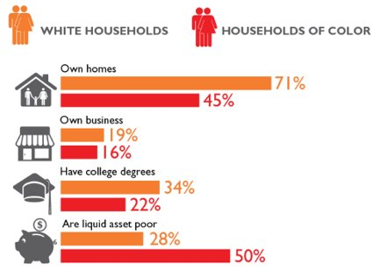
The Racial Wealth Divide
In 2016, the median wealth for white families was 10 times greater than black families’ wealth and 8 times greater than Hispanic families’ wealth.
- Urban Institute, "Nine Charts About Wealth Inequality in America."
Notes:
Inequality is not shared equally. Wealth is unequal especially along racial lines and across several measures of wealth such as homeownership and liquid assets. Housing is seen as one of the primary drivers of the wealth divide
In conversations about long-term housing and tax priorities, consider supporting the following:
Pending bipartisan bills to pilot emergency stabilization funds for families facing evictions.
A renters’ credit, which will help address our affordable housing crisis and will have a targeted impact on people of color.
Increasing the supply of affordable housing via expansions of the Housing Trust Fund.
Addressing other barriers to affordable housing and racial equity including restrictive zoning, credit scores, and application fees.
Targeting homeownership policies for first-time homebuyers impacted by segregation and redlining to reduce racial wealth inequality.
Passing bipartisan bills to create a Task Force on the Impact of Affordable Housing (S. 1772/H.R. 3211, introduced by Senator Young (R-IN) and Rep. Peters (D-CA)), to better understand the scope of and solutions to the affordable housing crisis.
Savings are an essential part of creating economic security. Yet many American families cannot weather a financial emergency, such as unexpected illness or job loss. According to a Prosperity Now report, the liquid asset poverty rate in the United States is 40 percent (see right) – with startling disparities by race. Over two million households are at risk of eviction each year and in 2016 one million evictions occurred, forcing households to move neighborhoods, change schools, and barring many from accessing safe and affordable housing again, due to a record of eviction. Pending bipartisan bills to pilot emergency stabilization funds and services for families facing evictions can help families stay stably housed.
RESULTS is deeply concerned about wealth inequality in the United States. Sadly, government policies over our country's history have worsened inequality and created a staggering racial wealth divide. Median wealth for white families is ten times greater than African American families and eight times greater than Hispanic families. Wealth is not only represented by a savings account. Wealth is the value of all your assets, which include your home, car, and retirement account, minus your debts, such as student loans, credit card debt, and mortgage. Wealth is often the foundation for economic wellbeing as it is a determinant of whether you attend and graduate from college, the kind of neighborhood you live in, the quality of the schools your child attends, the kind of job you have, and your likelihood to own a home.

Slide 36
Racial Discrimination in Federal Policy
1865
Land Reversals (1865) and Land Seizures (1865-Present Day)
1933
Public Works Administration
1934
National Housing Act
1934
Federal Housing Administration
1935
Social Security Act
1938
Fair Labor Standards Act
1944
G.I. Bill
1955
Urban Renewal Projects
1970s-Present
Subprime Loans (1970s-Present Day)
1971-Present
"War on Drugs" (1971-Present Day)
1530s-1865
Forced Removal of Native Americans and Slavery in North America
2005-09
Housing Bubble and Great Recession
Adapted from Bread For the World Racial Wealth Gap Simulation Policy Packet
Notes:
Not going to review this, long legacy that goes beyond. And even other policies (Chinese Exclusion Act, Japanese internment).
References what many learned via NETWORK yesterday (also online), and backgrounders.
Each of these policies played a role in contributing to and exacerbating racial wealth inequality through:
Forced removal and slavery: https://www.smithsonianmag.com/history/misguided-focus-1619-beginning-slavery-us-damages-our-understanding-american-history-180964873/
Stripping wealth building resources- land reversals/land seizures
Instituting homeownership discrimination/residential segregation – PWA, NHA, FHA, G.I. Bill essentially subsidized homeownership and movement into the suburbs primarily for white Americans, especially in the post-war era
Barring or limiting economic opportunity and financial security – SSA, FLSA, Subprime Loans
Displacing or disrupting communities of color – Urban renewal projects, War on drugs, housing bubble and foreclosures - Black median net worth decreased 61 percent from 2005 to 2009. Whites, in contrast, lost 21 percent of their wealth (US Census Data).

Slide 37
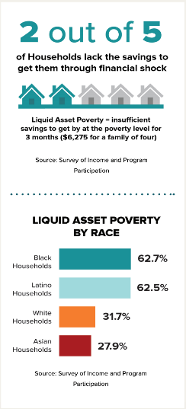
Housing Stability
According to a Prosperity Now report, the liquid asset poverty rate in the United States is 40 percent (see right) – with startling disparities by race.
Over two million households are at risk of eviction each year
In 2016 one million evictions occurred, forcing households to move neighborhoods, change schools, and barring many from accessing safe and affordable housing again, due to a record of eviction.
Pending bipartisan bills to pilot emergency stabilization funds and services for families facing evictions can help families stay stably housed.
Notes:
Wealth is unequal especially along racial lines and across several measures of wealth such as homeownership and liquid assets. Housing is seen as one of the primary drivers of the wealth divide
Savings are an essential part of creating economic security. Yet many American families cannot weather a financial emergency, such as unexpected illness or job loss. According to a Prosperity Now report, the liquid asset poverty rate in the United States is 40 percent (see right) – with startling disparities by race. Over two million households are at risk of eviction each year and in 2016 one million evictions occurred, forcing households to move neighborhoods, change schools, and barring many from accessing safe and affordable housing again, due to a record of eviction. Pending bipartisan bills to pilot emergency stabilization funds and services for families facing evictions can help families stay stably housed.
RESULTS is deeply concerned about wealth inequality in the United States. Sadly, government policies over our country's history have worsened inequality and created a staggering racial wealth divide. Median wealth for white families is ten times greater than African American families and eight times greater than Hispanic families. Wealth is not only represented by a savings account. Wealth is the value of all your assets, which include your home, car, and retirement account, minus your debts, such as student loans, credit card debt, and mortgage. Wealth is often the foundation for economic wellbeing as it is a determinant of whether you attend and graduate from college, the kind of neighborhood you live in, the quality of the schools your child attends, the kind of job you have, and your likelihood to own a home.

Slide 38
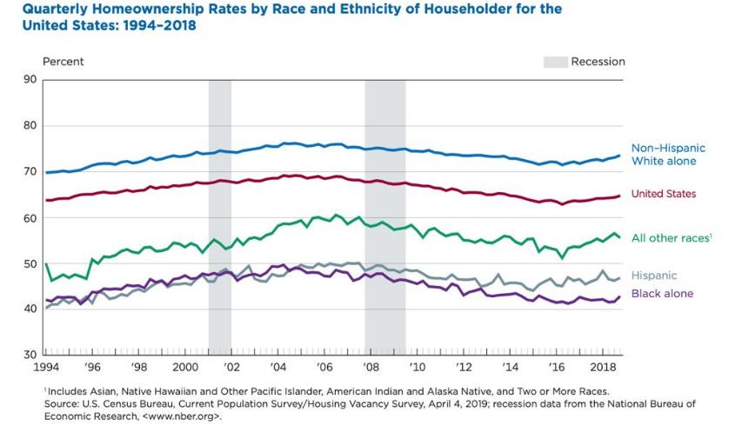
Homeownership Gaps
38

Slide 39
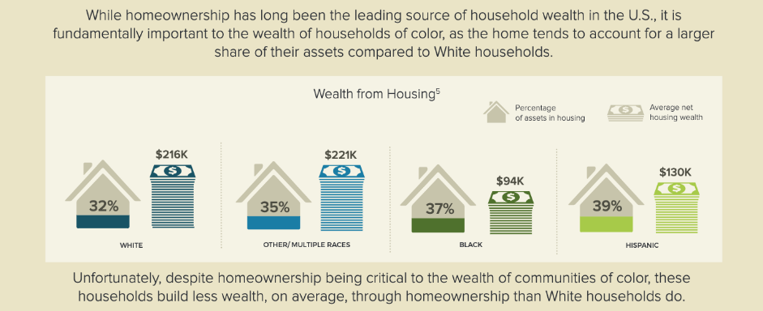
Housing and Racial Wealth Inequality
39
Notes:
Disproportionate share of wealth in housing for PoC. And even then, remember that those homes are not valued the same
Even when own, Brookings student devaluing of black homes in majority (50%) Black: $156bil, $48k per home, 23% less

Slide 40
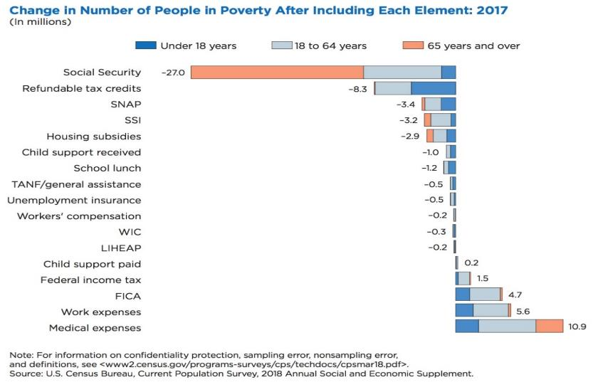
Targeted Ask: EITC and CTC
Notes:
Opportunities to dive deeper: policy brief, Policy Solutions to Racial Wealth Divide Sun afternoon, lots of Q&A Monday afternoon.
Wealth is unequal especially along racial lines and across several measures of wealth such as homeownership and liquid assets. Housing is seen as one of the primary drivers of the wealth divide
Savings are an essential part of creating economic security. Yet many American families cannot weather a financial emergency, such as unexpected illness or job loss. According to a Prosperity Now report, the liquid asset poverty rate in the United States is 40 percent (see right) – with startling disparities by race. Over two million households are at risk of eviction each year and in 2016 one million evictions occurred, forcing households to move neighborhoods, change schools, and barring many from accessing safe and affordable housing again, due to a record of eviction. Pending bipartisan bills to pilot emergency stabilization funds and services for families facing evictions can help families stay stably housed.
RESULTS is deeply concerned about wealth inequality in the United States. Sadly, government policies over our country's history have worsened inequality and created a staggering racial wealth divide. Median wealth for white families is ten times greater than African American families and eight times greater than Hispanic families. Wealth is not only represented by a savings account. Wealth is the value of all your assets, which include your home, car, and retirement account, minus your debts, such as student loans, credit card debt, and mortgage. Wealth is often the foundation for economic wellbeing as it is a determinant of whether you attend and graduate from college, the kind of neighborhood you live in, the quality of the schools your child attends, the kind of job you have, and your likelihood to own a home.

Slide 41
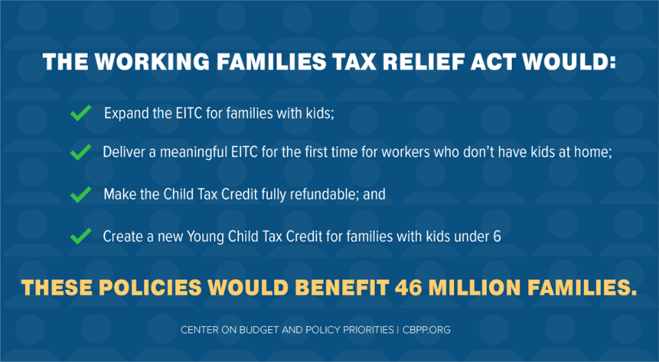
The Working Families Tax Relief Act
Notes:
Opportunities to dive deeper: policy brief, Policy Solutions to Racial Wealth Divide Sun afternoon, lots of Q&A Monday afternoon.
The Working Families Tax Relief Act (S. 1138/H.R. 3157), would improve the EITC and CTC to boost the financial security of 46 million households, including 8 million Black families, 9 million Latinx families, and 2 million Asian American families. The bill would also cut child poverty nationally by 28 percent, lifting 3.1 million children out of poverty and making another 7.7 million children less poor. Specifically, the bill would:
Increase the EITC for families with children by roughly 25 percent
Substantially increase the EITC for workers not raising children and lower eligibility to age 19; this is the only group in the tax code that is taxed into poverty
Make the full $2,000 CTC available to all low- and moderate-income families
Create a new Young Child Tax Credit that would provide families with children under 6 years old an extra $1,000 per child (for a total CTC of $3,000 per child)
Make the CTC equally accessible to families in Puerto Rico and expand Puerto Rico’s EITC
Overall, expanding the EITC and CTC would help make sure that low-income parents can give their children a good start in life, and help working people afford transportation and other things they need to stay on the job.

Slide 42
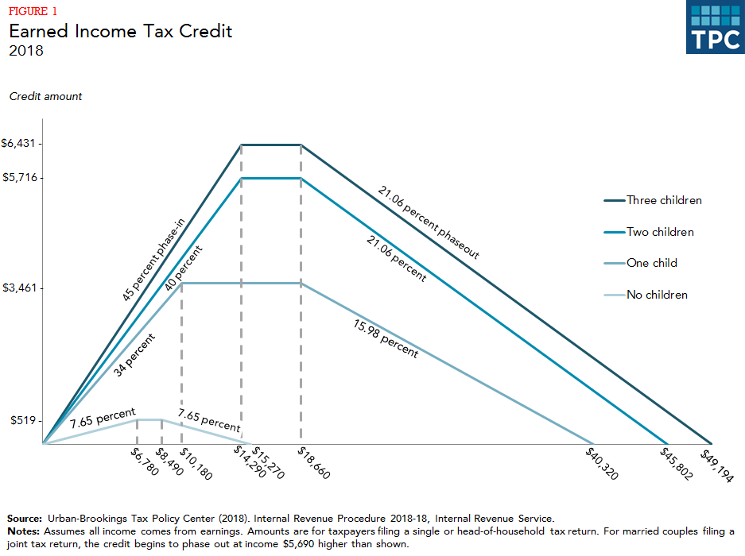
The Earned Income Tax Credit (EITC)
Notes:
Opportunities to dive deeper: policy brief, Policy Solutions to Racial Wealth Divide Sun afternoon, lots of Q&A Monday afternoon.
As a credit, the EITC reduces a low-income family’s overall tax liability. It is fully refundable, so if a family’s EITC exceeds the amount of federal taxes owed, the family receives the difference as a refund. The size of the EITC is calculated as a fixed percentage of the worker’s earnings. The credit “phases in,” meaning it increases with additional earnings until the maximum credit is reached (at about $14,290 for a family with three children). Once the EITC reaches the maximum, it begins “phasing out” providing a continued but decreasing refund for additional income earned until it disappears completely. This ensures that the EITC is targeted to those who need it. The amount of a person’s EITC depends on family size and marital status (see graph below). First enacted during President Gerald Ford’s administration as part of the Tax Reduction Act of 1975, the EITC was intended “to offset the Social Security taxes of low-income workers with children and to provide those taxpayers with an increased incentive to work.” Since its establishment, the EITC has become the nation’s leading anti-poverty program for working, low-income families. The credit has a long history of bipartisan support, having been expanded under both Republican and Democratic Congresses and presidents. In the Tax Reform Act of 1986, the EITC saw significant expansion, and later the Omnibus Budget Reconciliation Act of 1990 also expanded the credit and added a supplemental credit amount for families with two or more children.
RESULTS volunteers played a critical role in making important EITC and CTC provisions permanent in the bipartisan Protecting Americans from Tax Hikes (PATH) Act of 2015, increasing the EITC for larger families and reducing the marriage penalty for joint filers while lowering the income eligibility threshold for the CTC to $3,000. Through 225 meetings with members of Congress and 145 media pieces throughout 2014-2015, RESULTS volunteers played a key role in lifting incomes above or closer for more than 16 million people, including 8 million children, were. This is one of the biggest anti-poverty legislative victories in twenty years, and one that RESULTS volunteers played a critical role in achieving.
Research shows the positive impact of the EITC:
The EITC has proven to be an effective anti-poverty program. In 2016, the EITC lifted about 5.8 million people above the poverty line, including about 3 million children. The number of poor children would have been more than one-quarter higher without the EITC. The credit reduced the severity of poverty for another 18.7 million people, including 6.9 million children. The EITC (together with the Child Tax Credit) is the largest contributor to preventing poverty for working families. In 2018, the earned income tax credit (EITC) will provide credits ranging from $519 for workers with no children to $6,431 for workers with at least three children. The most recent relevant study found that a $1,000 increase in the EITC led to a 7.3 percentage point increase in employment and a 9.4 percentage point reduction in the share of families with after tax and transfer income in poverty.
Infant health is positively linked with increases in the EITC. Research reveals a positive correlation between increased EITCs and infant health markers such as birthweight and premature birth, so that higher EITCs result in healthier birthweights and fewer premature births.
The EITC strengthens work and earnings in the next generation. Research has found that for children in low-income families, each additional $3,000 per year received before age 6 correlates with an average yearly increase of 135 work hours between the ages of 25 and 37, and their average annual earnings increase by 17 percent. In addition, by boosting the employment and earnings of working-age women, the EITC boosts the size of the Social Security retirement benefits they ultimately will receive.
EITC children do better in school. Elementary and middle-school students earn higher test scores when their families receive larger refundable tax credits (such as the EITC and CTC). In addition, low-income children are more likely to go to college when their families have benefited from the EITC.
The EITC strengthens local economies. The EITC refund checks are often spent quickly and locally, resulting in at least $1.50-$2.00 in local economic activity for every $1 claimed.
The EITC increases promotes work, especially among single mothers. The EITC expansions of the 1990s helped more than a half a million families move from cash welfare assistance to work. Tax Credits for Working Families: http://www.taxcreditsforworkingfamilies.org/earned-income-tax-credit/
Tax Policy Center (TPC): http://www.taxpolicycenter.org/briefing-book/key-elements/family/eitc.cfm
Tax Policy Center (TPC): http://www.taxpolicycenter.org/taxtopics/encyclopedia/EITC.cfm
CBPP: https://www.cbpp.org/research/federal-tax/policy-basics-the-earned-income-tax-credit
Tax Policy Center (TPC): https://www.taxpolicycenter.org/briefing-book/how-does-earned-income-tax-credit-affect-poor-families
Ibid.
CBPP: http://www.cbpp.org/research/policy-basics-the-earned-income-tax-credit
CBPP: http://www.cbpp.org/research/federal-tax/eitc-and-child-tax-credit-promote-work-reduce-poverty-and-support-childrens?fa=view&id=3793
Center for American Progress (CAP): https://www.americanprogress.org/issues/poverty/report/2014/10/07/98452/harnessing-the-eitc-and-other-tax-credits-to-promote-financial-stability-and-economic-mobility/
CBPP: http://www.cbpp.org/research/federal-tax/eitc-and-child-tax-credit-promote-work-reduce-poverty-and-support-childrens?fa=view&id=3793

Slide 43
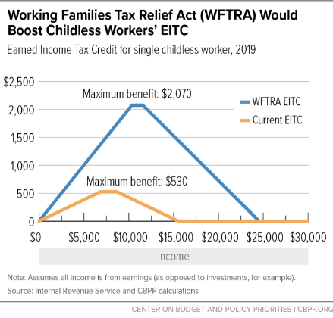
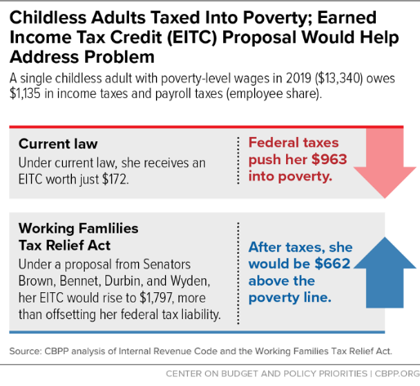
Expanding the EITC
Notes:
Opportunities to dive deeper: policy brief, Policy Solutions to Racial Wealth Divide Sun afternoon, lots of Q&A Monday afternoon.
As a credit, the EITC reduces a low-income family’s overall tax liability. It is fully refundable, so if a family’s EITC exceeds the amount of federal taxes owed, the family receives the difference as a refund. The size of the EITC is calculated as a fixed percentage of the worker’s earnings. The credit “phases in,” meaning it increases with additional earnings until the maximum credit is reached (at about $14,290 for a family with three children). Once the EITC reaches the maximum, it begins “phasing out” providing a continued but decreasing refund for additional income earned until it disappears completely. This ensures that the EITC is targeted to those who need it. The amount of a person’s EITC depends on family size and marital status (see graph below). First enacted during President Gerald Ford’s administration as part of the Tax Reduction Act of 1975, the EITC was intended “to offset the Social Security taxes of low-income workers with children and to provide those taxpayers with an increased incentive to work.” Since its establishment, the EITC has become the nation’s leading anti-poverty program for working, low-income families. The credit has a long history of bipartisan support, having been expanded under both Republican and Democratic Congresses and presidents. In the Tax Reform Act of 1986, the EITC saw significant expansion, and later the Omnibus Budget Reconciliation Act of 1990 also expanded the credit and added a supplemental credit amount for families with two or more children.
RESULTS volunteers played a critical role in making important EITC and CTC provisions permanent in the bipartisan Protecting Americans from Tax Hikes (PATH) Act of 2015, increasing the EITC for larger families and reducing the marriage penalty for joint filers while lowering the income eligibility threshold for the CTC to $3,000. Through 225 meetings with members of Congress and 145 media pieces throughout 2014-2015, RESULTS volunteers played a key role in lifting incomes above or closer for more than 16 million people, including 8 million children, were. This is one of the biggest anti-poverty legislative victories in twenty years, and one that RESULTS volunteers played a critical role in achieving.
Research shows the positive impact of the EITC:
The EITC has proven to be an effective anti-poverty program. In 2016, the EITC lifted about 5.8 million people above the poverty line, including about 3 million children. The number of poor children would have been more than one-quarter higher without the EITC. The credit reduced the severity of poverty for another 18.7 million people, including 6.9 million children. The EITC (together with the Child Tax Credit) is the largest contributor to preventing poverty for working families. In 2018, the earned income tax credit (EITC) will provide credits ranging from $519 for workers with no children to $6,431 for workers with at least three children. The most recent relevant study found that a $1,000 increase in the EITC led to a 7.3 percentage point increase in employment and a 9.4 percentage point reduction in the share of families with after tax and transfer income in poverty.
Infant health is positively linked with increases in the EITC. Research reveals a positive correlation between increased EITCs and infant health markers such as birthweight and premature birth, so that higher EITCs result in healthier birthweights and fewer premature births.
The EITC strengthens work and earnings in the next generation. Research has found that for children in low-income families, each additional $3,000 per year received before age 6 correlates with an average yearly increase of 135 work hours between the ages of 25 and 37, and their average annual earnings increase by 17 percent. In addition, by boosting the employment and earnings of working-age women, the EITC boosts the size of the Social Security retirement benefits they ultimately will receive.
EITC children do better in school. Elementary and middle-school students earn higher test scores when their families receive larger refundable tax credits (such as the EITC and CTC). In addition, low-income children are more likely to go to college when their families have benefited from the EITC.
The EITC strengthens local economies. The EITC refund checks are often spent quickly and locally, resulting in at least $1.50-$2.00 in local economic activity for every $1 claimed.
The EITC increases promotes work, especially among single mothers. The EITC expansions of the 1990s helped more than a half a million families move from cash welfare assistance to work. Tax Credits for Working Families: http://www.taxcreditsforworkingfamilies.org/earned-income-tax-credit/
Tax Policy Center (TPC): http://www.taxpolicycenter.org/briefing-book/key-elements/family/eitc.cfm
Tax Policy Center (TPC): http://www.taxpolicycenter.org/taxtopics/encyclopedia/EITC.cfm
CBPP: https://www.cbpp.org/research/federal-tax/policy-basics-the-earned-income-tax-credit
Tax Policy Center (TPC): https://www.taxpolicycenter.org/briefing-book/how-does-earned-income-tax-credit-affect-poor-families
Ibid.
CBPP: http://www.cbpp.org/research/policy-basics-the-earned-income-tax-credit
CBPP: http://www.cbpp.org/research/federal-tax/eitc-and-child-tax-credit-promote-work-reduce-poverty-and-support-childrens?fa=view&id=3793
Center for American Progress (CAP): https://www.americanprogress.org/issues/poverty/report/2014/10/07/98452/harnessing-the-eitc-and-other-tax-credits-to-promote-financial-stability-and-economic-mobility/
CBPP: http://www.cbpp.org/research/federal-tax/eitc-and-child-tax-credit-promote-work-reduce-poverty-and-support-childrens?fa=view&id=3793

Slide 44
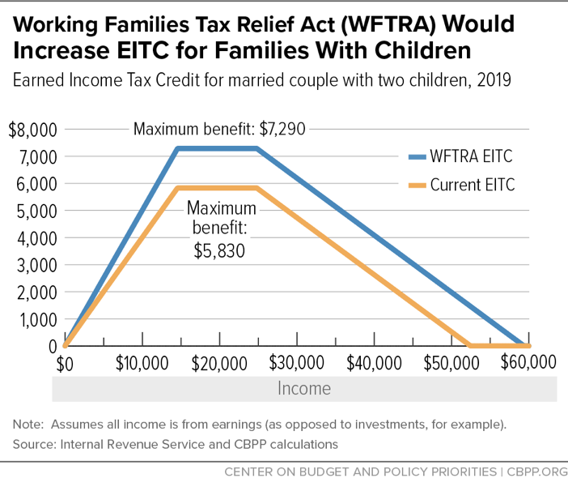
Expanding the EITC
Notes:
Opportunities to dive deeper: policy brief, Policy Solutions to Racial Wealth Divide Sun afternoon, lots of Q&A Monday afternoon.
As a credit, the EITC reduces a low-income family’s overall tax liability. It is fully refundable, so if a family’s EITC exceeds the amount of federal taxes owed, the family receives the difference as a refund. The size of the EITC is calculated as a fixed percentage of the worker’s earnings. The credit “phases in,” meaning it increases with additional earnings until the maximum credit is reached (at about $14,290 for a family with three children). Once the EITC reaches the maximum, it begins “phasing out” providing a continued but decreasing refund for additional income earned until it disappears completely. This ensures that the EITC is targeted to those who need it. The amount of a person’s EITC depends on family size and marital status (see graph below). First enacted during President Gerald Ford’s administration as part of the Tax Reduction Act of 1975, the EITC was intended “to offset the Social Security taxes of low-income workers with children and to provide those taxpayers with an increased incentive to work.” Since its establishment, the EITC has become the nation’s leading anti-poverty program for working, low-income families. The credit has a long history of bipartisan support, having been expanded under both Republican and Democratic Congresses and presidents. In the Tax Reform Act of 1986, the EITC saw significant expansion, and later the Omnibus Budget Reconciliation Act of 1990 also expanded the credit and added a supplemental credit amount for families with two or more children.
RESULTS volunteers played a critical role in making important EITC and CTC provisions permanent in the bipartisan Protecting Americans from Tax Hikes (PATH) Act of 2015, increasing the EITC for larger families and reducing the marriage penalty for joint filers while lowering the income eligibility threshold for the CTC to $3,000. Through 225 meetings with members of Congress and 145 media pieces throughout 2014-2015, RESULTS volunteers played a key role in lifting incomes above or closer for more than 16 million people, including 8 million children, were. This is one of the biggest anti-poverty legislative victories in twenty years, and one that RESULTS volunteers played a critical role in achieving.
Research shows the positive impact of the EITC:
The EITC has proven to be an effective anti-poverty program. In 2016, the EITC lifted about 5.8 million people above the poverty line, including about 3 million children. The number of poor children would have been more than one-quarter higher without the EITC. The credit reduced the severity of poverty for another 18.7 million people, including 6.9 million children. The EITC (together with the Child Tax Credit) is the largest contributor to preventing poverty for working families. In 2018, the earned income tax credit (EITC) will provide credits ranging from $519 for workers with no children to $6,431 for workers with at least three children. The most recent relevant study found that a $1,000 increase in the EITC led to a 7.3 percentage point increase in employment and a 9.4 percentage point reduction in the share of families with after tax and transfer income in poverty.
Infant health is positively linked with increases in the EITC. Research reveals a positive correlation between increased EITCs and infant health markers such as birthweight and premature birth, so that higher EITCs result in healthier birthweights and fewer premature births.
The EITC strengthens work and earnings in the next generation. Research has found that for children in low-income families, each additional $3,000 per year received before age 6 correlates with an average yearly increase of 135 work hours between the ages of 25 and 37, and their average annual earnings increase by 17 percent. In addition, by boosting the employment and earnings of working-age women, the EITC boosts the size of the Social Security retirement benefits they ultimately will receive.
EITC children do better in school. Elementary and middle-school students earn higher test scores when their families receive larger refundable tax credits (such as the EITC and CTC). In addition, low-income children are more likely to go to college when their families have benefited from the EITC.
The EITC strengthens local economies. The EITC refund checks are often spent quickly and locally, resulting in at least $1.50-$2.00 in local economic activity for every $1 claimed.
The EITC increases promotes work, especially among single mothers. The EITC expansions of the 1990s helped more than a half a million families move from cash welfare assistance to work. Tax Credits for Working Families: http://www.taxcreditsforworkingfamilies.org/earned-income-tax-credit/
Tax Policy Center (TPC): http://www.taxpolicycenter.org/briefing-book/key-elements/family/eitc.cfm
Tax Policy Center (TPC): http://www.taxpolicycenter.org/taxtopics/encyclopedia/EITC.cfm
CBPP: https://www.cbpp.org/research/federal-tax/policy-basics-the-earned-income-tax-credit
Tax Policy Center (TPC): https://www.taxpolicycenter.org/briefing-book/how-does-earned-income-tax-credit-affect-poor-families
Ibid.
CBPP: http://www.cbpp.org/research/policy-basics-the-earned-income-tax-credit
CBPP: http://www.cbpp.org/research/federal-tax/eitc-and-child-tax-credit-promote-work-reduce-poverty-and-support-childrens?fa=view&id=3793
Center for American Progress (CAP): https://www.americanprogress.org/issues/poverty/report/2014/10/07/98452/harnessing-the-eitc-and-other-tax-credits-to-promote-financial-stability-and-economic-mobility/
CBPP: http://www.cbpp.org/research/federal-tax/eitc-and-child-tax-credit-promote-work-reduce-poverty-and-support-childrens?fa=view&id=3793

Slide 45
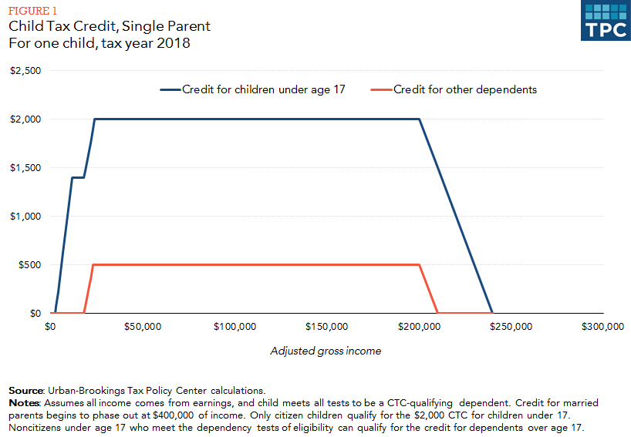
The Child Tax Credit (CTC)
Notes:
Opportunities to dive deeper: policy brief, Policy Solutions to Racial Wealth Divide Sun afternoon, lots of Q&A Monday afternoon.
The Child Tax Credit (CTC) is a partially refundable federal tax credit designed to help families offset some of the costs of raising children. When combined with the EITC, the CTC is an effective anti-poverty tool. The Center on Budget and Policy Priorities estimates that in 2017, CTC lifted approximately 2.8 million people out of poverty in 2017, including about 1.6 million children, and lessened poverty for another 13.1 million people, including 6.7 million children.” On Feb. 28, 2019, the non-partisan National Academy of Sciences released a consensus plan to cut child poverty in half. The two policy proposals that had the biggest impact on poverty reduction were both versions of an expanded Child Tax Credit. With the expenses of raising a child continually increasing, the CTC is a critical measure in ensuring that children receive the necessary resources and home stability that they deserve.
The CTC includes a refundable component, the Additional Child Tax Credit, for low-income families. This means that if the value of the CTC exceeds the amount of federal income tax a family owes, the family may receive part or all of the difference in the form of a refund check. As a result, many working families can benefit from the CTC even if their incomes are so low that they owe little or no federal income tax in a given year. This refundable feature is important for low-income working families, who otherwise wouldn’t receive the tax benefits available to higher-income families to help offset the cost of raising children.
First enacted in 1997, the CTC has a similar structure and function to EITC. As with the EITC, only working families are eligible to receive the credit, and the CTC “phases in” as income increases. Unlike the EITC, however, the CTC requires families to earn a minimum income of $3,000 to qualify for the credit and is only partially refundable. That means that if a family’s CTC exceeds its federal tax liability, the family may receive only a portion of the credit rather than the total difference as a refund.
In 2017 the Child Tax Credit was increased but the benefits largely go to high-income households. The credit was doubled to $2,000 per child, but only wealthier families will be able to receive the full benefit. Low-income families can at most get $1,400 per child back as a refund compared to a family earning $400,000, who will get to deduct the full $2,000 credit per child off their taxes.
CBPP: https://www.cbpp.org/research/federal-tax/policy-basics-the-child-tax-credit
ITEP: https://itep.org/the-case-for-extending-state-level-child-tax-credits-to-those-left-out-a-50-state-analysis/
CBPP: http://www.cbpp.org/research/policy-basics-the-child-tax-credit
IBID
CBPP: http://www.cbpp.org/research/policy-basics-the-child-tax-credit
Marr, C., Duke, B., Huang, C., “New Tax Law Is Fundamentally Flawed and Will Require Basic Restructuring.” https://www.cbpp.org/research/federal-tax/new-tax-law-is-fundamentally-flawed-and-will-require-basic-restructuring. 2018.

Slide 46
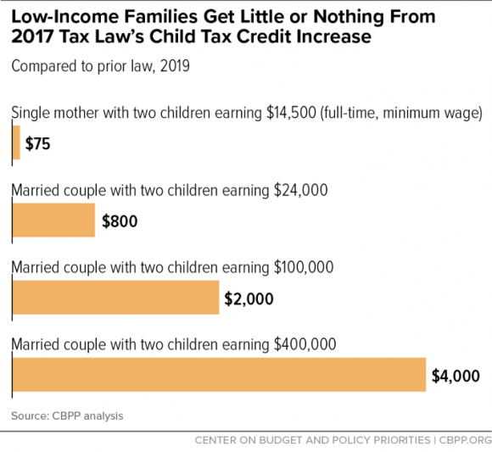
CTC in the 2017 Tax Law
Notes:
Opportunities to dive deeper: policy brief, Policy Solutions to Racial Wealth Divide Sun afternoon, lots of Q&A Monday afternoon.
The Child Tax Credit (CTC) is a partially refundable federal tax credit designed to help families offset some of the costs of raising children. When combined with the EITC, the CTC is an effective anti-poverty tool. The Center on Budget and Policy Priorities estimates that in 2017, CTC lifted approximately 2.8 million people out of poverty in 2017, including about 1.6 million children, and lessened poverty for another 13.1 million people, including 6.7 million children.” On Feb. 28, 2019, the non-partisan National Academy of Sciences released a consensus plan to cut child poverty in half. The two policy proposals that had the biggest impact on poverty reduction were both versions of an expanded Child Tax Credit. With the expenses of raising a child continually increasing, the CTC is a critical measure in ensuring that children receive the necessary resources and home stability that they deserve.
The CTC includes a refundable component, the Additional Child Tax Credit, for low-income families. This means that if the value of the CTC exceeds the amount of federal income tax a family owes, the family may receive part or all of the difference in the form of a refund check. As a result, many working families can benefit from the CTC even if their incomes are so low that they owe little or no federal income tax in a given year. This refundable feature is important for low-income working families, who otherwise wouldn’t receive the tax benefits available to higher-income families to help offset the cost of raising children.
First enacted in 1997, the CTC has a similar structure and function to EITC. As with the EITC, only working families are eligible to receive the credit, and the CTC “phases in” as income increases. Unlike the EITC, however, the CTC requires families to earn a minimum income of $3,000 to qualify for the credit and is only partially refundable. That means that if a family’s CTC exceeds its federal tax liability, the family may receive only a portion of the credit rather than the total difference as a refund.
In 2017 the Child Tax Credit was increased but the benefits largely go to high-income households. The credit was doubled to $2,000 per child, but only wealthier families will be able to receive the full benefit. Low-income families can at most get $1,400 per child back as a refund compared to a family earning $400,000, who will get to deduct the full $2,000 credit per child off their taxes.
CBPP: https://www.cbpp.org/research/federal-tax/policy-basics-the-child-tax-credit
ITEP: https://itep.org/the-case-for-extending-state-level-child-tax-credits-to-those-left-out-a-50-state-analysis/
CBPP: http://www.cbpp.org/research/policy-basics-the-child-tax-credit
IBID
CBPP: http://www.cbpp.org/research/policy-basics-the-child-tax-credit
Marr, C., Duke, B., Huang, C., “New Tax Law Is Fundamentally Flawed and Will Require Basic Restructuring.” https://www.cbpp.org/research/federal-tax/new-tax-law-is-fundamentally-flawed-and-will-require-basic-restructuring. 2018.

Slide 47
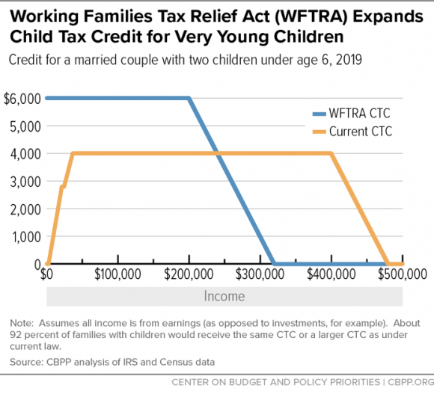
Expanding the CTC
Notes:
Opportunities to dive deeper: policy brief, Policy Solutions to Racial Wealth Divide Sun afternoon, lots of Q&A Monday afternoon.
The Working Families Tax Relief Act (S. 1138/H.R. 3157), would improve the EITC and CTC to boost the financial security of 46 million households, including 8 million Black families, 9 million Latinx families, and 2 million Asian American families. The bill would also cut child poverty nationally by 28 percent, lifting 3.1 million children out of poverty and making another 7.7 million children less poor. Specifically, the bill would:
Increase the EITC for families with children by roughly 25 percent
Substantially increase the EITC for workers not raising children and lower eligibility to age 19; this is the only group in the tax code that is taxed into poverty
Make the full $2,000 CTC available to all low- and moderate-income families
Create a new Young Child Tax Credit that would provide families with children under 6 years old an extra $1,000 per child (for a total CTC of $3,000 per child)
Make the CTC equally accessible to families in Puerto Rico and expand Puerto Rico’s EITC
Overall, expanding the EITC and CTC would help make sure that low-income parents can give their children a good start in life, and help working people afford transportation and other things they need to stay on the job.

Slide 48
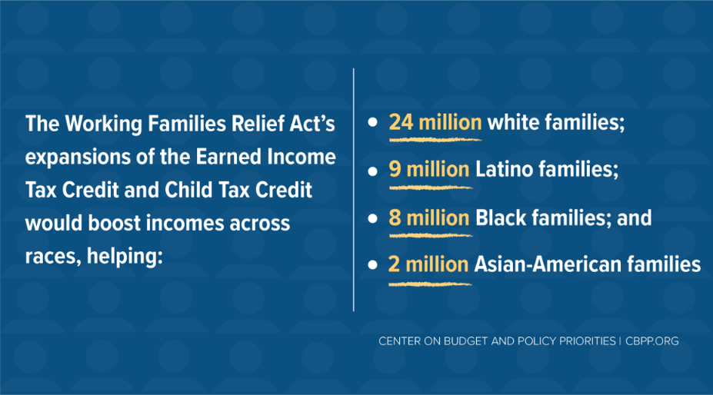
Impact: Working Families Tax Relief Act
And… cuts child poverty nationally by 28 percent!
Notes:
While we don’t expect the full Working Families Tax Relief Act to be enacted this year, it is “foundational” legislation that sets the terms of the debate for how we should be focusing our efforts to rewrite the 2017 Trump tax law to promote policies that help millions of Americans struggling to make ends meet and would help address income inequality that has affected white, Black, and brown working-class households.
The recently introduced Kildee-Evans bill (the Working Families Tax Relief Act) would substantially expand both the EITC and the Child Tax Credit. Substantially expand both the EITC for families with children and the EITC for workers not raising a child at home. The expansions include broadening the age range of workers eligible for the credit from 25-64 today to 19-67, a provision that would support young workers, especially those who lack a college degree.
The bill would have large effects on poverty. It would:
Reduce the overall poverty rate (using the Supplemental Poverty Measure, which analysts favor) from 14 percent to 12 percent — a 15-percent reduction.
Reduce the Black poverty rate from 21 percent to 17 percent, an 18-percent reduction.
Reduce the Latino poverty rate from 22 percent to 18 percent, a 20-percent reduction.
Lower the overall child poverty rate from 15 percent to 11 percent, a 28-percent reduction.
And shrink the Latino child poverty rate from 24 percent to 18 percent, a 27-percent reduction.
And shrink the Black child poverty rate from 23 percent to 15 percent, a 33-percent reduction.
Luckily, the Senate Working Families Tax Relief Act has broad support with 45 Senate cosponsors. With similar House legislation introduced last month by Representatives Kildee and Evans, we have a chance to build momentum with representatives during advocacy meetings in DC and back home.

Slide 49
Chance to Expand EITC/CTC This Year?
Last month, the House Ways and Means Committee passed temporary expansions of both the EITC and CTC in a broader “Extenders” tax package – the Economic Mobility Act (H.R. 3300), including:
Expansion of the EITC would raise the after-tax incomes of 16 million childless adults
CTC changes would benefit more than 42 million children under age 17.
ASK (targeted):
1. cosponsor S. 1138/H.R. 3157
2. As downpayment on bigger EITC/CTC expansions, urge Congressional leaders to include an expansion of the CTC and EITC in any tax legislation that moves this year
Notes:
the Ways and Means temporary bumps in credits are about
EITC $30bil
CTC $80bil
Child/ Dependent Care $15bil
We are not focusing on the child and dependent Care Credit, even the groups that work on child care more are not emphasizing it too much (vs CTC). This is more relevant for Senate Democrats as we push them to include EITC and CTC in any tax package this year, we will still continue to push bill cosponsorship in the House.
And, we may have an opportunity to expand the EITC and CTC in this Congress. Last month, the House Ways and Means Committee passed temporary expansions of both the EITC and CTC in a broader “Extenders” tax package – the Economic Mobility Act (H.R. 3300)’s expansion of the EITC would raise the after-tax incomes of 16 million childless adults and the CTC changes would benefit more than 42 million children under age 17. RESULTS volunteers will urge Congress to include an expansion of the CTC and EITC in any tax legislation that moves in this Congress, and cosponsor S. 1138/H.R. 3157 if they have not already done so.
CBPP: https://www.cbpp.org/research/federal-tax/expansions-of-the-earned-income-tax-credit-and-child-tax-credit-would-benefit-8
Two asks!

