Slide 1
2021 Advanced Enhanced Child Tax Credit
Francine J. Lipman, William S. Boyd Professor of Law @narfnampil Top 50 on #TaxTwitter
University of Nevada, Las Vegas

Slide 2
Children (esp children of color) have historically been the poorest age group by far in the United States
There are six people in our family. But only five sit down to dinner. That’s because my mom doesn’t eat. She wants to make sure we have enough food. Vanessa, age 6

Slide 3
This Photo by Unknown Author is licensed under CC BY-SA-NC

Slide 4
Child Tax Credit (effective 1998 at $400) (Presently Three Versions)
Pre and Post TCJA (prior to 2018 and after 2025)
TCJA 2018 – 2025 (excluding 2021)
American Rescue Plan Act 2021

Slide 5
Pre (2017) & Post TCJA (2026) CTC
Only refundable to the extent earned income > $3K x 15%
Dependency exemption comes back at about $4.75
Phase-out threshold $110K MFJ ($75K Single/HofH & $55K MFS)
$1K & taxpayer identification #

Slide 6
2018-2025 Tax Cut & Jobs Act CTC
Only refundable to the extent earned income > $2.5K x 15% ($3K pre-TCJA) limited to $1.4K (indexed)
Social Security Number required (others qualify for the $500 dependent care credit, but nonrefundable)
Increased amount of $2K (prior $1K)
Phase-out threshold increased to $400K MFJ ($200K for all others) from $110K MFJ ($75K Single/HofH)

Slide 7
2021 Advanced Enhanced CTC
Fully refundable (versus only refundable to the extent earned income > $2500 x 15%)
Increased amount of $1,600 (< age 6) or $1,000 for (< age 18) phases out beginning at $150KMFJ/$112.5K for HofH/$75 Single
50% paid monthly in advance starting 7/15 based upon 2020 or 2019 tax filings
Reconciliation required on 2021 federal income tax return
Payback protection safe harbor = $2K per qualifying children for lower-income households

Slide 8
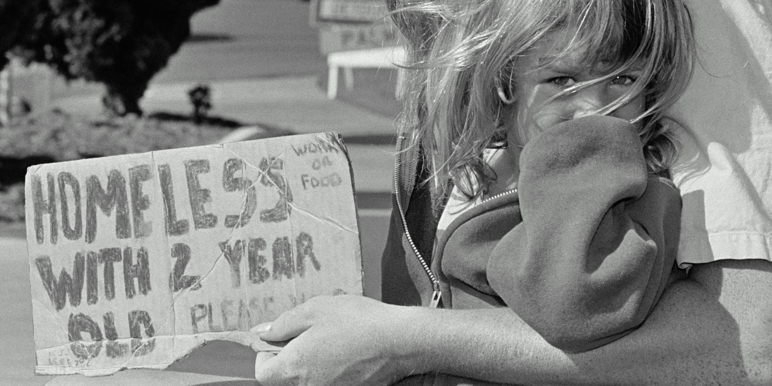
Thank You for YOUR time Comments and questions ARE welcome?
Contact me at
UNLV, William S. Boyd School of Law
Francine J. Lipman@unlv.edu

