Slide 1
Rise Advocacy Chapter Monthly Webinar
August 20, 2024

Slide 2
Welcome
Please let us know in the chat where you are joining us from!
Notes:
Margaret (also introduce myself, Karyne, Susan, and all coaches who are there)
8:30-8:35 PM: Welcome/Introductions (Margaret)
Susan & Karyne can check for new names
Welcome new folks, Please let us know in the chat where you are based. Introduce yourself since first time you are doing this.
Be sure to introduce people, Introduce Ken and Karyne and the rest of the Advocacy team of mentors and committee –Anne Child, Sarah Leone, Joanna Distefano, Susan Wright, Leslye Heilig, Margaret Moodian
Invite new folks to introduce themselves in the chat and share about their interest in advocacy
This is a non-partisan space where we learn how to build relationships with our members of Congress to influence policy. We center ourselves around mutual respect and inclusion.
Intro to vision and values of both organizations, provide the links to full statements
Invite Rise members to learn more about RESULTS by exploring their website, and RESULTS members to do the same with Together Women Rise. Review mission/vision/anti-oppression (only feel need to read full statement if there is time, but share links in any case)

Slide 3
Mission & Vision
Together Women Rise’s Mission
Together Women Rise cultivates the collective power of community to achieve global gender equality.
OUR VISION
Together Women Rise envisions a world where every person has the same opportunities to thrive regardless of their gender or where they live.
Notes:
Margaret
Together Women Rise:
Vision
Together Women Rise envisions a world where every person has the same opportunities to thrive regardless of their gender or where they live.
Gender Equality Beliefs
Together Women Rise champions gender equality because women’s rights are human rights. When women and girls are treated equally, the world is healthier, safer, more peaceful, inclusive, and economically just for everyone.
https://togetherwomenrise.org/our-anti-oppression-commitment/

Slide 4
Our Values & Resources
​At RESULTS we pledge to create space for all voices, including those of us who are currently experiencing poverty. We will address oppressive behavior in our interactions, families, communities, work, and world. Our strength is rooted in our diversity of experiences, not in our assumptions.
With unearned privilege comes the responsibility to act so the burden to educate and change doesn’t fall solely on those experiencing oppression. When we miss the mark on our values, we will acknowledge our mistake, seek forgiveness, learn, and work together as a community to pursue equity.
Read our full anti-oppression values statement here at results.org/values.
Find these resources and more at results.org/volunteers/anti-oppression:
Resource Guides from our Diversity & Inclusion trainings, including:
Interrupting Microaggressions
Creating Space for Critical Conversations
Information on how RESULTS responds to oppressive incidents
Notes:
Margaret
RESULTS Anti-Oppression Statement: https://results.org/volunteers/anti-oppression

Slide 5
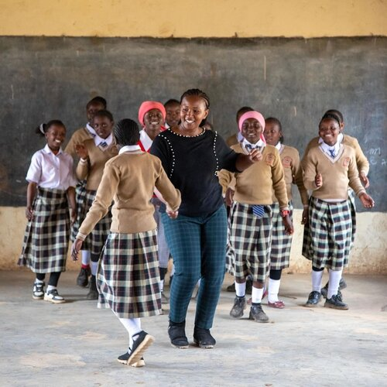
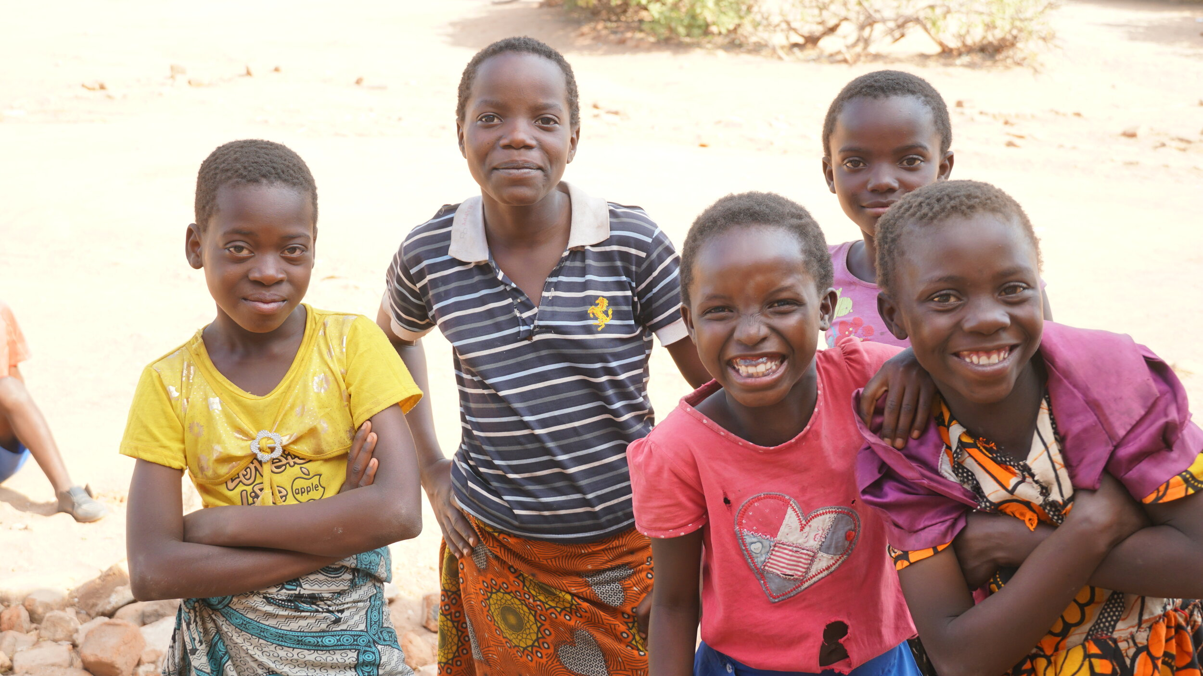
August Grantees
Spotlight on Global Education
Flying Kites
Impact Network International
Notes:
Susan

Slide 6
Reflections on Advocacy & Partnership
Notes:
Ken

Slide 7
Coaching, Persistence, Resilience Together Women Rise Webinar August 2024
Notes:
Ken

Slide 8
Working with Congress
Congressional Management Foundation & RESULTS
Building Relationships is Key
Conversation, Phone Call: Rinse and Repeat
Notes:
Ken

Slide 9
Working with Congress
PUPO is Real!
The Champion Scale is Our Guide
Use Stories and Local Perspectives
Notes:
Ken

Slide 10
Working with Advocates
Advocacy is Foreign to Most People:
Break it down
Help them see success
Deal with Discomfort
Share the Experience
Learn one number: (202) 224-3121
Notes:
Ken

Slide 11
Working with Advocates
PUPO is Real!
EPIC is a Gem
Overwhelmed? Start Over
See and Feel the Network
Our Voices Matter
Notes:
Ken

Slide 12
RESULTS website and social media
Notes:
Ken

Slide 13
August Recess & Election Engagement
Notes:
Karyne

Slide 14
Why Focus on Elections?
Establish early relationships
Get to candidates when they are listening
Educate candidates and the public on poverty
Get candidates on the record
Set the agenda for the next Congress
Engage the community

Slide 15
Election Engagement Campaign
August Perspectives on Democracy & In-District Meetings
September Importance of Candidate Engagement & Media Training
October Using Data to Combat Toxic Poverty Narratives
November Keeping Congress Accountable During End of Lame Duck Year
October

Slide 16
Election Engagement Campaign
Key Activities:
Direct Advocacy: meetings and birddogging
Raising poverty issues in the media
Continued community outreach & engagement

Slide 17
Election Engagement Resources
RESULTS.org/Issues/Community of Change
https://results.org/resources/2024-election-engagement-resources
Tight races: https://www.cookpolitical.com/ratings

Slide 18
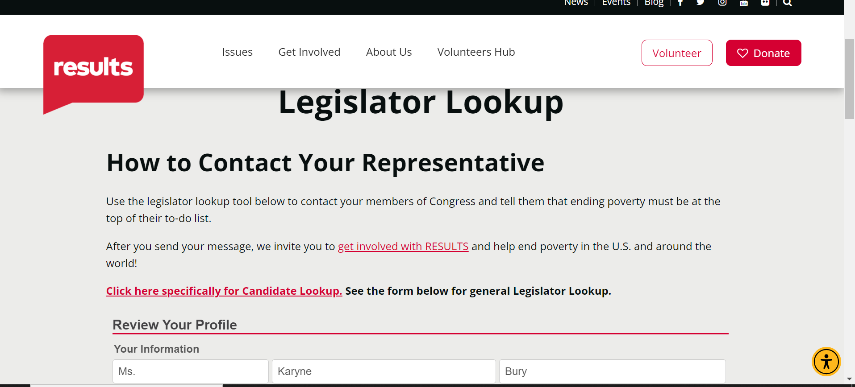
Election Engagement Resources
Notes:
Legislator Look Up:

Slide 19
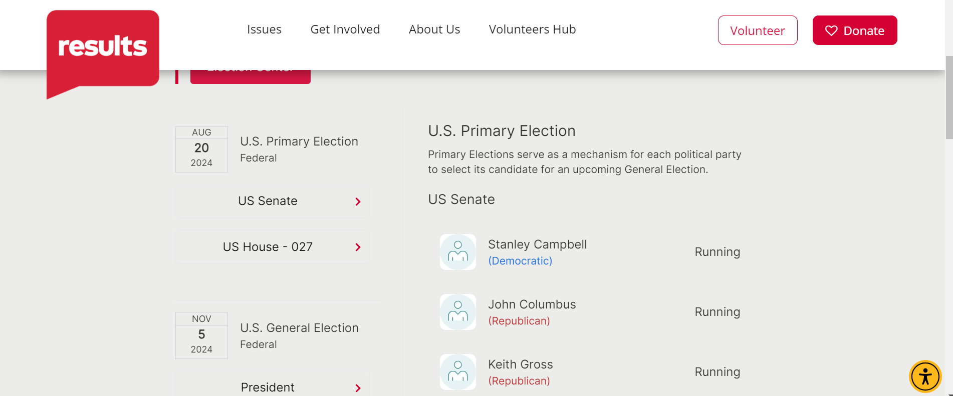
Election Engagement Resources
Notes:
Legislator Look Up:

Slide 20
August
Advocacy Action
Notes:
Karyne

Slide 21
Nutrition is fundamental
Credit: USAID Malawi

Slide 22
1,000 Days

Slide 23
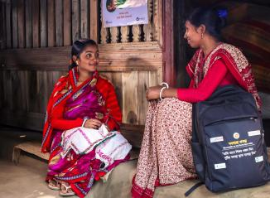
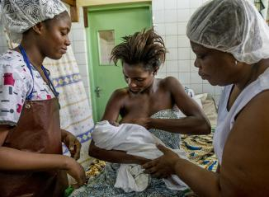
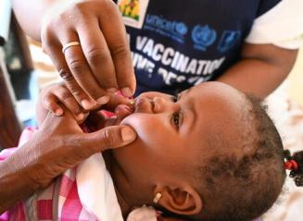
We can prevent malnutrition
© UNICEF/UN0668289/Dejongh
PHOTO CREDITS - 1. Mehzabin Rupa/World Vision / 2. Karen Kasmauski/MCSP / 3. © UNICEF/UN0668289/Dejongh
Notes:
https://www.flickr.com/photos/usaid_images/51952948100/in/photostream/
https://www.flickr.com/photos/mcspglobal/15294988248/

Slide 24
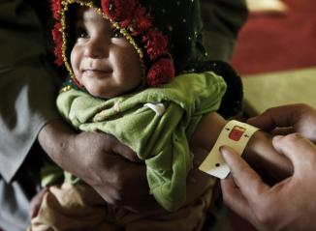
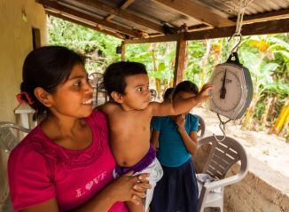
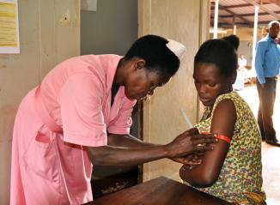
We can detect malnutrition early
PHOTO CREDITS - 1. ACF/Christina Tchad / 2. USAID-ACCESO/Fintrac Inc. / 3. Kate Consavage/USAID
Notes:
https://www.flickr.com/photos/usaidafrica/32390294158/
https://www.flickr.com/photos/usaid_images/14720125257/
https://www.flickr.com/photos/usaidafrica/41809766381/

Slide 25
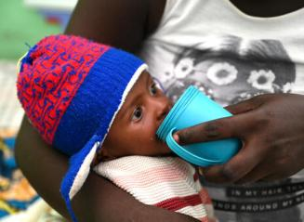
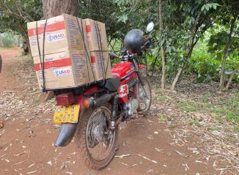
We can treat malnutrition
PHOTO CREDITS - 1. © UNICEF/UN0668307/Dejongh / 2 & 3. Kate Consavage/USAID
Notes:
https://www.flickr.com/photos/198231745@N02/52942498880/
https://www.flickr.com/photos/usaidafrica/41809739091/

Slide 26
Our big global moment
This Photo by Unknown Author is licensed under CC BY-SA

Slide 27
We want the US Government to
Make a specific, bold, new financial pledge
Make a powerful public signal to the world, encouraging others to be bold
Ask your member of Congress to join the Dear Colleague Letter (deadline Aug. 29)
Notes:
Sample email template, write to your Representative’s Foreign Policy Aide:
https://docs.google.com/document/d/1Rc3VC8uInWWkou3gmiOSRMCV2SkdaVq-lpf21ZPuk4I/edit

Slide 28
Take Action!
Check this scorecard see if your Representative has signed on to the Nutrition for Growth Dear Colleague Letter.
Use Legislator Lookup (if you are unsure of who to reach out to, please don’t hesitate to reach out to us for support).
Email convention: House: FirstName.LastName@mail.house.gov
Personalize this sample email requesting your members of Congress sign the Dear Colleague Letter.
Follow up! If you’ve taken one action, take the other action tomorrow!
Notes:
Karyne Sample email template, write to your Representative’s Foreign Policy Aide: https://docs.google.com/document/d/1Rc3VC8uInWWkou3gmiOSRMCV2SkdaVq-lpf21ZPuk4I/edit

Slide 29
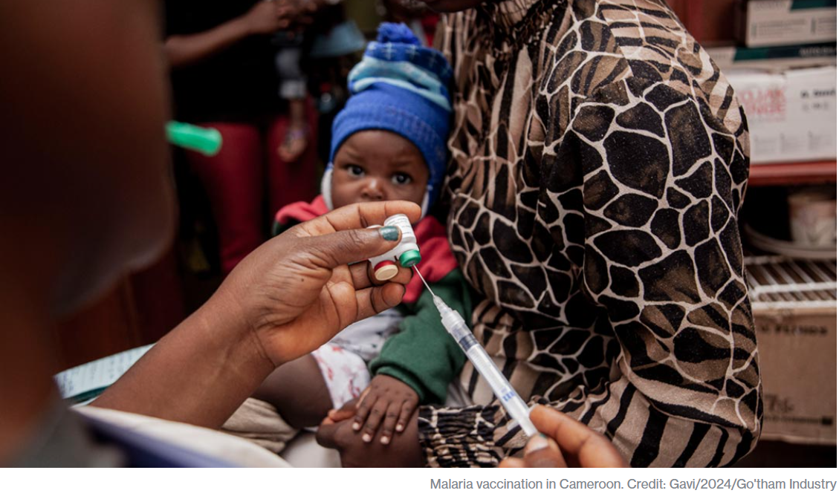
Notes:
Karyne

Slide 30
Take Follow Up Action on Gavi!
Check this scorecard see if your Representative or Senator has signed on to the Gavi Resolution (H. Res. 1286/ S. Res. 684).
Use Legislator Lookup (if you are unsure of who to reach out to, please don’t hesitate to reach out to us for support).
Email conventions: Senate: FirstName_LastName@SenatorsLastName.senate.gov House: FirstName.LastName@mail.house.gov
Personalize this sample email requesting your members of Congress co-sponsor H. Res. 1286 or S. Res. 684.
Follow up! If you’ve taken one action, take the other action tomorrow!
Notes:
Karyne

Slide 31
Invite fellow Rise members to change the world together! Together Women Rise Advocacy Chapter Maximize Your Impact for Change Tuesday, September 24 at 8:30 PM ET
As Together Women Rise members, you have demonstrated your power, influence, and impact in making the world a better place for women and girls worldwide. Join us on Tuesday, September 24 to learn how you can continue to make change and maximize your impact through advocacy. You will hear from invited guest speakers including current members of the Together Women Rise Advocacy Chapter, Rise grantees, and even from the office of a member of Congress. Advocacy changes things, and our action is critical to creating the environment through which our Rise grantees can thrive.
Register here: https://tinyurl.com/RisePower4Change
Save the Date!
Notes:
Susan

Slide 32
Invite others to join us in
changing the world together!
Sign up here: http://tinyurl.com/JoinRiseAdvocacyChapter
Notes:
Susan

