Slide 1
Action Network Power Hour
February 27th, 2025

Slide 3
Welcome to any new Managers, please go ahead and put your name and where you're joining from in the chat!

Slide 5
Who/what is your favorite cartoon or animated character?

Slide 6
2nd Action Alert February
Please call (202) 224-3121 and ask for your representative.
Leave this message with the receptionist:
"I urge Rep. ______________ to vote NO on the House budget resolution coming up for a vote soon. It is ridiculous that Congress wants to take health care and food assistance from millions of Americans to pay for tax cuts for the rich. Congress must put families over billionaires by rejecting SNAP and Medicaid cuts. Please tell Rep. ______________ to vote NO on the budget resolution!"

Slide 7
NEW CALL SCRIPT AS OF 2/27/25
Call (202) 224-3121 TODAY and leave this message with your senators and representatives:
My name is __________ and I am a constituent from __________. I am appalled by the Trump Administration's latest attack on foreign aid by canceling USAID contracts. We need you to fight to restart lifesaving programs at USAID and PEPFAR. The American people do not support these reckless decisions, which are costing lives and making America weaker around the world. It is time to take a stand. Please tell Rep./Sen. ______________ to publicly call on Secretary of State Rubio to reverse the termination of lifesaving programs now.
The Administration is flouting the orders of the courts. Congress is the only line of defense, and they cannot abdicate their constitutional duty. Too many lives are on the line. Please call today!

Slide 8
Benefits of utilizing the Action Center on the RESULTS website
Members can check their online actions
We can see when they've taken action, which we can then relay to you all
They can include a personalized message
The message will go directly to the correct email address for either their Member of Congress and/or the Newspaper (if it's an LTE)

Slide 9
Tips & Tricks for Keeping your Members Engaged
Leverage “Track & Resend”
Send emails earlier in the week
Send emails between 11am-4pm
Keep emails under 250 words
Include 1-2 Action Links At Most
Link to your Action earlier in the email
Personalized outreach ---> try giving your member a call and thanking them for their advocacy

Slide 10
Ways to Track Retention
If you're using email to send the alerts or your newsletter to your members; you can change your settings to deliver back an email that lets you know if they read it
Let me know if you need help doing this
You can use Mailchimp – it lets you know who opened your email

Slide 11
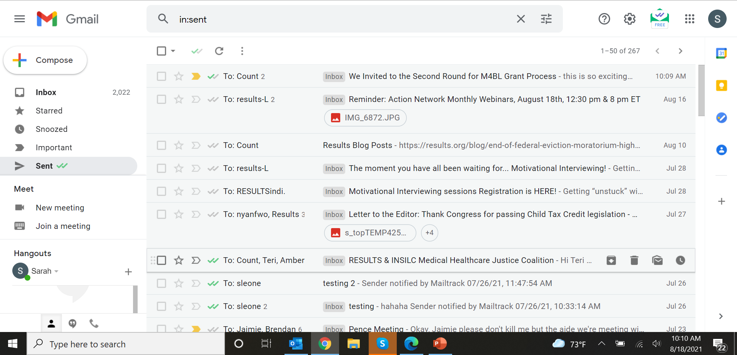
Example of Gmail – Tracking emails

Slide 12
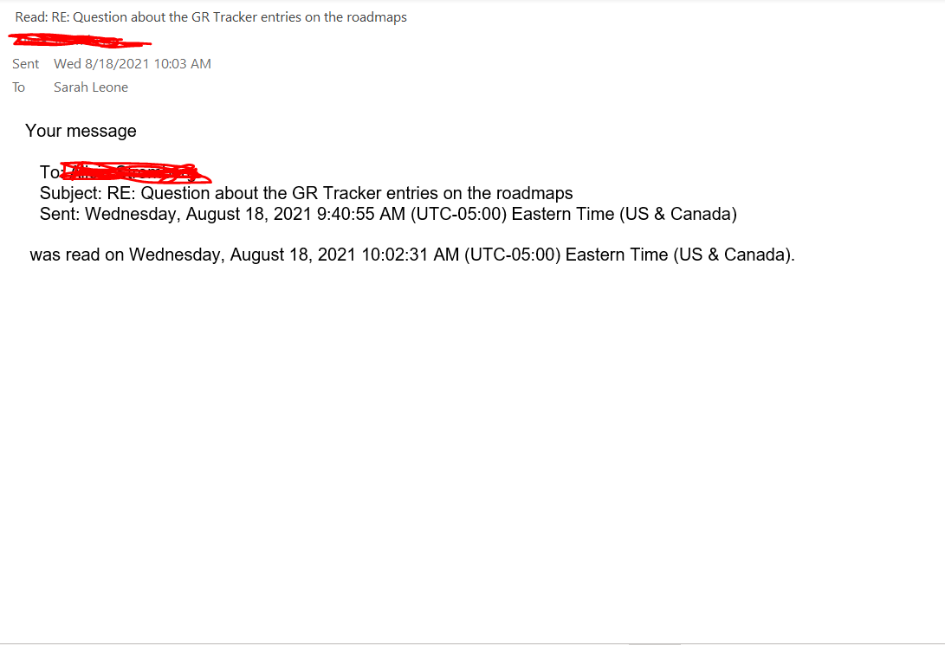
Example of Outlook – Tracking emails

Slide 13
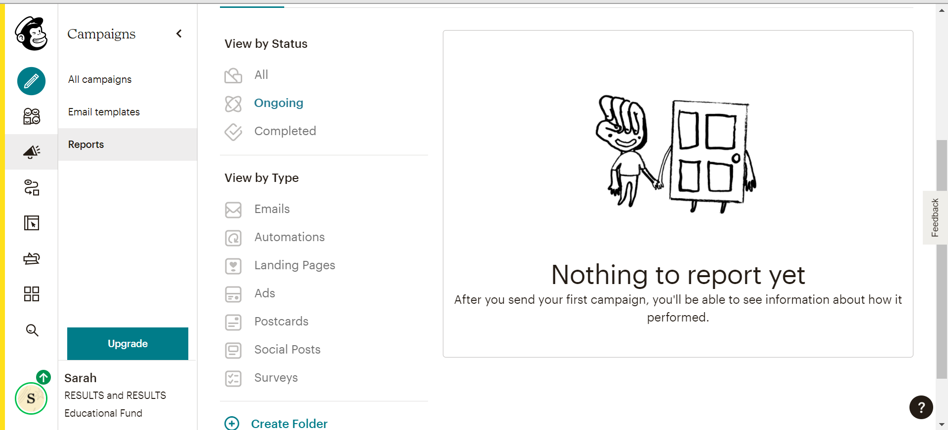
Mailchimp – Tracking Report

Slide 14
How do we encourage our AN’s to write Letters to the Editor (LTE’s)?
As part of being a Action Network member, they've agreed to not only contact their member of Congress, but also to write LTE's
Our next Action Alert will be a media alert, which is exciting!
While we encourage your members to personalize their letter, they can hit send these first few times as they get used to this new form of advocacy
I would recommend doing some personalized outreach to your most ACTIVE members who have been sending alerts every week and asking them to personalize their letter, I can create a template that you can personalize, if this would be helpful!

Slide 15
LTE's continued
As managers, you would do some local research from newspapers in your area to provide "hooks" for your members to use
This would help them grow their confidence with writing one
We would have a 1-minute option hit send, 5-minute option hit send, 10-minute option hit send (personalize LTE and include hook)
Thoughts on having an LTE webinar that you can invite your members to and RESULTS staff will run?
Even if we get one person that shows up, that's a success!
If no one shows up, we can review other ways to teach your members to personalize their media!

Slide 16
Who has added new members to their network?

Slide 17
2021 Example of VoterVoice Member Outreach
States | Number of Advocates I've reached out to from VoterVoice | Number of Advocates who want to become Members
Texas | 342 | 3
Maryland | 529 | 3
West Virginia | 97 | 0
Wisconsin | 255 | 3
Alaska | 107 | 0
North Carolina | 176 | 3
Kansas | 88 | 1
= 7 states | = 1594 advocates | = 13 new members

Slide 18
Would you like me to reach out to advocates in districts your group covers? Let me know!

Slide 19
How has your personal outreach been going? More resources here
Start talking to your friends and family about RESULTS!
Who do you know that works on similar issues? Use those networking skills!
Start by identifying local organizations, groups of activists, officials and influential members of your community that you can contact.
Community Action Program
Urban League
Domestic Violence shelters
Food Banks
Hunger Coalitions
Voter Right's Coalition
Universities! --> Contact the office of Student Affairs first

Slide 20
When doing outreach…
In recruiting volunteers, ask them to reflect on causes they care about and where they want to make a difference.
Volunteers who genuinely care about the causes an organization represents will be a lot more effective in making phone calls, writing letters to key policy makers and influencers, or soliciting donations.
Volunteering does far more than build rich relationships among people who share the same passion and values. Research has shown that volunteering makes people happier and healthier
When people are surrounded by others with a common purpose and a shared set of values, sparks ignite. What’s more, even micro activities add up, and every little deposit in this work will count over time. Whether it’s phone banking to support a cause they care about or spreading the word about a crowdfunding campaign they supported, that daily work makes a difference
Just as small habits matter, so do small steps toward meaningful relationships. An email to a policy maker or a call to remind a donor it’s time to give to the annual fund adds up over time to a powerful impact.
Source: What Nonprofits Fail to Say when They’re Recruiting Volunteers

Slide 21
Upcoming Action Alerts Dates You can find previous Action Alerts here.
March 10th, 2025
March 24th, 2025

Slide 22
Your Peer Manager has finally arrived! I will start introduce folks to one another beginning next week.

Slide 23
Have a great afternoon/evening!

