Slide 1
RESULTS February 2019 Global National Webinar
Appropriations Season Has Begun
Join at https://results.zoom.us/j/510407386. Or by phone at (669) 900-6833 or (929) 436-2866, meeting ID 510-407-386
Closed captioning: http://west.typewell.com/faelapgb

Slide 2
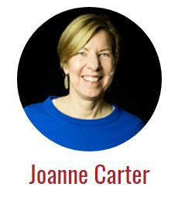
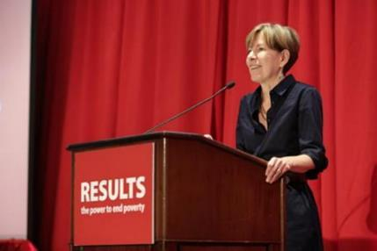
Our Executive Director

Slide 4
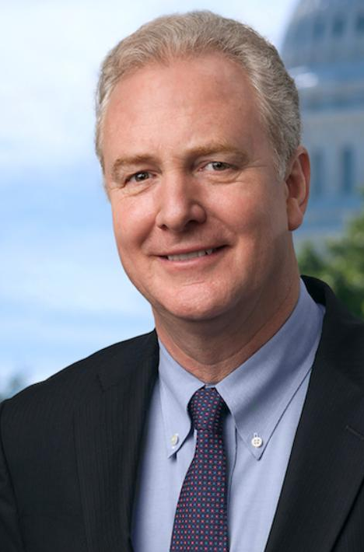
Today’s Guest Senator Chris Van Hollen (D-MD)

Slide 5
Questions?
On the webinar? Unmute by clicking the microphone.
On by phone? Unmute by hitting *6.
If you are not speaking, please stay muted.

Slide 6
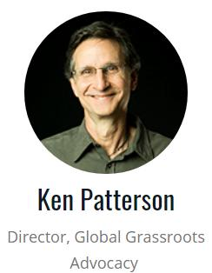
Grassroots Café
Setting the Agenda So Far

Slide 7
“Set the Agenda” Goals
From January – April:
Each group and Free Agent meets with all of the congressional offices we cover.
Each group has at least 1 face-to-face meeting as part of this effort.

Slide 8
Community Engagement Goals
From January – April:
Invite people to join you at meetings with members of Congress, staff, and DC-based foreign policy aides.
Use these experiences to grow the number of RESULTS advocates in your community.

Slide 9
Open Phones and Roleplay
On the webinar? Unmute by clicking the microphone.
On by phone? Unmute by hitting *6.
If you are not speaking, please stay muted.

Slide 10
Tell Us About MoC Meetings
What went well?
Did it make a difference to have a meeting early in the year?
If you met with a new MoC, what was it like starting that relationship?
If you invited new people to join you, were they inspired?

Slide 11
How to share
On the webinar? Unmute by clicking the microphone.
On by phone? Unmute by hitting *6.
If you are not speaking, please stay muted.

Slide 12
Inviting People to Join You with 1:1 Conversations
Don’t fear the “no”. Just ask—no harm will come to you.
Learn about their interests—ask questions and listen.
Connect their interests with what RESULTS does—show how it matches.
Make a plans for the next step—join the meeting, join planning conversation, etc.

Slide 13
Plans Affect Our Impact in the World
Let us know which members of Congress we are talking to
Becomes the agenda for meetings
Show us where we want to stretch to have greater impact
Holds us accountable
Let new people know what we are up to

Slide 14
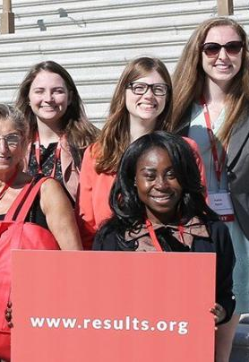
Please Turn in Your Trimester Plans! Help us have impact

Slide 15
Work with your group to:
Practice inviting
Schedule additional meeting with Congress
Decide who to invite to these meetings and invite them
Submit your Group Plan if you have not

Slide 16
Meetings Reported with Congress
Through Early February 2019
Face-to-face with Representatives - 3
With House aides – 4
Total in House = 7
Face-to-face with Senators - 0
With Senate aides - 1
Total in Senate = 1
Grand Total: 8

Slide 17
Your Outreach
Through Early February 2019
Outreach events - 13
New partners/advocates - 18
New Action Network members - 7

Slide 18
Your Media on Global Campaigns
Through Early February 2019
Op-eds - 0
Editorials - 0
Letters to the Editor - 5
Other media – 0
Total = 5

Slide 19
Opportunities to Learn and Share See the Weekly Update for details on how to join
February 11, 1 pm ET and 8 pm ET. RESULTS Global Free Agents Webinars (choose one).
February 12, 9 pm ET. Getting to Know the Global Fund to Fight AIDS, Tuberculosis and Malaria.
February 20, 8:30 pm ET. New Advocate Orientation.

Slide 20
Opportunities to Learn and Share See the Weekly Update for details on how to join
February 20, 9 pm ET. Working With New Members of Congress.
March 6, 8 pm ET. RESULTS Action Network Community of Practice. Join other Action Network Managers to learn and share best practices for building and managing a local Action Network.
March 7, 8:30 pm ET. New Advocate Orientation.

Slide 21
July 13-16 RESULTS International Conference Grand Hyatt Washington Registration is open! Earlybird rate in effect until May 15. www.resultsconference.org

Slide 22
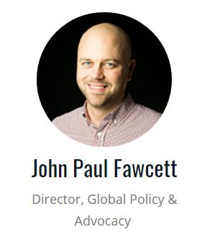
Campaigns Agenda

Slide 23
Appropriations for FY20

Slide 25
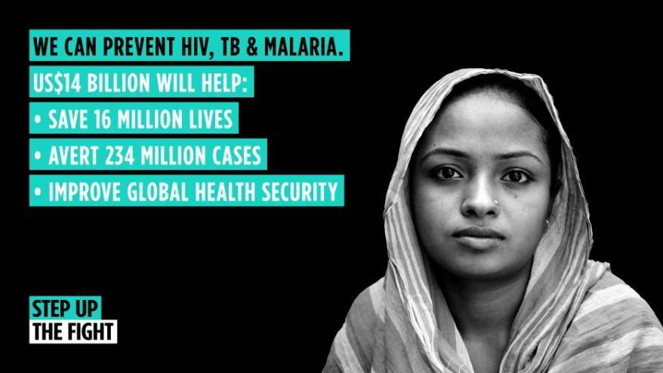
Global Fund Replenishment

Slide 26
Global Fund Replenishment
In January, the Global Fund unveiled its target for the October 2019 replenishment:
$14 billion from 2020-2022
This is a 15 percent increase from the current replenishment period, and will require increased funding from the U.S.

Slide 27
Global Fund Replenishment
Congressional leadership is key!
Continue to Set the Agenda and meet with your members of Congress
The Administration must hear from members of Congress that Global Fund is a priority
Congressional support will be a key signal to other donors as we approach the replenishment in October

Slide 28
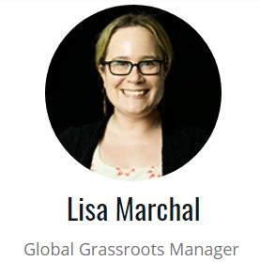
RESULTS Values Statement

Slide 29
How many people
from your group
joined in today’s webinar?
Let us know your numbers
directly in the chat box or send to
Lisa Marchal
lmarchal@results.org

Slide 30
RESULTS is a movement of passionate, committed everyday people. Together we use our voices to influence political decisions that will bring an end to poverty. Poverty cannot end as long as oppression exists. We commit to opposing all forms of oppression, including racism, classism, colonialism, white saviorism, sexism, homophobia, transphobia, ableism, xenophobia, and religious discrimination.

Slide 31
At RESULTS we pledge to create space for all voices, including those of us who are currently experiencing poverty. We will address oppressive behavior in our interactions, families, communities, work, and world. Our strength is rooted in our diversity of experiences, not in our assumptions.

Slide 32
With unearned privilege comes the responsibility to act so the burden to educate and change doesn’t fall solely on those experiencing oppression. When we miss the mark on our values, we will acknowledge our mistake, seek forgiveness, learn, and work together as a community to pursue equity.

Slide 33
There are no saviors — only partners, advocates, and allies. We agree to help make the RESULTS movement a respectful, inclusive space.

Slide 34
Close of Call:
Words of Hope and Encouragement

Slide 35
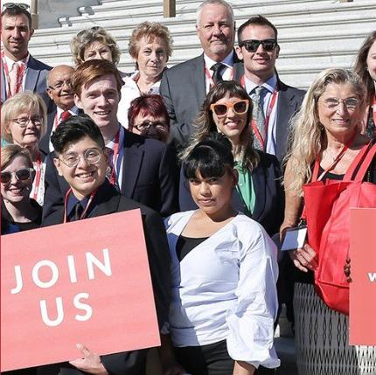
Let’s Keep Setting the Agenda!

Slide 36
Remember that Your Courage and Persistence in Contentious Times Yielded Great Successes in 2018!

