Slide 1
Monthly Webinar February 13, 2025

Slide 2
Welcome everyone!
Let us know where you are joining us
from in the chat!
Share a greeting in another language if you know one.

Slide 3
Our Values & Resources
3
​At RESULTS we pledge to create space for all voices, including those of us who are currently experiencing poverty. We will address oppressive behavior in our interactions, families, communities, work, and world. Our strength is rooted in our diversity of experiences, not in our assumptions.
With unearned privilege comes the responsibility to act so the burden to educate and change doesn’t fall solely on those experiencing oppression. When we miss the mark on our values, we will acknowledge our mistake, seek forgiveness, learn, and work together as a community to pursue equity.
Read our full anti-oppression values statement here at results.org/values.
Check out the Anti-Oppression Workshop Schedule for training opportunities.
Find these resources and more at results.org/volunteers/anti-oppression:
Resource Guides from our Diversity & Inclusion trainings, including:
Interrupting Microaggressions
Creating Space for Critical Conversations
Information on how RESULTS responds to oppressive incidents

Slide 4
Tonight’s Agenda
Welcome & Introductions
USAID Stop Work Order & Emergency Action
First 100 Days Campaign (now through April 2025)
Closing

Slide 5
Checking in…

Slide 6
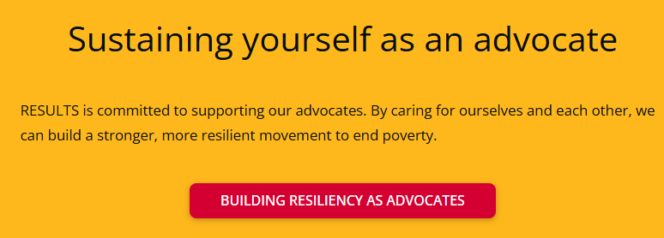
Notes:
Building resiliency as advocates: https://results.org/wp-content/uploads/Building-Resilience-as-an-Advocate_resources.pdf

Slide 7
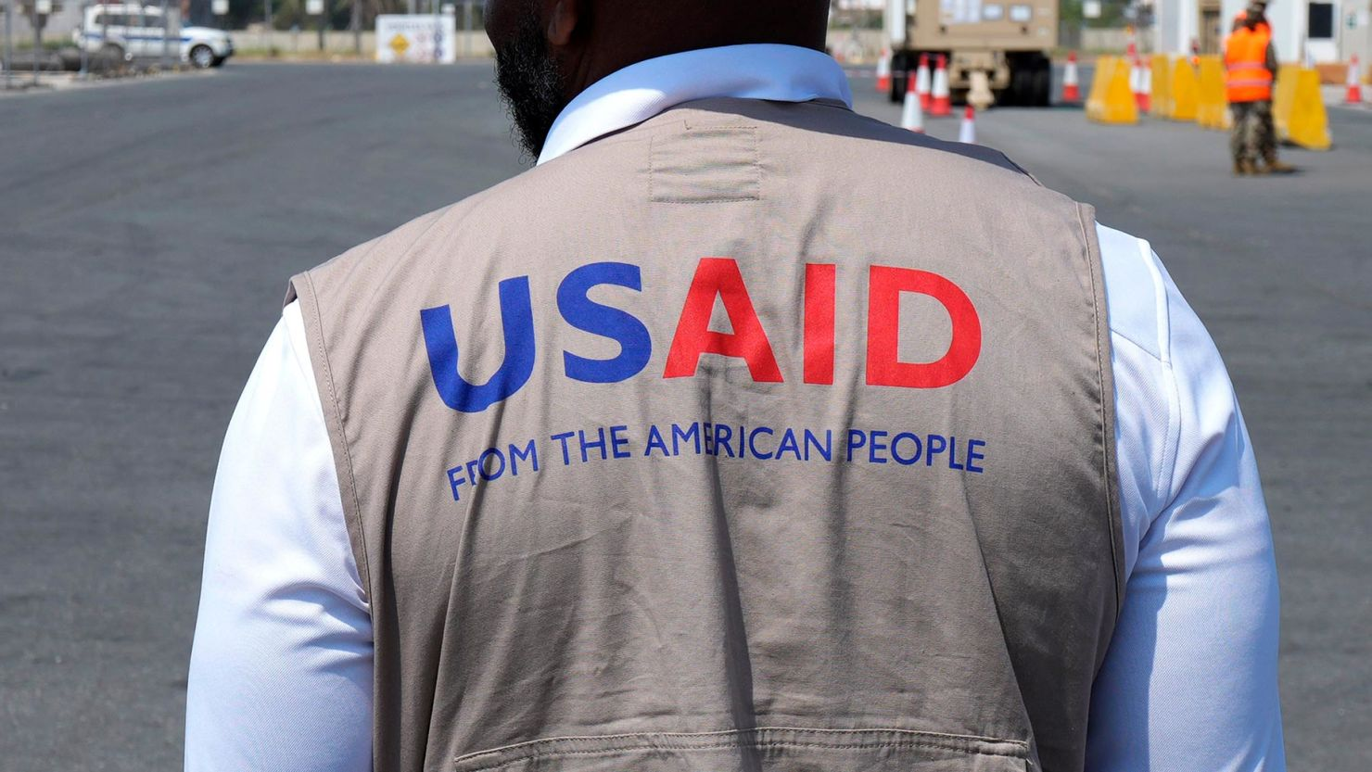
Notes:
https://results.org/blog/emergency-action-to-protect-lifesaving-foreign-aid

Slide 8
Timeline
January 24 - Executive order was issued by the Trump Administration to put an immediate freeze on all foreign aid and a “stop work order.”
January 29 – Internal USAID waiver put in place for all “lifesaving humanitarian assistance” to ensure these core programs continue even during the freeze on all State and USAID programming.
February 2 - On top of the devastating stop work order, media reports that the administration is aiming to shut down USAID by as soon as tomorrow (Feb 3).
Notes:
https://results.org/blog/emergency-action-to-protect-lifesaving-foreign-aid

Slide 9
Timeline
February 6 – USAID office was shuttered on Monday, Feb. 3, and all materials taken offline. On Tuesday, they announced that nearly all employees would be placed on administrative leave, and staff based internationally would be recalled home. The agency has been placed under the authority of the Secretary of State, after operating independently for decades.
February 7 – Internal USAID waiver put in place for all “lifesaving humanitarian assistance” to ensure these core programs continue even during the freeze on all State and USAID programming.
Notes:
https://results.org/blog/emergency-action-to-protect-lifesaving-foreign-aid

Slide 10
The Consequences
In just the first 90 days of halting foreign aid:
60,000 babies will be born not breathing and not able to be resuscitated;
28,000 people with drug resistant tuberculosis will not get life-saving medicine;
7 million children won’t get the nutrition they need to grow up healthy and strong; and,
3 million women will go into labor with no safe facilities to give birth. The Global Health Council Stop-Work Order Impact Report
Notes:
https://results.org/blog/emergency-action-to-protect-lifesaving-foreign-aid

Slide 11
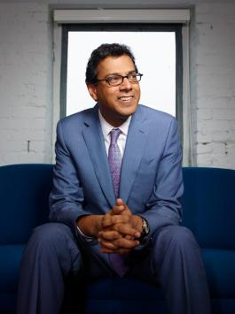
“…there is always a way forward” Dr. Atul Gawande RESULTS National Webinar (February 1)
Notes:
https://results.org/blog/emergency-action-to-protect-lifesaving-foreign-aid

Slide 12
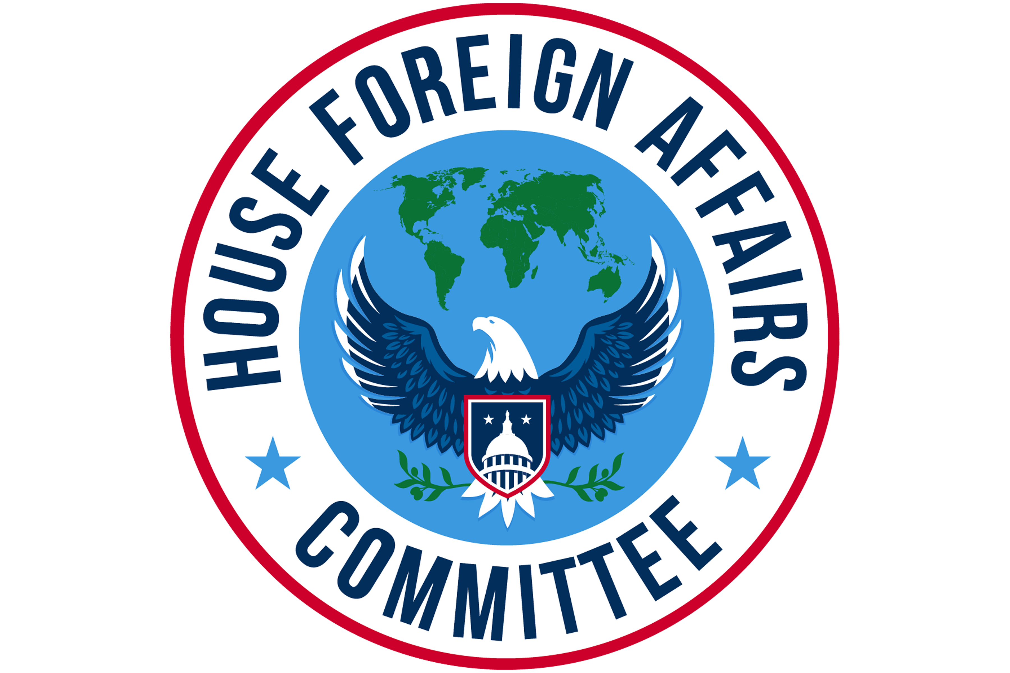
More to come after today’s House Foreign Affairs Committee Hearing…
Notes:
https://results.org/blog/emergency-action-to-protect-lifesaving-foreign-aid

Slide 13
Advocacy Action
Contact your members of Congress, request that:
End the stop-work order, and reinstate critical programs and staff to carry them out.
Push the State Department to verify that programs under the waiver have restarted, and expand the waiver to all global health and development programs.
Ensure Congress is involved in shaping the future of foreign aid — standing up for programs that are focused on ending poverty and creating good health, and committed to humanitarian and lifesaving impact.
Notes:
https://results.org/blog/emergency-action-to-protect-lifesaving-foreign-aid

Slide 14
Take action now!

Slide 15
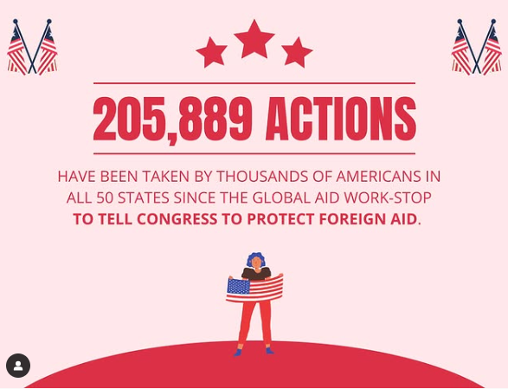

Slide 17
The First 100 Days campaign

Slide 18
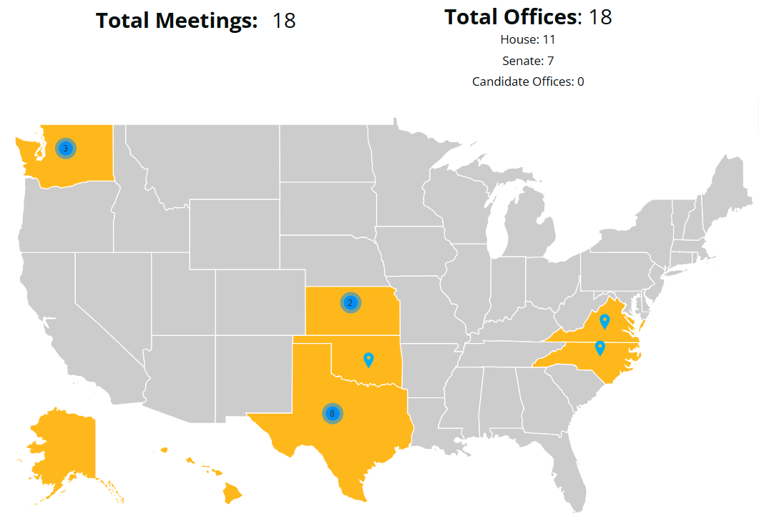
As of 2/13/2025

Slide 19
2025 Campaigns: Appropriations
How we advocate:
Dear Colleague Letters
Appropriations request forms
Direct Outreach to Legislators (Phone calls, emails, lobby meetings)
Media (Letters to the editor, Op Eds, etc.)

Slide 20
2025 Campaigns: Appropriations
USAID Maternal & Child Health, including Gavi, the Vaccine Alliance
USAID Nutrition
USAID Tuberculosis
The Global Fund to Fight AIDS, TB, & Malaria
USAID Basic Education, including Global Partnership for Education

Slide 21
2025 Campaigns: The Global Fund
The Global Fund Replenishment September 2025

Slide 22
Advocacy in 2025
Research & reach out
Continue to write and submit media
Engage with your community
What will be your next step?

Slide 23
Next Webinar:
Thursday, March 13 at 8:30 PM ET Invite others to join: https://tinyurl.com/2025GAPWebinars

