Slide 1
February Webinar February 8, 2024

Slide 2
Welcome everyone!
Let us know where you are joining us
from in the chat!
Share a greeting in another language if you know one.

Slide 3
Our Values & Resources
3
​At RESULTS we pledge to create space for all voices, including those of us who are currently experiencing poverty. We will address oppressive behavior in our interactions, families, communities, work, and world. Our strength is rooted in our diversity of experiences, not in our assumptions.
With unearned privilege comes the responsibility to act so the burden to educate and change doesn’t fall solely on those experiencing oppression. When we miss the mark on our values, we will acknowledge our mistake, seek forgiveness, learn, and work together as a community to pursue equity.
Read our full anti-oppression values statement here at results.org/values.
Check out the Anti-Oppression Workshop Schedule for training opportunities.
Find these resources and more at results.org/volunteers/anti-oppression:
Resource Guides from our Diversity & Inclusion trainings, including:
Interrupting Microaggressions
Creating Space for Critical Conversations
Information on how RESULTS responds to oppressive incidents

Slide 4
Overview of tonight’s webinar
Review our 2024 campaigns
Do a brief overview of the appropriations process
Training: How to have effective lobby meetings
Closing Announcements

Slide 5
Review of 2024 Campaigns
Funding vital programs for health and education
Pushing for a bold US pledge to Gavi, the vaccine alliance
Pushing for a bold US pledge at the Nutrition for Growth Summit
World Bank Accountability

Slide 6
Review of 2024 Campaigns
Tactics:
Meeting with members of Congress and staff
Building relationships with staff through regular contact
Raising our issues in election season
Media
Mobilizing others

Slide 7
Review of 2024 Campaigns
Find an action timeline for 2024 here:
https://results.org/2024-actions-timeline

Slide 8
Background: 2024 Campaigns
Because of advocacy, we've made a lot of progress on poverty globally, 38% to 12%
But at the current rate we won't reach 2030 Sustainable Development Goal of ending extreme poverty.
There are still have 700 million people living on less than $2.15/day. More than half are children.
We need to double-down on our advocacy.

Slide 9
2024: Malnutrition
Malnutrition is an underlying cause of poverty, affecting physical and mental health, and the ability to work.
Malnutrition is the underlying cause of nearly 50% of preventable child deaths, causes stunting (short for age) and is a leading cause of disabilities
1 in 5 children are affected by stunting—it robs children of their future potential.
Good nutrition starts with the mother.

Slide 10
2024: Malnutrition
We will:
Hold USAID accountable on the Global Malnutrition Prevention and Treatment Act.
Advocate for increased funding for global maternal and child health and nutrition.
Lay the groundwork for a US leadership around a Nutrition for Growth (N4G) pledging moment, likely in 2025.

Slide 11
2024: Vaccines
We will:
Advocate for increased funding for Gavi, the Vaccine Alliance.
Lay the groundwork for a bold, 4-year, US pledge for the Gavi replenishment moment.
Gavi has vaccinated over 1 billion children and prevented 17 million deaths.
Notes:
Ken

Slide 12
2024: Education
We will:
Advocate for the passage of the READ Act
Advocate for increased funding for global education, particularly the Global Partnership for Education (GPE)
Lay the groundwork for a bold US pledge the Global Partnership for Education during an upcoming pledging moment
Notes:
Ken

Slide 13
2024: Our Boldness
We need to feature our boldness and fearlessness in 2024, taking action, reaching out to others, showing that they too can be powerful.
This is an election year and a lot of people will be searching for ways to make a difference. Voting is only the first step.
Notes:
Ken

Slide 14
FY25 Appropriations
FY25 Appropriations

Slide 15
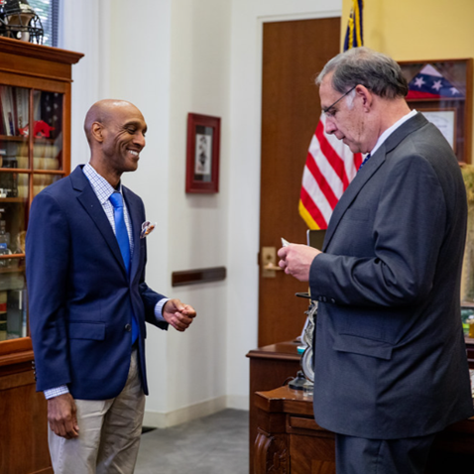
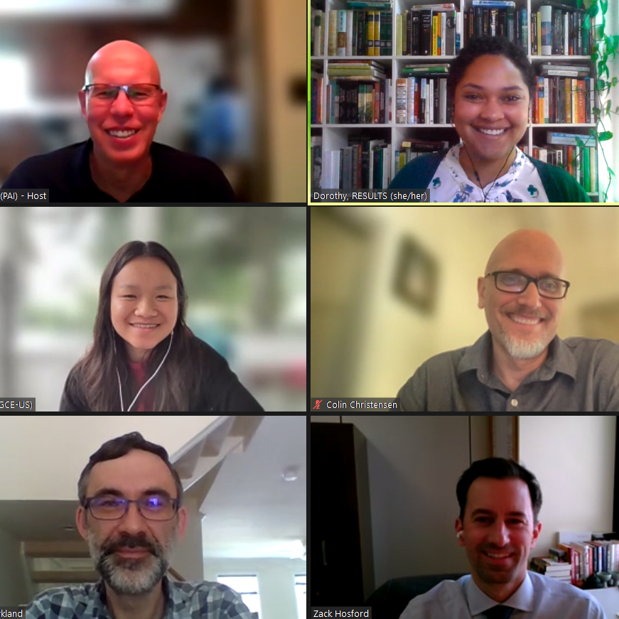
1) meeting with members of Congress & staff at home & in DC, and making our requests
We influence appropriations by…
Notes:
Mention lobby prep, Set the Agenda resources
Most Americans don’t follow the Appropriations process, meaning members of Congress don’t always feel pressure from their constituents to fight for specific programs. But you can get our issues on their radar by sending an email, calling their offices, and asking for a meeting with their Foreign Policy staffers. Your goal is to introduce our appropriations asks, share why those issues matter to you, and ask your senator or representative to speak to members of SFOPs about our requests.

Slide 16
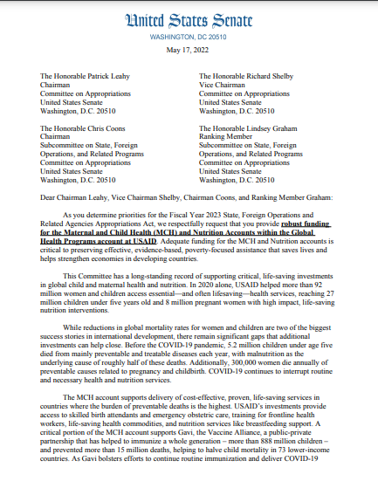
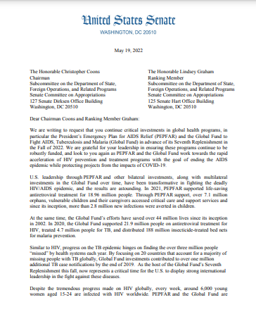
2) requesting that our members of Congress sign signatures “dear colleague” letters
we influence appropriations by…
Notes:
DCs- one for each issue
During the appropriations process, members of Congress can make their priorities known by signing on to “Dear Colleague” letters for issues that they care about. Each letter is circulated by champions in Congress asking other members to join them, like a petition. Then, the letters are sent to the leaders of the SFOPs subcommittee, which writes the foreign aid spending bill. These letters can have a lot of sway, and a large number of bipartisan signers shows the committee that there is strong support for that issue.
Our job is to ask members of Congress to sign the letters we’re endorsing. Typically, we prioritize Dear Colleague letters on global Tuberculosis, Maternal and Child Health and Nutrition, the PEPFAR/ Global Fund to Fight AIDS, Tuberculosis, and Malaria, and global education.

Slide 17
The Impact of Dear Colleague Letters
Account | FY17 Signers | FY17 Funding | FY20 Signers | FY20 Funding | FY23 Signers | FY23 Funding
USAID Maternal and Child Health | 146 House 27 Senate | $814.5 million | 146 House 37 Senate | $851 million | 178 House 35 Senate | $910 million
USAID Tuberculosis | 71 House 16 Senate | $241 million | 77 House 29 Senate | $310 million | 120 House 30 Senate | $394.5 million
Notes:
Increased number of signers-- higher priority for SFOPS-- greater funding

Slide 18
Advocacy Training:
How to request and prepare for an effective lobby meetings

Slide 19
Goal:
Meet with all of our members of Congress between February – April

Slide 20
Who has not met with a member of Congress and/or staff? What are your questions or concerns?
Notes:
Ken

Slide 21
Who has requests and met with a member of Congress and/or staff? How does it work?
Notes:
Ken

Slide 22
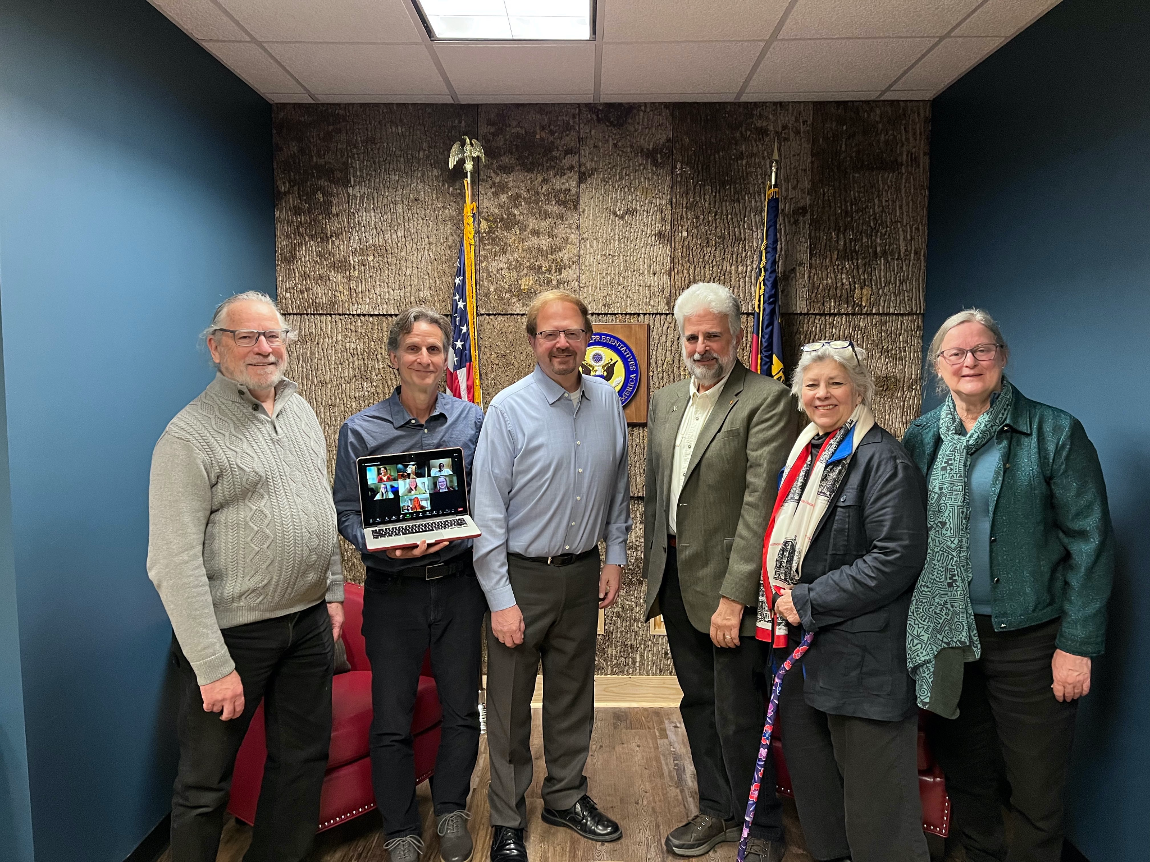
Meeting with new Rep: Chuck Edwards (NC-11) on Jan. 13, 2023
Notes:
Ken

Slide 23
Scheduling a congressional meeting
https://www.youtube.com/shorts/OZ1QTIKddBQ
Notes:
https://youtube.com/shorts/OZ1QTIKddBQ?si=iwiwjTOYdxTprt4a
1 min video featuring Ken Patterson

Slide 24
Request to meet with your member of Congress: a) Use Legislator Look Up, find the scheduler b) Use sample meeting request letter, copy staff
Request times that work with the people you want to join you if possible
Follow up on the request!
Requesting a Meetings
with Congress
Notes:
Ken

Slide 25
Requesting a Meeting
Once you have a time, invite people to join you: RPCVs, friends, family, RESULTS, faith community
Contact Karyne or Ken to set up a meeting planning time.
Review materials, leave behinds, laser talks
Notes:
Ken

Slide 26
Preparing to Meet
Create an agenda and assign roles using the RESULTS Lobby Planning Form
Practice speaking points (EPIC)
Reconfirm your meeting the day before
Notes:
Ken

Slide 27
After Your Meeting
Send a thank you note and summary of asks
Report your meeting
Continue to follow up on requests
Notes:
Ken

Slide 28
Who wants to try?
Notes:
Ken

Slide 29
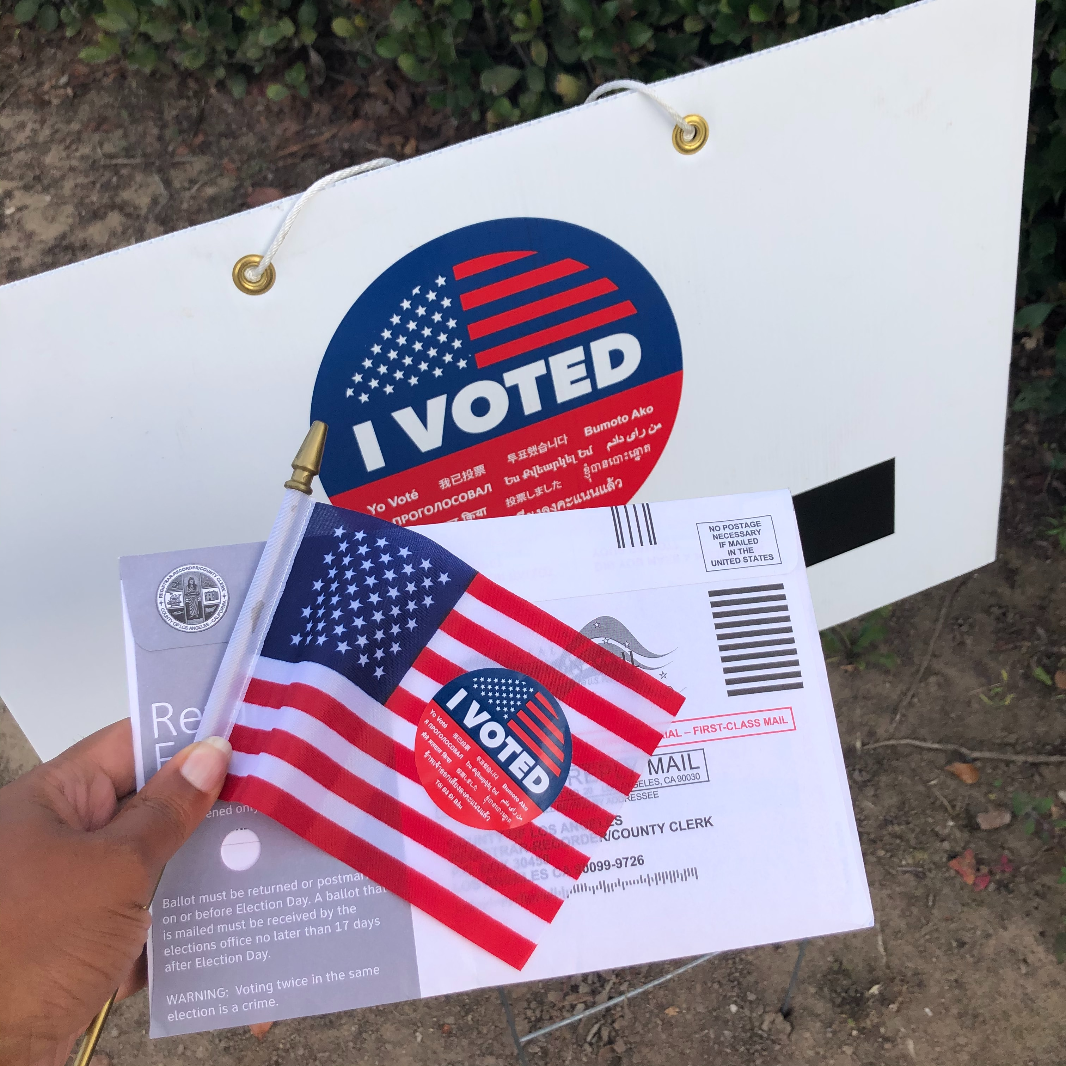
What’s coming up?
Photo courtesy of Unsplash.com (Janice Robinson)

Slide 30
Notes:
Peace Corps Week 2024 February 25 to March 2 “Optimism in Action” https://www.peacecorps.gov/peace-corps-week/#:~:text=February%2025%20to%20March%202,States%20and%20around%20the%20world.

Slide 31
NPCA Capitol Hill Day of Advocacy March 7 Register by Monday, February 26

Slide 32
Join our next GAP webinar: March 14 at 8:30 PM ET Feel free to bring a friend or fellow RPCV!

Slide 33
RESULTS March 2 Webinar: International Women’s Day Panel: Health and Nutrition
RESULTS April 6 Webinar: RESULTS Founder, Sam Daley Harris
Register to Join

Slide 34
Thanks for joining us tonight!

