Slide 1
Appropriations 101 February 19, 2025 Welcome!

Slide 2
Our Values
At RESULTS we pledge to create space for all voices, including those of us who are currently experiencing poverty. We will address oppressive behavior in our interactions, families, communities, work, and world. Our strength is rooted in our diversity of experiences, not in our assumptions.
With unearned privilege comes the responsibility to act so the burden to educate and change doesn’t fall solely on those experiencing oppression. When we miss the mark on our values, we will acknowledge our mistake, seek forgiveness, learn, and work together as a community to pursue equity.
Read our full anti-oppression values statement here at results.org/values.
Notes:
Updated AO slide (2/22)

Slide 3
Welcome!
Katie Fleischer Senior Advocacy Associate, Policy and Government Affairs
kfleischer@results.org

Slide 4
Why Appropriations?
Appropriations is a "dam" to shore up support for foreign aid
If we aren't talking about our issues— nobody is!
Source: Unsplash

Slide 5
The Federal Budget

Slide 6
Understanding the budget
How is the U.S. government funded?
Your federal taxes
How much is the annual U.S. budget?
Over $4 trillion
How much of that is poverty-focused global development?
Less than 1%

Slide 7
FY25 Federal Revenue
Source: CBO

Slide 8
FY25 Federal Spending
Source: CBO

Slide 9
Federal Spending
Mandatory spending:
Required by law, does not need to be approved every year
Ex. Medicare, Medicaid, SNAP, Social Security
Discretionary spending:
Incudes Defense (DOD) and Non-Defense (NDD)
NDD: Education, housing choice vouchers, WIC, scientific research, infrastructure, national parks, environmental protection, foreign assistance...

Slide 10
FY25 Discretionary Funding
Source: CBO

Slide 11
FY24 Non-defense Discretionary
Source: CBPP, data from OMB

Slide 12
The Appropriations Process

Slide 13
power of the purse
"No money shall be drawn from the Treasury, but in Consequence of Appropriations made by Law…”
Photos via Unsplash, Design: Dorothy Monza
Notes:
Article I, section 9, clause 7 of the U.S. Constitution states that "No money shall be drawn from the Treasury, but in Consequence of Appropriations made by Law..." This is what gives Congress the power to make these appropriations. The President, however, still has the power to veto appropriations bills.^{[2]} However, the President does not have line-item veto authority so that he must either sign the entire bill into law or veto it.

Slide 14
Congress decides where our money goes
Legally, it is Congress who decides how to spend money during the appropriations process
They can designate funding for health, education, and economic opportunity for families around the world

Slide 15
President’s Budget Request
A policy document, laying out the administration’s proposed vision
Can be “dead on arrival” even within the same party
The Office of Management and Budget (OMB) begins working on it up to 18 months before the start of the fiscal year

Slide 16
Appropriations Committees
12 subcommittees in each Chamber
Each is responsible for one appropriations bill
Our focus:
House: National Security, Department of State, and Related Programs (Formerly SFOPS)
Senate: State, Foreign Operations, and Related Programs (SFOPS)

Slide 17
What’s supposed to happen
President’s budget request
APPROPRIATIONS COMMITTEES
BUDGET COMMITTEES
OTHER COMMITTEES
Hold hearings
Draft and mark up budget resolution
Submit views and estimates to budget committees
Set suballocations to subcommittees: 302(b)
Hold hearings, set topline discretionary spending limit: 302(a)
Subcommittees draft and report bills
Full committees vote on bills and send to floor
Source: Congressional Research Service
Notes:
https://sgp.fas.org/crs/misc/R46468.pdf

Slide 18
What’s supposed to happen
February: PBR sent to Congress
March: Budget resolutions
April: Suballocations set, subcommittees draft bills
May: Bills advanced to Appropriations committee and full House/Senate
Sep 30: Final deadline for all 12 bills to avoid a government shutdown

Slide 19
What actually happens
PBR is often delayed
Congress may not pass a budget resolution
In 50 years, Congress has only managed to pass all 12 bills four times
Continuing resolutions (CR) are common
All aboard the omnibus!
Source: Unsplash

Slide 20
Where are we now?
FY25 runs until September 30
FY25 Appropriations are still ongoing
Long-term CR in effect
Another month-long or year-long CR is possible
CR deadline: March 14
Both Chambers passed budget resolutions last week

Slide 21
Possible FY26 Timeline
February: Member Forms beginning to open
March: Dear Colleague letters open, Member Forms open
April: Dear Colleague letters close, subcommittees draft bills
May: Delayed PBR released, full committees pass bills
Sep 30: Deadline for a CR or FY26 bills

Slide 22
Take Action!

Slide 23
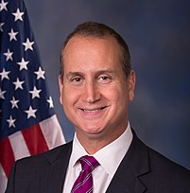
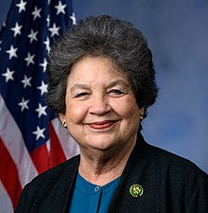
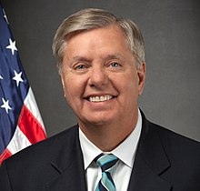
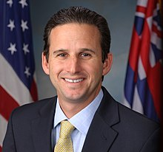
SFOPS Subcommittee Leadership
Chair Mario Diaz-Balart (R-FL)
Ranking Member Lois Frankel (D-FL)
Chair Lindsey Graham (R-SC)
Ranking Member Brian Schatz (D-HI)
Full Membership: appropriations.house.gov; appropriations.senate.gov

Slide 24
FY26 Appropriations
Account | FY24 Enacted | FY25 House | FY25 Senate | FY26 RESULTS Ask
Global Fund to Fight AIDS, TB and Malaria | $1.65 billion | $1.25 billion | $1.2 billion | $2 billion
USAID Tuberculosis | $394.5 million | $394.5 million | $394.5 million | $1 billion
USAID Maternal and Child Health | $915 million | $915 million | $940 million | $1.15 billion
Of which, Gavi | $300 million | $300 million | $300 million | $340 million
USAID Nutrition | $165 million | $172.5 million | $165.5 million | $300 million
USAID Basic Education | $922 million | $922 million | $640.55 million | $1.15 billion
Of which, GPE | $121.6 million | $121.6 million | $85 million | $200 million

Slide 25
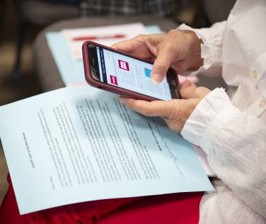
We influence appropriations by…

Slide 26
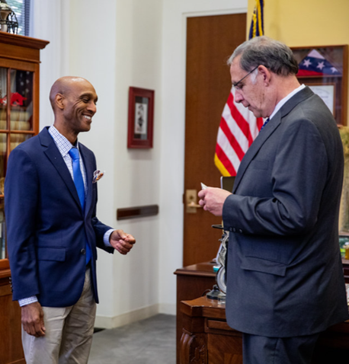
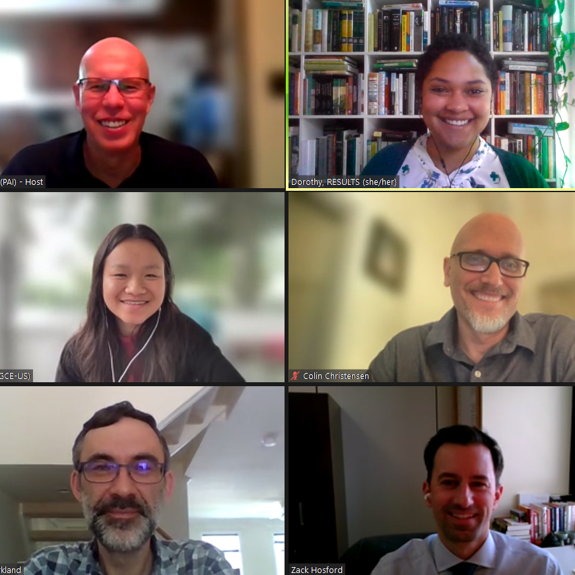
Meeting with MoCs and their staff
In DC, at home, and virtually

Slide 27
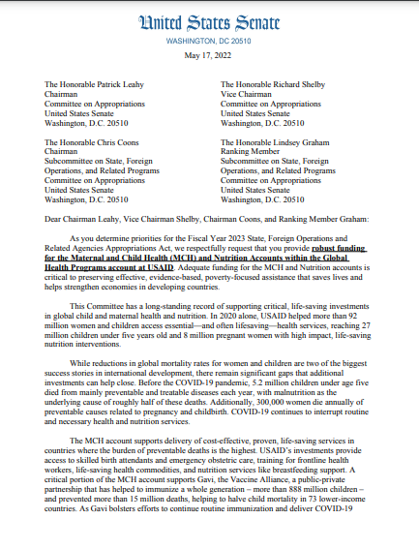
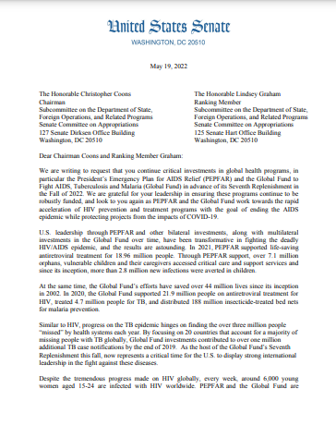
Requesting signatures on “Dear Colleague” letters

Slide 28
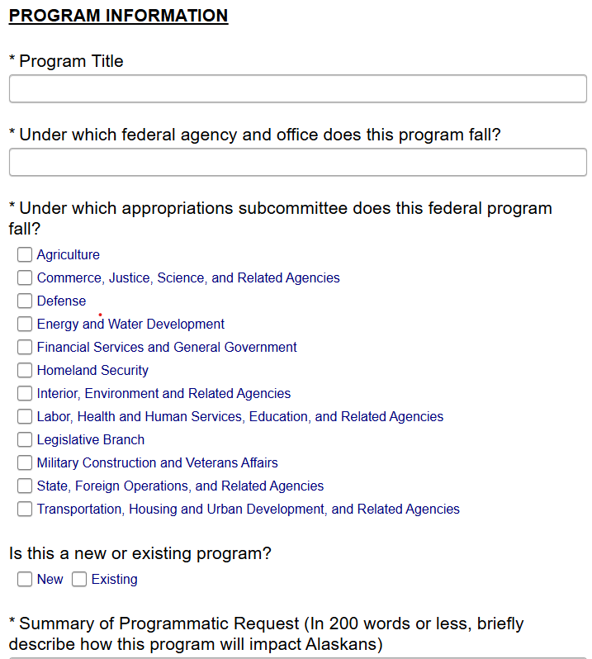
Asking MoCs to submit our funding levels in their personal requests

Slide 29
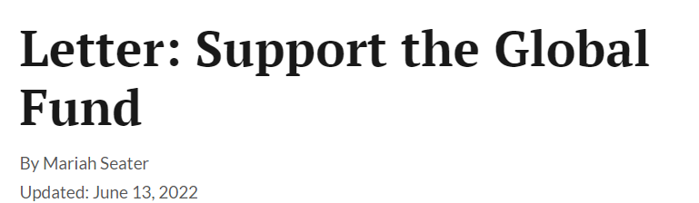
Generating local media
Source: Unsplash

Slide 30
Next Steps

Slide 31
Schedule meetings and lobby prep!
Katie can schedule a lobby prep session for you and your group!
Pay attention to:
Member form deadlines— ask offices for their forms
One-off opportunities like SFOPS Member’s Day
SFOPS subcommittee deadlines for Dear Colleague letters and personal requests
Appropriations committee members can continue to weigh in after deadlines

Slide 32
FY26 Resources
Leave-behind memos and Member Form cheat sheets: results.org/resources/fy26-global-appropriations-memos
Dear Colleague letters: Coming soon!
Member Form Office Hours: Coming soon!

Slide 34
RESULTS website and social media

