Slide 1
Rise Advocacy Chapter Monthly Webinar
June 18 2024

Slide 2
Welcome
Please let us know in the chat where you are joining us from!
Notes:
Susan
8:30-8:35 PM: Welcome/Introductions (Leslye)
Susan & Karyne can check for new names
Welcome new folks, Please let us know in the chat where you are based. Introduce yourself since first time you are doing this.
Be sure to introduce people, Introduce Ken and Karyne and the rest of the Advocacy team of mentors and committee –Anne Child, Sarah Leone, Joanna Distefano, Susan Wright, Leslye Heilig, Margaret Moodian
Invite new folks to introduce themselves in the chat and share about their interest in advocacy
This is a non-partisan space where we learn how to build relationships with our members of Congress to influence policy. We center ourselves around mutual respect and inclusion.
Intro to vision and values of both organizations, provide the links to full statements
Invite Rise members to learn more about RESULTS by exploring their website, and RESULTS members to do the same with Together Women Rise. Review mission/vision/anti-oppression (only feel need to read full statement if there is time, but share links in any case)

Slide 3
Mission & Vision
Together Women Rise’s Mission
Together Women Rise cultivates the collective power of community to achieve global gender equality.
OUR VISION
Together Women Rise envisions a world where every person has the same opportunities to thrive regardless of their gender or where they live.
Notes:
Susan
Together Women Rise:
Vision
Together Women Rise envisions a world where every person has the same opportunities to thrive regardless of their gender or where they live.
Gender Equality Beliefs
Together Women Rise champions gender equality because women’s rights are human rights. When women and girls are treated equally, the world is healthier, safer, more peaceful, inclusive, and economically just for everyone.
https://togetherwomenrise.org/our-anti-oppression-commitment/

Slide 4
Our Values & Resources
​At RESULTS we pledge to create space for all voices, including those of us who are currently experiencing poverty. We will address oppressive behavior in our interactions, families, communities, work, and world. Our strength is rooted in our diversity of experiences, not in our assumptions.
With unearned privilege comes the responsibility to act so the burden to educate and change doesn’t fall solely on those experiencing oppression. When we miss the mark on our values, we will acknowledge our mistake, seek forgiveness, learn, and work together as a community to pursue equity.
Read our full anti-oppression values statement here at results.org/values.
Find these resources and more at results.org/volunteers/anti-oppression:
Resource Guides from our Diversity & Inclusion trainings, including:
Interrupting Microaggressions
Creating Space for Critical Conversations
Information on how RESULTS responds to oppressive incidents
Notes:
Susan
RESULTS Anti-Oppression Statement: https://results.org/volunteers/anti-oppression

Slide 5
Campaign Updates
Notes:
Karyne

Slide 6
FY25 Appropriations
Notes:
Karyne
8:35-8:45 PM: Campaigns Updates (Ken)
World Bank advocacy action, letter that closed on 4/12 (maybe share a copy of the letter if we have it by then)
FY25 Appropriations
Dear Colleague Letters, with squishy deadlines - on the RESULTS blog linked here: https://results.org/blog/fy25-appropriations-tell-congress-to-fund-the-fight-against-poverty
House Basic Education letter closes 4/17 Close of Business (maybe take action on this one the night of the webinar)
Others are TBD, but give us some urgency
Scorecard for Dear Colleague letters can be found at the top of the page, direct link: https://docs.google.com/spreadsheets/d/1x35soUUCN2Io0sPfBvqIdjnQ6Sa6I_31HC-HVi2MlAo/edit?usp=sharing
Completing forms online (share about the training coming up by RESULTS on this?)
So you can see how the money we advocate for shows up on the ground, we will hear from Susan who will share a story from her work with USAID in Madagascar

Slide 7
FY25 Appropriations
Notes:
Karyne

Slide 8
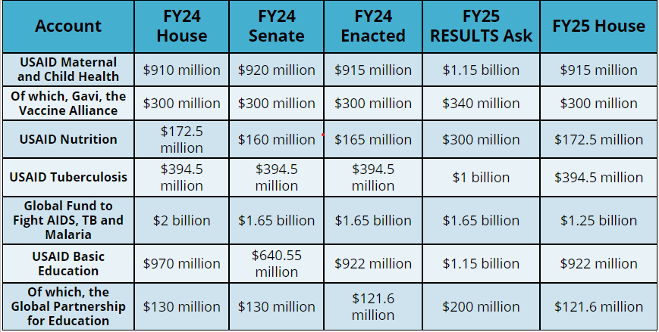
Where are we with FY25 appropriations?
Notes:
Karyne
8:30-8:35 PM: Welcome/Introductions (Leslye)
Susan & Karyne can check for new names
Welcome new folks, Please let us know in the chat where you are based. Introduce yourself since first time you are doing this.
Be sure to introduce people, Introduce Ken and Karyne and the rest of the Advocacy team of mentors and committee –Anne Child, Sarah Leone, Joanna Distefano, Susan Wright, Leslye Heilig, Margaret Moodian
Invite new folks to introduce themselves in the chat and share about their interest in advocacy
This is a non-partisan space where we learn how to build relationships with our members of Congress to influence policy. We center ourselves around mutual respect and inclusion.
Intro to vision and values of both organizations, provide the links to full statements
Invite Rise members to learn more about RESULTS by exploring their website, and RESULTS members to do the same with Together Women Rise. Review mission/vision/anti-oppression (only feel need to read full statement if there is time, but share links in any case)

Slide 9
Congrats on Dear Colleague Letters!
Dear Colleague Letters | House FY25 | House FY24 | Senate FY25 | Senate FY24
MNCH, Gavi, Nutrition | 138 | 154 | 39 | 42
TB | 131 | 129 | 26 | 33*
Global Fund | 161 | 144 | 36 | 38
Education | 115 | 129 | 33 | 36
Notes:
Karyne
8:30-8:35 PM: Welcome/Introductions (Leslye)
Susan & Karyne can check for new names
Welcome new folks, Please let us know in the chat where you are based. Introduce yourself since first time you are doing this.
Be sure to introduce people, Introduce Ken and Karyne and the rest of the Advocacy team of mentors and committee –Anne Child, Sarah Leone, Joanna Distefano, Susan Wright, Leslye Heilig, Margaret Moodian
Invite new folks to introduce themselves in the chat and share about their interest in advocacy
This is a non-partisan space where we learn how to build relationships with our members of Congress to influence policy. We center ourselves around mutual respect and inclusion.
Intro to vision and values of both organizations, provide the links to full statements
Invite Rise members to learn more about RESULTS by exploring their website, and RESULTS members to do the same with Together Women Rise. Review mission/vision/anti-oppression (only feel need to read full statement if there is time, but share links in any case)

Slide 10
What to do?
Thank members who signed: see the FY25 scorecard.
See and share the signed letters! Find them here.
Notes:
Karyne
8:30-8:35 PM: Welcome/Introductions (Leslye)
Susan & Karyne can check for new names
Welcome new folks, Please let us know in the chat where you are based. Introduce yourself since first time you are doing this.
Be sure to introduce people, Introduce Ken and Karyne and the rest of the Advocacy team of mentors and committee –Anne Child, Sarah Leone, Joanna Distefano, Susan Wright, Leslye Heilig, Margaret Moodian
Invite new folks to introduce themselves in the chat and share about their interest in advocacy
This is a non-partisan space where we learn how to build relationships with our members of Congress to influence policy. We center ourselves around mutual respect and inclusion.
Intro to vision and values of both organizations, provide the links to full statements
Invite Rise members to learn more about RESULTS by exploring their website, and RESULTS members to do the same with Together Women Rise. Review mission/vision/anti-oppression (only feel need to read full statement if there is time, but share links in any case)

Slide 11
Story share from USAID work inGhana
Notes:
Susan

Slide 12
Grantee Spotlight
GAIA Vaccine Foundation
Notes:
Susan

Slide 13
GAIA Vaccine Foundation (Mali)
Grant Amount: $48,522 Mission of Gaia Vaccine Foundation GAIA Vaccine Foundation's mission is to reduce the incidence of infectious diseases that disproportionately affect the underserved and promote the development of globally relevant, globally accessible vaccines that can be distributed on a not-for-profit basis in the developing world.
Summary Our grant will fund a year-long educational community outreach campaign on HPV, the HPV vaccine and cervical cancer. This campaign will assist in the introduction of the HPV vaccine to Mali and improve general knowledge about HPV/cervical cancer so that women and girls are able to make informed decisions that are in the best interests of their health and wellbeing. Why We Love This GAIA Vaccine works in conjunction with social influencers, religious leaders, renowned musicians, nurses, and doctors involved in women’s health care. It engages, educates, and destigmatizes information on HIV/AIDS by using storytelling cloths illustrating information about HIV transmission. These cloths are a unique and effective health education tool for a mostly illiterate society.
Notes:
Susan
Grant Amount: $50,000 Mission of Fistula Foundation Fistula Foundation is the global leader in fistula treatment, providing more surgeries to more women than any other organization, including the U.S. government and United Nations.
Summary This grant supports training of Community Health Volunteers and patient ambassadors, and radio advertising to spread awareness of fistula and fistula treatment options to enable the referral and treatment of women at two partner facilities in Tanzania. This will increase the number of women receiving life-transforming treatment and will add more community-based organizations to build the local capacity to offer quality treatment to women. Why We Love This We love the Fistula’s Foundation’s work because it addresses a significant need for fistula treatment and brings light to cultural norms and education around younger mothers and child marriage that contribute to this condition, while also providing prevention and awareness.

Slide 14
Notes:
Karyne

Slide 15
why gavi? why now?
Notes:
Karyne

Slide 16
Notes:
Karyne

Slide 17
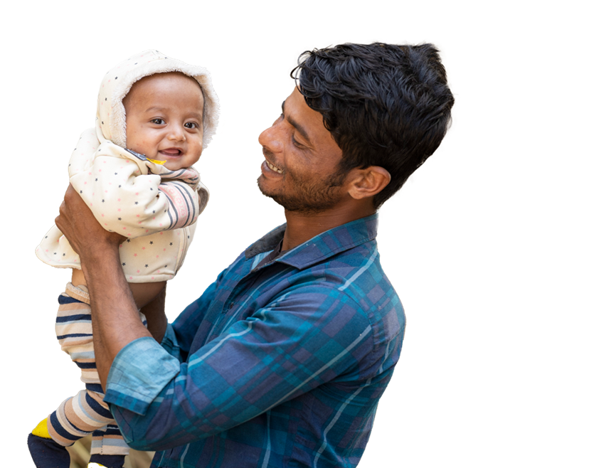
Gavi has helped prevent more than 17 million future deaths
Notes:
Karyne

Slide 18
gavi by the numbers
1 billion children immunized
17 million future deaths prevented
50% of the world’s children vaccinated by Gavi
$54 returned for every $1 invested
19 countries transitioned out of support
Notes:
Karyne

Slide 19
why gavi? why now?
Notes:
Karyne

Slide 20
JUNE
Investment Opportunity Launch
Paris, France
20
Notes:
Karyne -
Gavi will launch their investment case to fund their next strategic period from 2026-2030.
https://www.gavi.org/our-alliance/strategy/phase-6-2026-2030

Slide 21
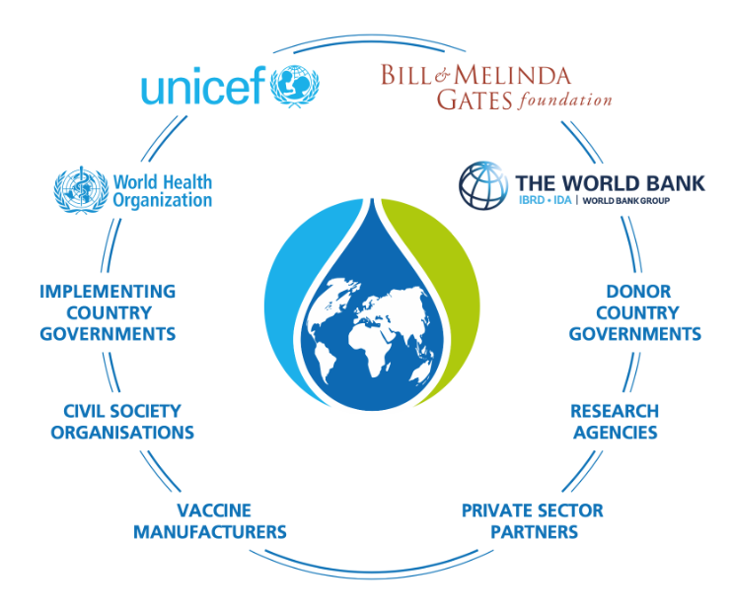
Notes:
Karyne

Slide 22
Gavi Resolutions – H.Res. 1286/ S. Res. 684
Senate Lead Sponsors: Sens. Wicker (R-MI) and Cardin (D-MD) House Lead Sponsors: Representatives Kean (R-NJ), Amo (D-RI), Salazar (R-FL), and Jacobs (D-CA).
Calls for United States to have supporting role in saving children’s lives of children and protecting people’s health through Gavi, the Vaccine Alliance.
Gavi has been a major contributor in reducing the number of childhood deaths in lower-income countries due to vaccine-preventable disease by 70 percent since 2000.
Country ownership and sustainability are at the core of the Gavi model.
Notes:
Gavi will launch their investment case to fund their next strategic period from 2026-2030.
https://www.gavi.org/our-alliance/strategy/phase-6-2026-2030

Slide 23
Advocacy Action:
Take Action on Gavi!
Check this scorecard see if your Representative or Senator has signed on to the Gavi Resolution (H. Res. 1286/ S. Res. 684).
Use Legislator Lookup (if you are unsure of who to reach out to, please don’t hesitate to reach out to us for support).
Email convention: FirstName_LastName@SenatorsLastName.Senate.Gov (example: alex_moree@rubio.senate.gov).
Personalize this sample email requesting your members of Congress co-sponsor H. Res. 1286 or S. Res. 684.
Follow up!
Notes:
Karyne

Slide 24
Wednesday, June 26 – UnCharitable Documentary Discussion
Upcoming Events
Notes:
Leslye
- Together Women Rise Grantees - Join the virtual national chapter meeting with a speaker from the grantee each month on the first Thursday of the month at 8 PM ET: Thursday, June 6th https://togetherwomenrise.org/upcoming-events/ - Together Women Rise Advocacy Chapter Monthly Webinar Tuesday, June 18 at 8:30 PM ET

Slide 25
Together Women Rise July Webinar - New Time: Monday, July 1 at 8 PM ET
Upcoming Events
Notes:
Leslye
- Together Women Rise Grantees - Join the virtual national chapter meeting with a speaker from the grantee each month on the first Thursday of the month at 8 PM ET: Thursday, June 6th https://togetherwomenrise.org/upcoming-events/ - Together Women Rise Advocacy Chapter Monthly Webinar Tuesday, June 18 at 8:30 PM ET

Slide 26
Advocacy Chapter - July Webinar
Special Guest - Colton Roughen District Representative for Congressman Mike Levin (CA-49)
Join us
Tuesday, July 18
8:30 PM ET
Notes:
Margaret
https://togetherwomenrise.org/upcoming-events/

Slide 27
Save the date!
Fall Rise Advocacy Chapter Orientation
Tuesday, September 24 8:30 PM ET
Notes:
Margaret
https://togetherwomenrise.org/upcoming-events/

Slide 28
Invite others to join us in
changing the world together!
Sign up here: http://tinyurl.com/JoinRiseAdvocacyChapter

Slide 29
vaccines save lives

Slide 31
Vaccines are crucial for children because they are particularly vulnerable to infectious illnesses.
Notes:
Children are not “mini adults” for infections. When we are babies and young children, our bodies have usually not been exposed to many diseases, and our ability to fight off infection — our immune system — is weak. Vaccines teach our bodies to have an immune response to common diseases. Your immune system keeps a memory of this, as a “blueprint” for how to respond, so you are less likely to get seriously sick in the future.

Slide 32
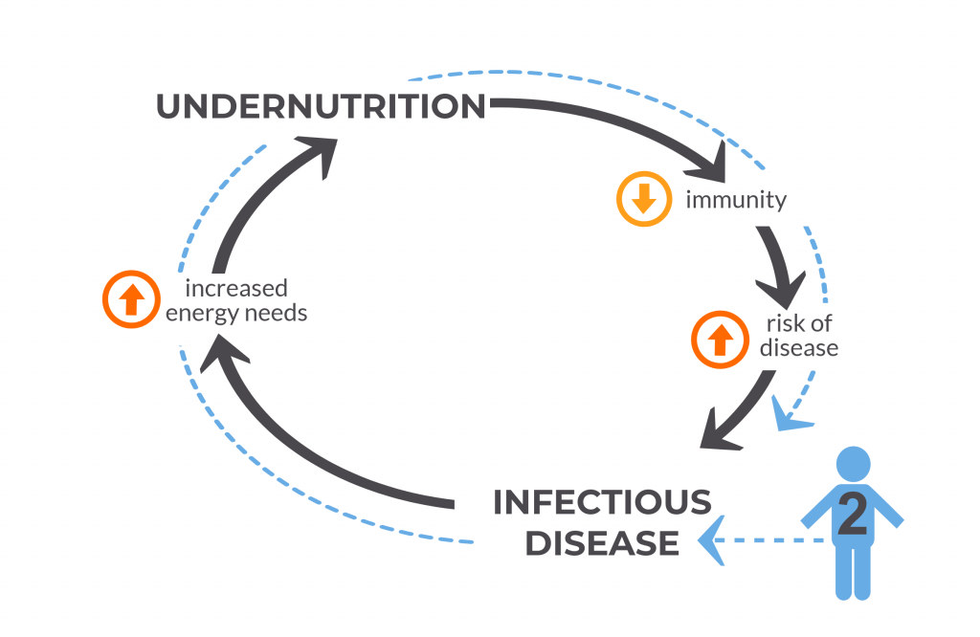
Notes:
https://immunizationevidence.org/wp-content/uploads/2022/08/NGD-VoICE-Figure-4-April-2018-1024x768-1.png

Slide 33
1920’s to 1960’s
Astounding number of new & effective vaccines

Slide 34
Child mortality by income level of country
The estimated share of newborns who die before reaching the age of five.
^{18%}
^{16%}
^{14%}
^{12%}
^{10%}
^{8%}
Low-income countries
^{6%}
^{4%}
Lower-middle-income countries
^{2%}
Upper-middle-income countries
^{0%}
High-income countries
1990
1995
2000
2005
2010
2015
2021
Data source: United Nations Inter-agency Group for Child Mortality Estimation (2023)
OurWorldInData.org/child-mortality | CC BY
Notes:
Unfortunately, progress is not reaching all communities and families at the same pace. If you take a closer look at the data, it is clear that inequality has extreme become much more extreme. In the richest parts of the world, child deaths have become rare due to improved living conditions and sustained government investment in social safety nets and routine immunization programs.

Slide 35
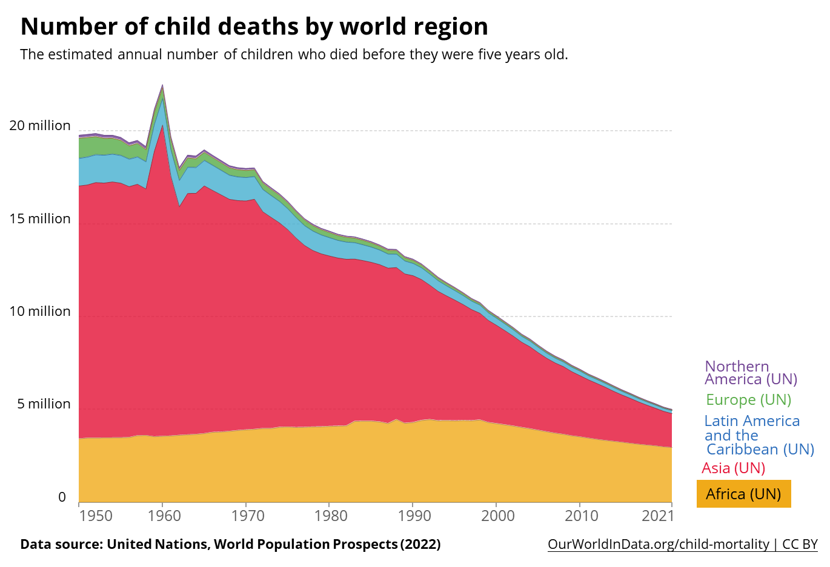
Notes:
And the vast majority of the decrease in child mortality has been due to improvements in the Asia region. There is still an extremely dire child mortality crisis, and it’s being felt especially hard in Africa.

Slide 36
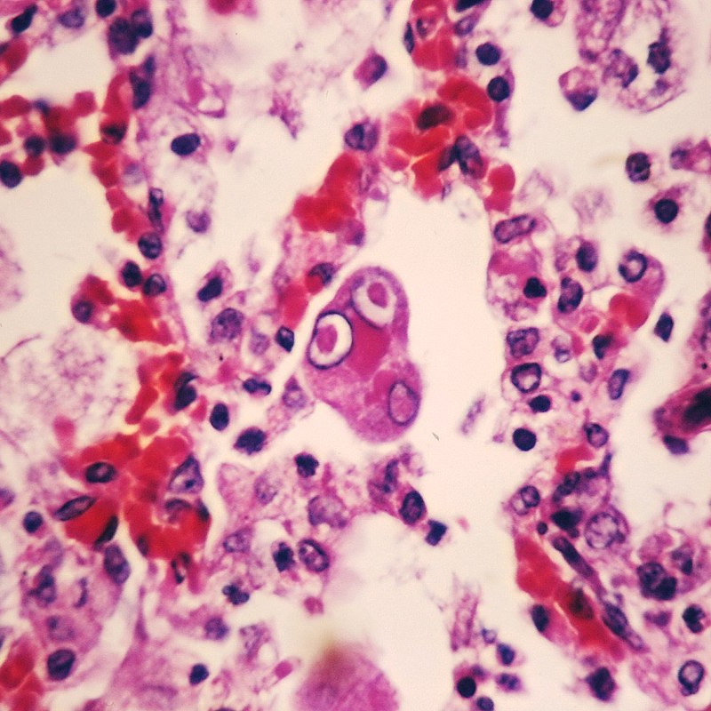
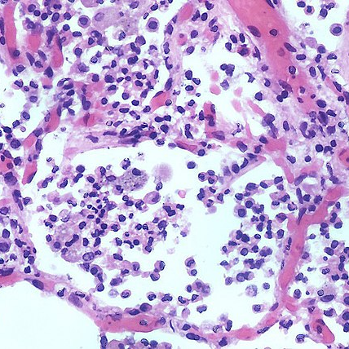
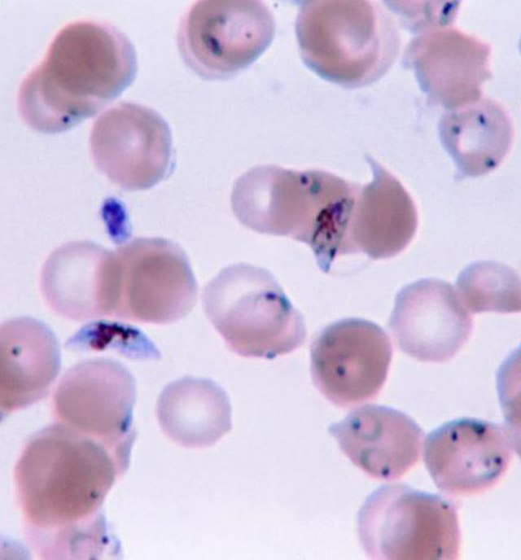
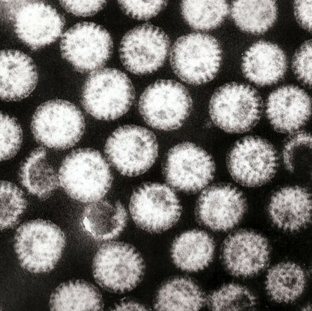
leading infectious killers
measles
pneumonia
malaria
rotavirus
Notes:
https://commons.wikimedia.org/wiki/File:Simian_measles_pneumonia_-_Case_287_(13431698195).jpg

Slide 38
why gavi? why now?

Slide 40
Gavi has helped prevent more than 17 million future deaths

Slide 42
gavi by the numbers
1 billion children immunized
17 million future deaths prevented
50% of the world’s children vaccinated by Gavi
$54 returned for every $1 invested
19 countries transitioned out of support

Slide 43
why gavi? why now?

Slide 44
JUNE
Investment Opportunity Launch
Paris, France
20
Notes:
Gavi will launch their investment case to fund their next strategic period from 2026-2030.
https://www.gavi.org/our-alliance/strategy/phase-6-2026-2030

Slide 45
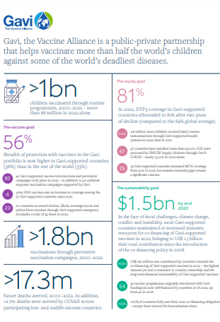
Learn more about Gavi’s amazing results here!
Notes:
https://digital.sciencehistory.org/works/wp988j884

