Slide 1
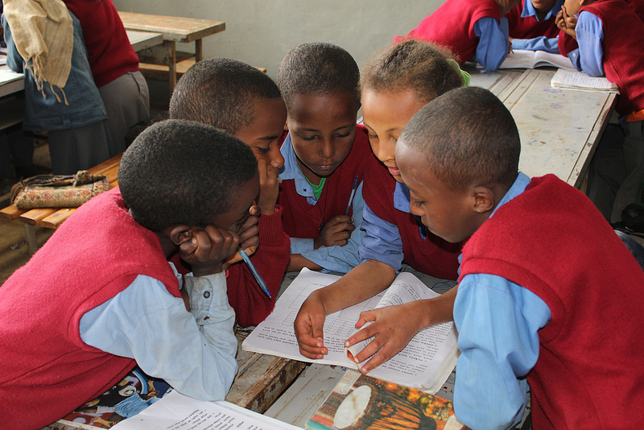
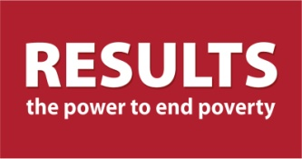
Education for All and the Global Partnership for Education
RESULTS Global Grassroots Webinar
February 19th, 2014
GPE/Alexandra Humme
Notes:
Photo credit: GPE/Alexandra Humme

Slide 2
Where are we in global education development? — The latest from the Education for All Global Monitoring Report 2013/4
Considerable progress toward education since 2000 has led to a global misconception of a job done, leading to a decline in aid to basic education while millions of children are still out of school and hundreds of millions of children in school but not learning.
The reality:
57 million children are still out of school.
Globally, 1 out of 10 children still can’t go to school.
In Africa, out-of-school children are on the rise, and 1 out of 4 girls aren’t receiving a basic education.
By 2015, only 56% of countries are likely to achieve universal primary education.
The poorest girls in sub-Sahara Africa won’t complete lower secondary school until the 22nd century.
Education for All and the Global Partnership for Education
RESULTS Global Grassroots Webinar
February 19th, 2014

Slide 3
Where are we in global education development? — The latest from the Education for All Global Monitoring Report 2013/4
Considerable progress toward education since 2000 has led to a global misconception of a job done, leading to a decline in aid to basic education while millions of children are still out of school and hundreds of millions of children in school but not learning.
The reality:
There is a learning crisis unfolding in most developing countries.
Worldwide, nearly 40% of children of primary school age (250 million) either do not reach grade 4 or, if they do, fail to attain even minimum learning standards.
Even with four years in school, 1 out of 4 young people in low and lower-middle income countries cannot read a sentence.
In a third of the countries analyzed by UNESCO’s latest Education for All Global Monitoring Report, less than 75% of primary school teachers are trained.
Globally, 1.6 million additional teachers are required to achieve universal primary education by 2015 and 5.1 million more to achieve universal lower secondary education by 2030.
Education for All and the Global Partnership for Education
RESULTS Global Grassroots Webinar
February 19th, 2014

Slide 4
Enter the Global Partnership for Education and the June 2014 GPE Pledging Conference
The Global Partnership for Education—
The world’s only multilateral partnership exclusively devoted to improving the provision of quality basic education.
Brings together a wide spectrum of stakeholders — governments, multilateral agencies, international organizations, foundations, the private sector, and civil society — to mobilize resources towards the areas in the greatest need.
Exercises a unique approach that strengthens national systems and builds government capacity to deliver education services
Specifically focuses the most urgent education issues, including education in fragile and conflict-affected states, promoting girls’ education, increasing basic numeracy and literacy skills, and improving teacher effectiveness.
Has committed nearly $3.7 billion in support to basic education since 2002 and is currently the 4th largest donor in the sector.
Education for All and the Global Partnership for Education
RESULTS Global Grassroots Webinar
February 19th, 2014

Slide 5
Enter the Global Partnership for Education and the June 2014 GPE Pledging Conference
The GPE Pledging Conference—
The 2015-2018 replenishment campaign: Securing the resources GPE needs to continue its impactful work over the 2015-2018 period.
The GPE Pledging Conference: The peak moment of the replenishment campaign.
June 26th, 2014 in Brussels, Belgium, hosted by the European Commission
Pivotal moment in which global leaders will make commitments that will largely determine the capacity of the GPE Fund and, with it, the futures of millions of children in some of the world’s most impoverished and fragile nations.
Education for All and the Global Partnership for Education
RESULTS Global Grassroots Webinar
February 19th, 2014

Slide 6
REASON #1: We cannot end poverty without investing in education.
Why Invest in the Global Partnership for Education Now More Than Ever
Maternal & Child Health: A child born to an educated mother is more than twice as likely to survive to the age of five.
Gender Equality: On average, for a girl in a poor country, each additional year of education beyond third or fourth grade will lead to 20% higher wages.
Economic Development: No country has achieved continuous and rapid growth without at least 40% of adults being able to read and write. Every US$1 invested in a person’s education yields $10-15 in economic benefit over that person’s working lifetime.
Security & Democracy: People of voting age with a primary education are 1.5 times more likely to support democracy than people with no education.
Education for All and the Global Partnership for Education
RESULTS Global Grassroots Webinar
February 19th, 2014

Slide 7
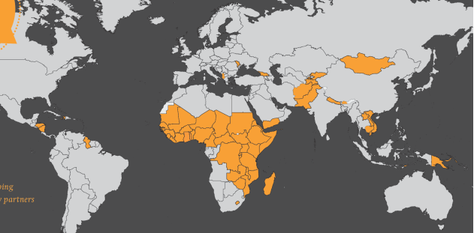
REASON #2: The Global Partnership for Education reaches those in the greatest need.
Why Invest in the Global Partnership for Education Now More Than Ever
Nearly three-quarters of the world’s 57 million primary-school-age children who are out of school live in GPE developing country partners.
Of the 250 million children estimated by UNESCO to either not be reaching grade 4 or reaching grade 4 without mastering minimum levels of learning, 100 million (40%) of them are in GPE developing country partners.
GPE developing country partners are home to 85% of the world’s out-of-school children living in conflict or fragile conditions.
Since its establishment, GPE has committed 60% of its funds to conflict-affected and fragile states — higher than the donor average, the World Bank, and the U.S.
Education for All and the Global Partnership for Education
RESULTS Global Grassroots Webinar
February 19th, 2014

Slide 8
REASON #3: GPE complements U.S. bilateral efforts in global education.
Why Invest in the Global Partnership for Education Now More Than Ever
GPE’s objectives of (1) supporting education in fragile and conflict-affected states and (3) increasing basic numeracy and literacy skills directly support Goal One and Goal Three of the USAID Education Strategy:
Goal One: Improved reading skills for 100 million children in primary grades by 2015.
Goal Three: Increased equitable access to education in crisis and conflict environments for 15 million learners by 2015.
GPE is building the partners that the U.S. is seeking:
System-strengthening approach
Civil Society Education Fund
GPE extends the reach of taxpayer money and U.S. bilateral assistance — both programmatically and geographically.
Education for All and the Global Partnership for Education
RESULTS Global Grassroots Webinar
February 19th, 2014

Slide 9
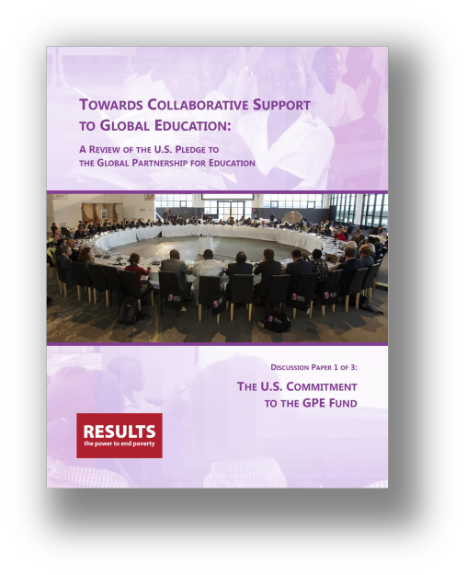
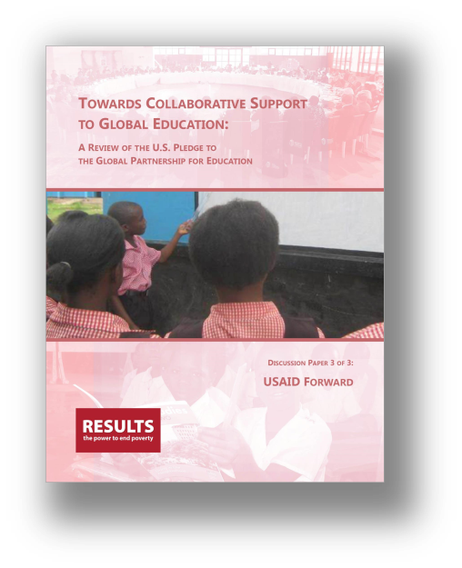
REASON #3: GPE complements U.S. bilateral efforts in global education.
Why Invest in the Global Partnership for Education Now More Than Ever
Education for All and the Global Partnership for Education
RESULTS Global Grassroots Webinar
February 19th, 2014

Slide 10
REASON #4: GPE mobilizes developing country resources towards their own education systems.
Why Invest in the Global Partnership for Education Now More Than Ever
Investments of developing country domestic resources in education:
GPE developing country partners: from 15.8% in 2000 to 18.2% in 2011 (a 15% increase)
Developing countries not part of GPE: from 15.3% in 2000 to only 16.2% in 2011 (a 6% percent increase).
Education for All and the Global Partnership for Education
RESULTS Global Grassroots Webinar
February 19th, 2014

Slide 11
REASON #5: GPE gets results.
Why Invest in the Global Partnership for Education Now More Than Ever
Since 2002, GPE has assisted low income countries to:
enroll 22 million children in school
construct over 53,000 classrooms
train more than 300,000 teachers
Education for All and the Global Partnership for Education
RESULTS Global Grassroots Webinar
February 19th, 2014

Slide 12
REASON #6: GPE is implementing innovative measures to further enhance performance.
Why Invest in the Global Partnership for Education Now More Than Ever
A new funding model that drives greater performance
Developing a new Humanitarian Fund and Innovation Fund
Expanding partnerships
Strengthening the Secretariat
Education for All and the Global Partnership for Education
RESULTS Global Grassroots Webinar
February 19th, 2014

Slide 13
REASON #7: Global support to basic education is radically declining.
Why Invest in the Global Partnership for Education Now More Than Ever
Disbursements for education dropped by 9% between 2009 and 2012.
Disbursements for basic education have dropped for three years in a row, resulting in a 16% reduction — rolling basic education aid levels back to where they were in 2008.
Basic education aid funds actually available to GPE developing country partners were cut by 23% from 2009 to 2012.
Education for All and the Global Partnership for Education
RESULTS Global Grassroots Webinar
February 19th, 2014

Slide 14
REASON #8: Demand for GPE support is on the rise.
Why Invest in the Global Partnership for Education Now More Than Ever
Demand is outweighing supply: As much as $585 million may need to be sourced from new commitments in the 2015-2018 replenishment period to meet existing grant requests.
Demand for GPE support will likely only increase: Having multiplied from 7 developing country partners in 2002 to 59 in 2014, GPE remains open to a total of 68 eligible countries.
Education for All and the Global Partnership for Education
RESULTS Global Grassroots Webinar
February 19th, 2014

Slide 15
A Successful GPE Pledging Conference
With a fully-funded 2015-2018 replenishment, GPE anticipates—
Primary school enrollment rates will be increased by 12%, or 17 million children, with girls experiencing a 14% increase.
Primary completion rates will be increased by an average of 3 percentage points each year, with the number of non-completers decreasing by a third.
An additional 16.5 million children will be able to enroll in lower secondary school, of which 8.3 million will be girls.
In fragile and conflict affected countries, an additional 16.5 million children will be able to access a primary education, with completion rising from 15.7 million children in 2014 to 19.1 million in 2018.
Education for All and the Global Partnership for Education
RESULTS Global Grassroots Webinar
February 19th, 2014

