Slide 1
Monthly Webinar December 12, 2024

Slide 2
Welcome everyone!
Let us know where you are joining us
from in the chat!
Share a greeting in another language if you know one.

Slide 3
Our Values & Resources
3
​At RESULTS we pledge to create space for all voices, including those of us who are currently experiencing poverty. We will address oppressive behavior in our interactions, families, communities, work, and world. Our strength is rooted in our diversity of experiences, not in our assumptions.
With unearned privilege comes the responsibility to act so the burden to educate and change doesn’t fall solely on those experiencing oppression. When we miss the mark on our values, we will acknowledge our mistake, seek forgiveness, learn, and work together as a community to pursue equity.
Read our full anti-oppression values statement here at results.org/values.
Check out the Anti-Oppression Workshop Schedule for training opportunities.
Find these resources and more at results.org/volunteers/anti-oppression:
Resource Guides from our Diversity & Inclusion trainings, including:
Interrupting Microaggressions
Creating Space for Critical Conversations
Information on how RESULTS responds to oppressive incidents

Slide 4
Tonight’s Agenda
Welcome & Introductions
Advocacy Wrapped: Reflections on 2024
Final Advocacy Actions for 118th Congress
Vision for 2025
Closing

Slide 5
Wrapped
2024
Advocacy Wrapped

Slide 6
Wrapped
15
Lobby Meetings

Slide 7
Wrapped
4
Letters to the Editor

Slide 8
Wrapped
93
Online Actions

Slide 9
Celebrating Global Health Wins
Gavi, the Vaccine Alliance
Almost 50 members signed on to bipartisan resolutions supporting increased U.S. investment
The Biden Administration announced a bold, early pledge of at least $1.58 billion over 5 years
Global Nutrition
106 bipartisan members of Congress signed on to a letter supporting Nutrition for Growth

Slide 10
Celebrating FY25 Appropriations
Highest ever signers on House TB DC, increased House Global Fund signers
Protected FY24 funding levels for Gavi, TB, and education
Increases included for maternal and child health and nutrition
Included requested language on maternal and child health, Gavi, nutrition and TB

Slide 11
Getting Congress on the record
This year, 207 Representatives and 48 Senators took at least one of our global policy actions!

Slide 12
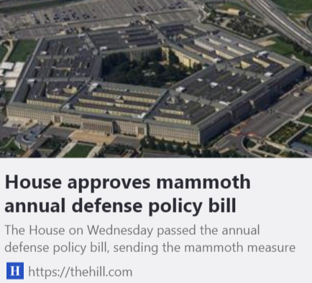
READ Act included in NDAA
Final Roll Call Vote
281 Y 140 N

Slide 13
End TB Now Act
S.288 introduced
by Sens. Young (R-IN) and Menendez (D-NJ)
Passed Senate Foreign Relations Committee
5 total cosponsors
Passed full Senate
by unanimous consent
H.R.1776 introduced
by Reps. Bera (D-CA) and Salazar (R-FL)
Passed House Foreign Affairs Committee
96 total cosponsors
Goal:
Attach to a Continuing Resolution (CR)

Slide 14
The Final Stretch 2024
118th Congress Ends next week:
House - December 19
Senate - December 20
Personalize and send this message to your House Rep, please add End TB Now & READ Acts to any must pass bills next week!

Slide 15
Continue Writing Media
118th Congress Ends next week:
House - December 19
Senate - December 20
Personalize and send this message to your House Rep, please add End TB Now & READ Acts to any must pass bills next week!

Slide 16
Vision for 2025

Slide 17
The First 100 Days campaign

Slide 18
Vision for 2025
FY 26 Appropriations
World TB Day: The Clock is Ticking March 24, 2025
Nutrition for Growth Conference (Paris) March 27 & 28, 2025
The Global Fund Replenishment September 2025

Slide 19
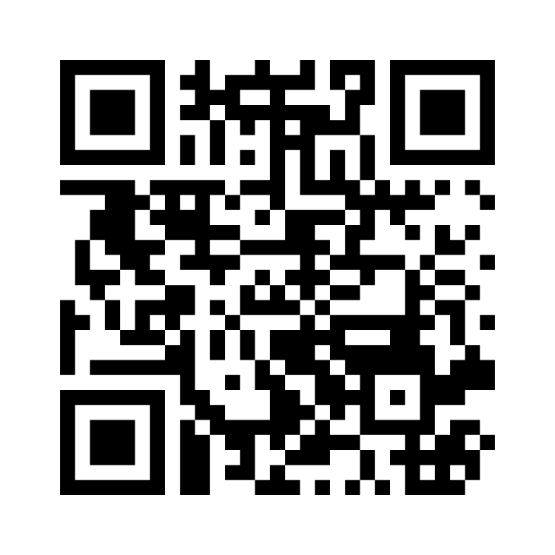
How are you feeling about 2025?
Menti.com
Enter code: 3497 1923
Notes:
https://www.menti.com/al3fbjocd5gu

Slide 20
First webinar of 2025
Thursday, January 9 at 8:30 PM ET Invite others to join: https://tinyurl.com/2025GAPWebinars

Slide 21
How are we doing? Please complete survey by Friday, December 20

Slide 22
Thank you for making 2024 a great year!

