Slide 1
December 2019 National Grassroots Webinar
Ending 2019 Well and Starting 2020 Even Better!
Join at https://results.zoom.us/j/510407386. Or by phone at (669) 900-6833 or (929) 436-2866, meeting ID 510-407-386
Closed captioning: http://west.typewell.com/faelapgb

Slide 2
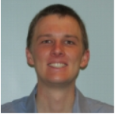
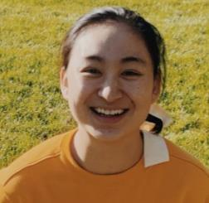
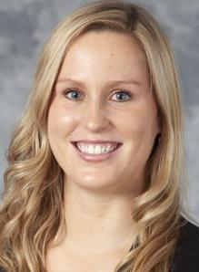
Sid Jacob
Yuxin Tang
Mary Kate O’Leary
RESULTS Madison
A Fresh Mix of Advocates

Slide 3
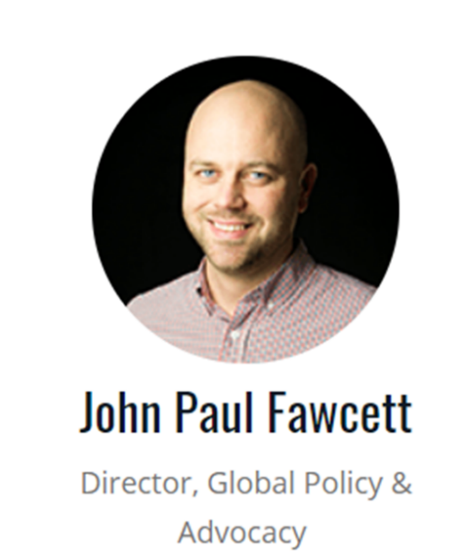
Finishing 2019 Starting 2020

Slide 4
Notes:
It was no accident that Congress was put into a position of leadership on the Global Fund replenishment. Everything you’ve been doing for that past 18 months has been to address a major dilemma—what do we do when the Administration undermines the Global Fund?

Slide 5
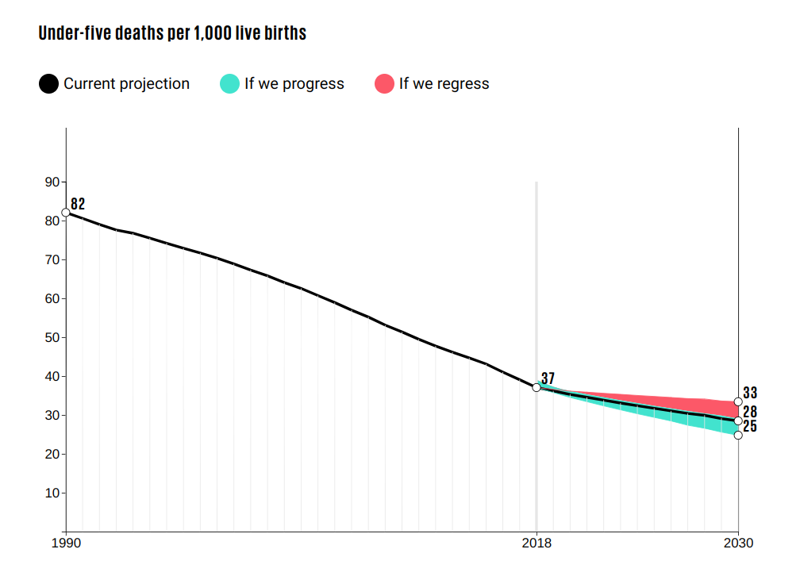

Slide 6
Ending Preventable Child Deaths
Immunization
Nutrition
Impact

Slide 7
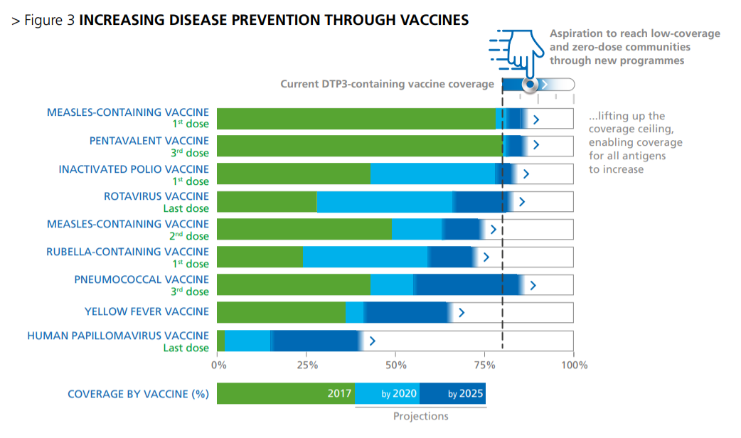

Slide 8
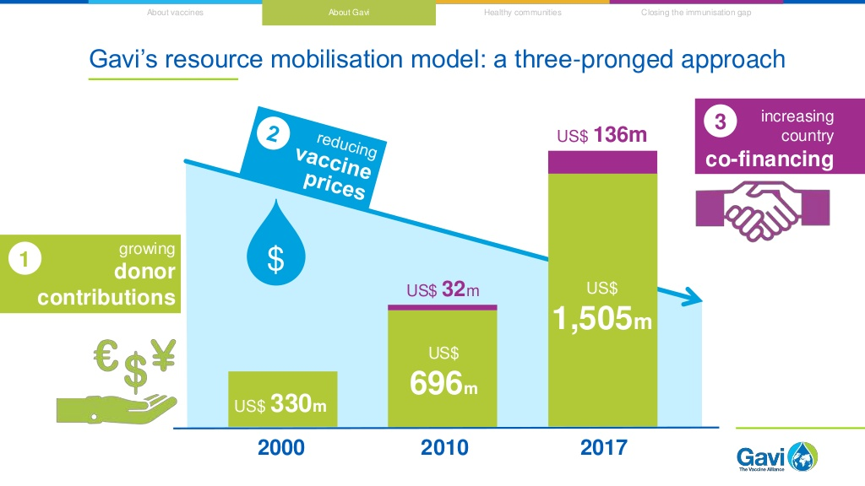

Slide 9
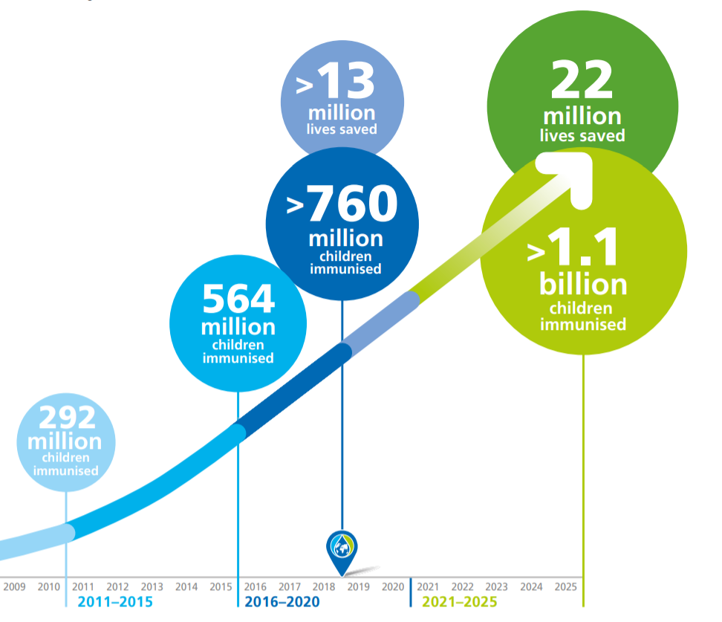
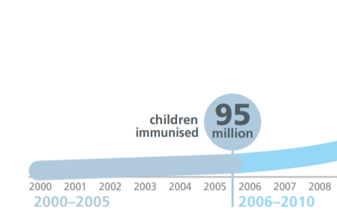

Slide 10
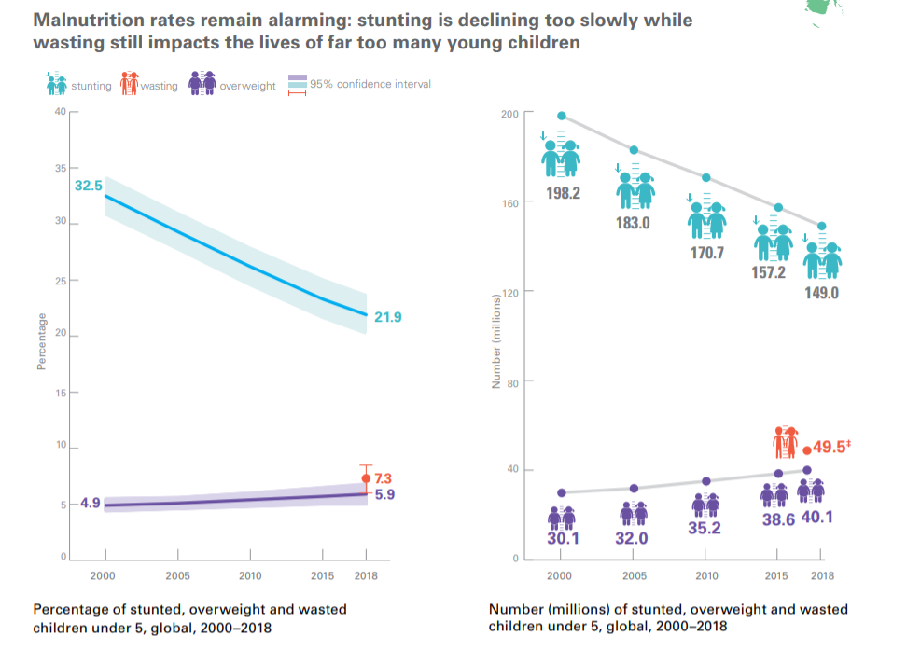

Slide 11
Key 2020 Moments and Opportunities
Appropriations
Gavi Replenishment (June)
RESULTS International Conference (June)
Nutrition for Growth (December)
Authorizing legislation

Slide 12
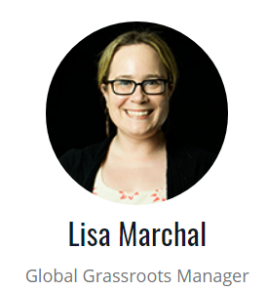
Grassroots Café

Slide 13
Virtual Thanksgiving Feast Peer-to-Peer Campaign

Slide 14
Virtual Thanksgiving Feast Peer-to-Peer Campaign
Thank You for making the Virtual Thanksgiving Feast
a success!
25+ fundraisers together raised over $32,000
with 232+ donations.
These campaigns not only help raise critical funds, they also expand our donor base and spread the word about our work. Thank you for everyone who participated or made a donation!

Slide 15
Expansion Celebration!
Total Volunteer inquiries: 343
Total who registered for RESULTS communications: 280
Total who decided to become a RESULTS advocate: 95

Slide 17
Mark Your Calendars! See the Weekly Update for details.
December 16, 2 pm ET only (Special time). Global Free Agents webinars.
January 14, 12 pm ET. First New Advocate Orientation of 2020.
January 15, 8:30 pm ET. Action Network Community of Practice.

Slide 18
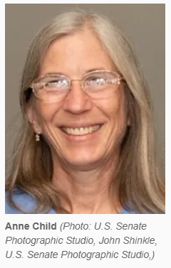
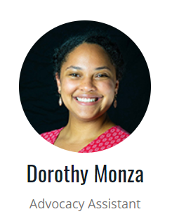
When Data is More Than Data

Slide 19
Outreach Events
74+

Slide 20
Media Hits
267+

Slide 21
Lobby Meetings
545+

Slide 22
Please Update Reporting Before December 31!
Check out the reporting links at the bottom of every Weekly Update and stay current!

Slide 23
Open Phones
On the webinar? Unmute by clicking the microphone.
On by phone? Unmute by hitting *6.
If you are not speaking, please stay muted.

Slide 24
Important!
December 25 – January 1. RESULTS Office is closed for Winter Break.

Slide 25
Coming Changes to How We Support You
25
Background
Looking to streamline our support and training
Maintain your effectiveness while respecting your time
More groups and new volunteers interested in being “glomestic” – work on both U.S. and global poverty issues
We wanted your active participation in the decision making
National Webinar Survey
74 responses: 38 percent global, 32 percent U.S., and 30 percent glomestic
How do you listen? U.S. volunteers typically listen individually; most global volunteers listen live with group
Convenience biggest factor in those who do not attend
What do you want to get out of the monthly webinars?
The info you need to take action
You also like inspiration, skill building, and org updates

Slide 26
Coming Changes to How We Support You
26

Slide 27
So what do we do to balance these competing preferences?
27
January webinar: Normal joint U.S. and global campaigns webinar, Saturday, January 11 at 1 pm ET (60 minutes) – focused on planning for 2020
New webinar format debuts on Saturday, February 1 at 1 pm ET
Most survey respondents wanted a Saturday webinar
Moving to the first Saturday of each month at 1 pm ET
More time to take actions; less likely to be on holiday weekend
90-minute webinar in three parts
1:00-1:30pm ET
U.S. Poverty Policy
1:30-2:00pm ET
Joint Grassroots Section
2:00-2:30pm ET
Global Poverty Policy
Glomestic groups
U.S. Poverty groups
Global Poverty groups

Slide 28
Coming Changes to How We Support You
28
90-minute format helps both single-focus and dual-focused groups
If your group focuses on just one issue, you can attend the first hour or second hour based on your issue area
If your group focuses on both, you can get it all on one, 90-minute webinar each month

Slide 29
BEGINNING IN FEBRUARY
NEW NATIONAL WEBINAR
1st Saturday of the Month
1 pm ET
Our 90-minute, three-block format begins ...
U.S. Poverty Campaigns
Organizing & Support
Global Poverty Campaigns

Slide 30
February 1, 1 pm ET
March 7, 1 pm ET
April 4, 1 pm ET

Slide 31
Changes also coming to the Weekly Update
Desire to reduce the number of e-mails you receive and give you everything you need in one place
Starting by the end of January, you will receive one joint U.S./global weekly update e-mail
E-mail includes the top action from each issue area and brief organizational updates
E-mail links to an extended online version with additional actions and updates for you

Slide 32
32
Please let us know what you like and don’t like as we move forward with these exciting changes and work to serve the needs of all advocates.
Help us name the new monthly webinar!
The winner gets a free registration to the 2020 RESULTS International Conference. E-mail your suggestion by January 8 to grassroots@results.org.
We’ll announce the winner on the January national webinar.

Slide 33
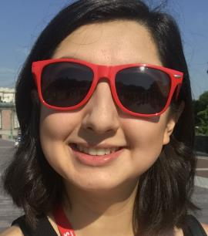
Hiba Fatima and Georgette Siqueiros REAL Change Fellows

Slide 34
Organizing for Impact
Relationship
Autonomy
Purpose

Slide 35
Start Well When is your first meeting in January 2020?

Slide 36
Start Well Who are the new faces you can invite to your first meeting?

Slide 37
Start Well Who might you ask to take a new leadership role?

Slide 38
Start Well What action will you plan to take at your first meeting?

Slide 39
What are you most excited about for 2020?

Slide 40
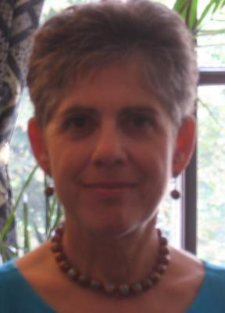
Elizabeth Berry
Northern Virginia

Slide 41
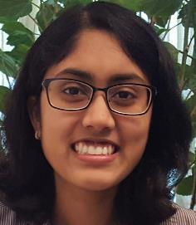
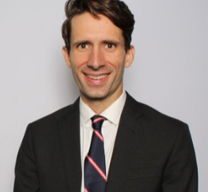
RESULTS Pittsburgh
A new group begins!
Shweta Gudapati, Lily Chowdhury,
and Ben Callaway

Slide 42
How many joined from
your location today?
Place your city + number in the chat box
Or send to Lisa Marchal at
lmarchal@results.org

Slide 43
Determination is power.
~ Charles Simmons ~

