Slide 1
Global Campaign Overview:
Being Powerful on the Hill

Slide 2
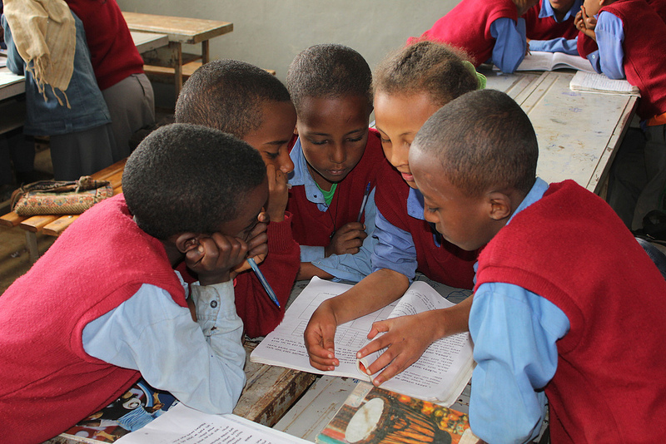
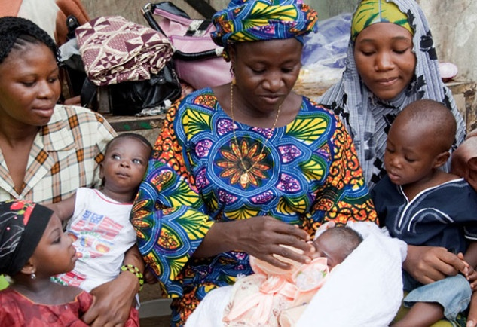
Global Campaigns Overview
Education for All
Ending Preventable Child Deaths

Slide 3
Getting Started
Connect with your states now
Report your upcoming meetings here:
  http://tinyurl.com/ICMeetingForm
Anyone not have a meeting set up with your member of Congress?

Slide 4
Advantages of Being in DC
You can look your Senator in the eye.
You can look the aide in the eye.
You can look the scheduler in the eye.
You can converse and brainstorm.
You can make the “hard ask” in person.
Hundreds of us are doing this together.

Slide 5
Prepare the Heart and Mind
All poverty solutions already exist
Be in touch with your outrage
Be in touch with fear and overcome it
You are a constituent “supervisor”
Members of Congress and staff are people
Your influence > influence of lobbyists
You are not alone in this rare work

Slide 6
Assess where they are, then move them up the Champion Scale
Advocacy: What are We Trying to Do?
4 Champion
3 Leader
2 Advocate
1 Supporter
0 Uninformed or Neutral
-1 Opponent
Notes:
In addition to knowing the problems and solutions of poverty,
political will is about moving decision makers up the champion scale toward becoming champions
Show on website:

Slide 7
How Decision Makers Decide
Constituents
Staff
Colleagues
Media
Paid Lobbyists
Experts
Personal History

Slide 8
Basic Meeting
Introductions and thank yous.
Meeting overview
Storyteller tells story to illustrate main issue
Make a requests with a yes or no answer, share media and letters.
Dialogue: probe vague answers, listen for commitment, offer additional information, stay focused
Summarize next steps
Leave materials, ask for photo, end the meeting with thanks and follow up plans
After: Decide who will make report on meeting:
  http://tinyurl.com/2016LobbyReport

Slide 9
Basic Roles
Facilitator
Storyteller
Issue explainer & asker (1 or 2 people)
Recorder
Supporting actors: add perspectives, tell additional stories

Slide 10
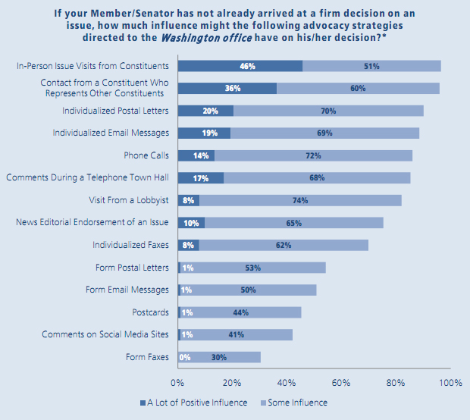
Good News About Influence
Source: Congressional Management Foundation

Slide 11
Good News About Influence
Source: Congressional Management Foundation

Slide 12
Good News About Influence
What is Helpful?
Source: Congressional Management Foundation

Slide 13
Good News About Influence
What is Helpful?
Source: Congressional Management Foundation

Slide 14
Be Remembered
Say thank you and make it a conversation
Not many people talking about global issues—you are unique
Connect it to the district and tell them why you care
Many visitors come with personal gain as the goal, not you.
Ask to collaborate, ask to be their resource, ask for their ideas
Stories: everyone has a story person: show some heart
    Show video
    Share from personal experience or someone else’s (with permission)
    Use the legislative packet stories
    Listen during the sessions and note stories and powerful quotes
Come with data and figures too
Never go away

Slide 15
Getting Face-to-Face
Confirm meetings on Monday:
  (202) 224-3121
Ask for a photo opportunity with the MoC
Ask to come back later if they’ll be there
Invite MoC to the reception
Speak personally to the scheduler set up August meeting

Slide 16
Preparing
Know some facts
Know your story
Know your Rep. or Senator (research)
Know your role and practice
Demonstrate support: media, letters, people joining via phone from home

Slide 17
Back Home
Follow up on your meeting requests
Meet face-to-face during August recess if you didn’t in DC.
Share your excitement and experience with folks at home, and engage people.
Take advantage of election season to see your reps, senators, and candidates

Slide 18
To be Powerful
See ourselves as supervisors
Be in touch with the absurdities in the world and be outraged by them
Learn new skills
Take a risk, step outside your comfort zones to get in touch with your true power
Suspend your believe that we can’t make a difference.
Persist, persist, and…persist

Slide 19
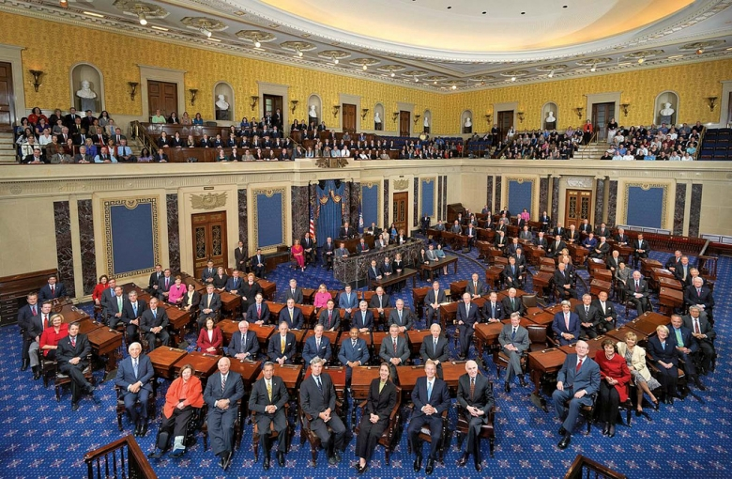
Down Time?
Visit the House or Senate Gallery

