Slide 1
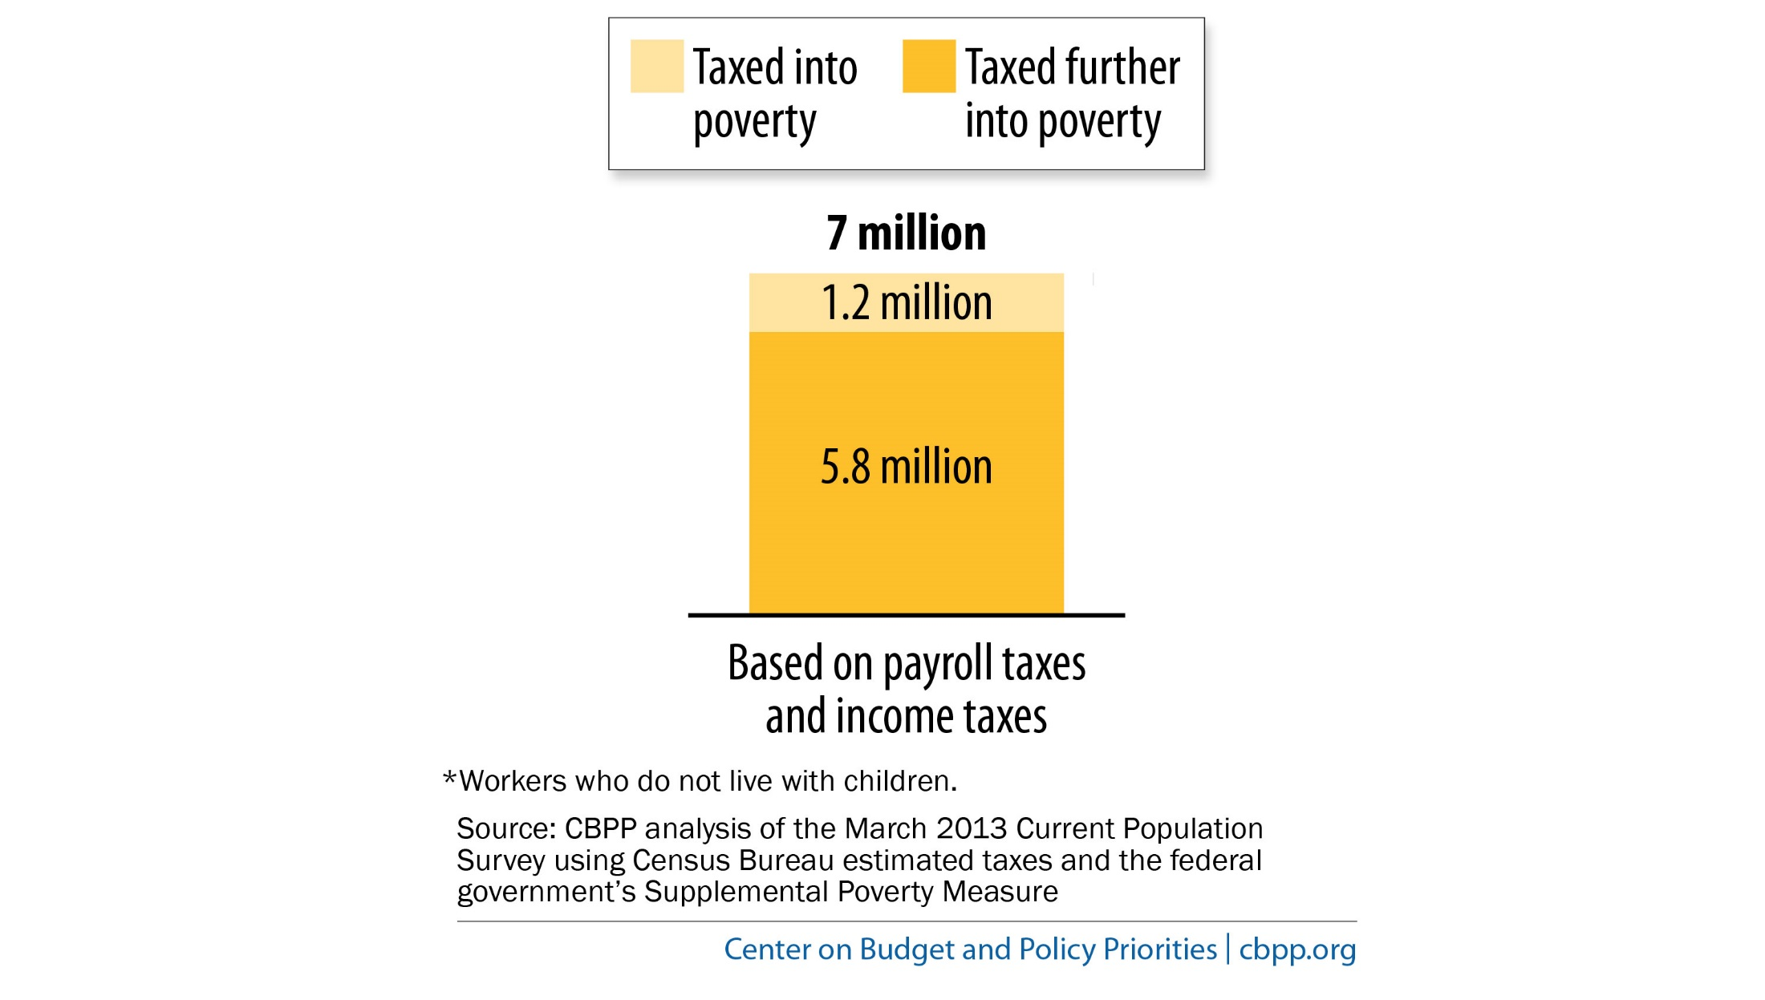
Federal Taxes Push Millions of “Childless Workers”* Into or Further into Poverty

Slide 2
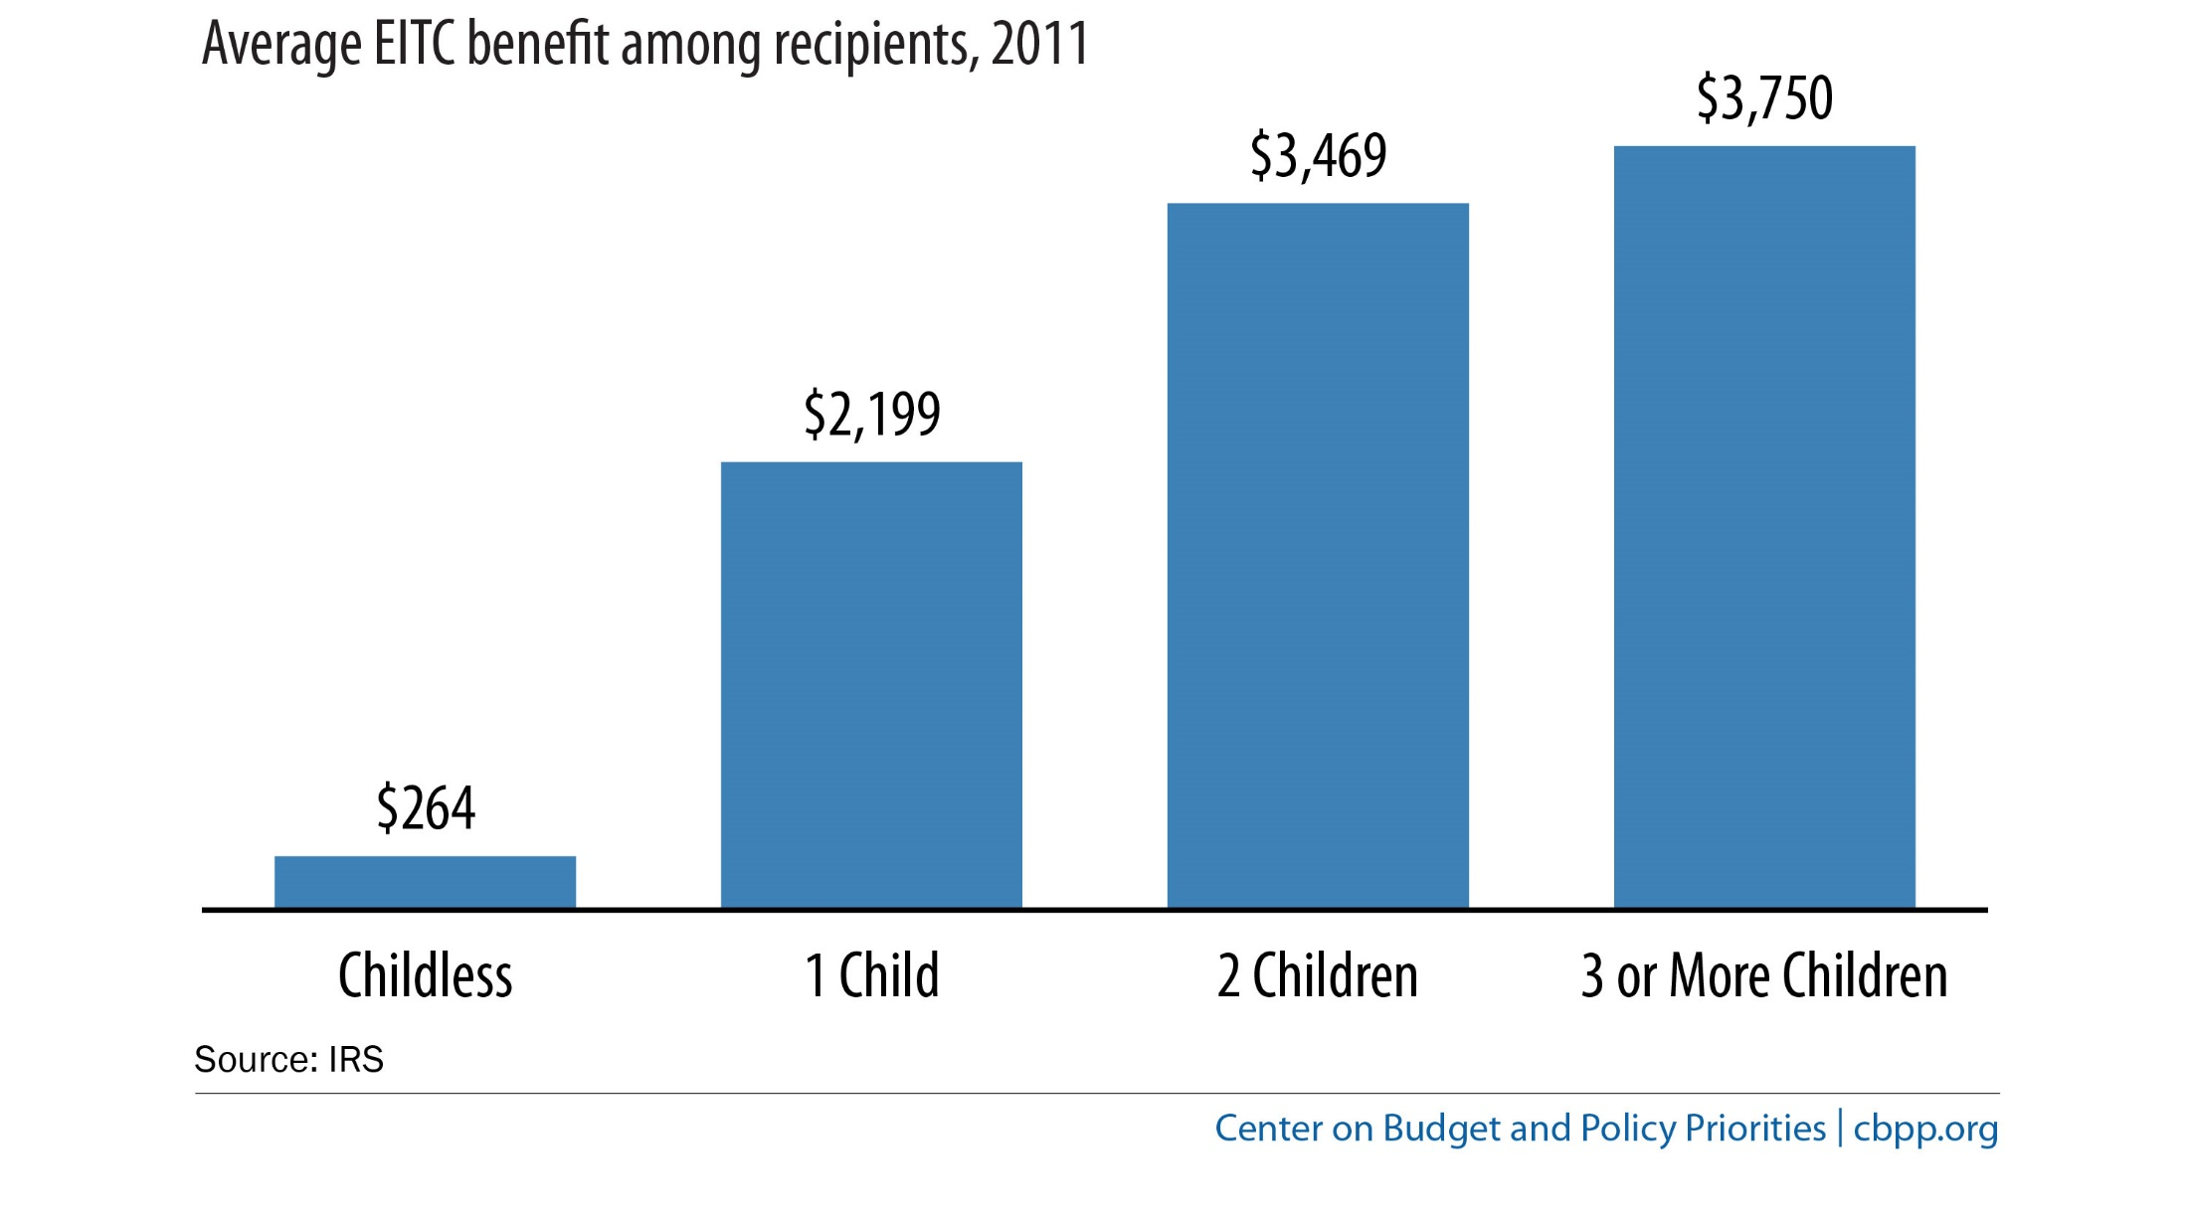
“Childless Workers” Receive Much Smaller Average EITC Benefit

Slide 3
“Childless Workers” Receive Much Smaller Average EITC Benefit

Slide 4
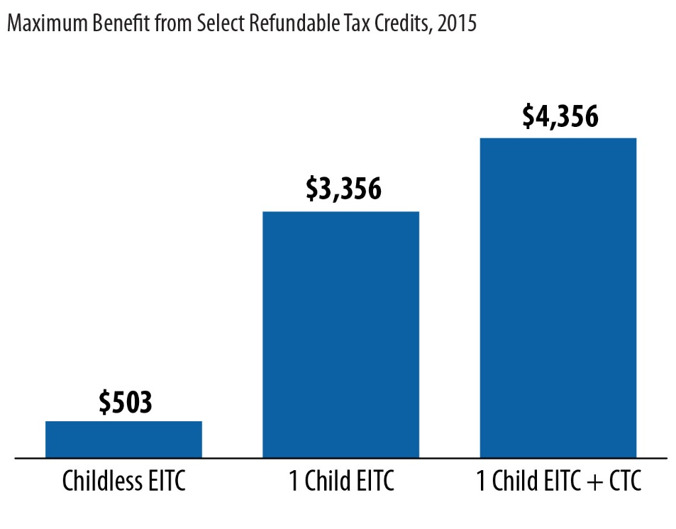
The Maximum EITC Benefit for “Childless Workers” is Small

Slide 5
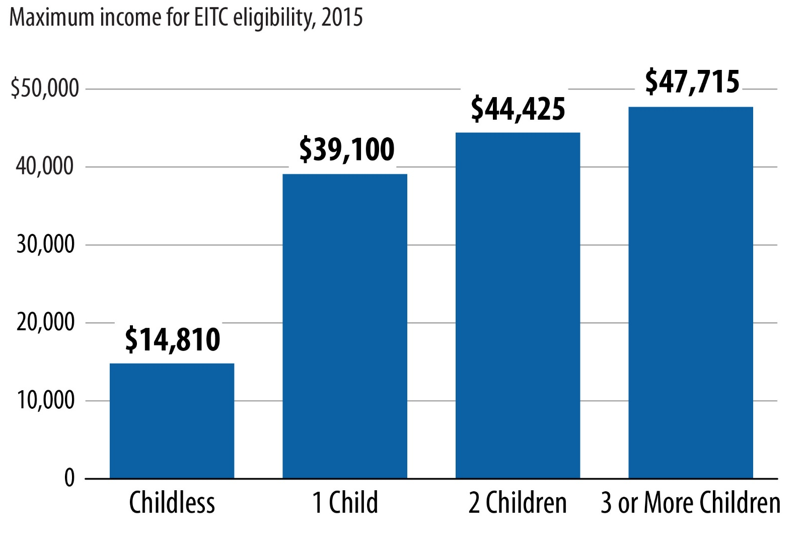
“Childless Workers” Lose EITC at Much Lower Income Level than Workers with Children

Slide 6
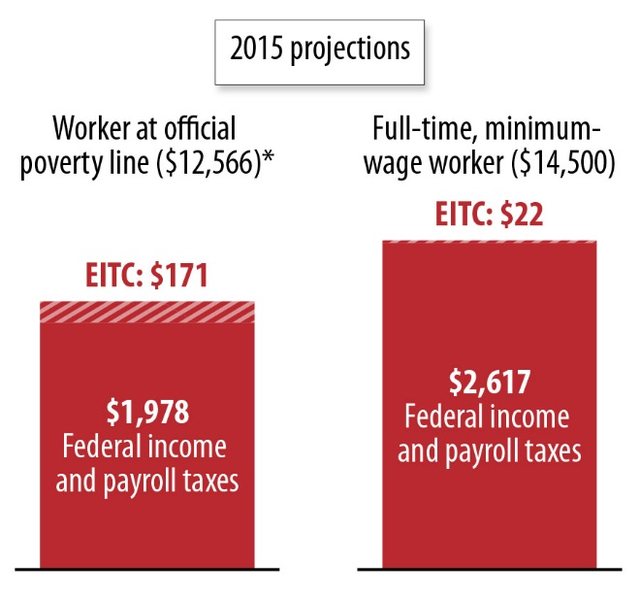
The Current “Childless Workers’” EITC Does Little to Offset Income and Payroll Taxes

Slide 7
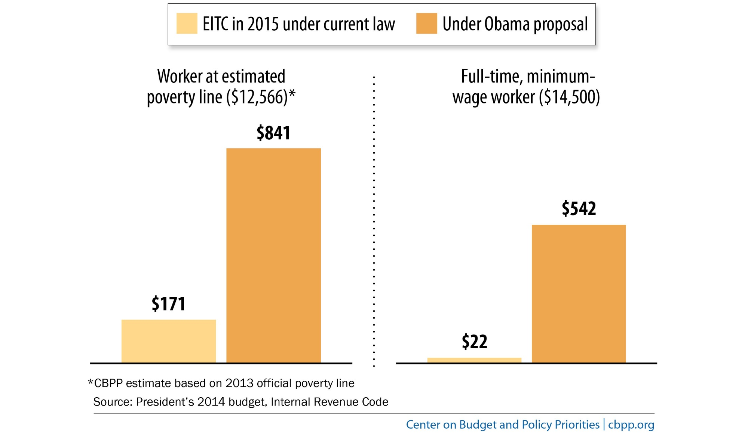
President’s Proposal Would Boost Earned Income Tax Credit (EITC) for “Childless Workers”

