Slide 1
Naturally More Nutritious: Addressing Hidden Hunger with Micronutrient-Rich Crops
Peg Willingham, Head of Advocacy and Policy, HarvestPlus
RESULTS International Conference
Innovation and Opportunity in Global Nutrition
July 14, 2019

Slide 2
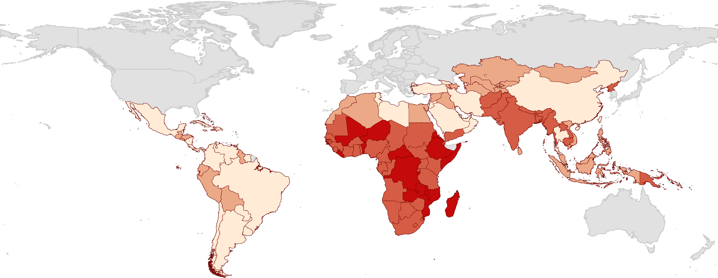
The Problem: Micronutrient deficiency (Hidden Hunger)
affects more than 2 bn people worldwide
Magnitude of
Hidden Hunger
Mild (<15)
Moderate (15-24.9)
Severe (25-39.9)
Alarmingly High (>40)
Data not available

Slide 3
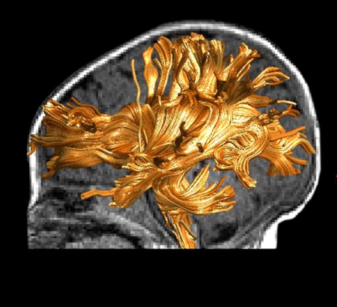
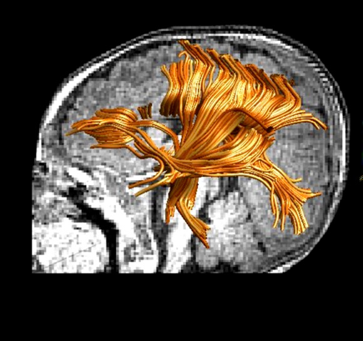
Poor Nutrition = Permanent Damage
World Development Report, 2016. World Bank
CHILD WITH STUNTED BRAIN DEVELOPMENT
HEALTHY, CARED FOR CHILD
World Development Report, 2016. World Bank
Healthy Child
Stunted Child
Nelson CAT et al. (Harvard Medical School), 2017
Notes:
In 2018, 21.9 per cent, or just under one in four children under age 5 worldwide had stunted growth.
Better nutrition means better brain development; World Development Report, 2016. World Bank

Slide 4
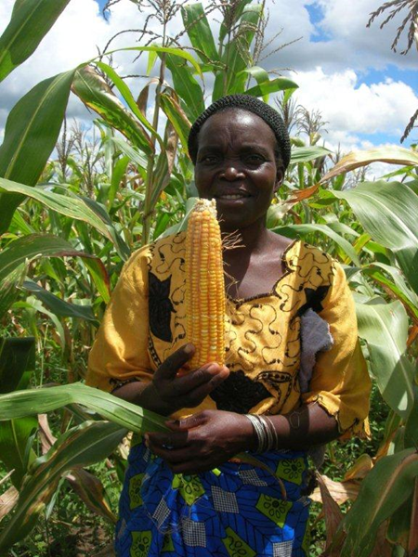
Nutrient-Rich Crops for Subsistence Farming Families
60+% of people in developing countries are low-income rural families with limited access to diverse diets, commercially fortified foods, or vitamin/mineral supplements
Vitamin A, iron and zinc: key nutrients
Innovative solution: naturally nutrient-rich seeds = healthier crops, food, and families
Adapted to local conditions, preferences
Cost-effective
50 million now benefiting

Slide 5
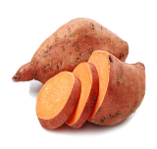
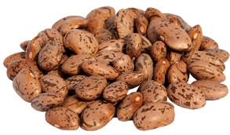
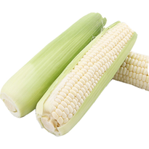
Biofortified Crops Include…
Sweet Potato
Vitamin A
Cassava
Vitamin A
Maize
Vitamin A Zinc
Beans
Iron
Pearl Millet
Iron
Wheat
Zinc
Rice
Zinc
Conventional crop breeding; resistant to disease, pests, climate

Slide 6
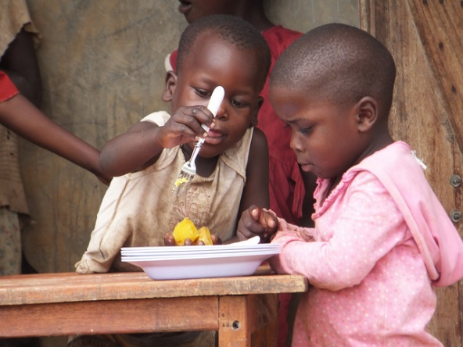
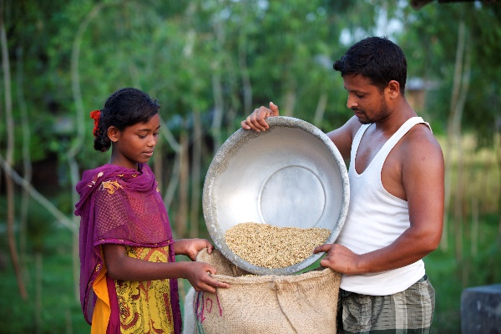
Better Crops = Better Nutrition
Biofortified staples provide 25-100% of a child’s daily vitamin A, iron or zinc needs.
Vitamin A biofortified crops reduce vitamin A deficiency & diarrhea, improve vision
Iron biofortified crops reverse iron deficiency and improve cognitive & physical functions
Zinc biofortified crops can improve immune function, reduce inflammation, pneumonia, vomiting and fever

