Slide 1
Appropriations 101
Welcome!

Slide 3
How is the U.S. government funded?
Your federal taxes!
Approximately how much is the annual U.S. budget?
Total U.S. budget = over $4 trillion
But funding for poverty-focused Global Development???
Still less than 1% of the budget
Notes:
“The Congress shall have Power To lay and collect Taxes, Duties, Imposts and Excises, to pay the Debts and provide for the common Defence and general Welfare of the United States; but all Duties, Imposts and Excises shall be uniform throughout the United States; ”

Slide 4
FY23 Federal Revenue
Funds collected from the public that arise from the government’s exercise of its sovereign powers

Slide 5
Components of federal spending, FY23

Slide 6
Discretionary spending is optional spending
Includes Defense (DOD – our military operations) and Non-Defense Discretionary (NDD – education, scientific research, infrastructure, national parks, environmental protection, AND foreign assistance/ international affairs, etc...) funding.
This is different from mandatory spending
Accounts for the biggest chunk of the budget.
Spending that does not have to be approved every year and is required by law. (Medicare, Medicaid, and Social Security as well as other programs including SNAP).
Where RESULTS Advocacy Fits into the Budget:

Slide 7
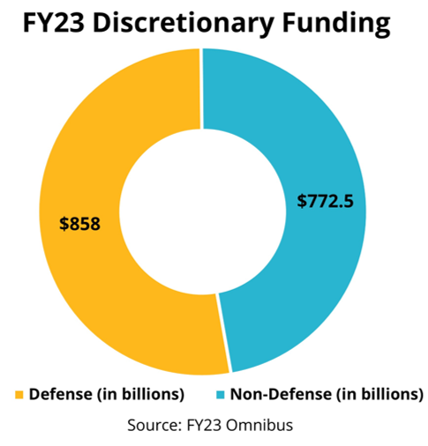
FY23 Discretionary Funding

Slide 8
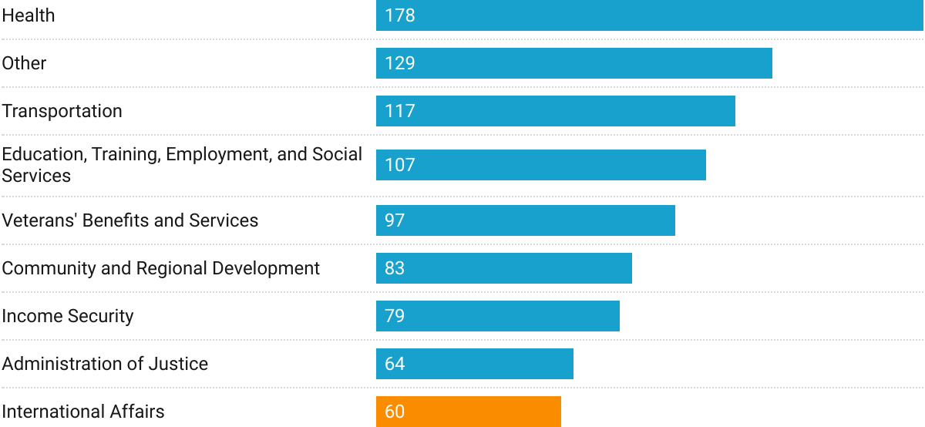
Nondefense discretionary spending, FY20 billions of dollars
REMINDER: The IA budget funds the State Department, foreign service, embassy security, etc...
Less than 1% of our $4 Trillion budget supports global anti-poverty programs!
Source: Office of Management and Budget

Slide 10
President's Budget Request
The Office of Management and Budget and White House officials begin shaping up to 18 months prior to the start of the Fiscal Year.
A policy document, part of the administration’s vision.
Can be seen as “dead on arrival”, even by many in their own party.
New policies are often previewed in the State of the Union address scheduled for March 7.
Likely to be released March 11

Slide 11
What’s supposed to happen...
Twelve appropriations subcommittees in the House and twelve in the Senate hold public hearings and prepare appropriations bills. Discretionary spending limits are set by the budget resolution, which also constrains tax or entitlement bills.
Appropriations Committees vote on the 12 bills approved in subcommittee. Then full House and full Senate vote on each appropriations bill.

Slide 12
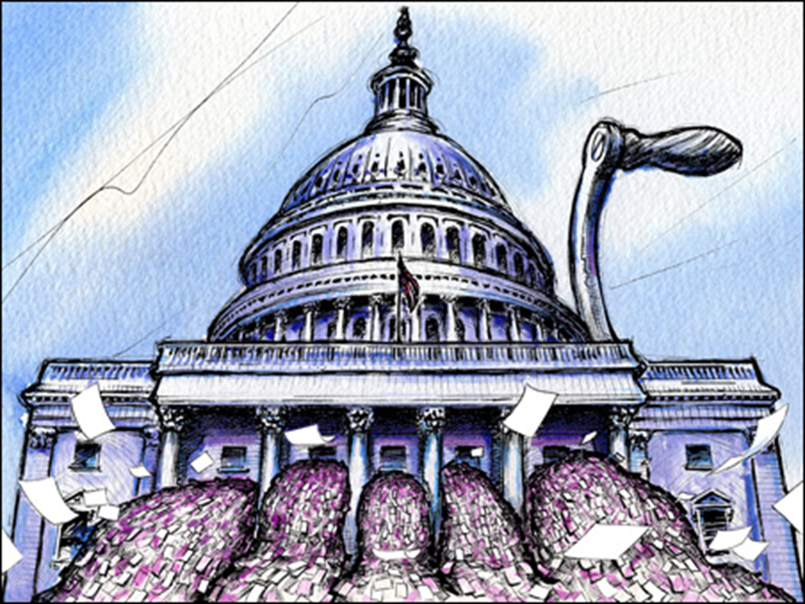
But in reality...
The PBR is often delayed thanks to urgent political realities and delays from previous years' spending bills
Budget resolutions are supposed to pass both the House and Senate, then go to conference, and set the funding allocations for all 12 sub-committees by mid-April...
In several recent years, we never even passed a budget resolution.
The bills MUST pass by the end of the fiscal year – September 30th – or the government goes unfunded.
“Laws are like sausages, it is better not to see them being made.”

Slide 13
All aboard the omnibus
the current budget process has been in effect almost 50 years—Congress has only managed to pass all its required measures four times (fiscal years 1977, 1989, 1995, 1997)
Source: Pew Research Center

Slide 14
So where are we now?
The U.S. fiscal year is the accounting period that runs Oct. 1 – Sept. 30 of the following year. We are currently in Fiscal Year 2024, which started on October 1, 2023.
Congress has still not passed its FY24 appropriations bills.
Instead, they've passed 3 different Continuing Resolutions (CRs) to maintain FY23 funding levels and avoid a government shutdown – last one passed on Jan.18th
The next CR deadlines: March 1 and 8
Now, preparations for FY25 appropriations are beginning.

Slide 15
FY25 Requests
Account | FY23 Enacted | FY24 House | FY24 Senate | FY25 RESULTS Request
Global Fund to Fight AIDS, TB and Malaria | $2 billion | $2 billion | $1.65 billion | $1.65 billion
USAID Tuberculosis | $394.5 million | $394.5 million | $394.5 million | $1 billion
USAID Maternal and Child Health | $910 million | $910 million | $920 million | $1.15 billion
Of which, Gavi, the Vaccine Alliance | $290 million | $300 million | $300 million | $340 million
USAID Nutrition | $160 million | $172.5 million | $160 million | $300 million
USAID Basic Education | $970 million | $970 million | $640.55 million | $1.15 billion
Of which, the Global Partnership for Education | $130 million | $130 million | $130 million | $200 million

Slide 16
What if I told you, your voice could be one of the most important factors in this process?

Slide 17
power of the purse
"No money shall be drawn from the Treasury, but in Consequence of Appropriations made by Law…”
Photos via Unsplash, Design: Dorothy Monza
Notes:
Article I, section 9, clause 7 of the U.S. Constitution states that "No money shall be drawn from the Treasury, but in Consequence of Appropriations made by Law..." This is what gives Congress the power to make these appropriations. The President, however, still has the power to veto appropriations bills.^{[2]} However, the President does not have line-item veto authority so that he must either sign the entire bill into law or veto it.

Slide 18
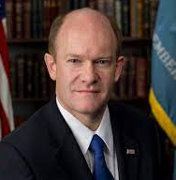
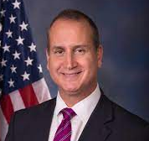
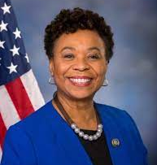
State and Foreign Operations Subcommittee
Chairman Chris Coons (D- DE)
Ranking Member Lindsay Graham (R-SC)
Chairman Mario Diaz-Balart (R-FL) Ranking Member Barbara Lee (D-CA)
And the full appropriations committee members!
www.appropriations.senate.gov www.appropriations.house.gov

Slide 19
How do we influence Congress to increase global health and education spending?

Slide 20
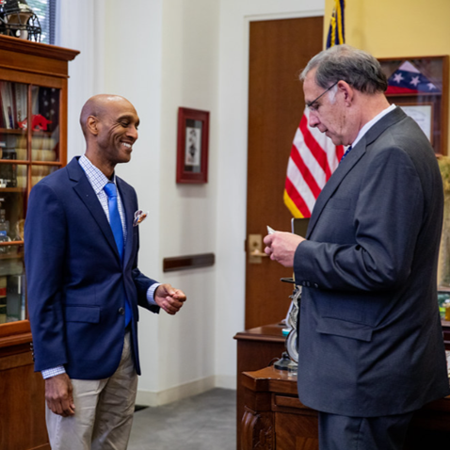
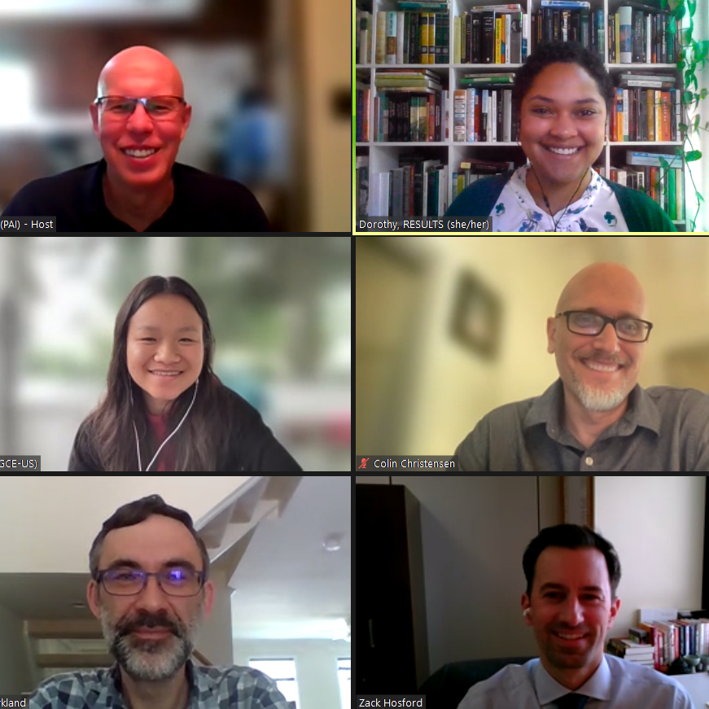
meeting with members of Congress and their staff (at home & in DC)
we influence appropriations by…

Slide 21
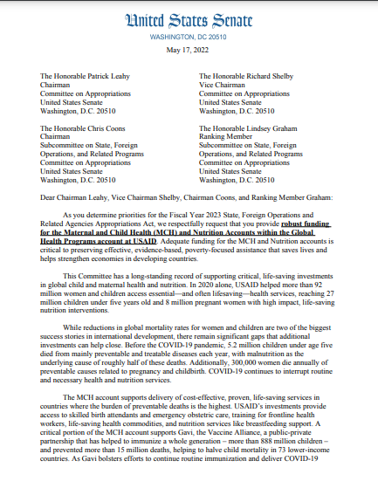
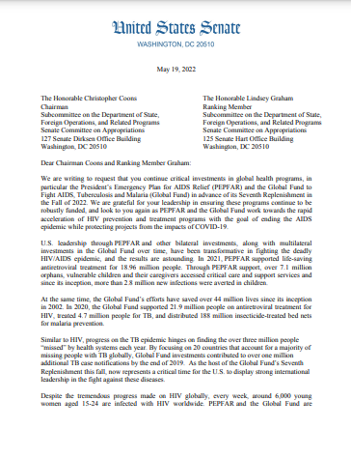
requesting signatures on annual “dear colleague” letters and by asking members to submit our funding levels in their personal requests to the SFOPS committee
we influence appropriations by…

Slide 22
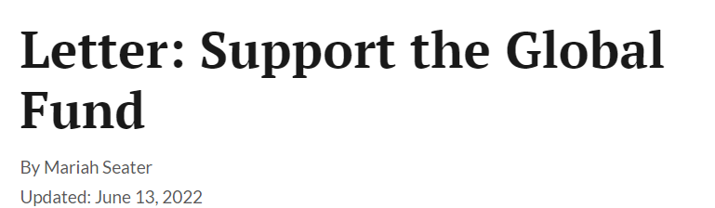
generating relevant local media
we influence appropriations by…

Slide 23
additional opportunities to weigh in
Individual office deadlines
Many offices will start setting them soon.
Ask your MoCs/staff when their deadlines are! Follow up!
Sign-On letters (AKA “Dear Colleagues”)
Pay attention! Each letter may have a different deadline!
Testify for Member’s Day for SFOPS
Subcommittee deadlines
These will dictate when sign-on letters close
Personal requests for all members are due to the committee chair and ranking member in an official request form.
Committee members can and should continue to weigh in individually after this deadline.

Slide 24
Timing? Well...
There’s a lot we still don’t know... But here’s what we do know:
President Biden will give his State of the Union Address on March 7th.
The administration is likely to send their budget request to Congress soon after that.
Congress already has a budget deal – but whether it will stand for FY25 is still a guess.
No final approps bills until AFTER the election

Slide 25
Lobby Prep and Approps Posse!
If you schedule a meeting – let Katie know! kfleischer@results.org and she can schedule a lobby prep session for you and your group!
If your member is on Appropriations and particularly if they are on the SFOPS subcommittee – we will have special convenings to keep you updated on dates approaching and for weighing in on Approps through the Spring.

Slide 26
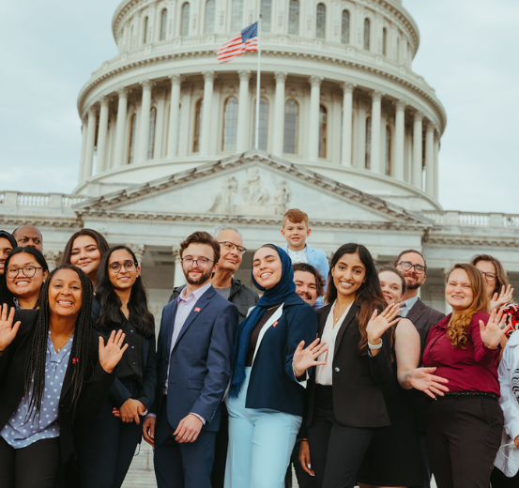
If you want to go fast, go alone. If you want to go far, go together.

Slide 27
FY25 Resources
results.org/community-of-change
results.org/resources/understanding-appropriations
results.org/resources/fy25-global-appropriations-memos

