Slide 1
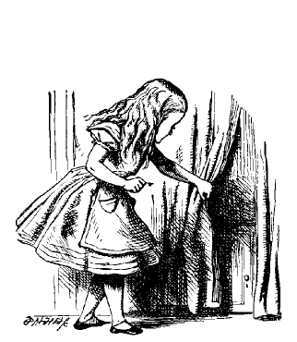
Behind the Curtain: The Creation of Wealth

Slide 2
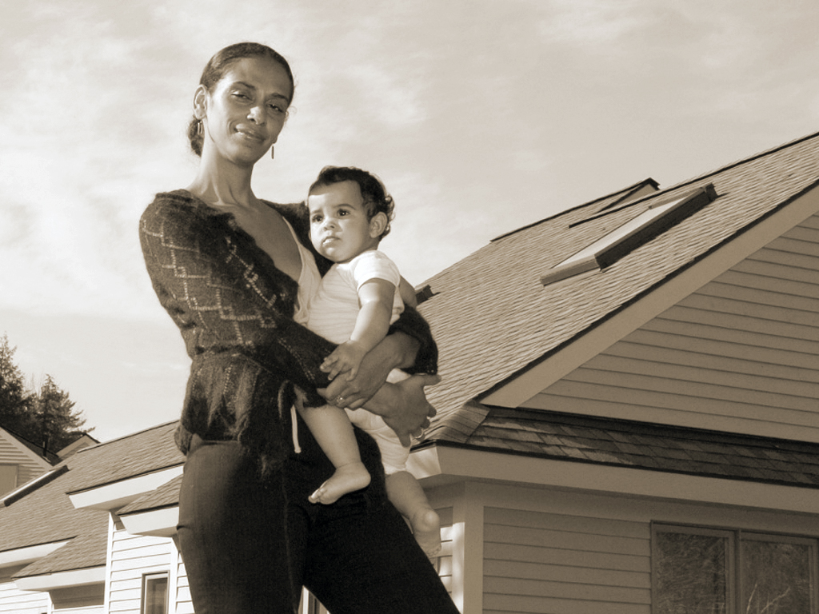
Wealth of Single Women
Source: SIPP 2011, Khai Zaw

Slide 3
Umbrellas Don’t Make it Rain: Why Studying and Working Hard Isn’t Enough for Black Americans

Slide 4
Source: Umbrella Don’t Make it Rain: Why Studying and Working Hard Isn’t Enough for Black Americans

Slide 5
Bootstraps Are for Black Kids:
Race, Wealth, and the Impact of Intergenerational Transfers on Adult Outcomes

Slide 6
black parents more likely to use limited resources to invest in their children’s education.

Slide 7
Received financial support from parents to pay for college
$58,583
INCOME
$17,300
WEALTH
62%
66%
COLLEGE DEGREE
HOMEOWNERSHIP
Received NO Financial support from parents to pay for college
$40,336
INCOME
$3,000
WEALTH
35%
11%
COLLEGE DEGREE
HOMEOWNERSHIP

