Slide 1
Advocacy 101: Engaging with Congress and Their Staff

Slide 2
Please feel free to introduce yourselves in the chat and where you are from.
Notes:
Now let’s do a quick review.

Slide 3
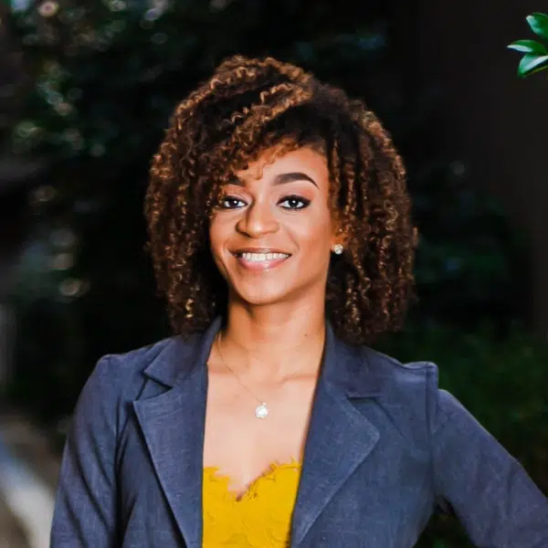
Errolyn Gray
Associate, Grassroots Expansion
Yolanda M. Gordon
Manager of Expansion and Advocacy

Slide 4
Agenda
What is advocacy and who do we advocate?
Discuss barriers to advocacy
Discuss how to research your members of Congress.
Importance of shared values
Walk through how to schedule a meeting.

Slide 6
What is Advocacy?
Definition
Policy work
What does it look like?

Slide 7
Why do we advocate?
To change minds
To end poverty
To build champions
To bring change

Slide 8
What holds people back?
Fear of making a mistake
The unknown
Fear of rejection
Not knowing how to start

Slide 9
Where do I find my member of Congress?
Govtrack.us
Google their name
Go to the RESULTS Website
Ask for assistance

Slide 10
Importance of Shared Values
Relationship building
We all want the same things.

Slide 11
How to schedule a meeting?
Website
Email scheduler
Email the person you need to meet with
Call the office

