Slide 1
RESULTS Action Network June Webinar
June 21, 2023

Slide 2
Our Values & Resources
2
​At RESULTS we pledge to create space for all voices, including those of us who are currently experiencing poverty. We will address oppressive behavior in our interactions, families, communities, work, and world. Our strength is rooted in our diversity of experiences, not in our assumptions.
With unearned privilege comes the responsibility to act so the burden to educate and change doesn’t fall solely on those experiencing oppression. When we miss the mark on our values, we will acknowledge our mistake, seek forgiveness, learn, and work together as a community to pursue equity.
Read our full anti-oppression values statement here at results.org/values.
Check out the 2023 Spring Anti-Oppression Workshop Schedule for training opportunities.
Find these resources and more at results.org/volunteers/anti-oppression:
  Resource Guides from our Diversity & Inclusion trainings, including:
    Interrupting Microaggressions
    Creating Space for Critical Conversations
  Information on how RESULTS responds to oppressive incidents
Notes:
Updated AO slide (2/22)

Slide 3
Check-ins!
Personal Check-ins: Share 1 thing you enjoy doing during the summertime!
Manager Goal Check-Ins: What are the goals you have for your Action Network, and how is that coming along?

Slide 4
Where to find Action Network media and actions! Pt. 1
Don’t forget you can check here to see who has submitted Action Network media and who has taken an action each month!
  Jos has done a great job of organizing our media, including non-group volunteers (AN members), so feel free to look at the media tab going back to 2019.
  I am working on finding their contact information, so you can formally invite these individuals into your action networks!

Slide 5
Where to find Action Network media and actions!
Pt. 2
I am working backward 6 months for 27 states, entering in who of your members acted, so please bear with me as I finish entering your members' names!
Next action alert (AA #2 of June) will be sent to your inboxes by COB 6 pm EST TODAY! (3 pm PST, 2 pm AKST, 5 pm CST)

Slide 6
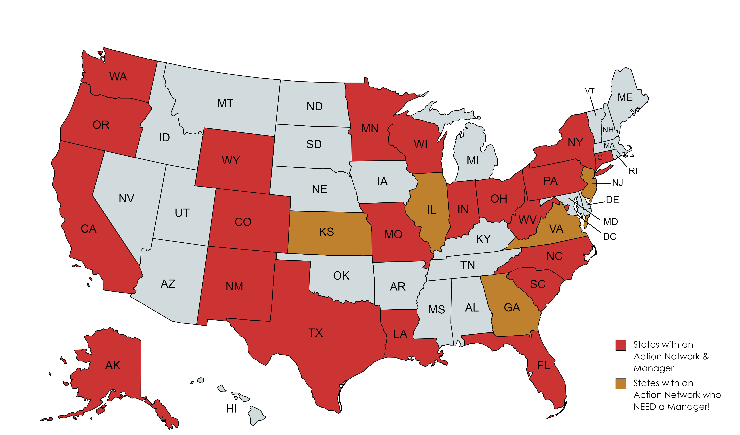
How many Action Networks are there? and where are they?

Slide 7
Following up from last month!
Last month I asked that you start thinking about your Action Networks as a whole...
How many members take action immediately once they receive your email/message?
    Once a month?
    Twice a month?
    Always?
Do you know if any of them have felt empowered to complete more advanced action alerts (submitting an LTE, making a phone call to their Rep)?

Slide 8
2023 Action Network Media Training!
September 20th at 8 pm EST! Facilitated by Sarah Leone & Jos Linn from the Grassroots Impact Team here at RESULTS!
We are going to be promoting this event starting next month! We are wanting non-group members from RESULTS to attend, which means your Action Network members!
It's a 45-minute training geared towards Action Network members and ways they can submit media without it taking a lot of time!
  This training can help their chances of getting published in their local media increase.

Slide 9
Upcoming Action Alerts & Webinars:
Action Alert
Action Alert #2 of June: TODAY, June 21st, 2023
Webinar
Action Network July Webinar: Wednesday, July 19th, 12:30 pm & 8:00 pm ET
Action Alert
Action Alert #1 of July: to be sent on July 5th, 2023 (after 4th of July)
Action Alert
Action Alert #2 of July: to be sent on July 18th, 2023
Action Network August Webinar: Wednesday, August 16th, 2023, 12:30 pm & 8 pm ET
Webinar

