Slide 1
Making Influential Noise Through the Media
Sept. 2, 2020

Slide 2
Objectives
2
Review why media matters
Learn about the nuts and bolts of writing and submitting a letter to the editor
Spend some time writing our letters, preparing them for submission
Learn how to make the most of media once published

Slide 3
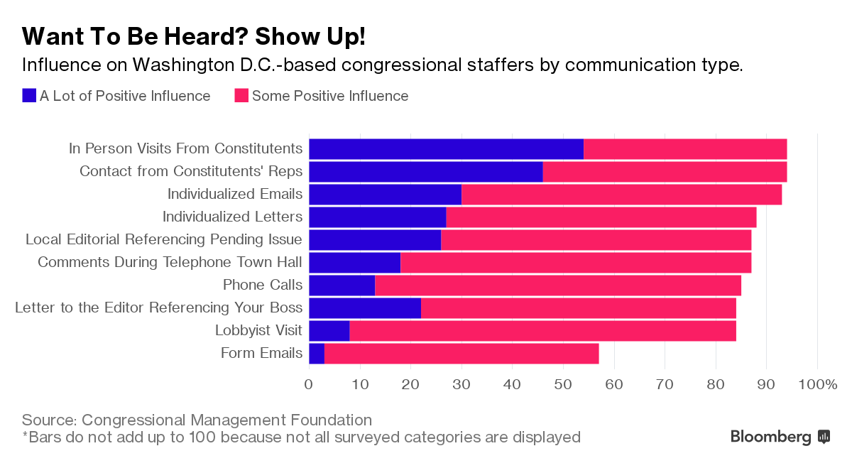
Advocacy Works!
3

Slide 4
4
Local Media is still the best way to get information and opinions about the community one lives in

Slide 5
Why Work with the Media?
5
Powerful tool
Editorial page most read section in the paper
Best source of local information and opinions
Strong media work can move decision-makers to alter their behavior, positions, and perceptions on an issue
Asheville Citizen-Times Circulation: 26,347 daily; 36,208 Sunday
Educates the public
Builds political will
Reaches wide audience
Engages new people

Slide 6
Secret to Getting Published (Shhhhh…)
Write
Submit
Repeat
Notes:
We’ll typically provide this for our advocacy efforts—no need to write

Slide 7
7
 | News | Editorials | Letters to the Editor | Op-Eds
Who writes it? | Them | Them | Us | Us
What’s it say? | Facts | Facts & Opinion | Facts & Opinion | Facts & Opinion

Slide 8
8
Opinion Media Madlibs
_____________ should _____________.
(person) (action)

Slide 9
What is a Letter to the Editor?
It’s a contribution to a new or on-going community conversation
Notes:
We’ll typically provide this for our advocacy efforts—no need to write

Slide 10
10
Noble
Worthy
Consistent

Slide 11
11
New angle
Unusual
Local
Personal
Important

Slide 12
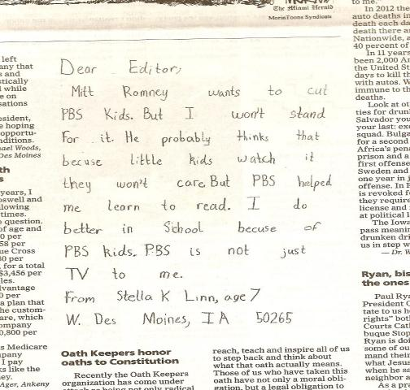
12
The Des Moines Register, October 9, 2012

Slide 13
13
Influence of Letters to the Editor

Slide 14
14
Letters to the Editor
150 – 200 words (check paper’s website)
3 key pieces:
Local or timely hook (best to respond to a story)
Why it matters
Call to action

Slide 15
EPIC Format for Writing & Speaking
ENGAGE: Something to capture their attention
PROBLEM: Outline the problem, paint a picture to help them understand
INFORM ON SOLUTION: Explain how your solution will confront the problem
CALL TO ACTION: Yes or no request
Local, Timely Hook
Why it Matters
Call to Action

Slide 16
16
Letters to the Editor
Structure
How it appears
Local & timely hook
Why it matters
Call to action
How you write it
Call to action
Why it matters
Local & timely hook

Slide 17
17
Three Parts of a LTE: Housing
Ditch the power struggles and help working people. Re: Aug. 16 article, “Americans waiting on help, but Congress is in recess.” I am amazed at the hard-heartedness of our federal government. Elected officials in Washington are worrying about spending too much when people have lost their jobs due to the pandemic.
How do they think our economy will recover and tax dollars be collected if people are homeless and buried in debt? How will people return to work when companies are going out of business? How will landlords pay their mortgages and taxes when renters can’t pay their rent?
Congress needs to put aside their power struggles and find solutions benefiting the people in this country. Pass a bill providing $100 billion in rent relief. Pass a bill assisting small businesses to stay solvent. Pass a bill to stop evictions. The hard-working people that kept our economy humming until the pandemic arrived deserve this respect.
Eloise Sutherland, Austin

Slide 18
18
Three Parts of a LTE: Global
Break the stalemate in Congress: A global pandemic requires a global response. Congress and the White House are indifferent to the world’s cry for relief. The U.S. must support low-income countries to deal with the immediate crisis and to strengthen healthcare systems. About 80 percent of tuberculosis, HIV and malaria programs worldwide have reported disruptions in services.
Public health experts warn the coronavirus is likely to set back years of painstaking progress against TB, HIV and malaria. Many kids are already missing out on life-saving vaccines. Food insecurity and starvation are also rising fast in Africa and Asia due to severe lockdowns. Whether it’s COVID-19 or other ongoing global health emergencies, we need a strong response from Congress here and around the world.
I’m counting on Congress and the White House to break the current stalemate and pass an emergency response package that includes no less than $20 billion for international development, including $4 billion for the Global Fund to fight AIDS, TB and Malaria, $4 billion for GAVI, the Vaccine Alliance and $2 billion for anti-hunger relief. We must act now.
Pat Payne, Castro Valley

Slide 19
19
Letters to the Editor
Structure
How it appears
Local & timely hook
Why it matters
Call to action
How you write it
CALL TO ACTION
Why it matters
Local & timely hook

Slide 20
20
Call to Action:
RESULTS Will Provide
Action Alerts, Monthly Action Sheets
Global Poverty
I call on Congress to break the stalemate in DC and pass an emergency response package that addresses the urgent needs of Americans and includes no less than $20 billion for international development and global health.
US Poverty
It's time for Congress and President Trump to resume negotiations now and enact a COVID-19 deal that includes $100 billion in emergency rental assistance and a national moratorium on evictions.
Notes:
From Action Alerts: Doesn’t have to be so specific—it can reinforce a specific ask you make

Slide 21
21
Call to Action:
RESULTS Will Provide
Action Alerts, Monthly Action Sheets
Combined
I call on my Representative and Senators to break the stalemate in DC and pass an emergency response package that includes $100 billion rental assistance and an eviction moratorium for Americans, and no less than $20 billion for international development and global health.
Notes:
From Action Alerts: Doesn’t have to be so specific—it can reinforce a specific ask you make

Slide 22
22
Call to Action
I’m counting on Congress and the White House to break the current stalemate and pass an emergency response package that includes no less than $20 billion for international development, including $4 billion for the Global Fund to fight AIDS, TB and Malaria, $4 billion for GAVI, the Vaccine Alliance and $2 billion for anti-hunger relief. We must act now.
—Pat Payne, Castro Valley
August 26, 2020

Slide 23
23
Call to Action
Congress needs to put aside their power struggles and find solutions benefiting the people in this country. Pass a bill providing $100 billion in rent relief. Pass a bill assisting small businesses to stay solvent. Pass a bill to stop evictions. The hard-working people that kept our economy humming until the pandemic arrived deserve this respect.
Eloise Sutherland, Austin
August 21, 2020

Slide 24
24
Letters to the Editor
Structure
How it appears
Local & timely hook
Why it matters
Call to action
How you write it
Call to action
WHY IT MATTERS
Local & timely hook

Slide 25
25
Why it matters
Why do I care about this issue?
What makes this issue compelling now?
Why does my member of Congress need to know about it?

Slide 26
26
Why it Matters
Public health experts warn the coronavirus is likely to set back years of painstaking progress against TB, HIV and malaria. Many kids are already missing out on life-saving vaccines. Food insecurity and starvation are also rising fast in Africa and Asia due to severe lockdowns. Whether it’s COVID-19 or other ongoing global health emergencies, we need a strong response from Congress here and around the world.
—Pat Payne, Castro Valley
August 26, 2020

Slide 27
27
Why it Matters
How do they think our economy will recover and tax dollars be collected if people are homeless and buried in debt? How will people return to work when companies are going out of business? How will landlords pay their mortgages and taxes when renters can’t pay their rent?
Eloise Sutherland, Austin
August 21, 2020

Slide 28
28
Letters to the Editor
Structure
How it appears
Local & timely hook
Why it matters
Call to action
How you write it
Call to action
Why it matters
LOCAL & TIMELY HOOK

Slide 29
29

Slide 30
30
Local and Timely Hook
Public health experts warn the coronavirus is likely to set back years of painstaking progress against TB, HIV and malaria. Many kids are already missing out on life-saving vaccines. Food insecurity and starvation are also rising fast in Africa and Asia due to severe lockdowns. Whether it’s COVID-19 or other ongoing global health emergencies, we need a strong response from Congress here and around the world.
—Pat Payne, Castro Valley
August 26, 2020

Slide 31
31
Local and Timely Hook
Ditch the power struggles and help working people. Re: Aug. 16 article, “Americans waiting on help, but Congress is in recess.” I am amazed at the hard-heartedness of our federal government. Elected officials in Washington are worrying about spending too much when people have lost their jobs due to the pandemic.
Eloise Sutherland, Austin
August 21, 2020

Slide 32
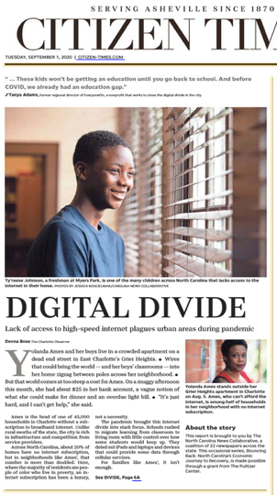
32
Local Timely Hook
“Thanks for your piece on the digital divide (DIGITAL DIVIDE, Sept. 1, 2020). Once again, the poorest among us are disadvantaged in ways that affect their entire lives. Some studies project that students lacking adequate internet access during COVID will never catch up in their education. We are seeing the same kind of divide everyday when it comes to food and housing. COVID has made it worse in NC.”

Slide 33
33
Rest of the Letter
Another massive divide we must not forget, is the global divide. In many low-income countries the pandemic is undermining decades of progress in fighting disease. Millions of children are missing out on life-saving vaccines and food insecurity and starvation are rising fast. Organizations like the Global Fund to Fight AIDS, TB, and Malaria and Gavi, the Vaccine Alliance are out of emergency funds and the stakes are great.
I call on our Representative and Senators to break the stalemate in DC and pass an emergency response package that includes $100 billion rental assistance and an eviction moratorium for Americans, and no less than $20 billion for international development and global health needs. The bill should also address the digital divide for American students who need it. It’s time to get back to the people’s work.

Slide 34
34
Local and Timely Hook
“Thanks for keeping us up to date on COVID-19 in Buncombe County (Death total up 6 over last week, Sept. 1, 2020). We must keep this pandemic in front of if we want to get in front of it. Regular reporting keeps us vigilant.”

Slide 35
35
Rest of the Letter
I wish Congress was more vigilant about their response to COVID-19 as well—they left DC for a long recess without passing an emergency COVID spending bill, leaving millions of people in danger of eviction in the U.S. or death globally. In many low-income countries the pandemic is undermining decades of progress in fighting disease. Millions of children are missing out on life-saving vaccines and food insecurity and starvation are rising fast. Global organizations like the Global Fund to Fight AIDS, TB, and Malaria and Gavi, the Vaccine Alliance are out of emergency funds and the stakes are great.
I call on our Representative and Senators to break the stalemate in DC and pass an emergency response package that includes $100 billion rental assistance and an eviction moratorium for Americans, and no less than $20 billion for international development and global health needs. It’s time to get back to the people’s work.

Slide 36
Local, Timely Hook
It brings hope to read about how our community has come together to address the coronavirus outbreak (cite article). And just as we are struggling here, we must also remember the challenges face by nations with fewer resources.

Slide 37
37
Local and timely hook
Coronavirus
Local election
Poverty and homelessness
Recession
Public health
Education
New stadium spending
Pop culture
2020 election coverage
Candidate profiles
Back to school
Gridlock in DC
Local or national budget cuts
Student housing
Tax issue
Charity drives

Slide 38
38
Short Letters Work Too
1: Hook) As Congress prepares for the next stage of the coronavirus response, it should include support for poverty-stricken countries so that they can deal with the immediate crisis and strengthen their health care systems in the long run.
3: Call to Action) I call on Sens. Bob Casey, D-Pa., and Pat Toomey, R-Pa., to give their support to the Global Fund to Fight AIDS, Tuberculosis and Malaria. 2: Why it Matters) This is a global pandemic, and it requires a global response. This is a good place to start.
LILY CALLAWAY Lawrenceville, PA
April 20, 2020

Slide 39
39

Slide 40
40
Get a draft letter to start your LTE on the RESULTS Website
Action Alerts
Monthly Actions

Slide 41
41
SEND IT!
100 percent of letters not sent never get published!
Submitting your LTE:
E-mail it directly to the paper (e.g. letters@kcstar.com - look on paper’s website for address)
Submit it through your paper’s website (usually an online form)
Submit it through the RESULTS website (https://results.org/volunteers/action-center/)
Mailing a hard copy to your local paper (takes longer)
Important! Most papers require you to include your name and contact info to be published. If you are a new writer, they will sometimes contact you to verify authorship.

Slide 42
42
RESULTS Website = Very Easy

Slide 43
43
Direct to the Paper = Pretty Easy

Slide 44
44
Media Success Checklist
Find a hook
Edit the template
Check your word count
Check for 3 key pieces
Hit “send”!
Send it to Congress
Send it to RESULTS
Repeat

Slide 45
45
Share your skills with others
Getting published is empowering and fun
Fast and visible
Media actions a great way to get people interested in advocacy
Invite others to write letters with you
Call a friend and ask him/her to write an LTE (support)
Collaborate on writing an op-ed
Hold an online training (use this PPT – it’s easy!)
Make it a game – who can get published first?
Always follow up after to celebrate success/try again

Slide 46
46
Persistence and Patience
Keep at it!
If one paper doesn’t publish, try another
If you get rejected multiple times, contact the editor and ask what they look for in letters
Work at building relationships with editorial staff and reporters
Send all you published media to your legislators

Slide 47
Next Steps
47
Send in a letter to the editor on housing and/or global health
Find online actions at: https://results.org/volunteers/action-center/
Let us know when you get published at www.tinyurl.com/RESULTSMedia
Send published letters to key aides and deliver them in lobby meeting
Invite others you know to share your letter and write their own letters too
If you are an LTE pro, consider an op-ed or editorial
Contact Jos Linn or Ken Patterson for help

Slide 48
Resources
48
RESULTS Media Tools: https://results.org/volunteers/media-tools/
RESULTS Online Media Actions: https://results.org/volunteers/action-center/
RESULTS Media Report Form: www.tinyurl.com/RESULTSMedia
RESULTS Advocacy Basics: https://results.org/volunteers/advocacy-basics/
Staff Media Support: Jos Linn, jlinn@results.org
RESULTS Training Resources: https://results.org/volunteers/training-webinars/

