Slide 1
RISE Advocacy Chapter July Webinar
July 18, 2023
Notes:
Leslye

Slide 2
Welcome
Please let us know in the chat where you are joining us from!
Notes:
Leslye

Slide 3
Mission & Vision
Together Women Rise’s Mission
Together Women Rise cultivates the collective power of community to achieve global gender equality.
OUR VISION
Together Women Rise envisions a world where every person has the same opportunities to thrive regardless of their gender or where they live.
Notes:
Leslye

Slide 4
Our Values & Resources
​At RESULTS we pledge to create space for all voices, including those of us who are currently experiencing poverty. We will address oppressive behavior in our interactions, families, communities, work, and world. Our strength is rooted in our diversity of experiences, not in our assumptions.
With unearned privilege comes the responsibility to act so the burden to educate and change doesn’t fall solely on those experiencing oppression. When we miss the mark on our values, we will acknowledge our mistake, seek forgiveness, learn, and work together as a community to pursue equity.
Read our full anti-oppression values statement here at results.org/values.
Check out the 2023 Spring Anti-Oppression Workshop Schedule for training opportunities.
Find these resources and more at results.org/volunteers/anti-oppression:
Resource Guides from our Diversity & Inclusion trainings, including:
Interrupting Microaggressions
Creating Space for Critical Conversations
Information on how RESULTS responds to oppressive incidents
Notes:
Leslye

Slide 5
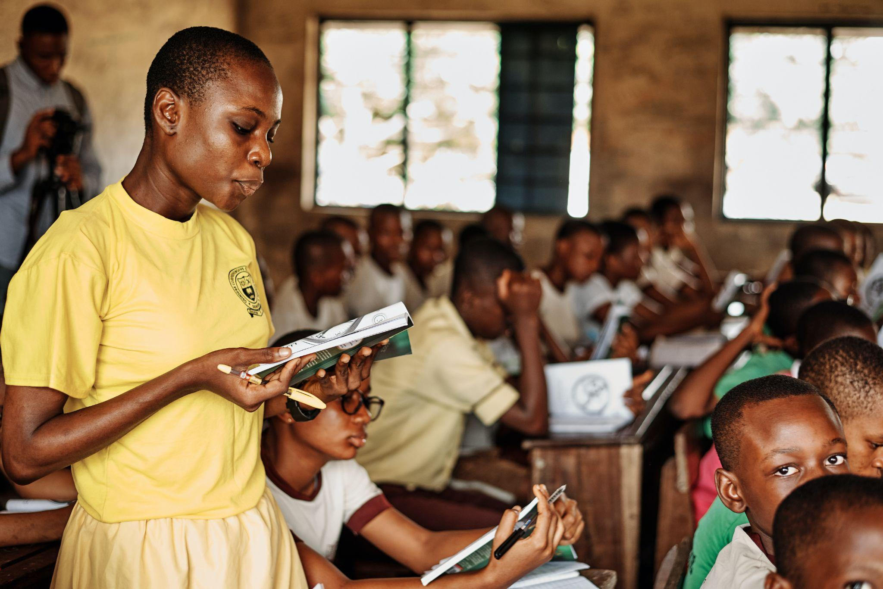
The READ Act:
Time is of the Essence!
Photo courtesy of Emmanuel Ikwuegbu, Unsplash.com
Notes:
Leslye

Slide 6
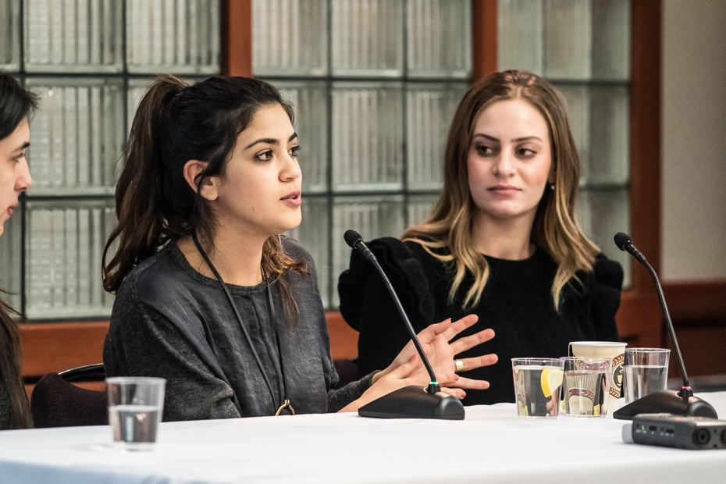
Grantee Spotlight
Tomorrow’s Women
Notes:
7 min: Grantee Story and/or Educational piece: Tomorrow’s women? (Chris and Leslye–explain about Oranim college)

Slide 7
Advocacy Action
What actions have you taken on the READ Act thus far?
What does it take to get the attention from our members of Congress?
Notes:
Ken 15 min: Checking in on actions taken on Read Act. What have you done? How have you taken action? How many times? What are you hearing back? What is next step on what you are or are not hearing back? (Ken)
Who are you reaching out to
Constituents matter
“We are reviewing it.” Any sense how long that will take–when should I check back. Do you have everything you need to review this? What else can we get you?
What does it take to get the attention from offices sometimes?
What are your next steps/strategies? Email with subject line, call, get others to call, get others to write.
August recess meeting is an opportunity: resources

Slide 8
Next Steps:
Choose your own adventure…
Photo courtesy of Dariusz Sankowski, Unsplash.com
Notes:
Ken
20 min: Take an action now as part of your plan: choose your adventure: Ken
Write email now (make sample available: Karyne)
Make phone call now
Send action to friends now
Write letter to the editor now

Slide 9
Follow Up Advocacy Action: Requesting co-sponsorship of the READ Act Reauthorization (H.R. 681/ S.41)
Notes:
Karyne

Slide 10
Follow Up Advocacy Action
Write an email now (use the sample email linked here)
Make phone call now, Capitol Switchboard (202) 224 - 3121
Send this action to friends now
Write letter to the editor now
Notes:
Ken
Link media to action alert for READ Act if we have one (or do a sample Google Doc) so it’s easy for folks to do
Write email now (make sample available: Karyne)
Make phone call now
Send action to friends now
Write letter to the editor now

Slide 11
Check here to see if your Representative or Senator has co-sponsored the READ Act Reauthorization of 2023 (H.R. 681/ S.41) or will likely support it if they co-sponsored last year (check here for past support during the 117th Congress).
Use Legislator Lookup if you are unsure of who to reach out to, please don’t hesitate to reach out to your Together Women Rise Advocacy Chapter Mentor for support.
Call the Capitol Switchboard at (202) 224 - 3121 to confirm they received your request, continue to follow up until you get a “yes” or “no” response.
Follow up Advocacy Action

Slide 12
Link for folks to sign up: https://results.salsalabs.org/diningforwomen/index.html
Next webinar: Tuesday, August 15 at 8:30 PM ET
If you would like to learn more about RISE grantees, there are chapters across the US, as well as a virtual national chapter meeting with a speaker from the grantee each month on the first Thursday of the month at 8 PM ET: https://togetherwomenrise.org/upcoming-events/
RESULTS Global Policy Forum - Thursday, August 17 at 9:00 PM ET Register here.
Closing
Notes:
Leslye

Slide 13
Thank you for joining us tonight!

Slide 14
READ Act
S.41, H.R.681
Calls for USAID to:
Develop comprehensive strategy that improves educational opportunities and addresses barriers to attendance, retention, completion, especially for girls;
Ensure education services for children affected by conflict and other emergencies;
Coordinate U.S. government efforts to efficiently and effectively manage resources;
Work with countries to strengthen systems in order to build long-term sustainability;
Engage with key partners including other donors, civil society and multilateral initiatives, including the Global Partnership for Education, for greatest impact
Require specific indicators and objectives with which to measure progress;
Improve the transparency and accountability of our basic education programs, ensuring taxpayer dollars have the most impact for children worldwide.
Notes:
Ken - 7 mins
Bills and what they do
READ Act Fact Sheet: https://results.org/wp-content/uploads/READ-Act-Reauthorization-Fact-Sheet.pdf

Slide 15
There is a phenomenon called “learning poverty,” and it targets the futures of children. Children who experience learning poverty cannot read or comprehend simple text by 10 years old.
Notes:
Karyne (skip if there is no time but share the link to it)
Engage: There is a phenomenon called “learning poverty,” and it targets the futures of children. Children who experience learning poverty cannot read or comprehend simple text by
10 years old.
Problem: According to the World Bank, roughly 57% of children in low- and middle-income countries experienced learning poverty in 2019. Thanks in part to the COVID-19 pandemic, that rate has increased to a stunning 70%.
Inform: The READ Act of 2017 made a difference in the lives of millions of young people and needs to be reauthorized in 2023. The bill calls on the U.S. to update its foundational literacy and numeracy strategy. It also calls for robust monitoring and evaluation.
Call to Action: Children around the world need reading and numeracy skills for success and a bright future. Will you be a READ Act co-sponsor?

Slide 16
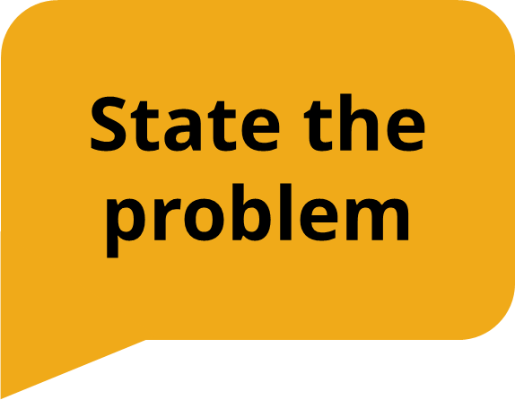
According to the World Bank, roughly 57% of children in low- and middle-income countries experienced learning poverty in 2019. Thanks in part to the COVID-19 pandemic, that rate has increased to a stunning 70%.
Notes:
Karyne

Slide 17
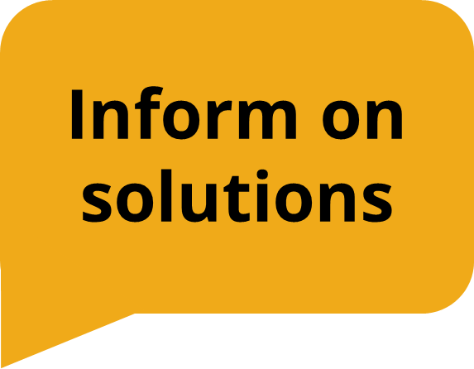
The READ Act of 2017 made a difference in the lives of millions of young people and needs to be reauthorized in 2023. The bill calls on the U.S. to update its foundational literacy and numeracy strategy. It also calls for robust monitoring and evaluation.
Notes:
Karyne

Slide 18
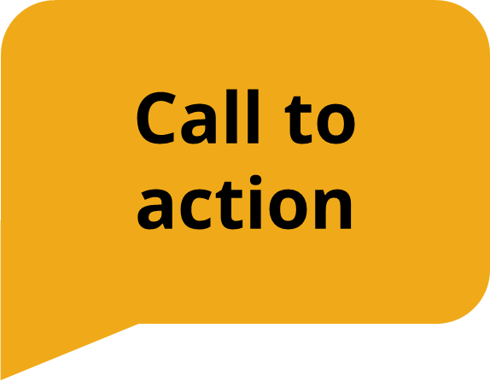
Children around the world need reading and numeracy skills for success and a bright future. Will you be a READ Act co-sponsor?
Notes:
Karyne (skip if there is no time but share the link to it)

