Slide 1
RISE Advocacy Chapter June Webinar
June 20, 2023
Notes:
Leslye

Slide 2
Welcome
Please let us know in the chat where you are joining us from!
Notes:
Leslye

Slide 3
Mission & Vision
Together Women Rise’s Mission
Together Women Rise cultivates the collective power of community to achieve global gender equality.
OUR VISION
Together Women Rise envisions a world where every person has the same opportunities to thrive regardless of their gender or where they live.
Notes:
Leslye

Slide 4
Our Values & Resources
​At RESULTS we pledge to create space for all voices, including those of us who are currently experiencing poverty. We will address oppressive behavior in our interactions, families, communities, work, and world. Our strength is rooted in our diversity of experiences, not in our assumptions.
With unearned privilege comes the responsibility to act so the burden to educate and change doesn’t fall solely on those experiencing oppression. When we miss the mark on our values, we will acknowledge our mistake, seek forgiveness, learn, and work together as a community to pursue equity.
Read our full anti-oppression values statement here at results.org/values.
Check out the Anti-Oppression Workshop Schedule for training opportunities.
Find these resources and more at results.org/volunteers/anti-oppression:
Resource Guides from our Diversity & Inclusion trainings, including:
Interrupting Microaggressions
Creating Space for Critical Conversations
Information on how RESULTS responds to oppressive incidents
Notes:
Leslye

Slide 5
So, why did you join us tonight?
Discussion
Notes:
Ken (5 mins) 8:35 -8:40pm Focus on the why (Ken) Share: Reactions - you could be doing a lot of other things tonight, why are you here? What is your commitment to making an impact on girls’ education - what actions have you taken or need to follow up on? Where have you seen global education make the biggest impact on the life of a girl/woman? (personal or community connection)
What is the current environment we are in that makes this issue critical to take action on right now (i.e. authoritarian govt’s limiting women’s rights to edu)

Slide 6
Discussion
Try to imagine your life if you only got a primary education, where would you be?

Slide 7
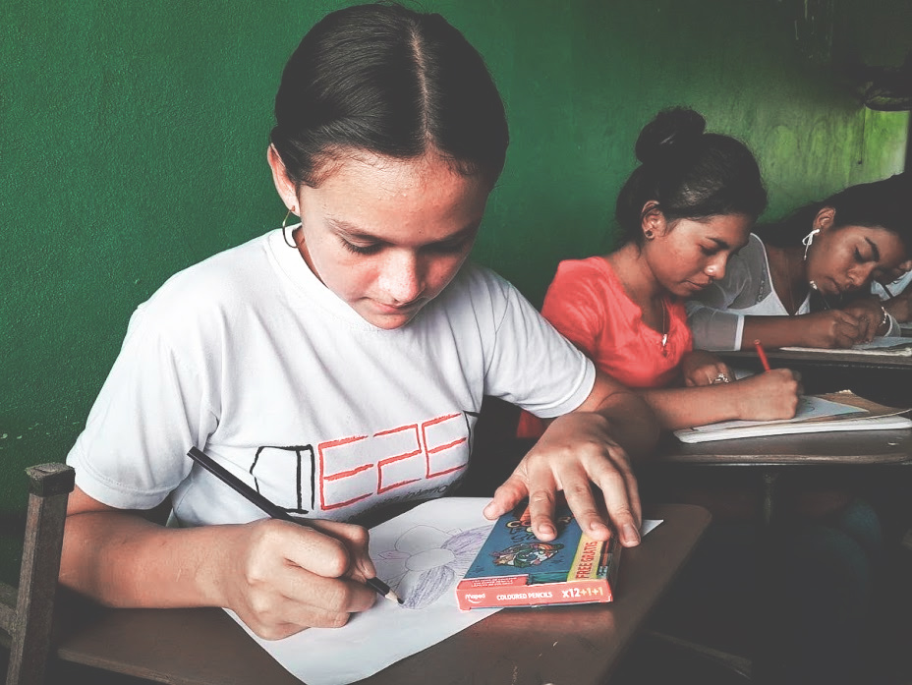
Grantee Spotlight
Educate2Empower International
Notes:
Chris or Leslye - 5 mins

Slide 8
Grantee Spotlight
Educate2Empower International
Project Title: Increasing Agency and Education Access of Rural Honduran Girls Location: Honduras Grant Amount: $50,000 Grantee Website: www.educate2envision.org/
Areas of Impact: Economic Sustainability, Education & Literacy
Notes:
Chris or Leslye - 5 mins

Slide 9
Grantee Spotlight
Educate2Empower International
Project Title: Increasing Agency and Education Access of Rural Honduran Girls Location: Honduras Grant Amount: $50,000 Grantee Website: www.educate2envision.org/
Areas of Impact: Economic Sustainability, Education & Literacy
Mission of Educate2Envision International Educate2Envision International equips rural youth in Latin America with the secondary education, resources, and leadership skills they need to build brighter futures and healthier communities.
Notes:
Chris or Leslye - 5 mins

Slide 10
Grantee Spotlight
Educate2Empower International
Project Summary This project addresses the key issues preventing girls’ full participation in their rural communities, including a pervasive machismo culture, lack of female role models, and an ill-equipped education system that fails to connect girls to future income-generating opportunities. Why We Love This Project Educate2 Envision has garnered international attention for its initiatives to address systemic problems in girls' schooling in the isolated, rural communities of Honduras. This project will improve the agency, schooling and economic independence of adolescent girls by enabling them to fully participate, engage, and be employed in the rural communities where they live.
Notes:
Chris or Leslye - 5 mins

Slide 11
Donate
give.togetherwomenrise.org
Notes:
Donation link: https://give.togetherwomenrise.org/give/316803/#!/donation/checkout?c_src=homepage&c_src2=June

Slide 12
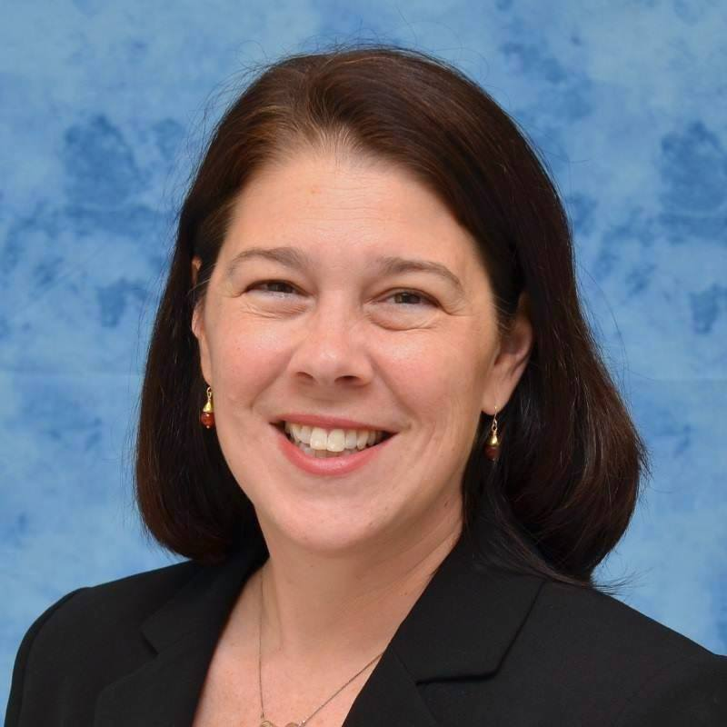
Meg Gardinier
Manager, Global Education Policy at RESULTS
Notes:
8:45 - 9:05pm Guest Speaker, Meg Gardinier, Manager Global Education Policy, RESULTS
Context/current environment around international education
FLN Meeting recap
Updates on READ Act (if appropriate): Advancements on Senate hotlining? Where are we in the House? Where does that put the bill now? What can advocates me doing to advance the bill?

Slide 13
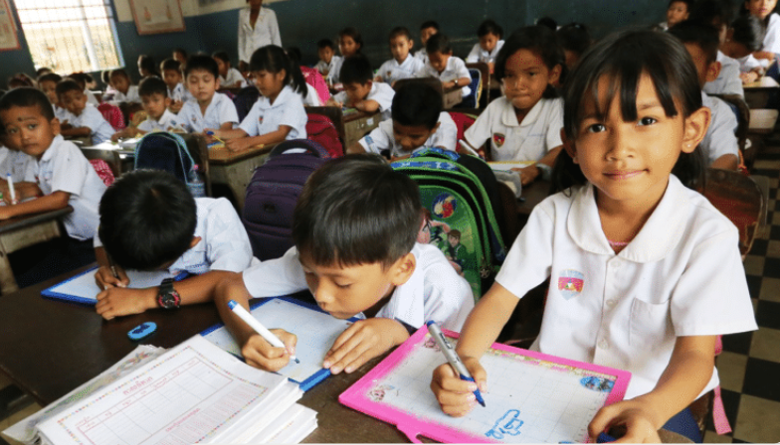
Advocacy Action
Follow-up action on the READ Act Reauthorization (H.R. 681/ S.41)
Notes:
Karyne (20 mins)

Slide 14
We’re making phone calls!
Notes:
Karyne

Slide 15
Advocacy Action
Call the Capitol Switchboard at (202) 224 – 3121
Ask for your Representative’s office
Leave a message (script below)
Repeat with your Senator’s office (S. 41)
Hello! My name is Name. I am constituent living in city or zip code and volunteer with Together Women Rise. I am calling this evening to share my support for H.R. 681 – The READ Act Reauthorization.
The READ Act of 2017 made a difference in the lives of millions of young people and needs must be reauthorized in 2023. The bill calls on the U.S. to update its foundational literacy and numeracy strategy to ensure that children are learning. According to the World Bank, roughly 57% of children in low- and middle-income countries experienced learning poverty in 2019. Thanks in part to the pandemic, that rate has increased to 70%. H.R. 681 is an accountability bill – it calls for robust monitoring and evaluation.
Will Representative Name please co sponsor H.R. 681? Thank you!
Notes:
Karyne

Slide 16
Script
Hello! My name is Name. I am constituent living in city or zip code and volunteer with Together Women Rise. I am calling this evening to share my support for H.R. 681 – The READ Act Reauthorization.
The READ Act of 2017 made a difference in the lives of millions of young people and needs must be reauthorized in 2023. The bill calls on the U.S. to update its foundational literacy and numeracy strategy to ensure that children are learning. According to the World Bank, roughly 57% of children in low- and middle-income countries experienced learning poverty in 2019. Thanks in part to the pandemic, that rate has increased to 70%. H.R. 681 is an accountability bill – it calls for robust monitoring and evaluation.
Will Representative Name please co sponsor H.R. 681? Thank you!

Slide 17
Link for folks to sign up: https://results.salsalabs.org/diningforwomen/index.html
Next webinar: July 18 at 8:30 PM ET
If you would like to learn more about RISE grantees, there are chapters across the US, as well as a virtual national chapter meeting with a speaker from the grantee each month on the first Thursday of the month at 8 PM ET: https://togetherwomenrise.org/upcoming-events/
Closing
Notes:
Leslye

Slide 18
Thank you for joining us tonight!

Slide 19
READ Act
S.41, H.R.681
Calls for USAID to:
Develop comprehensive strategy that improves educational opportunities and addresses barriers to attendance, retention, completion, especially for girls;
Ensure education services for children affected by conflict and other emergencies;
Coordinate U.S. government efforts to efficiently and effectively manage resources;
Work with countries to strengthen systems in order to build long-term sustainability;
Engage with key partners including other donors, civil society and multilateral initiatives, including the Global Partnership for Education, for greatest impact
Require specific indicators and objectives with which to measure progress;
Improve the transparency and accountability of our basic education programs, ensuring taxpayer dollars have the most impact for children worldwide.
Notes:
Ken - 7 mins
Bills and what they do
READ Act Fact Sheet: https://results.org/wp-content/uploads/READ-Act-Reauthorization-Fact-Sheet.pdf

