Slide 1
Organizing Training: ”I Gotta Do Something!” Engaging New Advocates in Uncertain Times
May 6, 2020

Slide 2
Objectives
Identify barriers to getting involved in advocacy with RESULTS
Learn from each other how one can overcome those barriers
Review tools & practices for helping new advocates overcome barriers to engagement

Slide 3
Expansion #s
Fall (Aug-Dec) 2019: Busy Time | Spring (Jan-April) 2020: Slower
Inquiries: 347 Oriented: 101 Intros to groups: 96 | Inquiries: 533 Oriented: 141 Intro to Groups: 103

Slide 4
Unprecedented Interest = Opportunity
How do we seize it?
Notes:
Our expansion team has seen record-breaking interest in RESULTS and chances are people in your community are more interested than ever in doing something that will make a difference during these troubled times. This is a good time to show people what we have to offer, and do it in a way that their motivation to so something is greater than the barriers to getting involved. What are those barriers to following through to becoming an advocate?

Slide 5
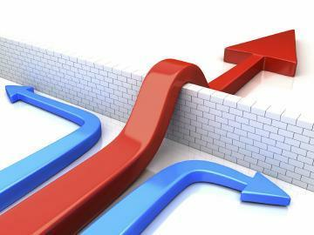
Motivation Must Be Greater than Barriers to Entry
Notes:
Our expansion team has seen record-breaking interest in RESULTS and chances are people in your community are more interested than ever in doing something that will make a difference during these troubled times. This is a good time to show people what we have to offer, and do it in a way that their motivation to so something is greater than the barriers to getting involved. What are those barriers to following through to becoming an advocate?

Slide 6
What are the Barriers?
Don’t know the issues
Feel like an outsider
Never did this before
Overwhelm

Slide 7
Exercise
Take 2 Minutes to Answer this Question:
Thinking about your experience of getting involved in RESULTS, what was the turning point or critical moment when you decided to become a RESULTS advocate or to stay involved with RESULTS?

Slide 8
Exercise
Take 2 Minutes to Answer this Question:
What barriers did you overcome to get involved with RESULTS? How did you overcome them?

Slide 9
What are the Barriers?
It’s overwhelming
I could never be as good as “they” are at this
I don’t know anything about these issues
I’ve never done advocacy—it seems hard
Nobody cares I’m around—I don’t feel welcome
Hard to get to know people—I feel like an outsider
The group isn’t organized—I don’t know when they meet
There’s so much lingo
I don’t think this really makes a difference

Slide 10
Based on Your Experience, How Can We Help New People Overcome Each Barrier?
It’s overwhelming
I could never be as good as “they” are at this
I don’t know anything about these issues
I’ve never done advocacy—it seems hard
Nobody cares I’m around—I don’t feel welcome
Hard to get to know people—I feel like an outsider
The group isn’t organized—I don’t know when they meet
There’s so much lingo
I don’t think this really makes a difference

Slide 11
Other Barriers You Came Up With

Slide 12
What would a first conversation with someone who is newly interested sound like?

Slide 13
Some Tools
Engagement Process Chart
“Organizing” Practices
Ladder of Engagement

Slide 14
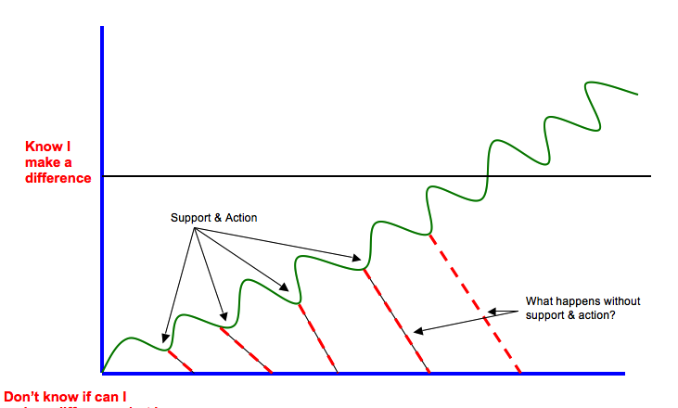
Engagement Process
Don’t know if I can make a difference, but want to try
Notes:
Cultivation Experience vs Conversion Experience

Slide 15
Organizing vs Mobilizing
Organizing | Mobilizing
Organizing is about leadership development and growing long-term people power | Mobilizing is about getting the most # of people to take an action to demonstrate broad support
Personalized Communications (1:1s) | Mass Communications
Relationship Based | Not Relationship Based
High value for time | Low value for time
Notes:
Transformational: Support people to do things they would not do on their own. Challenge people to go outside their comfort zones. Really feel that are delivering on their passion to make a difference.
Transactional: Take the action you feel comfortable taking. Not pushing or supporting people to become something else. Take this action…
Best example is what staff and RCs do with groups

Slide 16
Organizing Characteristics
Relationship
Give volunteers work that bring them in contact with others
Agency
Provide strategic autonomy on how the work is done
Purpose
Show volunteers how their work fits into the bigger picture—the campaign, the change they are creating in the world

Slide 17
Ladder of Engagement
Let’s navigate there
Link: https://results.org/wp-content/uploads/The-RESULTS-Ladder-of-Engagement-Jan-2020.pdf

Slide 18
Opportunities
Writing LTEs: Both May Action Sheets focus on media. You can do this remotely.
International Conference: have people in your network register before 5/26 to lobby.
Other ideas?

Slide 19
Resources
Where you’ll find this recording and resources: https://results.org/volunteers/training-webinars/
Organizing: https://results.org/orientation-and-advocacy-training/
Ladder of Engagement: https://results.org/wp-content/uploads/The-RESULTS-Ladder-of-Engagement-Jan-2020.pdf. In GL Training Module 2
Engagement Process Chart: In these slides.

