Slide 1
RISE Advocacy Chapter May Webinar
May 16, 2023
Notes:
Leslye

Slide 2
Welcome
Please let us know in the chat where you are joining us from!
Notes:
Leslye

Slide 3
Mission & Vision
Together Women Rise’s Mission
Together Women Rise cultivates the collective power of community to achieve global gender equality.
OUR VISION
Together Women Rise envisions a world where every person has the same opportunities to thrive regardless of their gender or where they live.
Notes:
Leslye

Slide 4
Our Values & Resources
​At RESULTS we pledge to create space for all voices, including those of us who are currently experiencing poverty. We will address oppressive behavior in our interactions, families, communities, work, and world. Our strength is rooted in our diversity of experiences, not in our assumptions.
With unearned privilege comes the responsibility to act so the burden to educate and change doesn’t fall solely on those experiencing oppression. When we miss the mark on our values, we will acknowledge our mistake, seek forgiveness, learn, and work together as a community to pursue equity.
Read our full anti-oppression values statement here at results.org/values.
Check out the 2023 Spring Anti-Oppression Workshop Schedule for training opportunities.
Find these resources and more at results.org/volunteers/anti-oppression:
Resource Guides from our Diversity & Inclusion trainings, including:
Interrupting Microaggressions
Creating Space for Critical Conversations
Information on how RESULTS responds to oppressive incidents
Notes:
Leslye

Slide 5
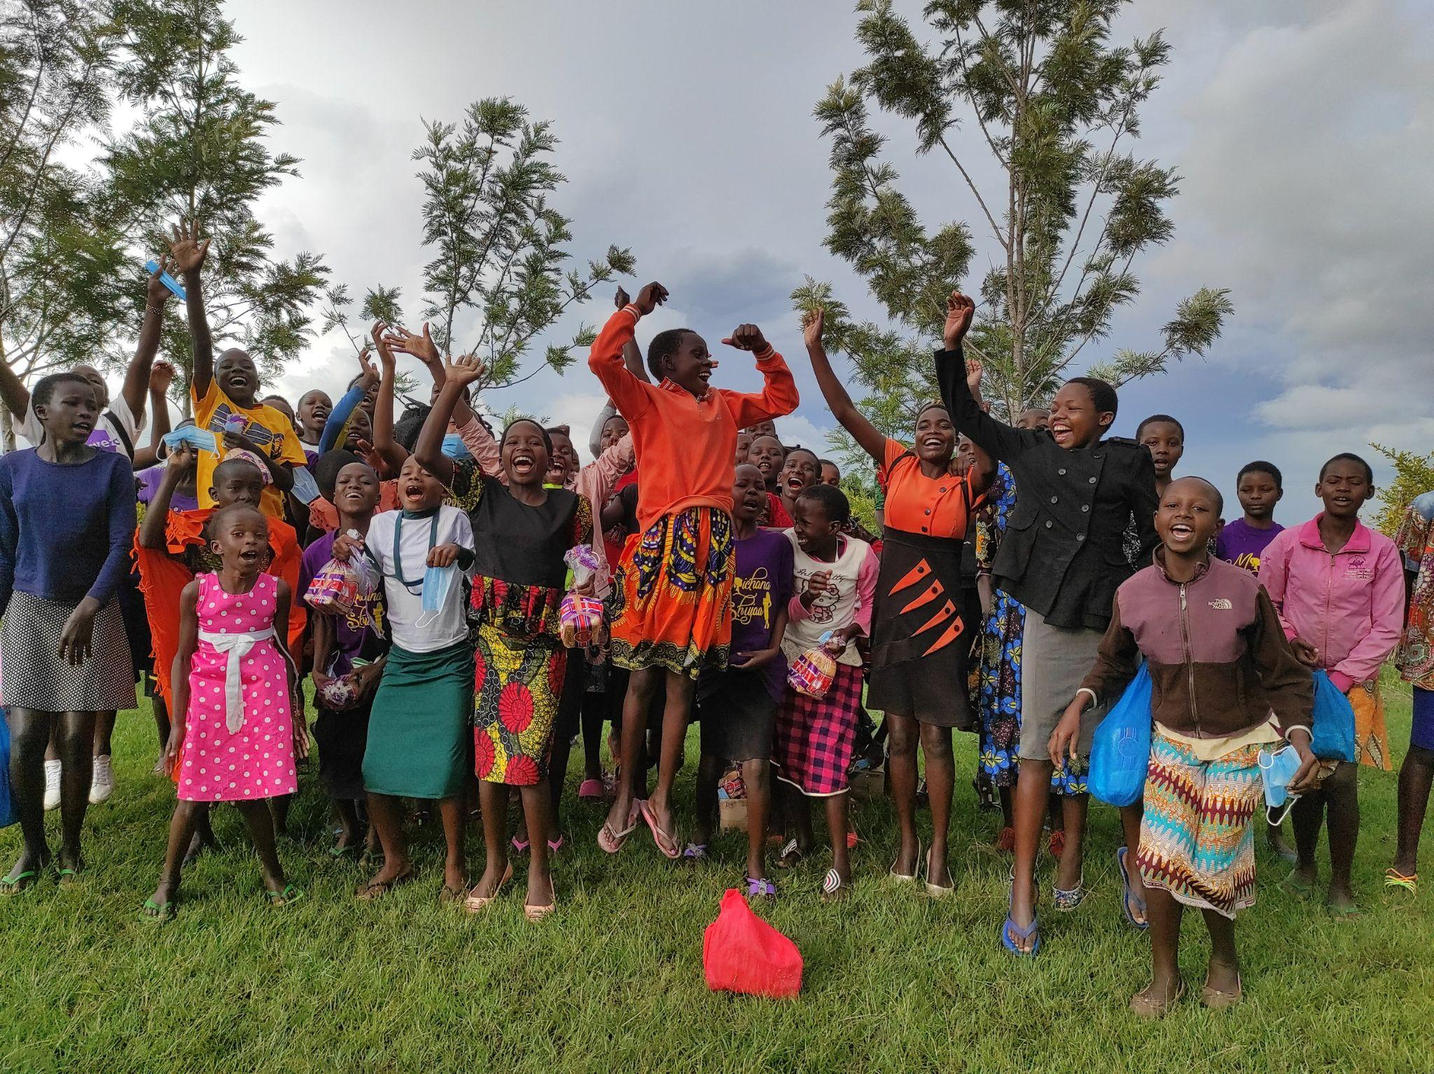
Grantee Spotlight
AMPLIFY Girls
Notes:
Chris or Leslye - 5 mins https://www.amplifygirls.org/
https://togetherwomenrise.org/wp-content/uploads/2023/01/AMPLIFY-Girls-Together-Women-Rise-Dec.-2022-Report.pdf
https://togetherwomenrise.org/tag/amplify/

Slide 6
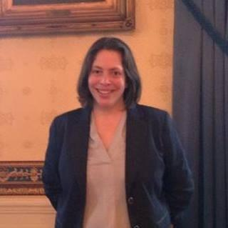
Jennifer G. Rigg
Executive Director, Global Campaign for Education - US
Notes:
Jennifer G. Rigg (15 mins)
https://www.gce-us.org/who-we-are/
Karyne to introduce Jennifer - Jennifer Rigg (she/her) is the Executive Director of the Global Campaign for Education-US (GCE-US). GCE-US, a coalition of over 80 organizations, promotes access to quality education as a human right and mobilizes the public to create political will in the U.S. and internationally to ensure universal access to quality education worldwide. Jennifer brings over 20 years of experience, including international education and development, public policy, coalition building, strategic communications and public management. Previously, Jennifer was the Director of Policy & Partnerships and Interim Executive Director at the 1,000 Days Partnership. At Save the Children, Jennifer led policy and advocacy on education, early childhood development, nutrition and food security, livelihoods, microfinance, and aid effectiveness. Jennifer has also worked with CARE, United Way Worldwide, and the Nancy Bell Evans Center on Nonprofits & Philanthropy at the University of Washington. She received an MPA and graduate certificate in International and Community Development Policy and Management from the University of Washington, a certificate in Nonprofit Leadership and Management from the University of Wisconsin/Learning Institute for Nonprofits, and a BA in International Studies/Political Science from Emory University.

Slide 7
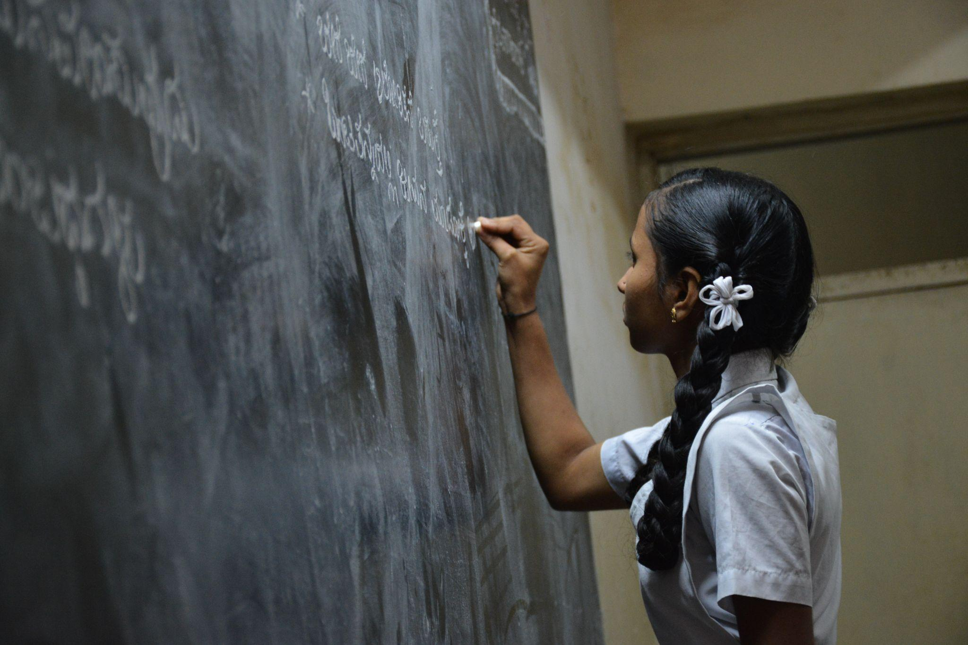
Sharing our thoughts on girls’ education
Photo courtesy of Nikhita S., Bengaluru, India, Unsplash.com
Notes:
Karyne to transition to Mentimeter for word cloud

Slide 8
Follow Up Advocacy Action: Requesting co-sponsorship of the READ Act Reauthorization (H.R. 681/ S.41)
Notes:
Karyne

Slide 9
Check here to see if your Representative or Senator has co-sponsored the READ Act Reauthorization of 2023 (H.R. 681/ S.41) or will likely support it if they co-sponsored last year (check here for past support during the 117th Congress).
Use Legislator Lookup if you are unsure of who to reach out to, please don’t hesitate to reach out to your Together Women Rise Advocacy Chapter Mentor for support.
Personalize this sample email. House: FirstName.LastName@mail.house.gov
Senate: FirstName_LastName@SenatorsLastName.Senate.Gov
Follow up! Call the Capitol Switchboard at (202) 224 - 3121 or email (change number of request in subject line).
Follow up Advocacy Action
Notes:
Karyne

Slide 10
Use these steps to contact your representatives about supporting the
End TB Now Act (H.R. 1776/ S. 288)
Bonus Advocacy Action
Notes:
Karyne

Slide 11
Link for folks to sign up: https://results.salsalabs.org/diningforwomen/index.html
Next webinar: June 20 at 8:30 PM ET
If you would like to learn more about RISE grantees, there are chapters across the US, as well as a virtual national chapter meeting with a speaker from the grantee each month on the first Thursday of the month at 8 PM ET: https://togetherwomenrise.org/upcoming-events/
RESULTS Global Policy Forum - Thursday, May 18 at 9:00 PM ET Speaker: Selamawit Bekele, Manager, Global Health Partnerships Register here.
Closing
Notes:
Leslye

Slide 12
Thank you for joining us tonight!

Slide 13
READ Act
S.41, H.R.681
Calls for USAID to:
Develop comprehensive strategy that improves educational opportunities and addresses barriers to attendance, retention, completion, especially for girls;
Ensure education services for children affected by conflict and other emergencies;
Coordinate U.S. government efforts to efficiently and effectively manage resources;
Work with countries to strengthen systems in order to build long-term sustainability;
Engage with key partners including other donors, civil society and multilateral initiatives, including the Global Partnership for Education, for greatest impact
Require specific indicators and objectives with which to measure progress;
Improve the transparency and accountability of our basic education programs, ensuring taxpayer dollars have the most impact for children worldwide.
Notes:
Ken - 7 mins
Bills and what they do
READ Act Fact Sheet: https://results.org/wp-content/uploads/READ-Act-Reauthorization-Fact-Sheet.pdf

Slide 14
There is a phenomenon called “learning poverty,” and it targets the futures of children. Children who experience learning poverty cannot read or comprehend simple text by 10 years old.
Notes:
Karyne (skip if there is no time but share the link to it)
Engage: There is a phenomenon called “learning poverty,” and it targets the futures of children. Children who experience learning poverty cannot read or comprehend simple text by
10 years old.
Problem: According to the World Bank, roughly 57% of children in low- and middle-income countries experienced learning poverty in 2019. Thanks in part to the COVID-19 pandemic, that rate has increased to a stunning 70%.
Inform: The READ Act of 2017 made a difference in the lives of millions of young people and needs to be reauthorized in 2023. The bill calls on the U.S. to update its foundational literacy and numeracy strategy. It also calls for robust monitoring and evaluation.
Call to Action: Children around the world need reading and numeracy skills for success and a bright future. Will you be a READ Act co-sponsor?

Slide 15
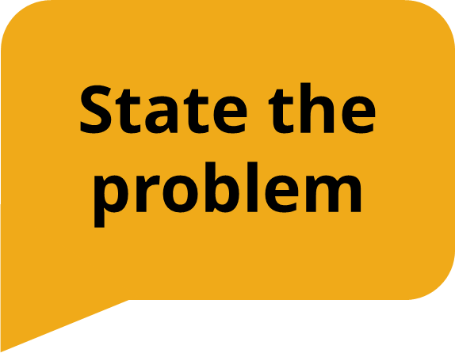
According to the World Bank, roughly 57% of children in low- and middle-income countries experienced learning poverty in 2019. Thanks in part to the COVID-19 pandemic, that rate has increased to a stunning 70%.
Notes:
Karyne

Slide 16
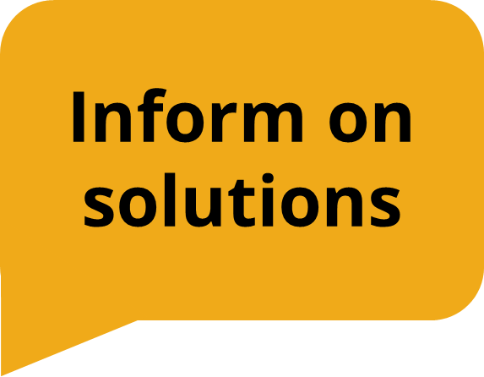
The READ Act of 2017 made a difference in the lives of millions of young people and needs to be reauthorized in 2023. The bill calls on the U.S. to update its foundational literacy and numeracy strategy. It also calls for robust monitoring and evaluation.
Notes:
Karyne

Slide 17
Children around the world need reading and numeracy skills for success and a bright future. Will you be a READ Act co-sponsor?
Notes:
Karyne (skip if there is no time but share the link to it)

