Slide 1
DFW Advocacy Chapter with RESULTS
May Webinar: Using Media to Support a Strong COVID-19 Response
May 13, 2020

Slide 2
Welcome!
This Group is for Everyone
No advocacy experience (most people)
Some advocacy experience
Lots of advocacy experience (few people)
But it does require getting outside your comfort zone—that’s what it takes to make a difference.
Let’s learn and make a difference together!
Notes:
Welcome newcomers and those who got started last month

Slide 3
Zoom Instructions
We want to hear from you, but please stay muted unless speaking. To unmute, click the microphone icon, dial *6 on the phone, or raise your hand so we can unmute you.
Also share comments and/or questions using the “Chat” icon

Slide 4
Welcome to the
DFW Advocacy Chapter with RESULTS
May Webinar: Using Media to Support a Strong COVID-19 Response
May 13, 2020

Slide 5
What are We Trying to Do
as Advocates?
Influence our decision makers in Congress, guiding them toward solutions that will positively impact the lives of women, girls, and children living in poverty.
Notes:
Any move we make on the Champion Scale is a win. If they move from Opponent to silence, there is less opposition. If we move them from a supporter to advocating with another member of Congress, it is a win. We do this through relationship building.

Slide 6
Assess where our members of Congress are on the Champion Scale, then move them up
What are We Trying to Do
as Advocates?
4 Champion
3 Leader
2 Advocate
1 Supporter
0 Uninformed or Neutral
-1 Opponent
Notes:
Any move we make on the Champion Scale is a win. If they move from Opponent to silence, there is less opposition. If we move them from a supporter to advocating with another member of Congress, it is a win. We do this through relationship building.

Slide 7
Ways to Reach Congress
Constituents
Staff
Colleagues
Media
Paid Lobbyists
Experts
Personal History

Slide 8
Advocacy Matters
“We don’t talk about the issues of poverty nearly the way that we should, nearly as often as we should, and as deeply as we should. RESULTS is there at the barricades all the time.”
  – Sen. Sherrod Brown (D-OH) on the May 2020 RESULTS National Webinar

Slide 9
2020 Campaigns
Improve maternal health and child survival:
Ensure the US is funding maternal & child health, child vaccinations, and child nutrition at robust levels for FY21 (Now)
Ensure the US does its part to fund Gavi, the Vaccine Alliance’s 5-year work plan (June)
Ensure that US and world leaders make serious commitments to end child malnutrition (Dec.)

Slide 10
2020 Campaigns Wins
Ensure the US is funding maternal & child health, child vaccinations, and child nutrition at robust levels. (Now)
  We generated more congressional support than ever for FY21 maternal and child health programs
2019 Signers of MNCH Letters | 2020 Signers of MNCH Letters
37 Senate | 38 Senate
146 House | 183 House

Slide 11
2020 Campaigns
Improve maternal health and child survival:
Ensure the US is funding maternal & child health, child vaccinations, and child nutrition at robust levels. (Now)
COVID-19 RESPONSE (ADDED) (Now)
Ensure the US does its part to fund Gavi, the Vaccine Alliance’s 5-year work plan. (June)
Ensure that US and world leaders make serious commitments to end child malnutrition. (Dec.)
Notes:
We’ll focus on this tonight: COVID Response

Slide 12
Importance of Advocacy Now
Communities facing poverty, including women, girls, and children, face the greatest risks.
Unless advocates speak up, low-income nations will not receive the support they need to respond to COVID-19 and protect progress.
Viruses don’t discriminate, but people and policies too often do.

Slide 13
Importance of Advocacy Now
“In low-income countries, including those in Africa, HIV/AIDS, maternal conditions and tuberculosis together account for one in every two deaths among adult women in reproductive years.”
-WHO (World Health Organization)
So suspending these programs will harm women and girls. But this is what we are seeing.

Slide 14
Importance of Advocacy Now
“Our least severe scenario (coverage reductions of essential maternal and child health interventions by 9.8–18.5% and wasting increase of 10%) over 6 months would result in 253,500 additional child deaths and 12,200 additional maternal deaths.”
“Our most severe scenario (coverage reductions of 39.3–51.9% and wasting increase of 50%) over 6 months would result in 1,157,000 additional child deaths and 56,700 additional maternal deaths.”
-The Lancet: https://www.thelancet.com/journals/langlo/article/PIIS2214-109X(20)30229-1/fulltext

Slide 15
Importance of Advocacy Now
Stop TB Partnership estimates an additional 6.3 million cases of TB and 1.4 million additional deaths. They say that it will set TB progress back by 5 years.
UNAIDS: Gains made in preventing mother-to-child transmission of HIV could be reversed, with new HIV infections among children up by as much as 104%
UNAIDS: A six-month disruption of antiretroviral therapy could lead to more than 500 000 extra deaths from AIDS-related illnesses, including from tuberculosis, in sub-Saharan Africa in 2020–2021.

Slide 16
Importance of Advocacy Now
Additional investments are needed to reduce disruptions in health services and backsliding on diseases, vaccinations, and education. In many cases, services would be taken house-to-house, which is more costly and time consuming.
Increases in domestic violence is also a documented risk. But investments in efforts to put medical professionals in house-to-house visits may mute some of this as nearly all healthcare professionals are trained to investigate for signs of abuse.

Slide 17
What are We Advocating For?
The new House bill, so far, has little to no money to address the challenges just discussed!
We need additional investments in:
  The Global Fund to Fight AIDS, TB, and Malaria
  Gavi, the Vaccine Alliance
  Bi-lateral TB programs
  Maternal & child nutrition
  Basic Education

Slide 18
Actions We Need to Take
Generate media calling on Congress to include funding to support international partners in poorer nations to address health and education challenges. DFW Priority #1
Contact members of Congress with the request above. RESULTS Priority #1

Slide 19
DFW Story: Chris King

Slide 20
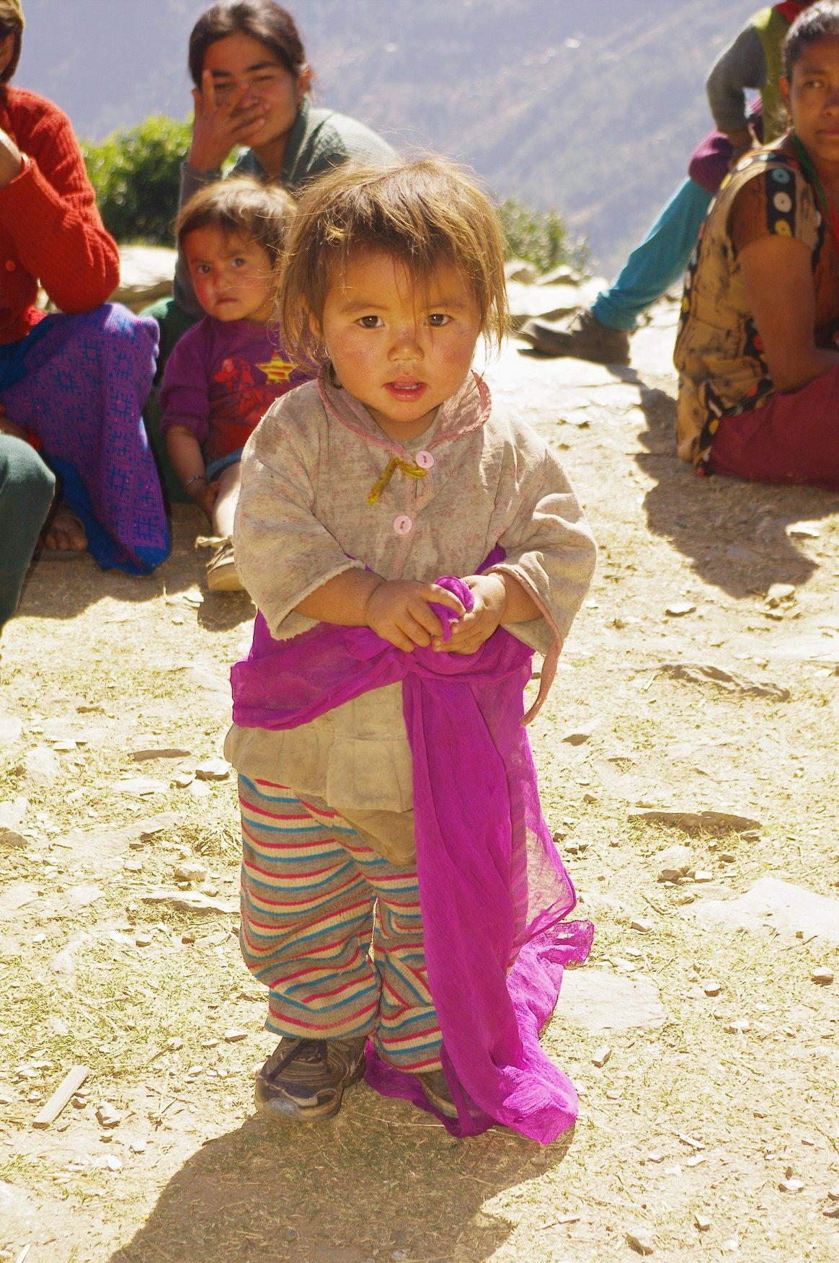
May Grantee: Educate the Children, Nepal
UN and USAID studies have shown that rural Nepalese children suffer from malnutrition resulting in wasting and stunted growth. Such children will have a very hard time learning in school.
Vitamin A deficiency is common in Nepal, resulting in blindness, infant mortality, complications in pregnancy, and reduced immunity.
Educate the Children (ETC) takes on the intertwined problems of food insecurity, malnutrition, income generation/poverty and women’s empowerment in an integrated and holistic way.
From an Independent Evaluation of ETC conducted two years ago, green vegetable intake has increased dramatically, resulting in a large increase in consumption of Vitamin A.

Slide 21
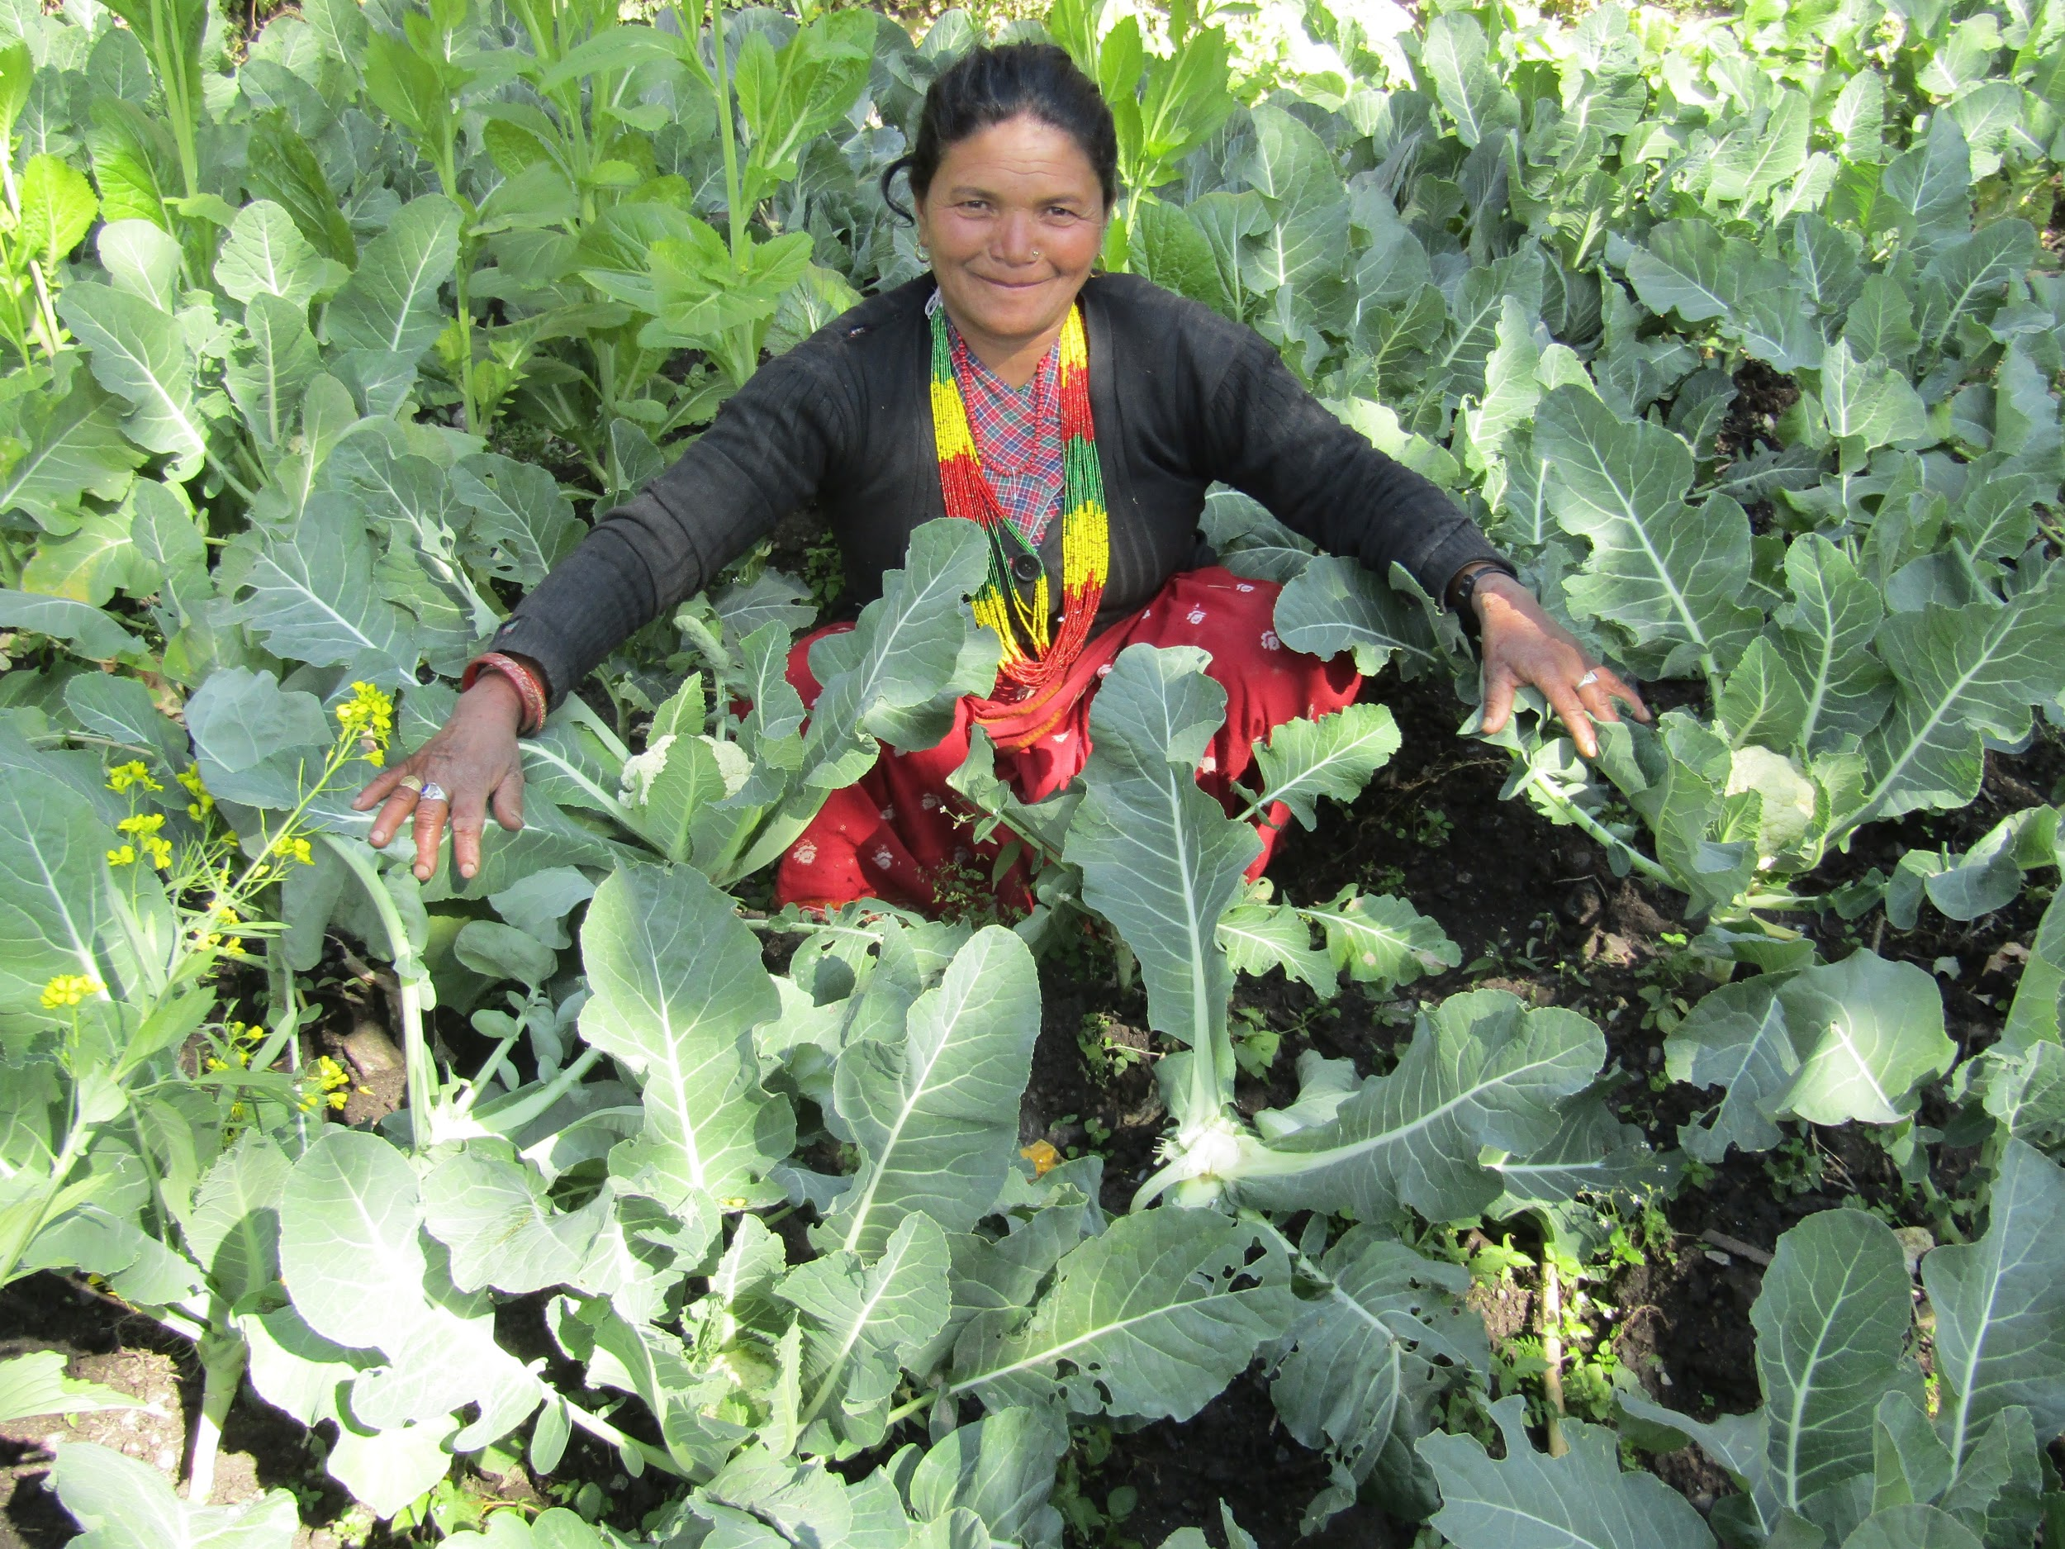
“Previously we used to have very little vegetables and mostly potatoes, radishes and green leafy vegetables. No matter how much effort you put, it was only sufficient for a few months. After receiving training, we now have varieties of vegetables including cauliflowers, cabbages, tomatoes, broccoli, turnips etc. that can be used throughout the year. Sometimes we even have some excess vegetables, which we sell.”
Indramaya, age 50

Slide 22
How this connects to COVID-19
“Women will be the hardest hit by this pandemic, but they will also be the backbone of recovery in communities. Every policy response that recognizes this will be the more impactful for it.”
UN Policy Brief: The Impact of COVID-19 on Women , 9 APRIL 2020
“I urge governments to put women and girls at the centre of their efforts to recover from COVID-19.”
António Guterres, UN Secretary-General

Slide 23

Ways to Reach Congress
Constituents
Staff
Colleagues
Media
Paid Lobbyists
Experts
Personal History

Slide 24
Tactics that work

Slide 25
Media Matters
Grace Liu
Garret Wilkinson
David Ehrenkrantz
Notes:
We’ll typically provide this for our advocacy efforts—no need to write

Slide 26
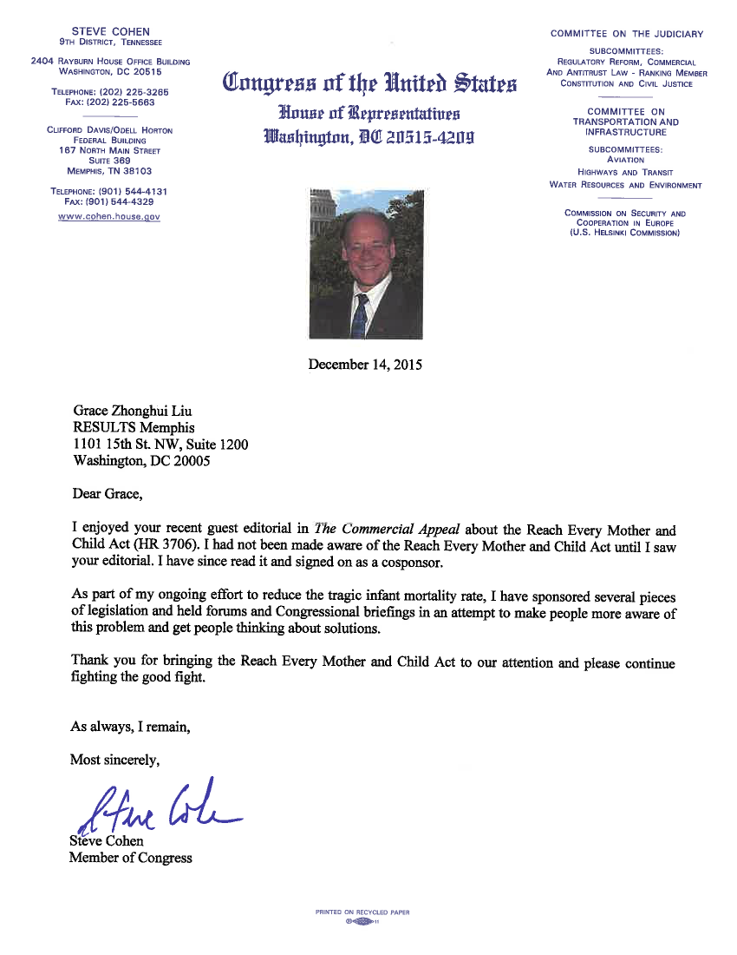

Slide 27
LETTER: Boyle responds to letter, supports education initiatives
Nov 19, 2017
To the Editor:
Dear Mr. Ehrenkrantz:
Thank you for taking the time to express your support for House Resolution 466, the Global Partnership for Education and U.S. funding for global health initiatives (“U.S. needs to commit to developmental investments,” Oct. 22).
Over 10,000 pieces of legislation were introduced during the last session of Congress alone. I highly value the input I receive from citizens like you because it directly informs my voting decisions and policy positions and helps bring legislation to my attention. This type of open dialogue is my top priority as your representative — and the foundation of a healthy democracy…

Slide 28
Secret to Getting Published
Write
Submit
Repeat
Notes:
We’ll typically provide this for our advocacy efforts—no need to write

Slide 29
29
Letters to the Editor
150 – 200 words in community dialogue
3 key parts of a letter:
  Local or timely hook
  Why it matters
  Call to action

Slide 30
30
RESULTS Makes it Easy
We’ll give you:
The “Call to action”
“Why it Matters”, though you can personalize this
Easy way to submit your letter to multiple papers!
So,you create the opening “hook” so it relates to your community—that’s all!

Slide 31
How to Submit a Letter

Slide 32
How to Submit a Letter

Slide 33
How to Submit a Letter

Slide 34
How to Submit a Letter
Notes:
You must write and submit

Slide 35
35
What You’ll Find There
It now falls to the Senate to make sure our country has a global response to this global pandemic, because the House left the international response out of its bill completely.
WHY IT MATTERS: Congress should include support for lower-income countries to deal with the immediate crisis and to strengthen healthcare systems in the long run. It's the right thing to do, and the only way we get through this pandemic as a global community.
CALL TO ACTION: Our government already supports international organizations that do this, like the Global Fund to Fight AIDS, Tuberculosis and Malaria and Gavi, the Vaccine Alliance, as well USAID's programs focused on global health. We should build on these efforts.
This is a global pandemic, and it requires a global response.
Notes:
The reason it is in reverse is because you know what you want your letter to do—call someone into action.
Your Why it Matters could be for you, or could be for different audiences who read the letter
The hook is about making it relevant to an on-going conversation or understanding

Slide 36
36
What You’ll Find There
Coronavirus is a global challenge that needs a global response. But the new bill in the House of Representatives left this out, with no international focus.
WHY IT MATTERS: Whether it's COVID-19 or other ongoing global health emergencies, we need a strong global response from Congress that honors the needs and human rights of people experiencing poverty.
CALL TO ACTION: Organizations like the Global Fund to Fight AIDS, Tuberculosis and Malaria, Gavi, the Vaccine Alliance, and the Global Partnership for Education are responding to the emergency. We should support them.
Global challenges aren't solved in isolation - they're solved in partnership. I'm now counting on our Senators to help fill this gaping hole in the bill moving in Washington.
Notes:
The reason it is in reverse is because you know what you want your letter to do—call someone into action.
Your Why it Matters could be for you, or could be for different audiences who read the letter
The hook is about making it relevant to an on-going conversation or understanding

Slide 37
Local, Timely Hook
Anything in your local paper or being discussed in your community
Anything that everyone knows about. For example: upcoming elections, coronavirus, economy, jobs, social distancing

Slide 38
38
Ideas for Hooks?
You have a connection to the COVID outbreak in your community (volunteer, healthcare or frontline worker)
You are in a local DFW chapter connection and you understand the importance of global investments
You have observations about how your community is responding to COVID
You want to provide some hope, which many people need
Notes:
The reason it is in reverse is because you know what you want your letter to do—call someone into action.
Your Why it Matters could be for you, or could be for different audiences who read the letter
The hook is about making it relevant to an on-going conversation or understanding

Slide 39
Local, Timely Hook
It brings hope to read about how our community has come together to house and feed those in need during coronavirus outbreak (cite article if possible). And just as we are struggling here, we must also remember the challenges face by nations with fewer resources.

Slide 40
Action-Taking Exercise
In Breakout Rooms of 3-4 for 12 minutes
Take 40 seconds each (2-3 min) to introduce yourselves to each other:
  where you are located,
  why you’ve become an advocate,
  hook you are thinking of using for your letter
3 minutes to write the hook, or beginning of your letters
2 minutes to share the hook with each other
2 minutes to finalize the hook and paste into RESULTS media tool
2 minutes to share contact information to support each other in finalizing letters, if they weren’t completed, or to write a second letter to the editor.

Slide 41
How to Submit a Letter
Write your letter
Go to www.results.org and click on “Current Volunteers”
Click on “Media Action: Virus reminds us everyone needs access to healthcare”
Edit existing letter, add your address
Hit “Send Message”
Your letter will be sent to papers near you

Slide 42
How was that?
What did it feel like to take action?
Questions?
Notes:
You must write and submit

Slide 43
How to Track Your Letter
Go to the website of the papers your letter went to and check “letters” section
Set up a Google Alert with your name in it:
  https://www.google.com/alerts
Notes:
You must write and submit

Slide 44
Important Dates
June 20-21: RESULTS Virtual International Conference. Sign up by May 26 to lobby.
  Dr. Muhammad Yunus, Nobel Peace Prize Winner
  Joia Mukherjee, Chief Medial Officer, PIH
  Liz Theoharris, President Poor People’s Movement
  Amazing workshops
June 17: Next DFW Advocacy Webinar, 8:30 pm ET
Notes:
You must write and submit

Slide 45
Important Dates
DFW will continue to host Virtual Chapter Meetings on Thursday evenings at 7PM, this week Eastern time, next week Pacific Time and this is the link: https://diningforwomen.org/virtual-meetings/
Notes:
You must write and submit

