Slide 1
Making Your Voice Heard through the Media: Letters to the Editor Training
April 22, 2020

Slide 2
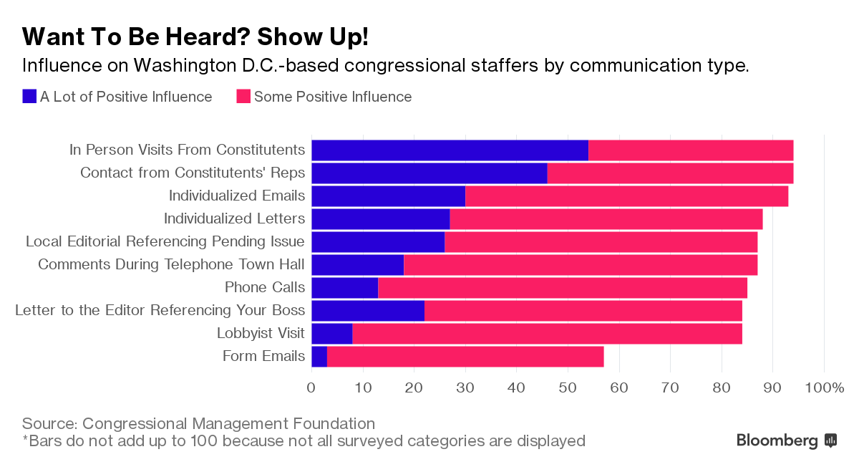
Advocacy Works!
2

Slide 3
Advocacy Works!
3

Slide 4
What does the media landscape feel like these days?
4

Slide 5
5
Local Media is still the best way to get information and opinions about the community one lives in

Slide 6
Why Work with the Media?
6
Powerful tool
Editorial page most read section in the paper
Best source of local information and opinions
Strong media work can move decision-makers to alter their behavior, positions, and perceptions on an issue
Asheville Citizen-Times Circulation: 26,347 daily; 36,208 Sunday
Educates the public
Builds political will
Reaches wide audience
Engages new people

Slide 7
7
Share your skills with others
Getting published is empowering and fun
Fast and visible
Media actions a great way to get people interested in advocacy
Invite others to write letters with you
Call a friend and ask him/her to write an LTE (support)
Collaborate on writing an op-ed
Hold an online training (use this PPT – it’s easy!)
Make it a game – who can get published first?
Always follow up after to celebrate success/try again

Slide 8
8
 | News | Editorials | Letters to the Editor | Op-Eds
Who writes it? | Them | Them | Us | Us
What’s it say? | Facts | Facts & Opinion | Facts & Opinion | Facts & Opinion

Slide 9
Secret to Getting Published (Shhhhh…)
Write
Submit
Repeat
Notes:
We’ll typically provide this for our advocacy efforts—no need to write

Slide 10
10
Opinion Media Madlibs
_____________ should _____________.
(person) (action)

Slide 11
11
Noble
Worthy
Consistent

Slide 12
12
New
Unusual
Local
Personal
Important

Slide 13
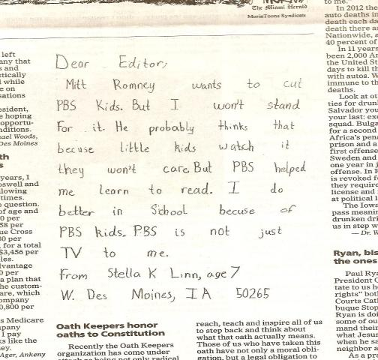
13
The Des Moines Register, October 9, 2012

Slide 14
14
Letters to the Editor
150 – 200 words (check paper’s website)
3 key pieces:
Local or timely hook (best to respond to a story)
Why it matters
Call to action

Slide 15
EPIC Format for Writing & Speaking
ENGAGE: Something to capture their attention
PROBLEM: Outline the problem, paint a picture to help them understand
INFORM ON SOLUTION: Explain how your solution will confront the problem
CALL TO ACTION: Yes or no request
Local, Timely Hook
Why it Matters
Call to Action

Slide 16
16
Letters to the Editor
Structure
How it appears
Local & timely hook
Why it matters
Call to action
How you write it
Call to action
Why it matters
Local & timely hook

Slide 17
17
Three Parts of a LTE
In reference to your recent article, “Missouri lawmakers approve $6 billion COVID-19 emergency funding bill”, I am grateful that both our state legislature and Congress have now passed emergency legislation to help people survive this crisis.
But more is desperately needed. Thousands of laid off workers in Kansas City have no income now and no guarantee they’ll still have jobs when the crisis ends. Without help, they and their families face hunger, eviction, and possibly homelessness. We must help. In the next coronavirus response bill, Congress must prioritize housing and hunger by providing $100 billion for emergency rental assistance, passing a national moratorium on evictions, and increasing the maximum SNAP (formerly Food Stamps) benefit by 15 percent.
I urge our Congressman Cleaver and Sens. Blunt and Hawley to help people secure stable housing and keep their families fed during this economic crisis and beyond.

Slide 18
18
Local Timely Hook & Why It Matters
As we respond to the tragedy of this pandemic, we know it's also threatening communities facing poverty all around the world. Just as we have seen it racing through our long-term care facilities, it will race through resource poor communities, and especially, refugee camps.
As Congress prepares for the next stage of its coronavirus response, they should include support for lower-income countries to deal with the immediate crisis and to strengthen their health care systems in the long run.
Our government already supports international organizations that do this well, including the Global Fund to Fight AIDS, Tuberculosis and Malaria as well as Gavi, the Vaccine Alliance, in addition to U.S. programs focused on global health. We should build on these efforts.

Slide 19
19
Call to Action
U.S. Rep. Richard Neal, D-Springfield, and U.S. Sens. Warren and Markey, D-Mass., must ensure that, in addition to our domestic response, Phase 4 of the U.S. COVID-19 response includes support for programs on the front lines in low-income nations. Organizations like the Global Fund and Gavi have leaped into action, but will need additional support.
If this crisis has taught us anything, it's that we live in a connected world and that what happens "over there" in other nations is our concern. Let's support our neighbors everywhere.
This is a global pandemic, and it requires a global response.
Leslye Heilig,
Great Barrington
April 20, 2020

Slide 20
20
Letters to the Editor
Structure
How it appears
Local & timely hook
Why it matters
Call to action
How you write it
CALL TO ACTION
Why it matters
Local & timely hook

Slide 21
21
Call to Action:
RESULTS Will Provide
Global Poverty
Congress must prioritize global health systems, alongside the domestic response, as we move forward together. People who are disenfranchised must not bear the brunt of this pandemic.
US Poverty
Workers and families are hurting and we can do more to help. I urge our members of Congress to pass legislation that helps Americans keep a roof over the heads and and food on the table through this economic crisis and beyond.
Notes:
From Action Alerts: Doesn’t have to be so specific—it can reinforce a specific ask you make

Slide 22
22
Call to Action
U.S. Rep. Richard Neal, D-Springfield, and U.S. Sens. Warren and Markey, D-Mass., must ensure that, in addition to our domestic response, Phase 4 of the U.S. COVID-19 response includes support for programs on the front lines in low-income nations. Organizations like the Global Fund and Gavi have leaped into action, but will need additional support.
If this crisis has taught us anything, it's that we live in a connected world and that what happens "over there" in other nations is our concern. Let's support our neighbors everywhere.
This is a global pandemic, and it requires a global response.
Leslye Heilig,
Great Barrington
April 20, 2020

Slide 23
23
Call to Action: RESULTS Will Provide this
Global Poverty
Congress develops a Phase 4 COVID-19 response package it should include measures that:
Support low-income countries to respond to COVID-19, building on the progress we’ve made in global health.
Ensure other health programs that address diseases of poverty are not undermined by the COVID-19 response.
Address the non-health impacts of the pandemic, particularly access to quality education and other areas that disproportionately affect the poor.
Notes:
A more specific ask

Slide 24
24
Letters to the Editor
Structure
How it appears
Local & timely hook
Why it matters
Call to action
How you write it
Call to action
WHY IT MATTERS
Local & timely hook

Slide 25
25
Why it matters
Why do I care about this issue?
What makes this issue compelling now?
Why does my member of Congress need to know about it?

Slide 26
26
Why it matters
To the editor:
In reference to your recent article, “Missouri lawmakers approve $6 billion COVID-19 emergency funding bill”, I am grateful that both our state legislature and Congress have now passed emergency legislation to help people survive this crisis.
But more is desperately needed. Thousands of laid off workers in Kansas City have no income now and no guarantee they’ll still have jobs when the crisis ends. Without help, they and their families face hunger, eviction, and possibly homelessness. We must help. In the next coronavirus response bill, Congress must prioritize housing and hunger by providing $100 billion for emergency rental assistance, passing a national moratorium on evictions, and increasing the maximum SNAP (formerly Food Stamps) benefit by 15 percent.
I urge our Congressman Cleaver and Sens. Blunt and Hawley to help people secure stable housing and keep their families fed during this economic crisis and beyond.

Slide 27
27
Local Timely Hook & Why It Matters
As we respond to the tragedy of this pandemic, we know it's also threatening communities facing poverty all around the world. Just as we have seen it racing through our long-term care facilities, it will race through resource poor communities, and especially, refugee camps.
As Congress prepares for the next stage of its coronavirus response, they should include support for lower-income countries to deal with the immediate crisis and to strengthen their health care systems in the long run.
Our government already supports international organizations that do this well, including the Global Fund to Fight AIDS, Tuberculosis and Malaria as well as Gavi, the Vaccine Alliance, in addition to U.S. programs focused on global health. We should build on these efforts.

Slide 28
28
Short Letters Work Too
1: Hook) As Congress prepares for the next stage of the coronavirus response, it should include support for poverty-stricken countries so that they can deal with the immediate crisis and strengthen their health care systems in the long run.
3: Call to Action) I call on Sens. Bob Casey, D-Pa., and Pat Toomey, R-Pa., to give their support to the Global Fund to Fight AIDS, Tuberculosis and Malaria. 2: Why it Matters) This is a global pandemic, and it requires a global response. This is a good place to start.
LILY CALLAWAY Lawrenceville, PA
April 20, 2020

Slide 29
29
Letters to the Editor
Structure
How it appears
Local & timely hook
Why it matters
Call to action
How you write it
Call to action
Why it matters
LOCAL & TIMELY HOOK

Slide 30
30

Slide 31
31

Slide 32
32
Local and timely hook
Thank you for helping us stay fed during the COVID crisis (Quarantine kitchen: Chef Dero’s no-rules grilled lasagna recipe”, April 22). It’s great to have such great local food resources.
But I’ve read a lot about people who are struggling to get basic sustenance. I have colleagues in Zambia and Kenya and the lock downs there have taken away the livelihood of street vendors and a source of food for people who shop there. People seeking medical treatment for AIDS, tuberculous, malaria or trying to get life-saving vaccines are turned away from overwhelmed or closed medical facilities.
As we all cope with our own situations and search for solution, we must make sure that Congress doesn’t forget…

Slide 33
Local, Timely Hook
It brings hope to read about how our community has come together to address the coronavirus outbreak (cite article). And just as we are struggling here, we must also remember the challenges face by nations with fewer resources.

Slide 34
34
Local and timely hook
Coronavirus
Local election
Poverty and homelessness
Recession
Public health
Education
New stadium spending
Pop culture
2020 election coverage
Candidate profiles
Candidate endorsement
Gridlock in DC
Local or national budget cuts
Student housing
Tax issue
Charity drives

Slide 35
35
Call to Action:
RESULTS Will Provide
Global Poverty
Congress must prioritize global health systems, alongside the domestic response, as we move forward together. People who are disenfranchised must not bear the brunt of this pandemic.
US Poverty
Workers and families are hurting and we can do more to help. I urge our members of Congress to pass legislation that helps Americans keep a roof over the heads and and food on the table through this economic crisis and beyond.
Notes:
From Action Alerts: Doesn’t have to be so specific—it can reinforce a specific ask you make

Slide 36
36
Writing Time
Call to action
Why it matters
Local, timely hook

Slide 37
37
Peristence and Patience
Keep at it!
If one paper doesn’t publish, try another
If you get rejected multiple times, contact the editor and ask what they look for in letters
Work at building relationships with editorial staff and reporters
Send all you published media to your legislators

Slide 38
38

Slide 39
39
SEND IT!
100 percent of letters not sent never get published!
Submitting your LTE:
E-mail it directly to the paper (e.g. letters@kcstar.com - look on paper’s website for address)
Submit it through your paper’s website (usually an online form)
Submit it through the RESULTS website (https://results.org/volunteers/action-center/)
Mailing a hard copy to your local paper (takes longer)
Important! Most papers require you to include your name and contact info to be published. If you are a new writer, they will sometimes contact you to verify authorship.

Slide 40
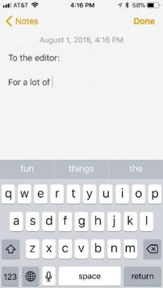
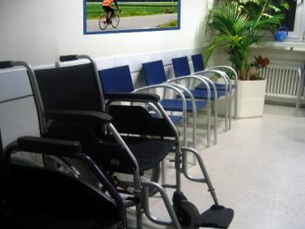
40
You Can Submit an LTE Anywhere, Anytime

Slide 41
41
RESULTS Website = Easy

Slide 42
How to Submit a Letter

Slide 43
How to Submit a Letter

Slide 44
How to Submit a Letter

Slide 45
How to Submit a Letter
Notes:
You must write and submit

Slide 46
46
Media Success Checklist
Find a hook
Edit the template
Check your word count
Check for 3 key pieces
Hit “send”!
Send it to Congress
Send it to RESULTS
Repeat

Slide 47
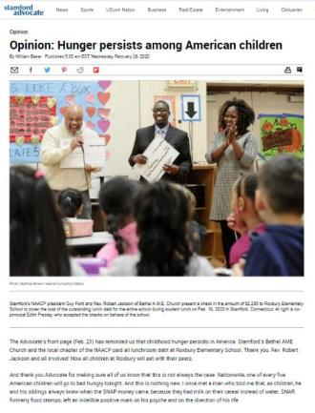
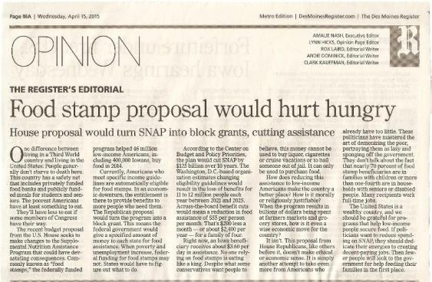
47
Take it to the Next Level?
Editorial
Op-ed

Slide 48
Next Steps
48
Send in a letter to the editor on housing and/or global health
Find online actions at: https://results.org/volunteers/action-center/
Let us know when you get published at www.tinyurl.com/RESULTSMedia
Send published letters to key aides and deliver them in lobby meeting
Invite others you know to write letters too
If you are an LTE pro, consider an op-ed or editorial
Contact Jos Linn for help (jlinn@results.org)
Attend the Virtual RESULTS International Conference (June 20-21)
Stay tuned for more details at: https://results.org/conference/about

Slide 49
Resources
49
RESULTS Media Tools: https://results.org/volunteers/media-tools/
RESULTS Online Media Actions: https://results.org/volunteers/action-center/
RESULTS Media Report Form: www.tinyurl.com/RESULTSMedia
RESULTS Advocacy Basics: https://results.org/volunteers/advocacy-basics/
Staff Media Support: Jos Linn, jlinn@results.org
RESULTS Training Resources: https://results.org/volunteers/training-webinars/

