Slide 1
RISE Advocacy Chapter March Webinar
March 21, 2023
Notes:
Leslye

Slide 2
Welcome
Please let us know in the chat where you are joining us from!

Slide 3
Mission & Vision
Together Women Rise’s Mission
Together Women Rise cultivates the collective power of community to achieve global gender equality.
OUR VISION
Together Women Rise envisions a world where every person has the same opportunities to thrive regardless of their gender or where they live.
Notes:
Leslye

Slide 4
Our Values & Resources
​At RESULTS we pledge to create space for all voices, including those of us who are currently experiencing poverty. We will address oppressive behavior in our interactions, families, communities, work, and world. Our strength is rooted in our diversity of experiences, not in our assumptions.
With unearned privilege comes the responsibility to act so the burden to educate and change doesn’t fall solely on those experiencing oppression. When we miss the mark on our values, we will acknowledge our mistake, seek forgiveness, learn, and work together as a community to pursue equity.
Read our full anti-oppression values statement here at results.org/values.
Check out the 2023 Spring Anti-Oppression Workshop Schedule for training opportunities.
Find these resources and more at results.org/volunteers/anti-oppression:
Resource Guides from our Diversity & Inclusion trainings, including:
Interrupting Microaggressions
Creating Space for Critical Conversations
Information on how RESULTS responds to oppressive incidents

Slide 5
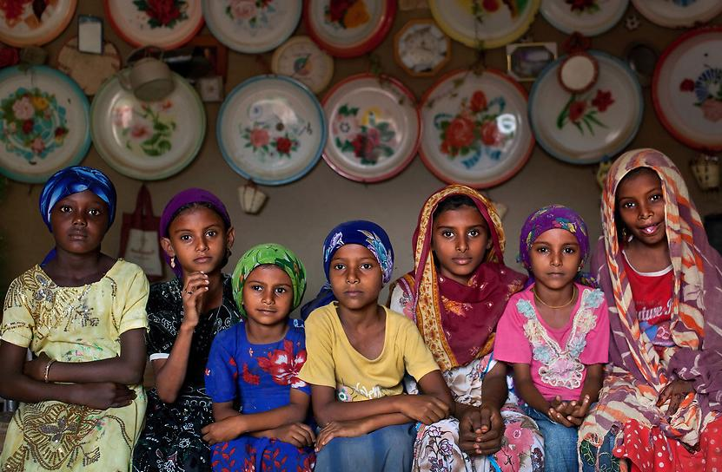
Grantee Spotlight
Too Young to Wed
Notes:
Chris

Slide 6
Grantee Spotlight
About Too Young to Wed
Too Young to Wed’s mission is to empower girls and end child marriage globally.
Areas of Impact: Economic Sustainability, Education, Environmental Sustainability, Gender Equality, Health
Project Title: The Butterfly Project- $50,000 Grant (March 2023)
Notes:
Project Title: The Butterfly Project: Bringing the Bedrocks of Lasting Change to Northern Pastoralist Kenya’s Most Excluded Girls
Location: Kenya
Grant Amount: $50,000
Grantee Website: www.tooyoungtowed.org/main/index
Areas of Impact: Economic Sustainability, Education, Environmental Sustainability, Gender Equality, Health
Mission of Too Young To Wed
Too Young to Wed’s mission is to empower girls and end child marriage globally.
Project Summary
By informing girls and families of their rights, providing access to education, financial inclusion, and mentorship, this project will reduce the occurrence of child marriage and Female Genital Mutilation/Cutting (FGM/C) while increasing school attendance and literacy.
Why We Love This Project
Too Young to Wed’s Butterfly Project focuses on reducing gender disparity among historically excluded girls who are at risk of child marriage, FGM/C and other harmful practices. They achieve this by increasing school attendance and literacy, delaying marriage, informing girls and families of their rights, and providing support and access to education, financial inclusion, safe spaces, mentors, and leadership opportunities.

Slide 7
About The Butterfly Project
Bringing the Bedrocks of Lasting Change to Northern Pastoralist Kenya’s Most Excluded Girls
By informing girls and families of their rights, providing access to education, financial inclusion, and mentorship, this project will reduce the occurrence of child marriage and Female Genital Mutilation/Cutting (FGM/C) while increasing school attendance and literacy.
Notes:
Project Title: The Butterfly Project: Bringing the Bedrocks of Lasting Change to Northern Pastoralist Kenya’s Most Excluded Girls
Location: Kenya
Grant Amount: $50,000
Grantee Website: www.tooyoungtowed.org/main/index
Areas of Impact: Economic Sustainability, Education, Environmental Sustainability, Gender Equality, Health
Mission of Too Young To Wed
Too Young to Wed’s mission is to empower girls and end child marriage globally.
Project Summary
By informing girls and families of their rights, providing access to education, financial inclusion, and mentorship, this project will reduce the occurrence of child marriage and Female Genital Mutilation/Cutting (FGM/C) while increasing school attendance and literacy.
Why We Love This Project
Too Young to Wed’s Butterfly Project focuses on reducing gender disparity among historically excluded girls who are at risk of child marriage, FGM/C and other harmful practices. They achieve this by increasing school attendance and literacy, delaying marriage, informing girls and families of their rights, and providing support and access to education, financial inclusion, safe spaces, mentors, and leadership opportunities.

Slide 8
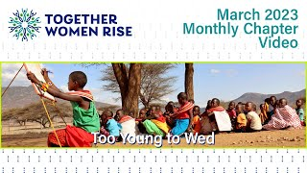
Grantee Spotlight
Too Young to Wed
Notes:
Chris

Slide 9
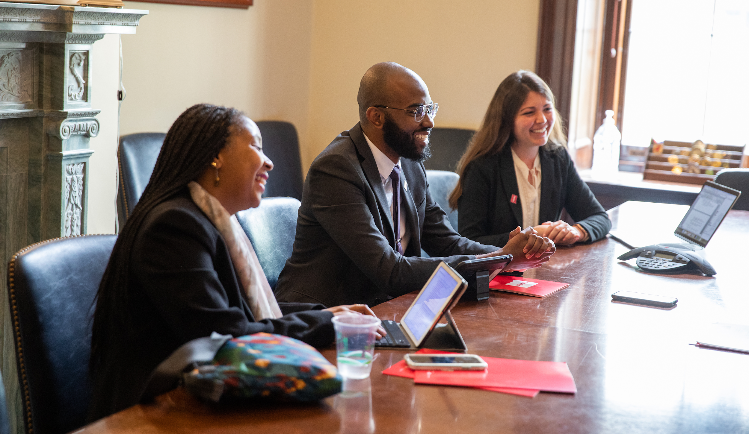
Campaign Updates
results.org/set-the-agenda
Notes:
Ken
Campaign Updates (Set the Agenda)

Slide 10
2023 Global Policy Priorities
Now - April: Funding/Appropriations & MoC Meetings
Today: Make final requests on House Dear Colleague letters
Today, tomorrow, and next couple of weeks: Make Senate appropriations requests and Dear Colleague letter requests
Meet with Senators and Representatives
Funding Requests
Maternal & child health, nutrition, vaccinations
Global Fund to Fight AIDS, TB, malaria
Education
Bilateral TB
Notes:
Ken

Slide 11
2023 Global Policy Priorities
April - December: Legislation
Gather cosponsors for the End TB Now Act: (S.288, H.R. ??)
Gather cosponsors for READ Act, global education bill (S.41, H.R.681)
July/August: Global TB Actions
Generate media and sign on letter to Administration on UN High-Level meeting on TB (9/22/2023)
Notes:
Ken

Slide 12
Campaign Updates
Set the Agenda page: Resources for Now
Resources for setting up meetings with Congress
Resources for having meetings with your member of Congress, including, scorecards.
Resources to learn about the issues
Resources to send to your members of Congress
Notes:
Ken

Slide 13
Campaign Updates
Set the Agenda page:
Advocacy Resources
Prioritizing your asks using the Champion Scale
Maximize advocacy efforts on World TB Day with these resources
Notes:
Ken

Slide 14
Friday, March 24, 2023
Notes:
https://www.stoptb.org/advocate-to-endtb/world-tb-day

Slide 15
Advocacy Action Part 1: Speaking powerfully on appropriations for TB
Notes:
Karyne

Slide 16
Tuberculosis - an airborne bacteria - now kills more people each year than HIV and malaria combined.
Notes:
Karyne
Engage: Tuberculosis - an airborne bacteria - now kills more people each year than HIV and malaria combined.
Problem: COVID, conflict, and other crises have specifically taken a toll on the fight against tuberculosis. This disease drives and exacerbates global poverty, and it targets vulnerable populations. Alarmingly, TB cases increased in both 2020 and 2021. In 2021, 1.6 million people worldwide died from this often-curable disease.
Inform: The U.S. has been a leader in the fight against TB, and fiscal year 2024 decisions will soon be made in Congress by the committee that funds foreign aid.
Call to Action: Will you write and speak to the leadership of the State and Foreign Operations Subcommittee of Appropriations and ask that they include at least $1 billion for USAID bilateral tuberculosis funding in the FY24 spending bill? Will you also ask for at least $2 billion for the Global Fund to Fight AIDS, TB and Malaria?

Slide 17
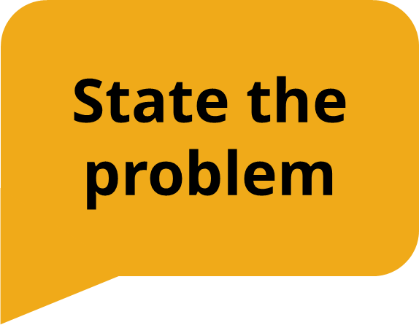
COVID, conflict, and other crises have specifically taken a toll on the fight against tuberculosis. This disease drives and exacerbates global poverty, and it targets vulnerable populations. Alarmingly, TB cases increased in both 2020 and 2021. In 2021, 1.6 million people worldwide died from this often-curable disease.
Notes:
Karyne

Slide 18
The U.S. has been a leader in the fight against TB, and fiscal year 2024 decisions will soon be made in Congress by the committee that funds foreign aid.
Notes:
Karyne

Slide 19
Will you write and speak to the leadership of the State and Foreign Operations Subcommittee of Appropriations and ask that they include at least $1 billion for USAID bilateral tuberculosis funding in the FY24 spending bill? Will you also ask for at least $2 billion for the Global Fund to Fight AIDS, TB and Malaria?
Notes:
Karyne

Slide 20
Advocacy Action Part 1
Let’s go over it again, this time unmute and shout out the missing information
Notes:
Karyne

Slide 21
Tuberculosis - an airborne bacteria - now kills more people each year than HIV and malaria combined.
Notes:
Karyne
Engage: Tuberculosis - an airborne bacteria - now kills more people each year than HIV and malaria combined.

Slide 22
Tuberculosis - an airborne bacteria - now kills more people each year than HIV and malaria combined.
Notes:
Karyne
Engage: Tuberculosis - an airborne bacteria - now kills more people each year than HIV and malaria combined.

Slide 23
COVID, conflict, and other crises have specifically taken a toll on the fight against tuberculosis. This disease drives and exacerbates global poverty, and it targets vulnerable populations. Alarmingly, TB cases increased in both 2020 and 2021. In 2021, 1.6 million people worldwide died from this often-curable disease.
Notes:
Karyne Problem: COVID, conflict, and other crises have specifically taken a toll on the fight against tuberculosis. This disease drives and exacerbates global poverty, and it targets vulnerable populations. Alarmingly, TB cases increased in both 2020 and 2021. In 2021, 1.6 million people worldwide died from this often-curable disease.

Slide 24
COVID, conflict, and other crises have specifically taken a toll on the fight against tuberculosis. This disease drives and exacerbates global poverty, and it targets vulnerable populations. Alarmingly, TB cases increased in both 2020 and 2021. In 2021, 1.6 million people worldwide died from this often-curable disease.
Notes:
Karyne Problem: COVID, conflict, and other crises have specifically taken a toll on the fight against tuberculosis. This disease drives and exacerbates global poverty, and it targets vulnerable populations. Alarmingly, TB cases increased in both 2020 and 2021. In 2021, 1.6 million people worldwide died from this often-curable disease.

Slide 25
The U.S. has been a leader in the fight against TB, and fiscal year 2024 decisions will soon be made in Congress by the committee that funds foreign aid.
Notes:
Karyne -
Inform: The U.S. has been a leader in the fight against TB, and fiscal year 2024 decisions will soon be made in Congress by the committee that funds foreign aid.

Slide 26
The U.S. has been a leader in the fight against TB, and fiscal year 2024 decisions will soon be made in Congress by the committee that funds foreign aid.
Notes:
Karyne -
Inform: The U.S. has been a leader in the fight against TB, and fiscal year 2024 decisions will soon be made in Congress by the committee that funds foreign aid.

Slide 27
Will you write and speak to the leadership of the State and Foreign Operations Subcommittee of Appropriations and ask that they include at least $1 billion for USAID bilateral tuberculosis funding in the FY24 spending bill? Will you also ask for at least $2 billion for the Global Fund to Fight AIDS, TB and Malaria?
Notes:
Karyne Call to Action: Will you write and speak to the leadership of the State and Foreign Operations Subcommittee of Appropriations and ask that they include at least $1 billion for USAID bilateral tuberculosis funding in the FY24 spending bill? Will you also ask for at least $2 billion for the Global Fund to Fight AIDS, TB and Malaria?

Slide 28
Will you write and speak to the leadership of the State and Foreign Operations Subcommittee of Appropriations and ask that they include at least $1 billion for USAID bilateral tuberculosis funding in the FY24 spending bill? Will you also ask for at least $2 billion for the Global Fund to Fight AIDS, TB and Malaria?
Notes:
Karyne Call to Action: Will you write and speak to the leadership of the State and Foreign Operations Subcommittee of Appropriations and ask that they include at least $1 billion for USAID bilateral tuberculosis funding in the FY24 spending bill? Will you also ask for at least $2 billion for the Global Fund to Fight AIDS, TB and Malaria?

Slide 29
Advocacy Action Part 1
Let’s go over it again, this time think about the missing information

Slide 30
Advocacy Action Part 1
You’re making a call to your Representative, can you make the FY24 appropriations request for bilateral TB funding?
Notes:
Karyne - volunteer to deliver the laser talk for FY24 appropriations for TB

Slide 31
Advocacy Action Part 2: Requests to Senators
Notes:
Karyne

Slide 32
Appropriations forms, Dear Colleague Letters, co-sponsorship…oh my!
Notes:
Karyne

Slide 33
Appropriations request forms
Co-sponsorship of Senate bills: - The R.E.A.D. Act Reauthorization (S. 41)
The End TB Now Act (S. 288)
Dear Colleague Letter
FY24 Maternal & Child Health and Nutrition (April 7 deadline)
Advocacy Action Part 2
Notes:
Karyne
Sample email request:
https://docs.google.com/document/d/1sXAmw5bE2_Q6Kci-ABCrOtPSHW9fgA-bx7cNOSTzdYQ/edit

Slide 34
1. Check if your Senator is on the Dear Colleague Letter 2. Find them in Legislator Lookup (look for the name of their “foreign policy staff”) 3. Email convention: FirstName_LastName@SenatorsLastName.Senate.Gov 4. Personalize this request letter and hit send 5. Follow up, Follow up, Follow up
Advocacy Action Part 2
Steps to make these requests to your Senator:
Notes:
Karyne
Instructions
Check if your Senator has signed the FY24 Dear Colleague Letter for Maternal and Child Nutrition here. If not, send the request to their office.
Use Legislator Lookup to find your Senator’s foreign policy aide, if you are unsure of who to reach out to, please don’t hesitate to reach out to your Together Women Rise Advocacy Chapter Mentor for support.
Email convention: FirstName_LastName@SenatorsLastName.Senate.Gov
Personalize the sample email below and hit send
Follow up!

Slide 35
FY24 House Global Tuberculosis Dear Colleague Letter
FY24 House Maternal and Child Health and Nutrition Dear Colleague Letter
Advocacy Action Part 2
Bonus Action: 2 House Dear Colleague Letters closing tomorrow!
Notes:
Karyne
FY24 House Global Tuberculosis Dear Colleague Letter
· Deadline: March 22, 2023
· Bipartisan letter led by Reps. Ami Bera (D-CA) and Ann Wagner (R-MO)
· Asks appropriators for $1 billion for bilateral TB programs at USAID
· Sign on here via Quill and contact Emma.Bruce@mail.house.gov (Bera) or Molly.Joseph@mail.house.gov (Wagner) with additional questions.
FY24 House Maternal and Child Health and Nutrition Dear Colleague Letter
· Bipartisan letter led by Reps. Brian Fitzpatrick (R-PA), Sara Jacobs (D-CA), Maria Elvira Salazar (R-FL), and Jim McGovern (D-MA)
· Asks appropriators for $300 million for USAID Nutrition and $1.15 billion for USAID Maternal and Child Health, including $340 million for Gavi, the Vaccine Alliance
· Deadline to sign on - March 22
· Sign on here via Quill and contact matthew.clarkin@mail.house.gov (Fitzpatrick) with additional questions.

Slide 36
Link for folks to sign up: https://results.salsalabs.org/diningforwomen/index.html
Next webinar: April 18 at 8:30 PM ET
If you would like to learn more about RISE grantees, there are chapters across the US, as well as a virtual national chapter meeting with a speaker from the grantee each month on the first Thursday of the month at 8 PM ET: https://togetherwomenrise.org/upcoming-events/
If you are interested in working on advocacy at a committee level at Together Women Rise, please let me know.
Closing
Notes:
Leslye

Slide 37
Thank you for joining us tonight!

