Slide 1

RESULTS National Webinar
June 6, 2026

Slide 2
Our Values
At RESULTS we pledge to create space for all voices, including those of us who are currently experiencing poverty. We will address oppressive behavior in our interactions, families, communities, work, and world. Our strength is rooted in our diversity of experiences, not in our assumptions.
With unearned privilege comes the responsibility to act so the burden to educate and change doesn’t fall solely on those experiencing oppression. When we miss the mark on our values, we will acknowledge our mistake, seek forgiveness, learn, and work together as a community to pursue equity.
Read our full anti-oppression values statement here at results.org/values.
Notes:
Updated AO slide (2/22)

Slide 3
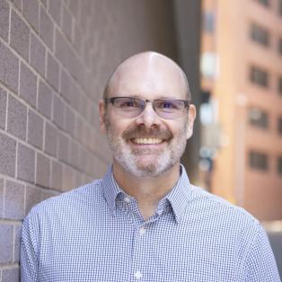
Welcome!
Jos Linn
Director
Grassroots Impact
Jlinn@results.org

Slide 4
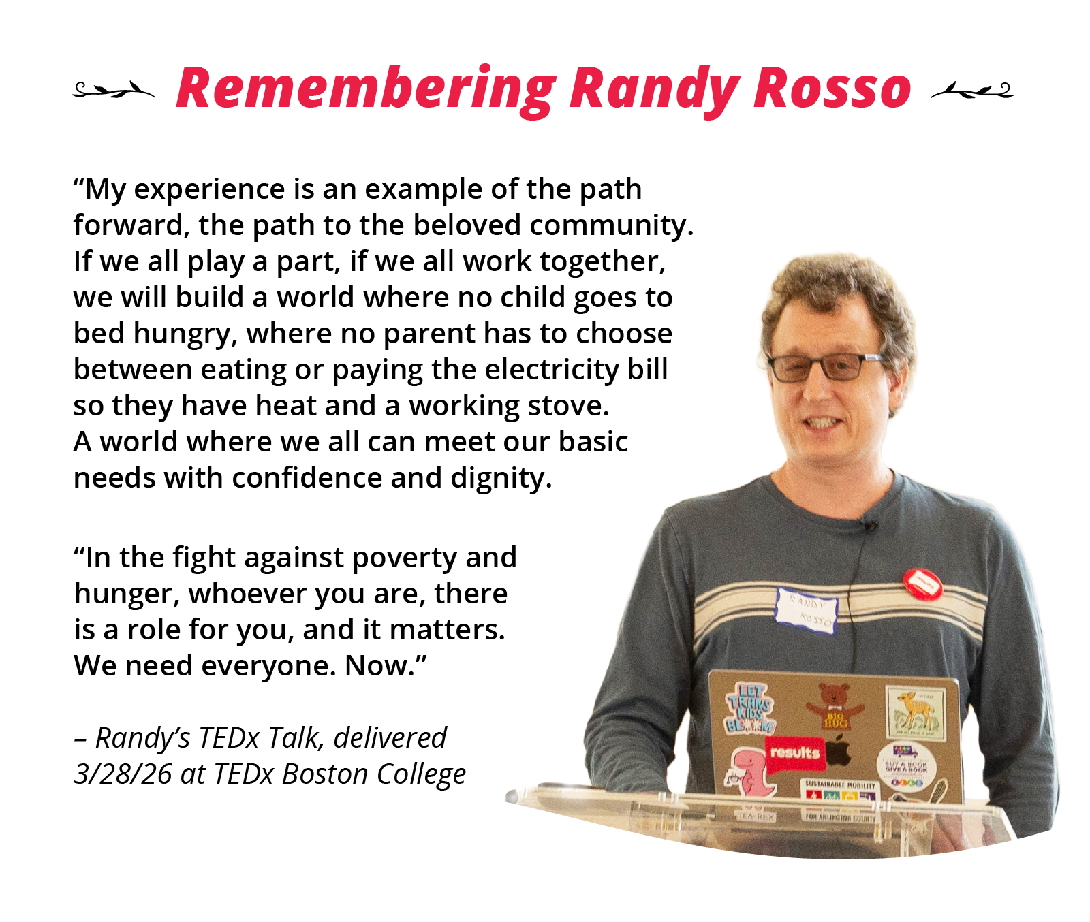

Slide 5
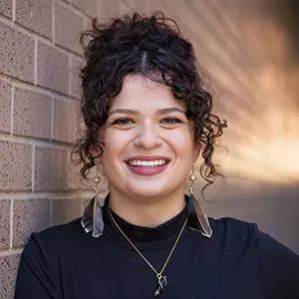
Rooted in resistance
Sarah Leone
Senior Associate,
Grassroots Team
sleone@results.org

Slide 6
Global Poverty Campaigns Update

Slide 7
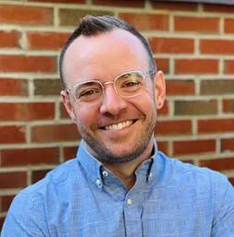
Colin Puzo Smith
Director of Global Policy
csmith@results.org

Slide 8
Our 2026 Goals
Reminder!
Re-forge a system for U.S. “bilateral” global health funding.
Maximize the pooled global funds that can deliver health impact NOW

Slide 9
Is there money?
Is the money flowing?
Is there a strategy?
Is it creating impact?

Slide 10
The future of global health
Newcomers and skeptics:
Co-sponsoring new bipartisan resolution
Supporters:
Weighing in with congressional leadership
Select Champions:
Tailored outreach to the Trump Administration

Slide 11
Tuberculosis
Bipartisan End TB Now Act (coming soon!)
Bold targets for progress and saving lives
Path to scale up new innovations
Focus on impoverished communities
Real oversight to turn money into impact

Slide 12
U.S. Poverty Campaigns Update

Slide 13
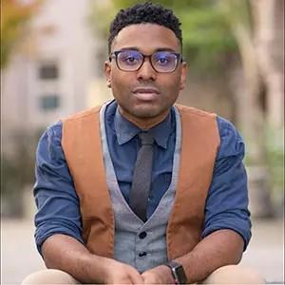
TaShon Thomas
Interim VP, Campaigns and Advocacy
tthomas@results.org

Slide 14

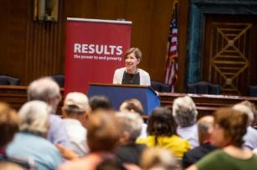
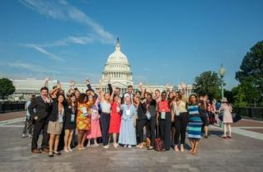
July 12-14, Washington, DC
Register today!
www.results.org/conference

Slide 15
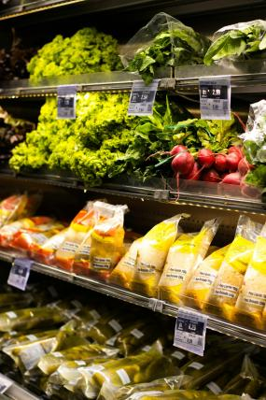
Farm Bill Update
Current Farm bill does NOT address the catastrophic cuts made to SNAP last year
Enrollments are already plummeting (see data)
Strong Dem opposition to the FB in the Senate without delaying the state cost sharing policy
Encouraging signs that the policy could be delayed​
Photo by Eduardo Soares on Unsplash

Slide 16
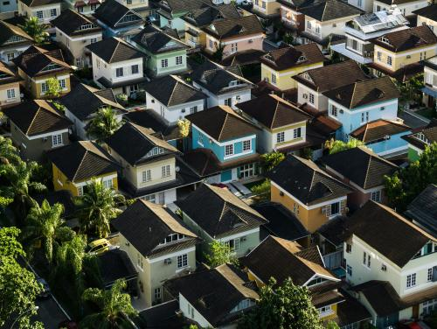
Housing Choice Vouchers
House proposed THUD bill misses the mark
Fails to renew all current vouchers
The Senate must reverse course
HCVs should be fully renewed and funded to provide an additional 250,000 vouchers
Photo by Breno Assis on Unsplash

Slide 17
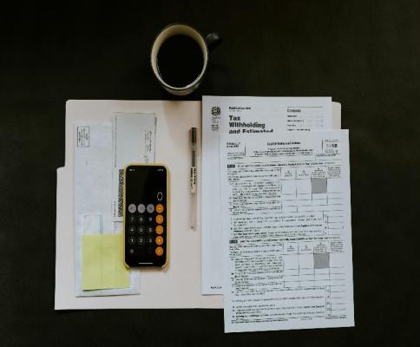
Child Tax Credit
19 million kids don’t receive the full CTC
Stronger Start for Working Families Act improves the phase-in
3.5 million families with low income would get additional $375 in their tax return
Ask Senators to cosponsor SSFWA
Photo by Kelly Sikkema on Unsplash

Slide 18
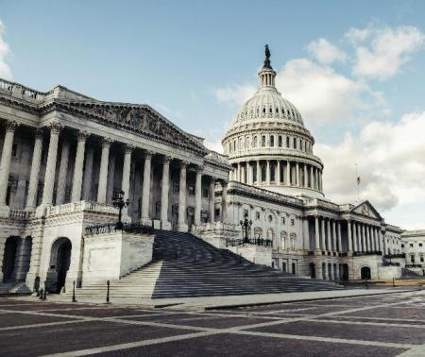
Reconciliation Passes Senate
Reconciliation passed the Senate on June 5 (52-47)
Focus is on ICE and CBP funding
Lack of ICE accountability is the biggest threat in this reconciliation bill
House to vote on Monday
Call your House Representatives to urge a ”no” vote
Photo by Tim Mossholder on Unsplash

Slide 19
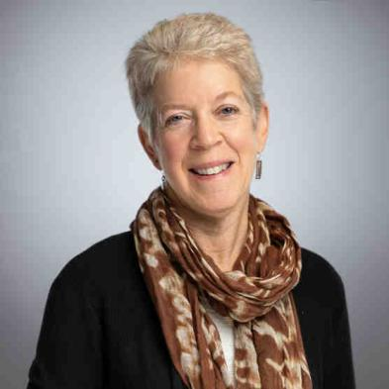
National Conference U.S. Poverty Plenary Speaker
Ellen Nissenbaum
Senior Advisor, Center on Budget and Policy Priorities

Slide 20
Grassroots Inspiration & Action

Slide 21

Amplify Your Voice
Every RESULTS volunteer submits at least one media piece by the end of July
Every RESULTS group asks a community partner to submit local media by the end of July
You’ve gotten 161 media pieces published so far in 2026!
See published media here.

Slide 22
Media resources
Media tools on our Working with Media page
LTE templates: https://results.org/volunteers/action-center/action-alerts?vvsrc=%2fCampaigns
Media best practices blog: https://results.org/blog/your-voice-in-opinion-media-makes-a-difference
Interview with media editor Jay Evensen (May webinar): https://results.org/resources/may-2026-media-media-media
Media & Democracy Project: Journalism Directory.
Every time you submit a piece, please let us know.
When you get published, please report it.

Slide 23
Media Office Hour
Wednesday, June 17, 2-3 p.m. ET
Grassroots media is a powerful tool to influence lawmakers and strengthen democracy. If you need help brainstorming, writing, editing, or submitting a media piece, RESULTS staff welcomes you to bring your questions to this open office hour.
Join via Zoom at https://results.zoom.us/j/91601524175
or dial (312) 626-6799, meeting ID 916 0152 4175.

Slide 24
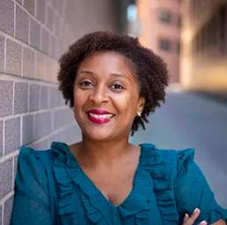
Karyne Bury
Manager, Grassroots Impact
kbury@results.org

Slide 25
The Conference is bigger than DC
Advocates in DC carry the voices of their communities with them
Media submitted
Letters delivered
Calls made
Partners engaged
Stories shared
Relationships built

Slide 26
Four ways to contribute
Take Individual Action
Expand your Voice
Mobilize Others
Media, calls, letters
Friends, family, action networks
Partners, organizations, community connections
Build Leadership
Support New Advocates
Strengthen our advocacy in July. Build community power for the future.
Notes:
Sarah

Slide 27
National Conference Action Guide
Raise Issues Publicly
Submit Media
Invite someone to write with you
Build a Community Voice
Collect letters & postcards
Host a gathering to engage partners
Amplify Lobby Day
Call Congress on July 14
Invite others to call

Slide 28
National Conference Action Guide
Raise Issues Publicly
Submit Media
Invite someone to write with you
Build a Community Voice
Collect letters & postcards
Host a gathering to engage partners
Amplify Lobby Day
Call Congress on July 14
Invite others to call

Slide 29
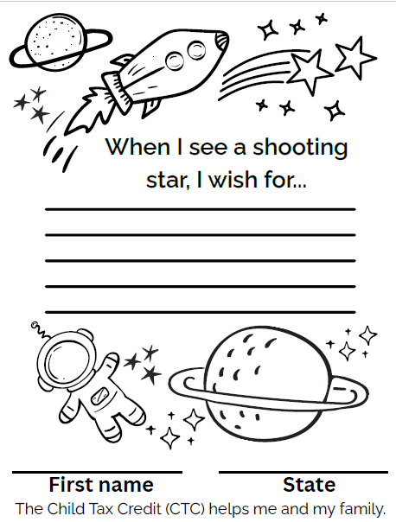

ABC Coalition Color for a Cause

Slide 30
National Conference Action Guide
Raise Issues Publicly
Submit Media
Invite someone to write with you
Build a Community Voice
Collect letters & postcards
Host a gathering to engage partners
Amplify Lobby Day
Call Congress on July 14
Invite others to call

Slide 31
We want to hear from you!
Raise your hand / Share in chat
What kind of community and relationships do you want your advocacy to create?
How can you use the National Conference moment to help build that?
31

Slide 32
Start Small. Build Power.
Take one action.
Make one connection.
Invite one person to take action.

Slide 33
June Power Building Hour
June 23 at 5 pm ET
Come get unstuck, spark new ideas, and plan your next steps to grow your advocacy power.
Join us on Zoom:
https://results.zoom.us/j/91624920740

Slide 34
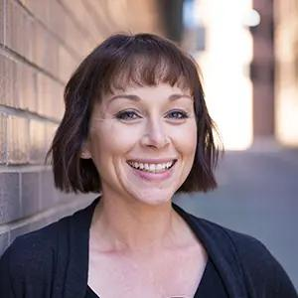
Amanda Beals
Associate Director,
Grassroots Expansion
abeals@results.org

Slide 35
July 12-14, Washington, DC
Register today!
www.results.org/conference

Slide 36
Lobby Prep season has arrived!
U.S. Nutrition, Housing, and Tax
  Monday, June 8, 8:30 p.m. ET
  Wednesday, June 10, 12:00 p.m. ET
Global Tuberculosis
  Wednesday, June 17, 8:30 p.m. ET
  Thursday, June 18, 12:00 p.m. ET
Cross-Cutting Foreign Aid Issues
  Tuesday, June 23, 12:00 p.m. ET
  Thursday, June 25, 8:30 p.m. ET
Catch-All Sessions (late updates and questions)
  Monday, July 6, 12:00 p.m. ET
  Tuesday, July 7, 8:30 p.m. ET
  One Zoom link for all sessions: https://results.zoom.us/j/93609884210?from=addon
  (no registration necessary)

Slide 37
Find Conference materials on the RESULTS website!
Go to the Conference page at https://results.org/conference or by clicking “Conference” at the top of any page on our website.
Scroll down the Conference page to find the agenda and Conference resources (sample meeting requests, conference checklist, and more!). This resource will grow over the coming weeks.

Slide 38
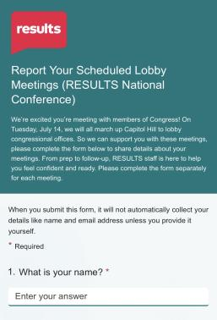
Please report all your scheduled Conference lobby meetings!
https://forms.cloud.microsoft/r/uQedg9BnS9

Slide 39
National Conference Hill Day
Tuesday, July 14, 2026
Lobby Day Kickoff on Senate side.
We recommend scheduling your Senate meetings in the morning and House meetings in the afternoon.
As you schedule your July 14 lobby meetings, please report them here!
Congressional reception from 4:30-6:00pm.
Full conference agenda is on our website: https://results.org/conference.

Slide 40
Help us help you attend the National Conference!
Active, U.S-based volunteers who need help with registration and/or travel costs are encouraged to apply to our Conference Equity Fund.
Deadline to apply is June 12.
https://tinyurl.com/RESULTSEquityFund

Slide 41
National Conference Action Guide
Raise Issues Publicly
Submit Media
Invite someone to write with you
Build a Community Voice
Collect letters & postcards
Host a gathering to engage partners
Amplify Lobby Day
Call Congress on July 14
Invite others to call

Slide 42
Action Matters
The fun still continues even if you can’t attend the Conference in person!
Let’s recap the National Conference Action Guide for how to stay engaged
We need you!

Slide 43
We have a surprise!
We're excited to introduce the RESULTS Connect 2026 National Conference Portal!
Your one-stop hub for everything you need before and during this year's conference.

Slide 44
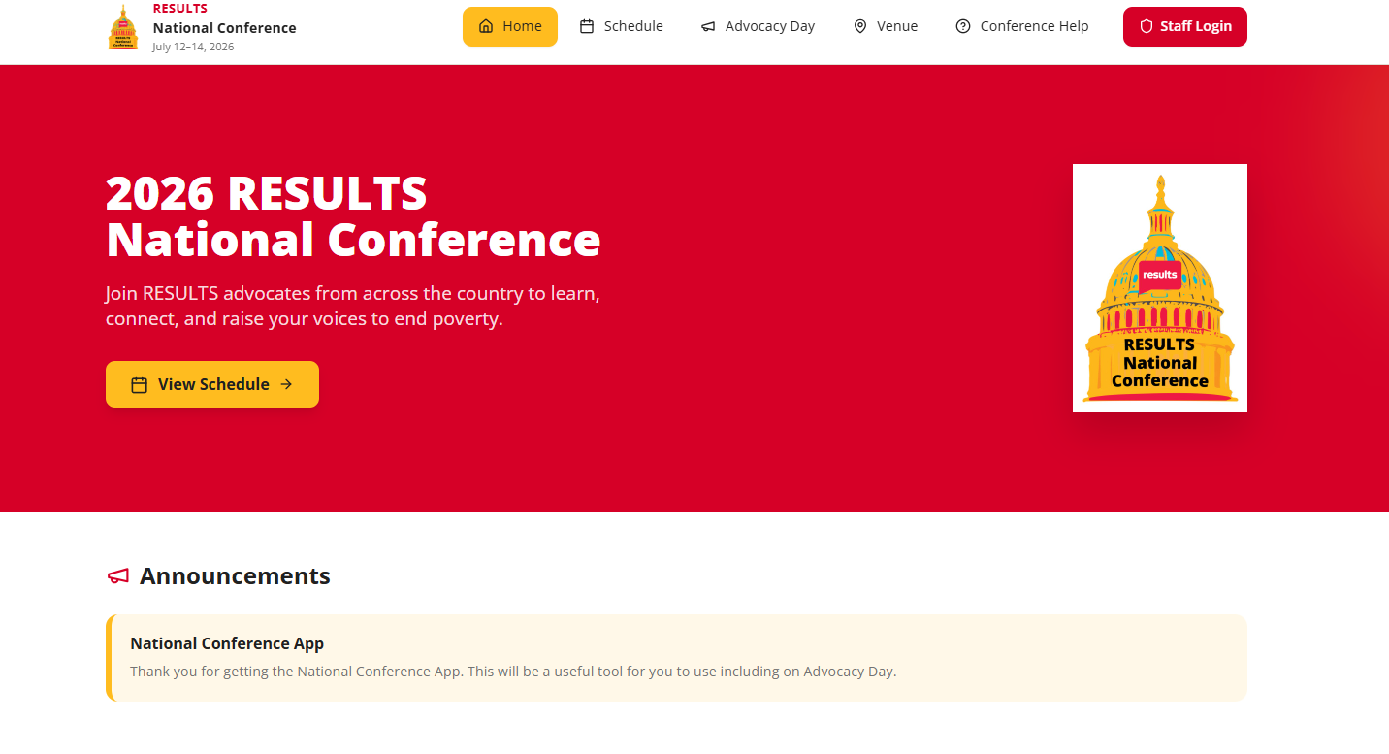
The RESULTS Conference Portal

Slide 45
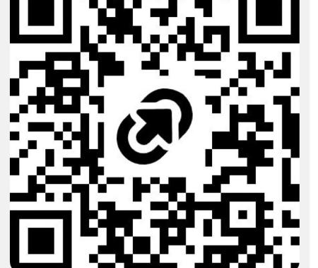
The RESULTS Conference Portal
Access the portal at: www.tinyurl.com/RESULTSNC26 or use this QR code!

Slide 46
Announcements + Closing

Slide 47
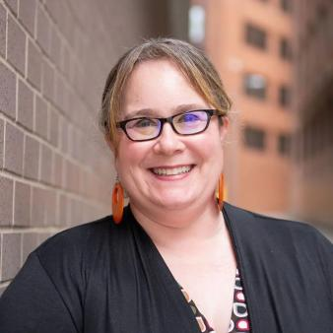
Lisa Marchal
Senior Manager,
Grassroots Impact
lmarchal@results.org

Slide 48
Thank you for joining us!
Who is joining you in the room today?
Please complete the Zoom poll by indicating the number of people in the room with you today
(including yourself).

Slide 49
Prep for July Lobbying
Researching Your Member(s) of Congress” on June 11 at 8:30 pm ET
Register today for this 90-minute webinar.
_________________________
Weekly lobby prep webinars. Each week, we will offer the same webinar twice.
Again here are the dates and topics (find login details in our Events calendar):
U.S. nutrition, housing and tax: June 8 (8:30 pm ET) and June 10 (12 pm ET)
Global tuberculosis: June 17 (8:30 pm ET) and June 18 (12 pm ET)
Cross-cutting foreign aid issues: June 23 (12 pm ET) and June 25 (8:30 pm ET)
Late-breaking updates and Q&A: July 6 (12 pm ET) and July 7 (8:30 pm ET)

Slide 50
Friends & Family Fundraising
Some of your fellow advocates are finishing up
Friends & Family fundraisers
to support RESULTS' trainings, resources, and campaigns.
If you'd like to learn more about creating your own, please contact Beth Wilson at bethwilson1950@gmail.com.
Or support your fellow volunteers by making a donation to their fundraisers.
https://results.org/donate/fundraise

Slide 51
Grassroots Board election voting closes JUNE 15!
All active RESULTS volunteers are eligible to vote in this election. If you accidentally vote more than once, your last vote will be counted.
Read the candidates’ written and video statements at https://results.org/blog/results-2026-grassroots-board-elections
Then cast your ballot and encourage your fellow RESULTS volunteers
to raise their voices too!
https://www.surveymonkey.com/r/GRDC2026
Notes:
B

Slide 52
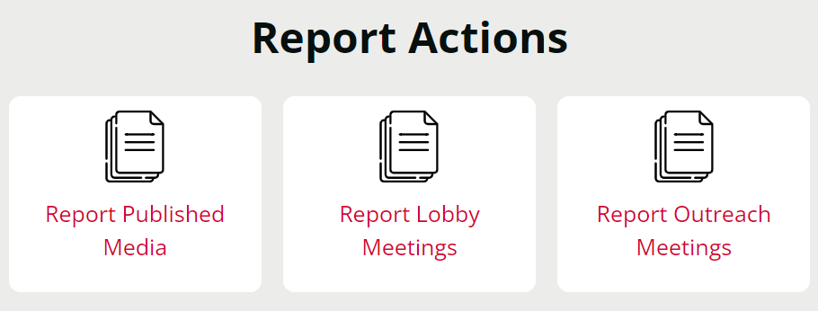
Let us know the amazing things you are doing!
https://results.org/volunteers/reporting-your-advocacy-actions

Slide 53
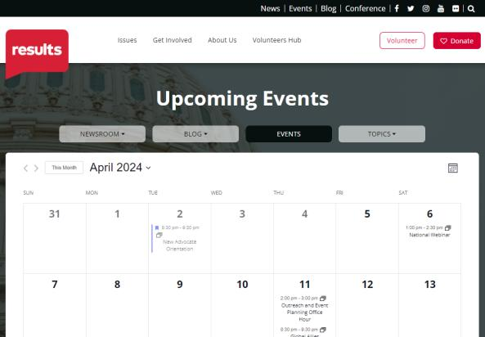
Find RESULTS events
www.results.org/events

Slide 54
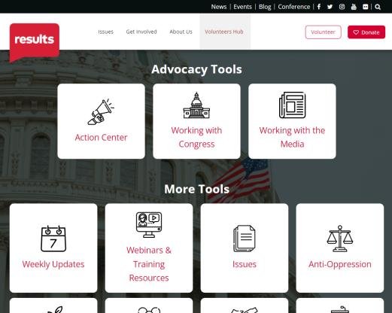
Find webinar slides and recording
www.results.org/volunteers/national-webinars

Slide 55
No National Webinar in July.
Join us Saturday, August 1 for the next!
Registration is always open
for the 2026 National Webinars!
www.tinyurl.com/RESULTS2026

Slide 56
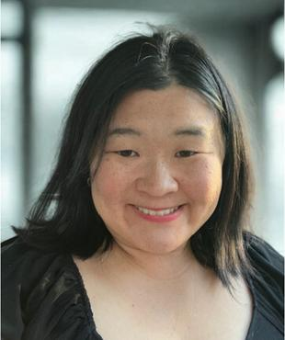
Nina Zhang
RESULTS California advocate

Slide 57
See you soon!
Have a great June!

